Slide 1
STARLING OFFICE / OPEN SOURCE
Big ideas.
Start here.
Writer. Slides. Sheets.
An open source office suite.
W
S
#
Writer
Slides
Sheets
Documents
Presentations
Spreadsheets
THREE APPS. ONE OPEN SOURCE SUITE.

Slide 2
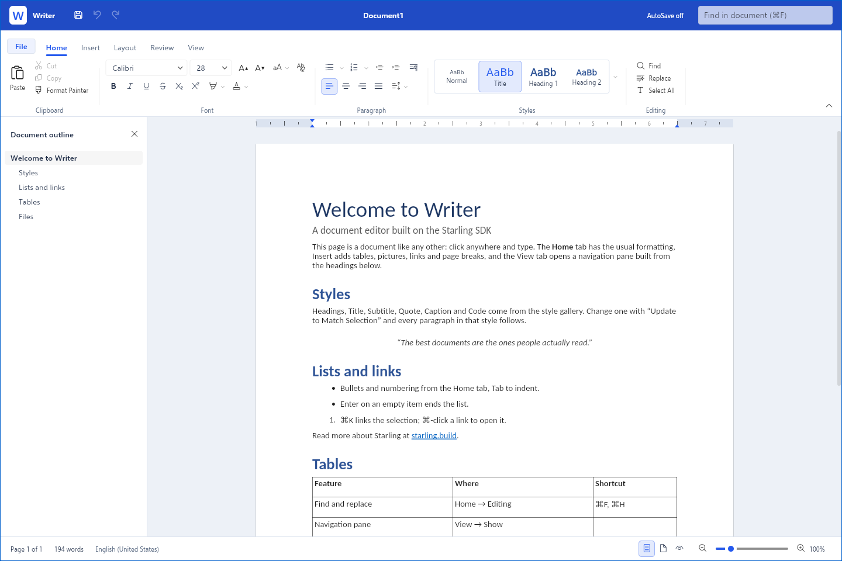
01 / MEET WRITER
Write something
great.
A familiar ribbon. A clean page.
Room for your next big idea.
DOCX · RTF · MARKDOWN · TEXT

Slide 3
02 / MEET SLIDES
Make your
point.
A clear idea.
MAKE EVERY SLIDE COUNT
Clear message
Strong visuals
Your next big idea
Build a deck. Tell your story.
Present it with confidence.
PPTX · THEMES · CHARTS · ANIMATIONS

Slide 4
03 / MEET SHEETS
Let the numbers
tell the story.
fx =SUM(C2:C4)
Project
Budget
Actual
Design
2,400
2,100
Build
6,800
6,500
Launch
1,800
1,400
Total
11,000
10,000
Organize your data.
Turn formulas into answers.
XLSX · CSV · FORMULAS · FILTERS

Slide 5
04 / SIX PLATFORMS. ONE AMBITION.
Your office.
Everywhere.
macOS
Windows
Planned
Planned
Linux
iOS
Planned
Planned
Android
Web
Planned
In your browser
Documents. Presentations. Spreadsheets.
Across your devices. Built in the open.

Slide 6
05 / OPEN SOURCE. FROM THE START.
Open code.
Shared
ambition.
Read the code. Follow the progress.
Help shape what comes next.
Built on the Starling SDK.
Apache 2.0 licensed.
WRITER · SLIDES · SHEETS

