Slide 1
„Considering WordArt“
Word Art Perspective
(shadow)
Gradient Fill elements
Test solid line border; text fill

Slide 2
Circle
Arch Up
Arch Down
Button
Arch Up Pour
Arch Down Pour
Circle Pour
Button Pour

Slide 3
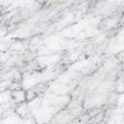
Callout (Adjusted)
Callout (Adjusted)
Callout (Adjusted)
Arrow + Texture
With Action (Sound)

Slide 4
Shapes on Master
Text
Text
Textbox with Radial Gradient Fill

Slide 5
Gradient fill in Backgroung of slide

