Slide 1
Date :25 NOV 2021 BTP Presentation
Title: Transformer based multi-horizon temporal modeling of heterogenous signals
Name.: HArshavardhan alimI
Roll no.: 18EC10021
BTP supervisor: Prof. Sourangshu Bhattacharya

Slide 2
Introduction
Temporal data:
Time-series, ex: weather conditions, Health monitoring
Event sequence, ex: extreme weather conditions, medical records.
Both types carry rich information about the evolution of complex systems, based on which effective predictions are crucial to subsequent decision making.
The basic idea is to learn the probability distribution of future values conditioned on heterogeneous past sequences

Slide 3
Related work : VSMHN
A generative model which jointly models the event sequence and time-series for learning the complex correlations between heterogeneous temporal sequences.
Based on conditional variational auto-encoder.
Drawbacks:-
Long-term dependencies.
Trainability.
Parallelism.

Slide 4
Motivation: Transformer Hawkes Process
Temporal point process.
Based on the Transformer architecture.
Self-attention mechanism.
Computationally efficient.

Slide 5
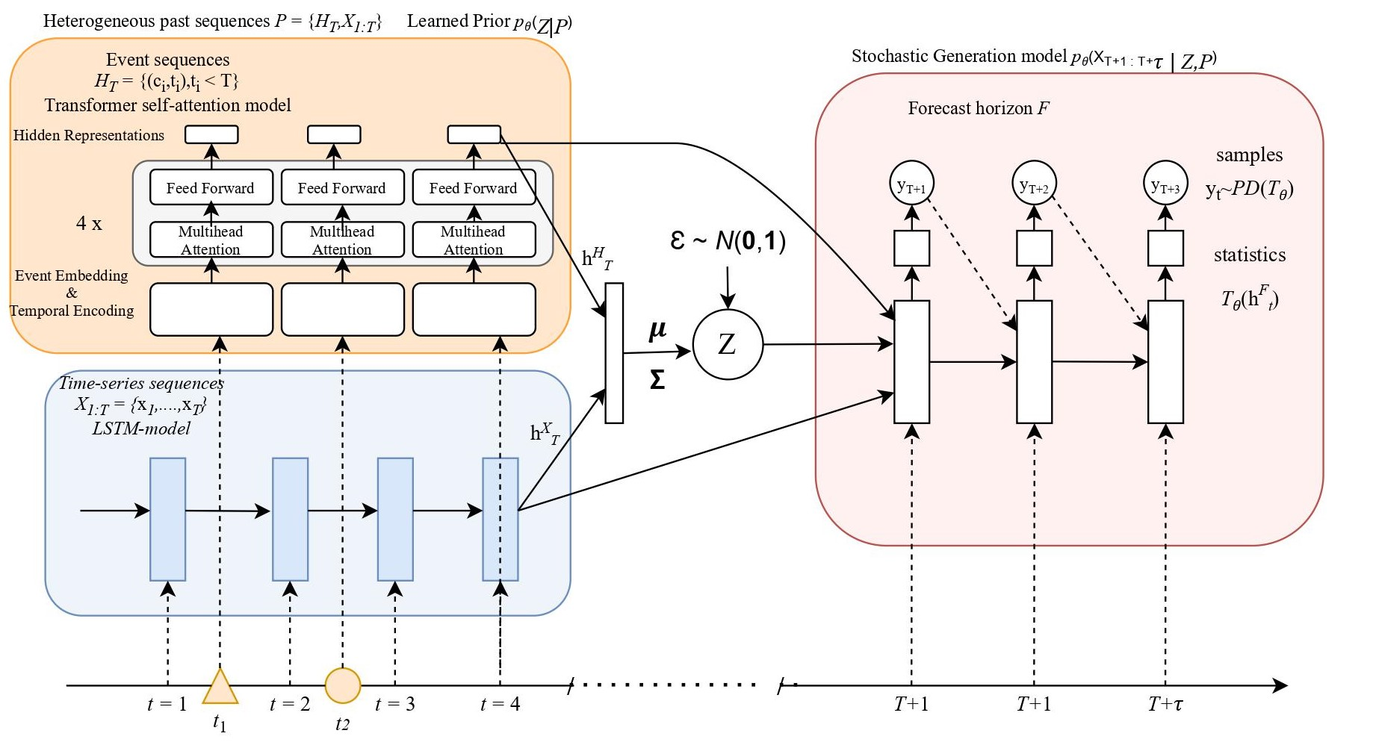
Proposed Model

Slide 6
Experiments:
Dimension of latent variable = 50
Encoder layers in transformer =4
1000 trails of Monte-Carlo simulations.
Gaussian observation model in stochastic RNN generation model.
Adam optimiser with learning rate=0.001

Slide 7
Experiments:
Dataset:
4 temporal features.
The Hourly sampled dataset used, 10% of time-series Data(along with events in the time-line) is held for evaluation of model.
The models are trained to predict the future day (24 data points) given the past week (168 points), along with events within that week
Environment :This is a public air quality multi-variate dataset.
Hourly sampled variables PM2.5, Dewpoint, Temperature, and Pressure.
Events : wind start, wind stop, and rain start.

Slide 8
Experiments:
Data preprocessing:
Batch input.
Events padding in a batch.
Temporal features.
Features modified into normal distribution.
Compared baselines:
VSMHN
VSMHN-TS
Evaluation metric:
RMSE
CRPS

Slide 9
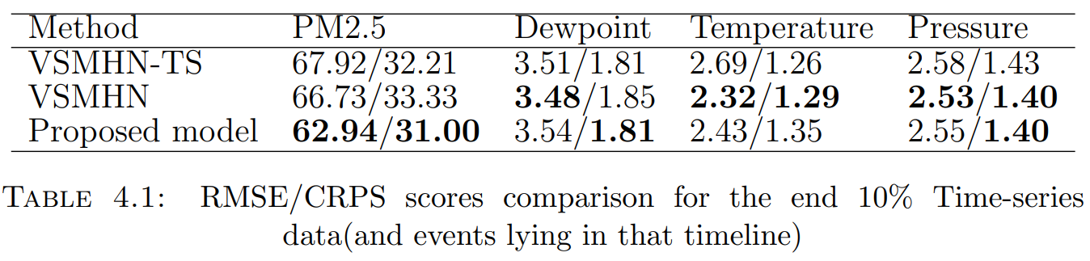
Results:- baselines comparison

Slide 10
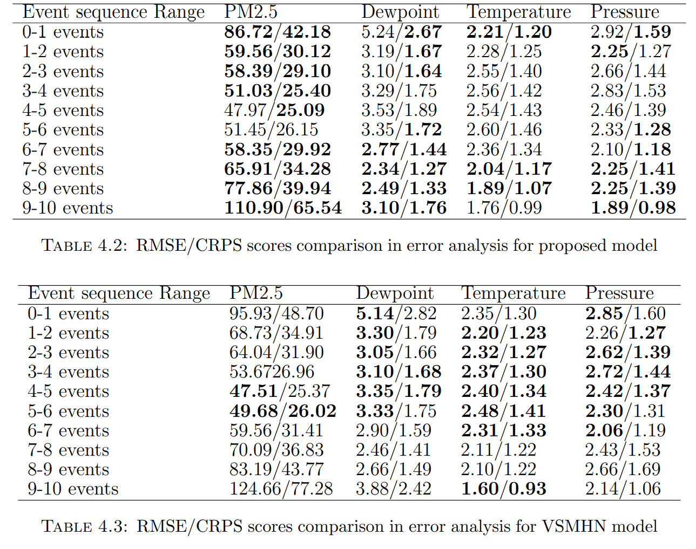
Results:- Error analysis

Slide 11





Thank you

