Slide 1
DSP SIMULATION ASSIGNMENT – 2
Group Members :
Harshavardhan Alimi - 18EC10021
Sandeep reddy kasireddy - 18EC10026
Shashank pilla - 18EC10042
Chinni krishna chapala - 18EC10010

Slide 2
Aim:​
1.To come up with an idea for implementing a lock key system using audio as the key.​
2.To calculate the pitch and explore pitch extraction algorithm.
Description:​
1.Four people volunteered to provide their voice samples for analysis.​
2.Each person recorded 8 samples in 4 days i.e., one sample in the morning and one​
sample after lunch for 4 days.​
3.We intend to derive a relation among the different audio samples by analysing their​
spectrum.​

Slide 3
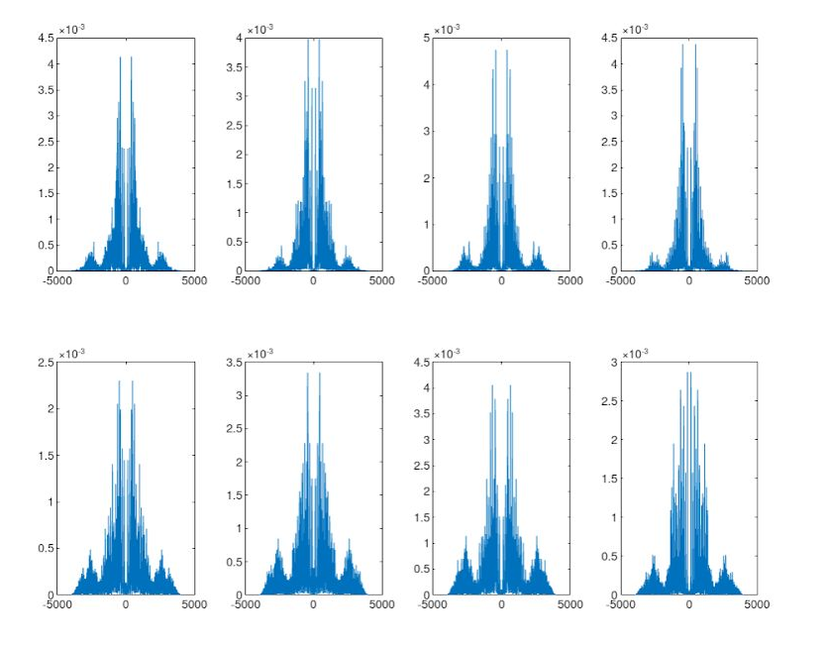
Top row in each of the following figures indicate frequency response of the morning samples and the bottom row indicates frequency response of the afternoon samples.
Below four figures represent the frequency response of the samples.
Audio samples of
Rudrajyoti

Slide 4
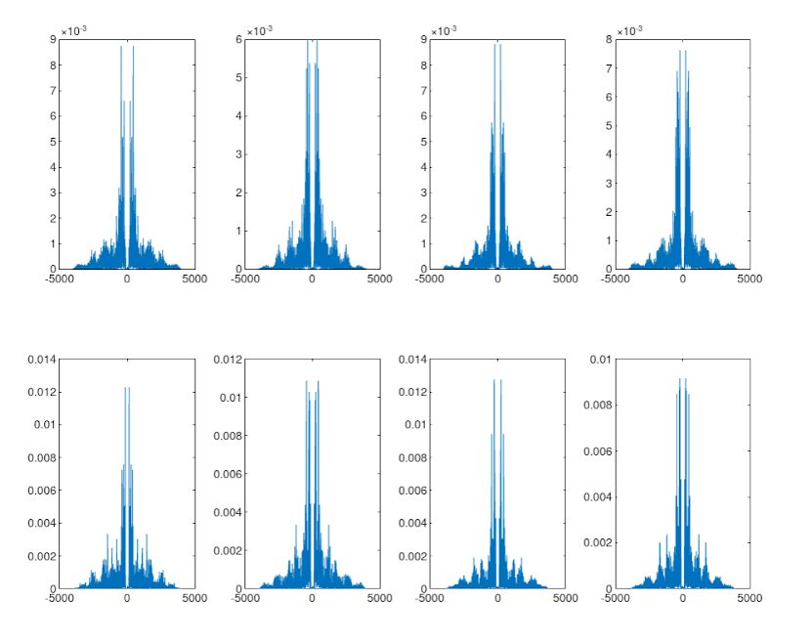
Shouviks' audio samples

Slide 5
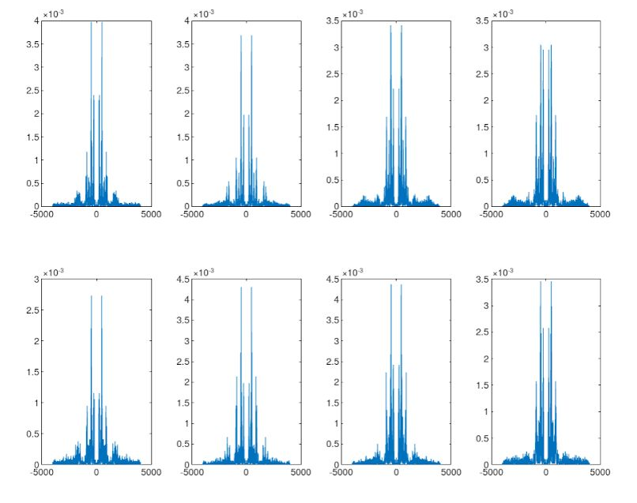
Prerna's audio samples

Slide 6
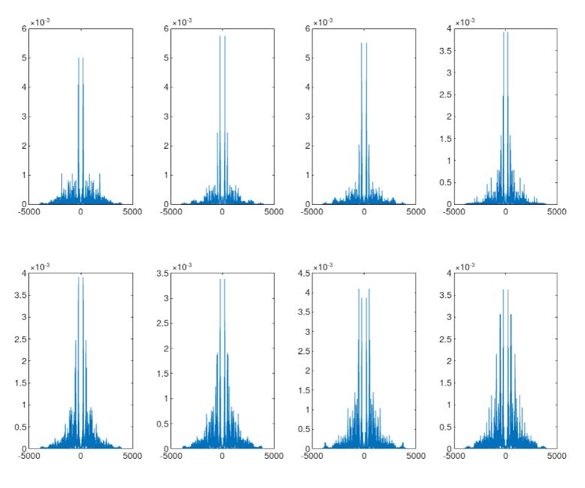
Niveditas' audio samples

Slide 7
Result :
❖We had developed an algorithm using the mean-variance concept which allows only a particular speaker to be able to open the lock by uttering the combination lock number.
❖ For every speaker we have extracted the mean value, variance and standard deviation of energy of a particular band using the 8 sample signals.
❖ The concept behind this is we know that 99% of the distribution of any process lies in the range [mean-2.5*standard_deviation,mean+2.5*standard deviation].
❖ So for a particular person we will design the lock system such a way:-
➢ For example, we have given a random audio signal, then it checks for each band of frequency whether the energy values of that particular band lies in the range [mean-2.5*standard deviation,mean+2.5*standard deviation](of a particular
band of a particular person),if it satisfies for each band then it will give access.
❖ This concept depends on the window that we have taken.
❖ The lowest false acceptance and lowest false rejection is achieved when we take banks=20 and rectangular window.

Slide 8
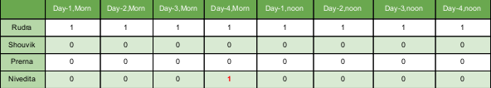
When the algorithm defined to give access only to Rudra, when banks used=20 and rectangular window, Below table shows, to which samples this algorithm will give access(1).
False acceptance ratio = 1/32
False rejection ratio = 0

Slide 9
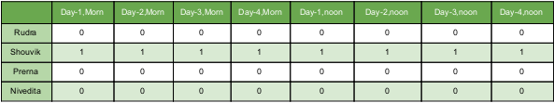
When algorithm defined to give access only to Shouvik, when banks used=20 and rectangular window, below table shows, to which samples this algorithm will give access(1).
False acceptance ratio = 0
False rejection ratio = 0

Slide 10

When algorithm defined to give access only to Prerna, when banks used=20 and rectangular window, below table shows, to which samples this algorithm will give access(1).
False acceptance ratio = 0
False rejection ratio = 0

Slide 11

When algorithm defined to give access only to Nivedita, when banks used=20 and rectangular window, below table shows, to which samples this algorithm will give access(1).
False acceptance ratio = 0
False rejection ratio = 0

Slide 12
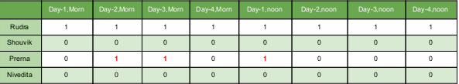
When algorithm defined to give access only to Rudra, when banks used=12(unequal spacing as mentioned previously) and Blackman window, Below table shows, to which samples this algorithm will give access(1).
False acceptance ratio = 3/32
False rejection ratio = 0

Slide 13

When algorithm defined to give access only to Shouvik, when banks used=12(unequal spacing as mentioned previously) and Blackman window, Below table shows, to which samples this algorithm will give access(1).
False acceptance ratio = 0
False rejection ratio = 0

Slide 14

When algorithm defined to give access only to Prerna, when banks used=12(unequal spacing as mentioned previously) and Blackman window, Below table shows, to which samples this algorithm will give access(1).
False acceptance ratio = 0
False rejection ratio = 0

Slide 15
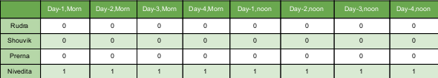
When algorithm defined to give access only to Nivedita, when banks used=12(unequal spacing as mentioned previously) and Blackman window, Below table shows, to which samples this algorithm will give access(1).
False acceptance ratio = 0
False rejection ratio = 0

Slide 16
Pitch Detection Algorithm (PDA)
A pitch extraction algorithm (PDA) is an algorithm designed to estimate the pitch or fundamental frequency of a quasiperiodic or oscillating signal, usually a digital recording of speech or a musical note or tone. This can be done in the time domain, the frequency domain, or both.
PDAs are used in various contexts (e.g. phonetics, music information retrieval, speech coding, musical performance systems) and so there may be different demands placed upon the algorithm. There is as yet no single ideal PDA, so a variety of algorithms exist, most falling broadly into the classes given below.
A PDA typically estimates the period of a quasiperiodic signal, then inverts that value to give the frequency.

