Slide 1
DSP Tutorial-4
18th feb 2021

Slide 2
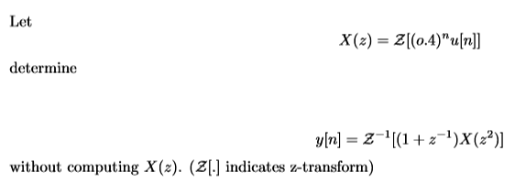
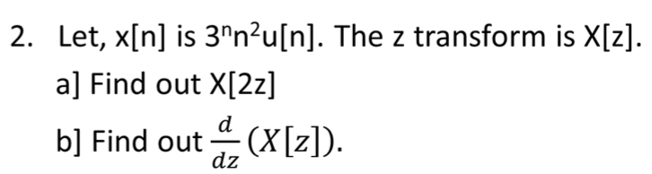

Questions:
30min.
1.
3. A transmitted cell phone signal (x[n]) gets distorted due to the multipath reflections from city buildings. Hence, in place of x[n] the cell phone receives y[n], where,
Our aim is to find an inverse filter g[n] that can recover x[n] from y[n]. Can such a filter be made? If yes, what is the impulse response of g[n]?

Slide 3
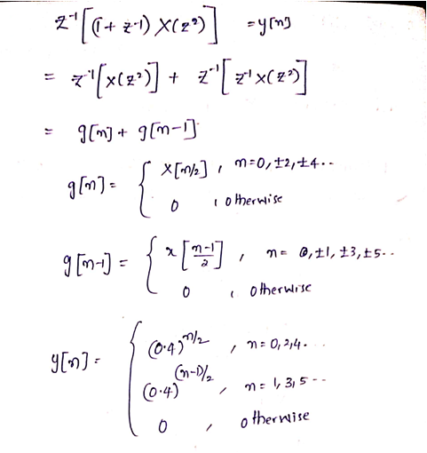
1. Ans.

Slide 4
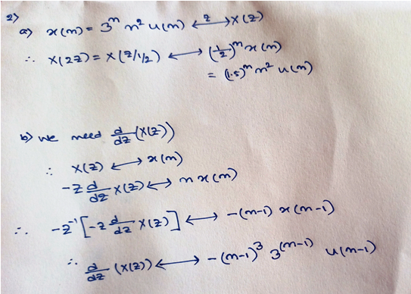

Slide 5
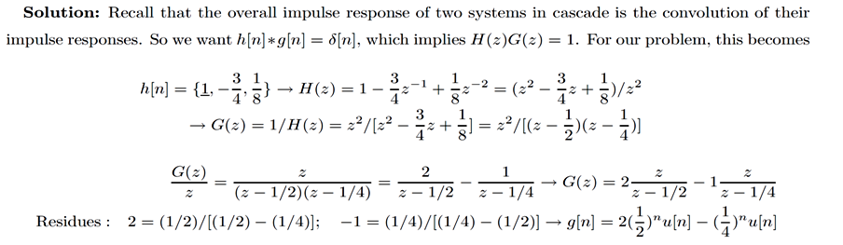
3.

