Slide 1
DSP Tutorial 6
18/03/2021

Slide 2
Discussion
1) A monochrome video signal that ranges from 0 to 8V, is digitized using an 8-volt ADC.
A) Determine the resolution of ADC.
B) Calculate the mean squared quantization error.
C) Suppose the ADC is counter controlled. The counter is up count and positive edge triggered with clock frequency 1 MHz. What is the time taken in seconds to get a digital equivalent if 1.59 V?
Answer:
A) Resolution of n bit ADC with a range of input voltage 0-V volt is V/(2^{n}-1).
Resolution = 8/(2⁸-1)=8/255=31.37 mV.
B) Q_{e}=Δ²/12 where Δ is step size.
Q_{e}=31.37²/12=81.3 microvolts.
C) In counter ADC, with n output bits, a maximum of 2^{n} clock pulses are required for the largest analog input possible.
Maximum analog input is 8 volts.
For 8 volt signal we need 256 clock pulses.
So for 1.59 volt we need 1.59*256/8= 50.88 clock pulses.
Clock frequency is 1 MHz. Therefore every clock pulse takes 1 micro second.
Time taken= 51 micro seconds.

Slide 3
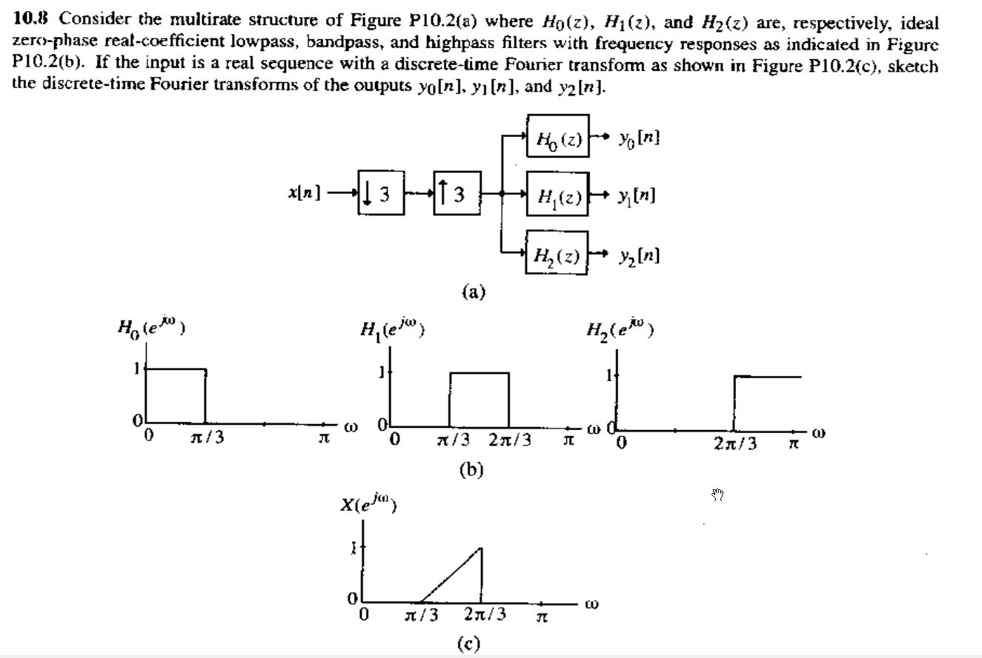
Discussion
2)

Slide 4
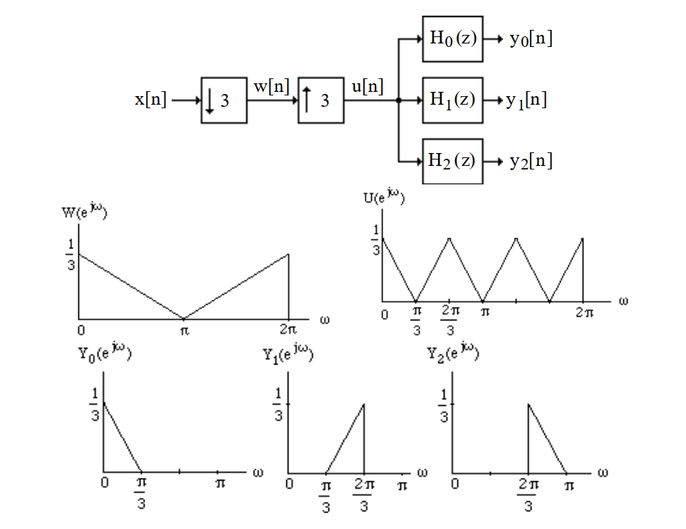
Discussion
Answer:

Slide 5
Questions
30 min
Show that the SNR for ADC conversion is exponentially proportional to 2*B where (B+1) is the total number of bit used for encoding. Further show that, (SNR)_{dB}=(1.76+6B) dB for a sinusoid input with amplitude m_{p} and X_{m} covering exactly the full range of input.
Let Xa(t) is a band-limited signal with fixed bandwidth B Hz and variance σ_{x}² .Show that the signal-to-quantization noise ratio SQNR=10log₁₀ (σ_{x}²/ σ_{e}²) increases by 3dB each time we double the sampling frequency.
Develop a computationally efficient realization of a factor of 4 decimator employing a length-16 Type-I FIR filter.

Slide 6
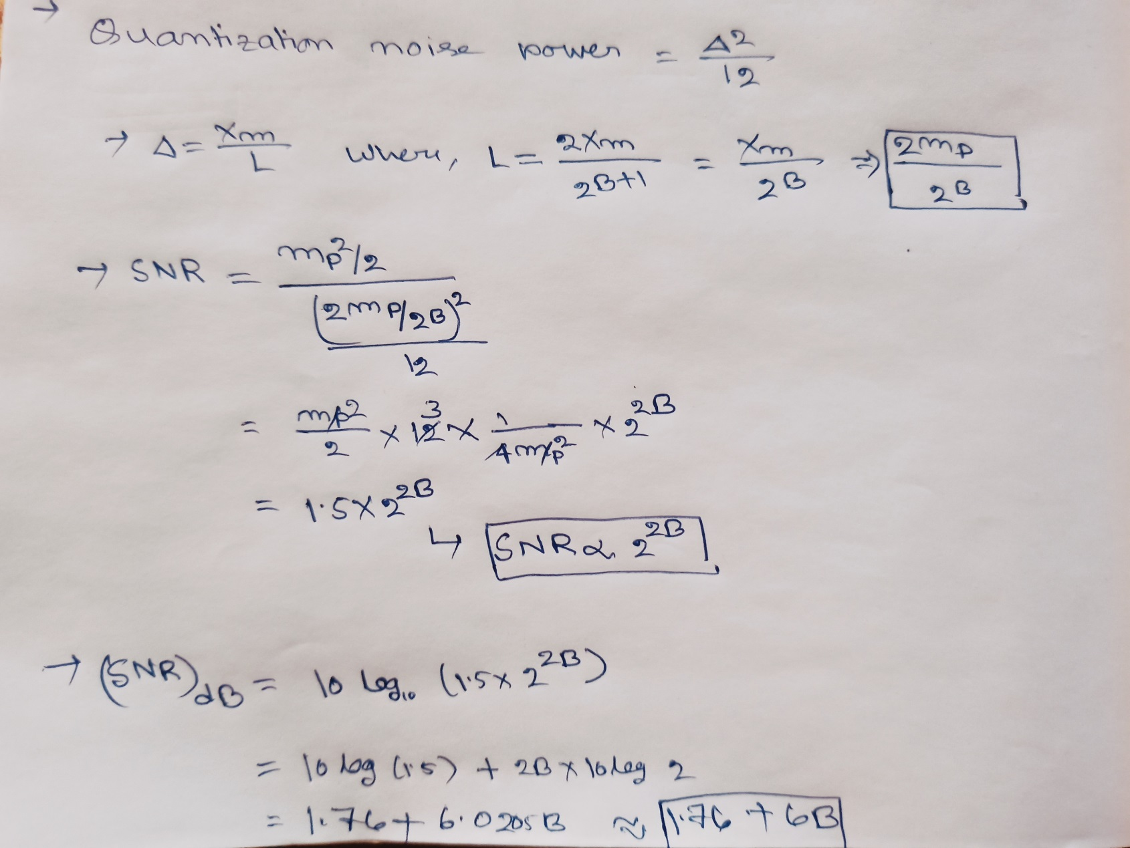
Answer 1

Slide 7
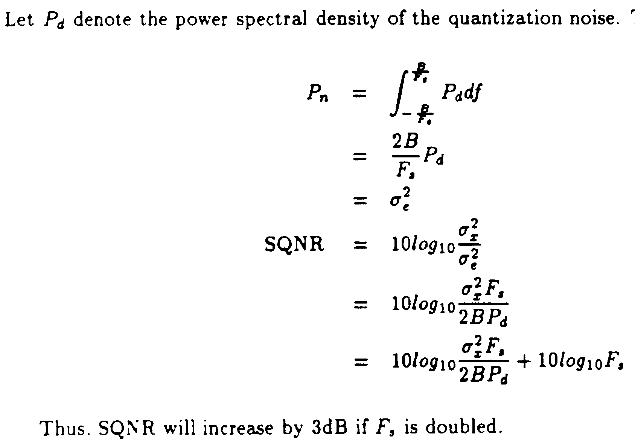
Answer 2

Slide 8
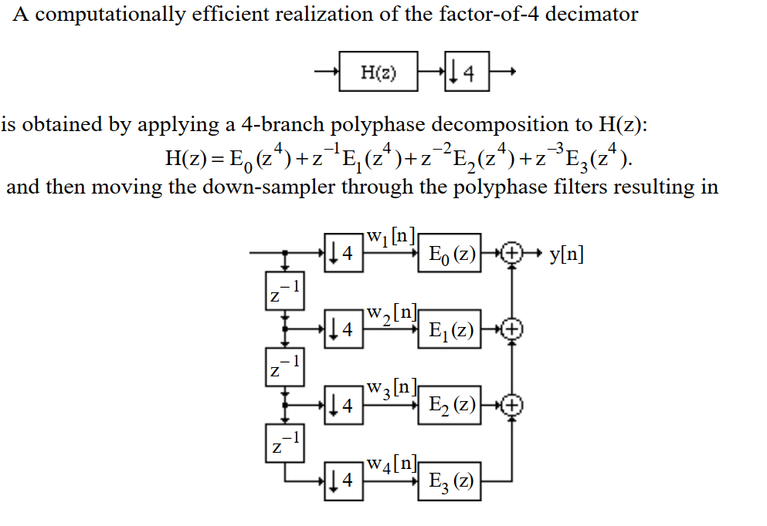
Answer 3

Slide 9
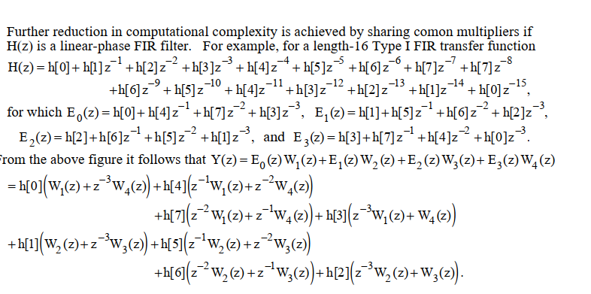
Ans3

Slide 10
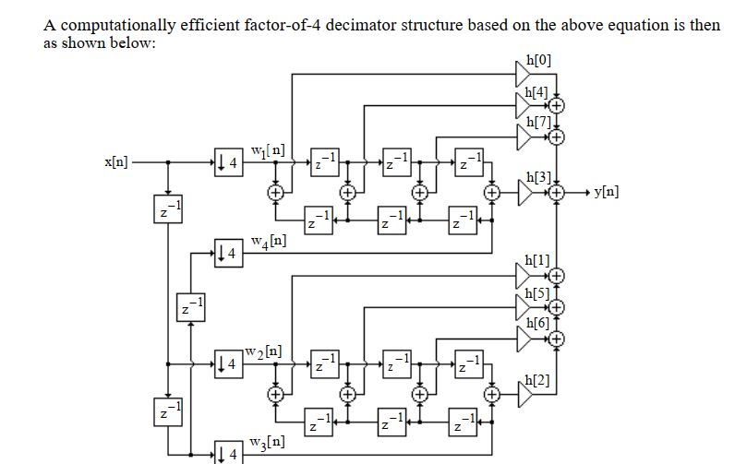
Ans 3

