Slide 1
DSP Tutorial-7
25th march 2021

Slide 2
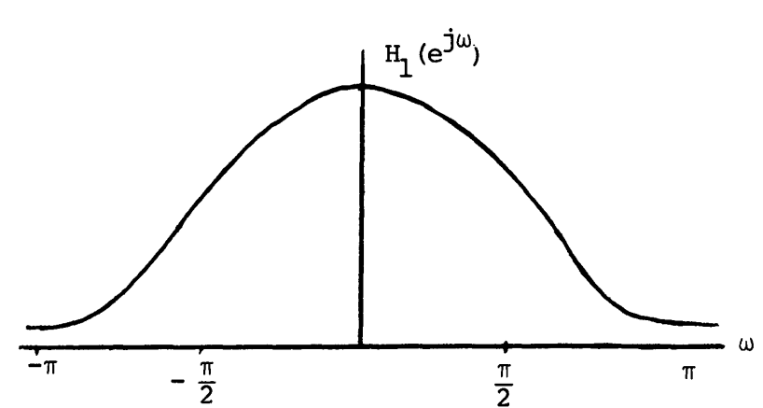
Discussion
1. Let h₁(n) and h₂(n) denote the unit sample responses of two FIR filters of length 8. The two are related by a 4-point circular shift, given by
The Fourier transform of h₁(n) is as given in figure below, and correspond to a low pass filter with cut-off frequency π/2.
a) Find the relationship between DFT of h₁(n) and h₂(n). Also show that the magnitude of DFT of h₁(n) is equal to h₂(n).
b) Is h₂(n) also a low-pass-filter with cut-off frequency π/2 ?

Slide 3
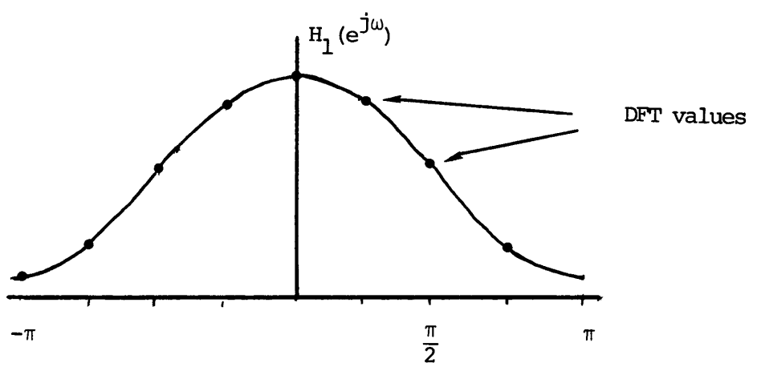
Ans. 1 a) Since h₁(n) and h₂(n) are related by a circular shift, their DFTs are related by
Hence, their magnitudes are equal.
b) Since the DFT corresponds to samples of the Fourier transform, the values of H₁ (k) are the samples of H₁ (e^{jW}) indicated below,
From the relation between H₂(k) and H₁(k) in solution a), the values H₂(k) are as indicated below.

Slide 4
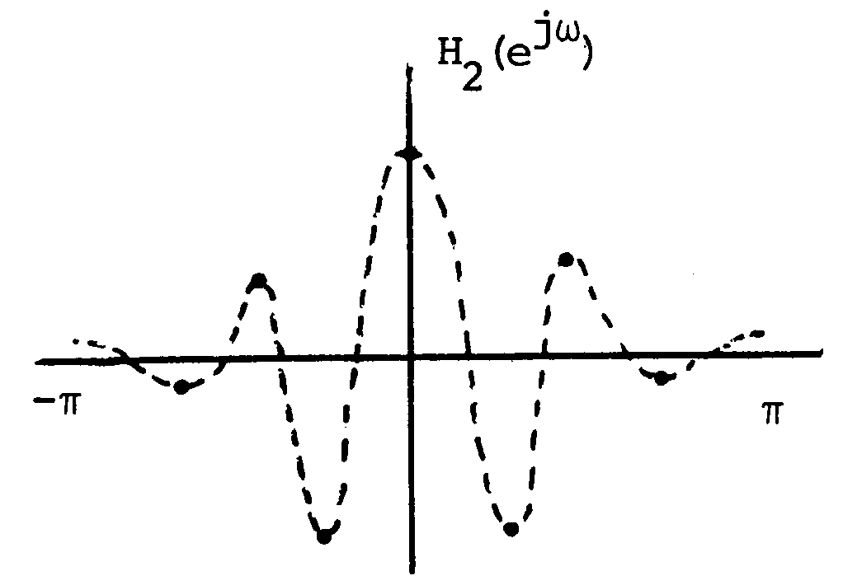
Since these alternate in polarity, the continuous frequency response of which these are samples, must go through zero in between these samples.
Thus, h₂(n) does not correspond to a good low pass filter, even though the magnitude of its DFT values are identical to those of the low pass filter h₁(n).

Slide 5

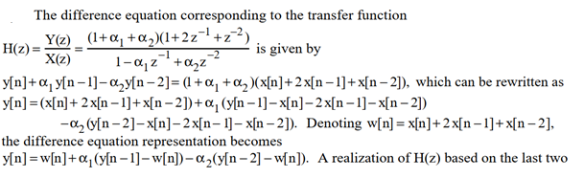
2. Develop of two-multiplier canonic realisation of the following second order transfer function where the multiplier coefficients are ɑ1 and -ɑ2, respectively
Ans.

Slide 6
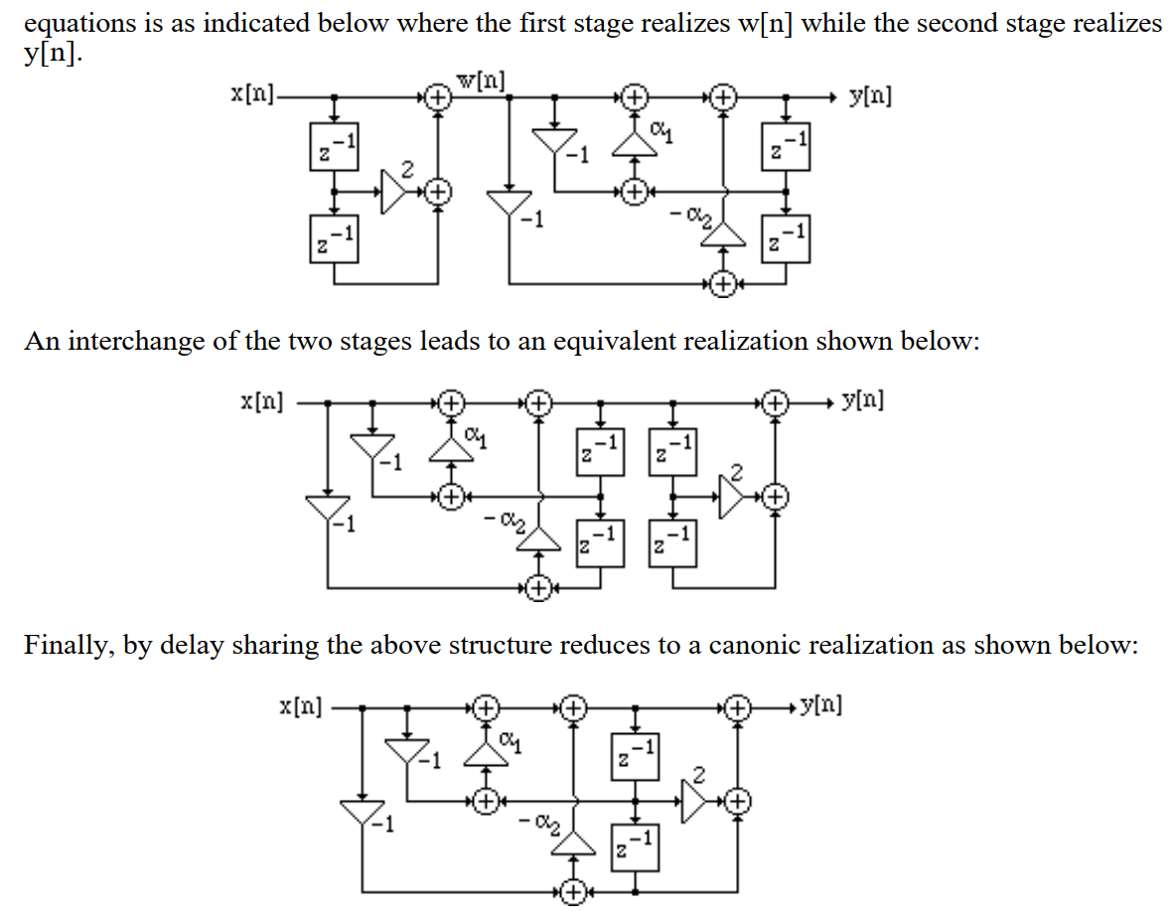

Slide 7
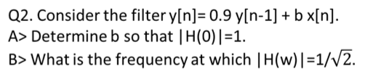

Questions
30 minutes
Q1. a. Determine the frequency response of a length N=5 FIR Type III filter.
b. Determine the frequency response of a length N=4 FIR Type IV filter.
Q3. Develop a two-multiplier canonic realisation of the following second order transfer function where the multiplier coefficients are ɑ1 and -ɑ2, respectively.
C> Is it a LPF? Justify.
D> What type of filter it will be if y[n]= -0.9 y[n-1] + b x[n] ?

Slide 8
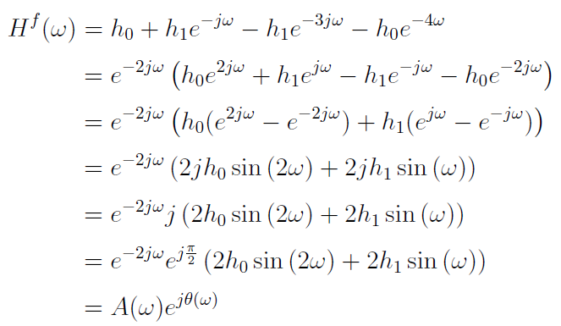
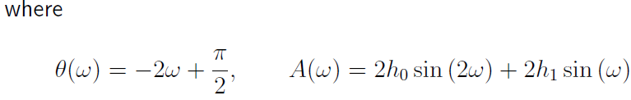
Solutions
a. Determine the frequency response of a length N=5 FIR Type III filter.
Ans.

Slide 9
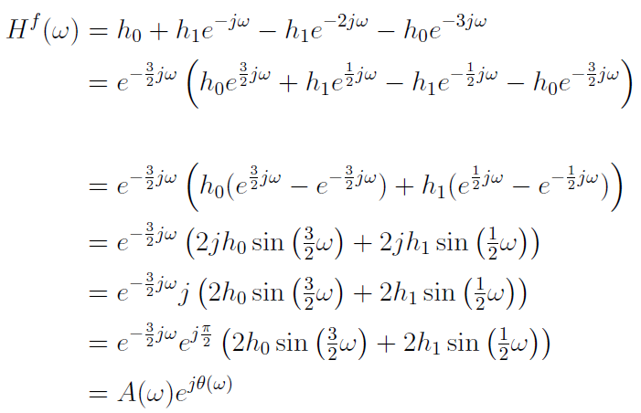
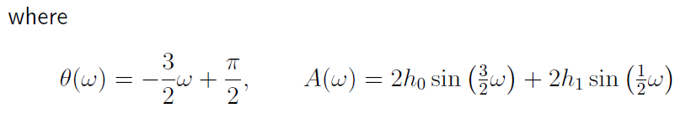
b. Determine the frequency response of a length N=4 FIR Type IV filter.
Ans.

Slide 10
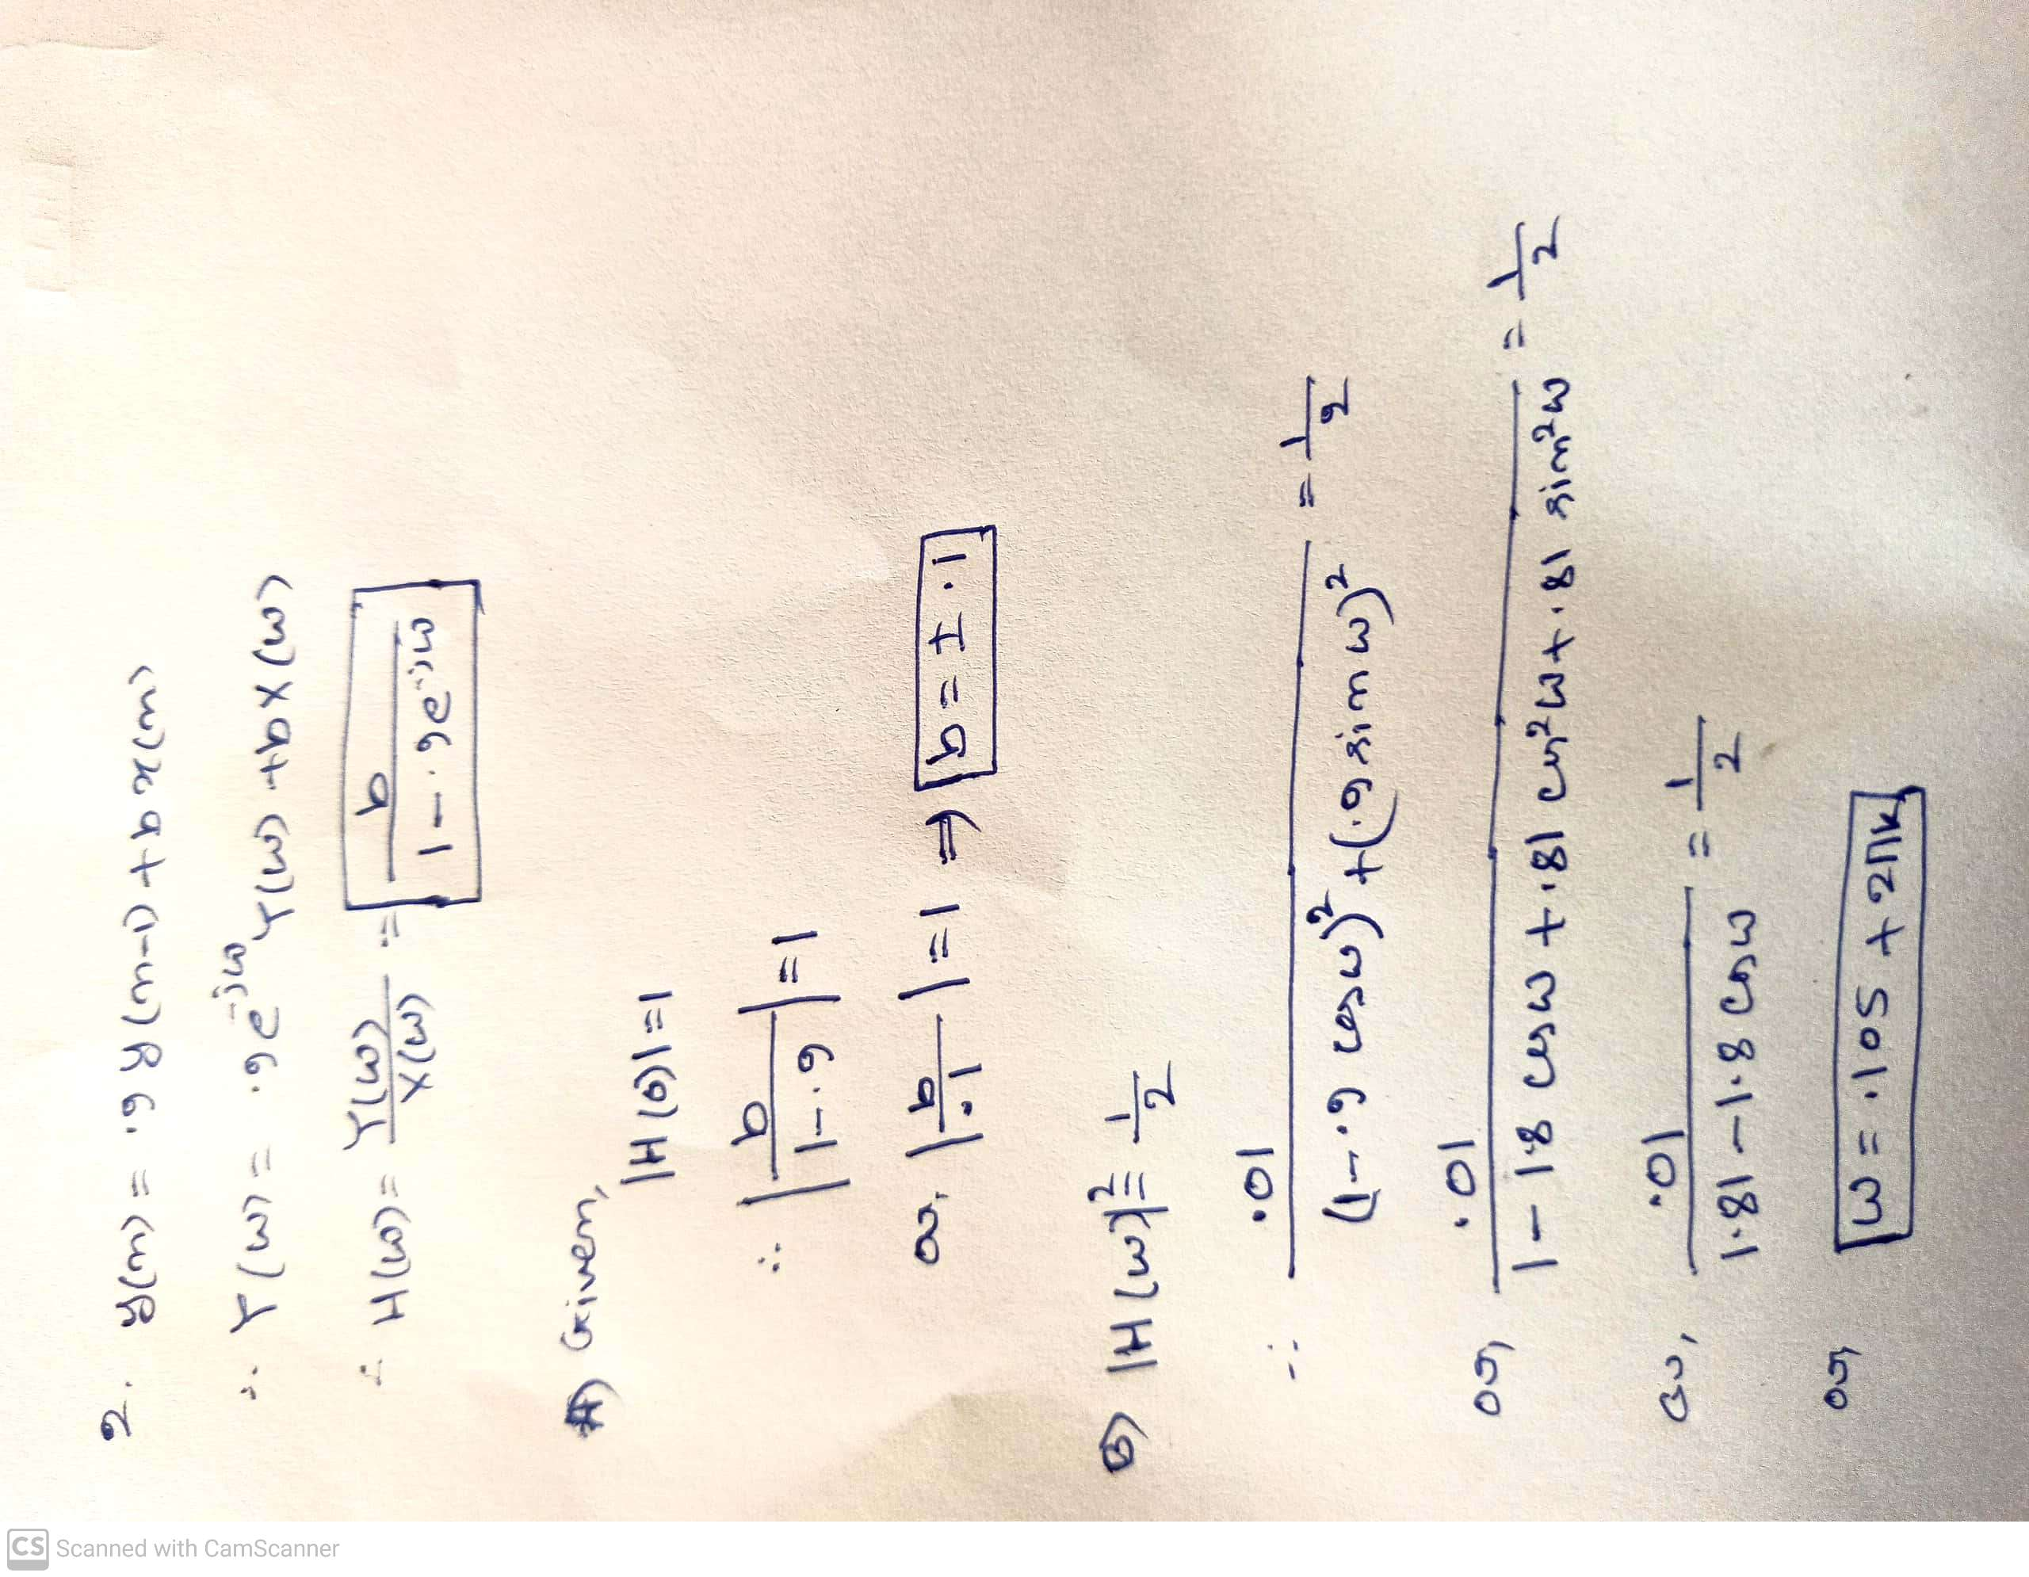
C> Is it a LPF? Justify.
D> What type of filter it will be if y[n]= -0.9 y[n-1] + b x[n] ?

Slide 11
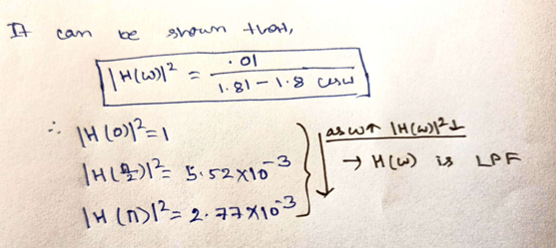
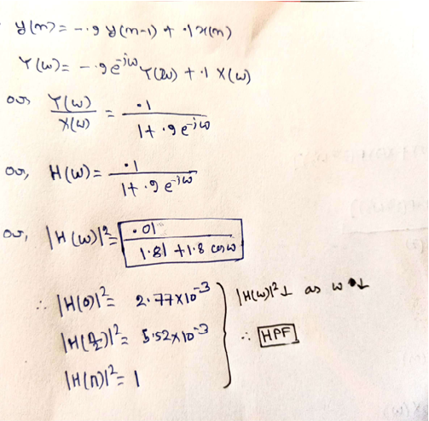
2. C
D.

Slide 12
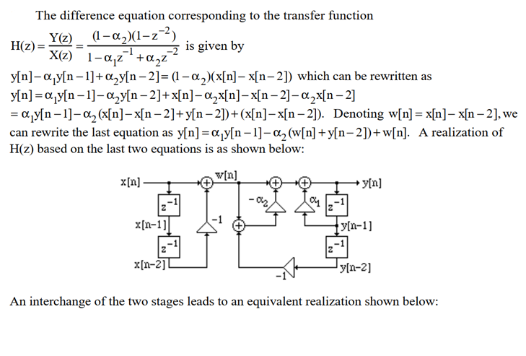
3. Ans.

Slide 13
