Slide 1

Analyzing Medicare Data for Multiple Chronic Conditions
BY,
GROUP 7

Slide 2

AGENDA
Introduction
Dataset Overview
Methodology
Data
Results
Conclusion
Future Direction

Slide 3

INTRODUCTION
PROBLEM OVERVIEW:
The prevalence of multiple chronic conditions among Medicare beneficiaries is on the rise, posing significant challenges to healthcare delivery and management.
Managing the healthcare utilization, costs, and outcomes for individuals with complex health needs requires a deep understanding of the factors influencing their care.

Slide 4

INTRODUCTION
MOTIVATION:
Analyzing Medicare data is crucial for improving care quality and efficiency for beneficiaries with multiple chronic conditions.
Data-driven insights have the potential to enhance healthcare services, patient outcomes, and resource allocation strategies.
Evidence-based decision-making in healthcare policy is essential to address the diverse and complex needs of this vulnerable population.

Slide 5

DATASET OVERVIEW
Title: Analyzing Medicare Data for Multiple Chronic Conditions
Source: Centers for Medicare & Medicaid Services Data website (data.cms.gov)
Dataset Size: 44,974 records
Variables:
Bene_Geo_Lv: Geographic level of beneficiary's location
Bene_Age_Lvl: Age group of the beneficiary
Bene_MCC: Number of chronic conditions/beneficiary
Tot_Mdcr_Stdzd_Pymt_PC: Standardized Medicare payment/beneficiary/year
Hosp_Readmsn_Rate: Hospital readmission rate/1,000 beneficiaries

Slide 6

METHODOLOGY
ENDOGENEITY CONSIDERATIONS:
Definition: Endogeneity arises when independent variables are correlated with the error term, potentially biasing regression estimates.
Example: ER_Visits_Per_1000_Benes may exhibit endogeneity if influenced by unobserved factors affecting Hosp_Readmsn_Rate, leading to biased estimates.
REASONS FOR ENDOGENEITY:
Factors: Patients' health status, accessibility to healthcare facilities, and changes in healthcare policies, can influence both ER visits and hospital readmission rates.
Correlation: These factors may lead to a correlation between the independent variable (ER_Visits_Per_1000_Benes) and the error term in the regression model.

Slide 7

METHODOLOGY
INSTRUMENTAL VARIABLES (IV):
Choice: Utilize ER_Visits_Per_1000_Benes as an instrument for itself in the regression analysis.
Rationale: Assumes that while ER visits are correlated with ER_Visits_Per_1000_Benes, the latter is uncorrelated with the error term, addressing endogeneity.
MODEL ESTIMATION:
Approach: Employ ordinary least squares (OLS) regression with instrumental variables to mitigate endogeneity concerns.
Instrument Parameter: Specify the instrument parameter to include ER_Visits_Per_1000_Benes in the regression model.

Slide 8

METHODOLOGY
ENDOGENEITY ASSESSMENT:
Potential Issues: Challenges may persist if the instrument is weakly correlated with the endogenous variable or if unobserved confounding factors are present.
IV approach relies on assumptions of exogeneity, relevance, and exclusion restrictions, which if violated, can lead to biased estimates.
Multicollinearity: Address strong multicollinearity issues in the regression results, which may affect the stability and interpretation of coefficients.
Robustness Checks: Highlight the importance of conducting sensitivity analyses and robustness checks to assess the consistency and reliability of results.

Slide 9
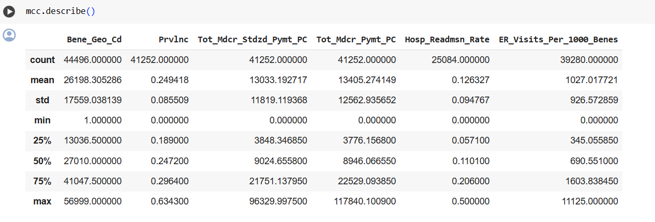
DATA
SUMMARY STATISTICS:

Slide 10
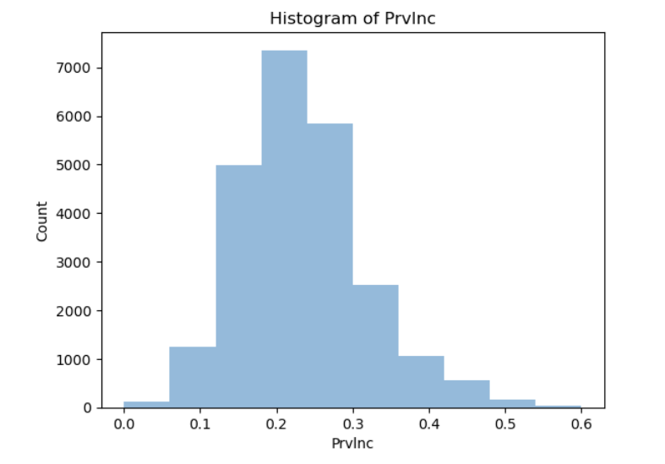
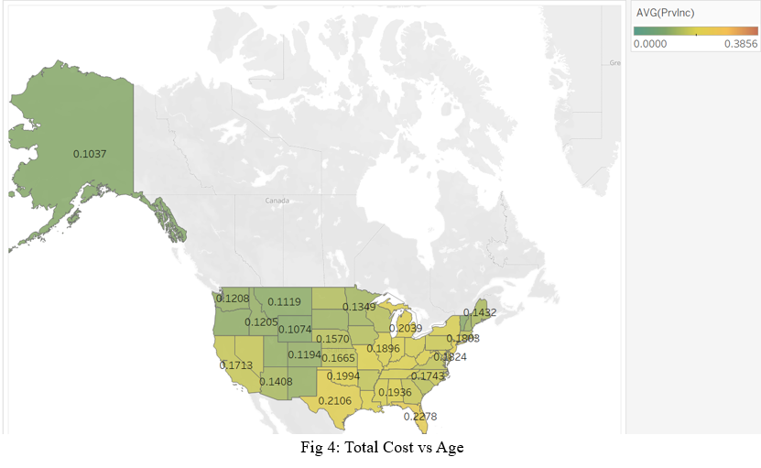
DATA
ANALYSIS BY PREVALENCE:

Slide 11
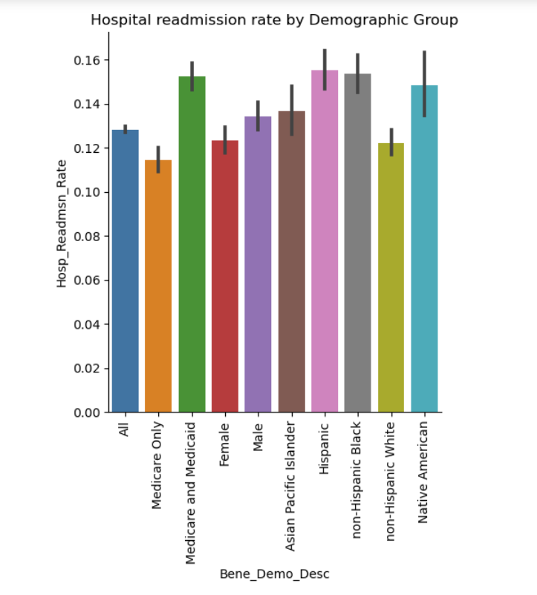
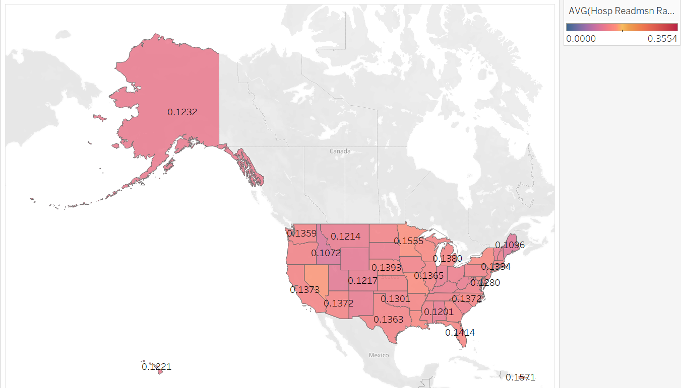
DATA
ANALYSIS BY HOSPITAL READMISSION RATE AND ER VISITS:

Slide 12
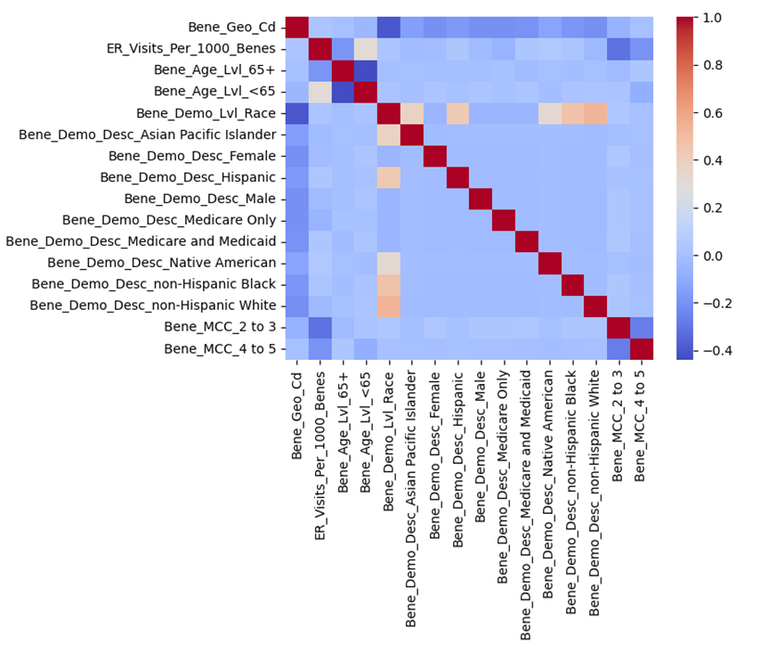
DATA
CORRELATION CHECK:

Slide 13
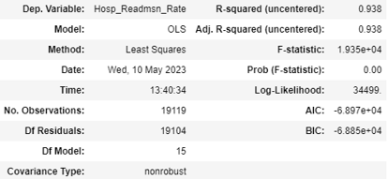
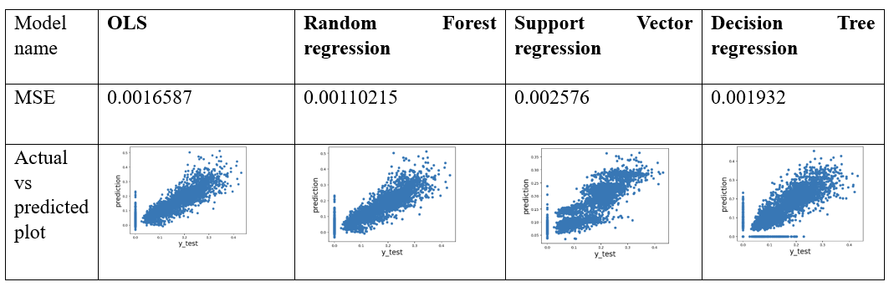
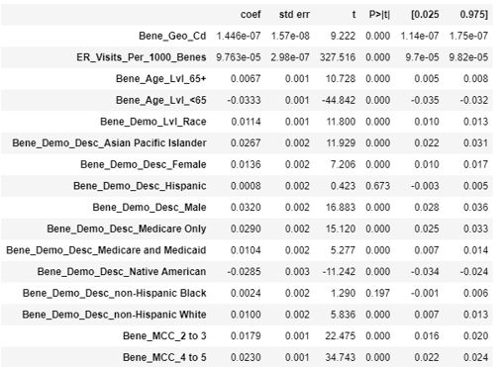
RESULTS
MODEL ESTIMATION:

Slide 14
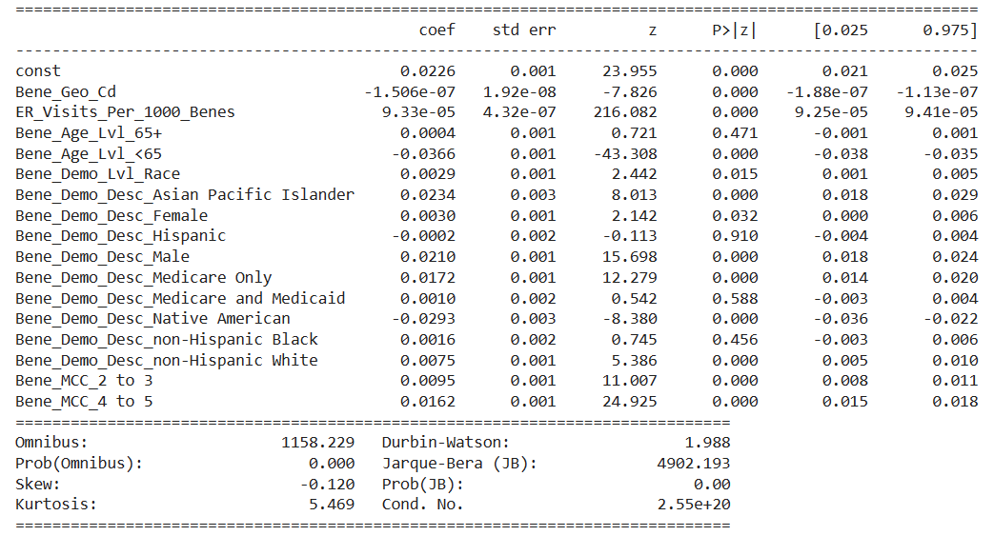
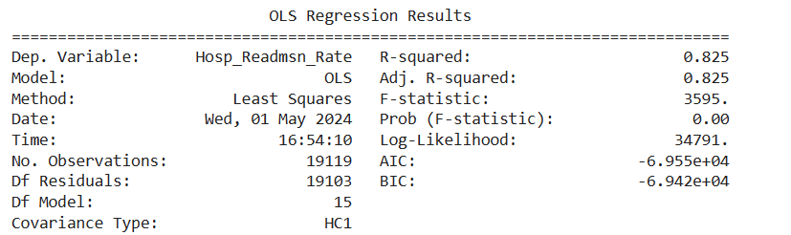
RESULTS
HANDLING ENDOGENEITY:

Slide 15
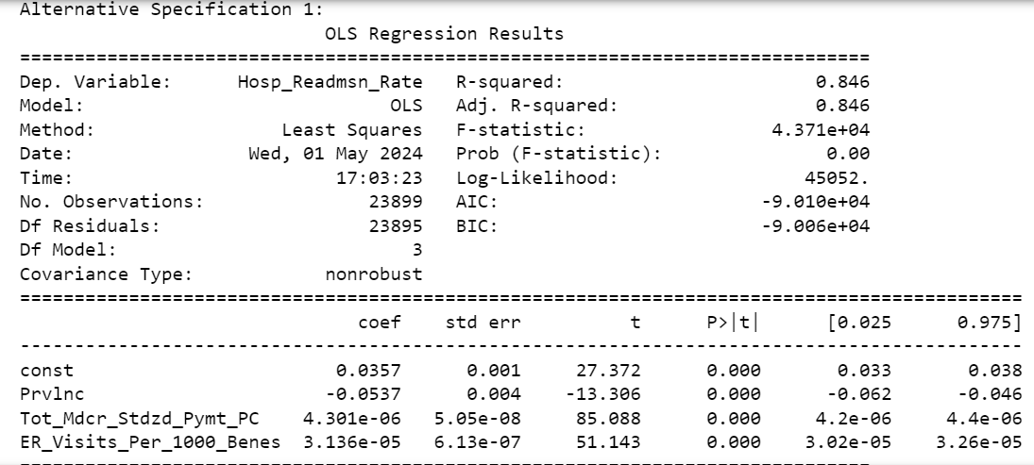
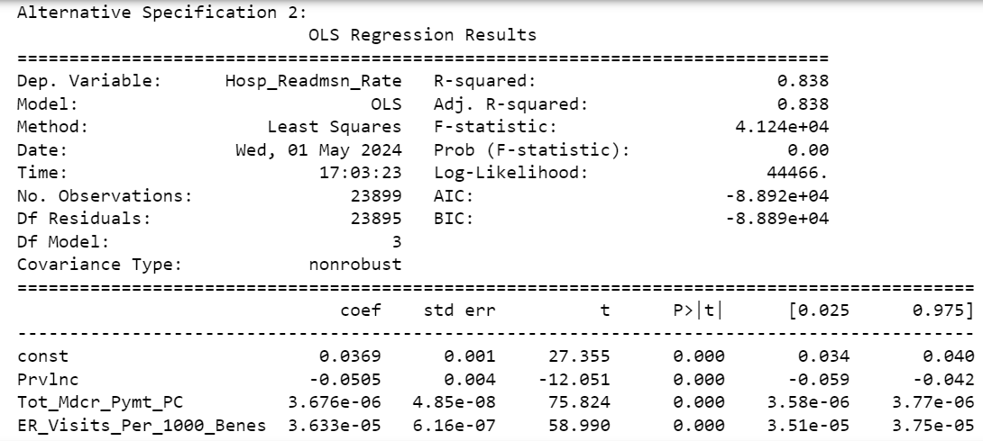
RESULTS
ROBUSTNESS CHECKS (ALTERNATIVE SPECIFICATIONS):
Prvlnc Coefficient: -0.0537 (SE = 0.004, p < .001)
Tot_Mdcr_Stdzd_Pymt_PC Coefficient: 4.301e-06 (SE = 5.05e-08, p < .001)
ER_Visits_Per_1000_Benes Coefficient: 3.136e-05 (SE = 6.13e-07, p < .001)
Prvlnc Coefficient: -0.0505 (SE = 0.004, p < .001)
Tot_Mdcr_Pymt_PC Coefficient: 3.676e-06 (SE = 4.85e-08, p < .001)
ER_Visits_Per_1000_Benes Coefficient: 3.633e-05 (SE = 6.16e-07, p < .001)

Slide 16
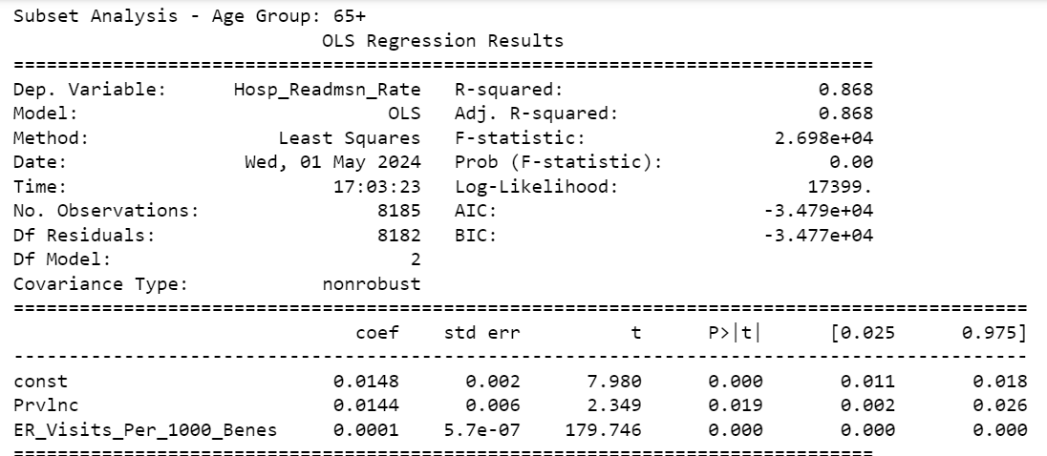
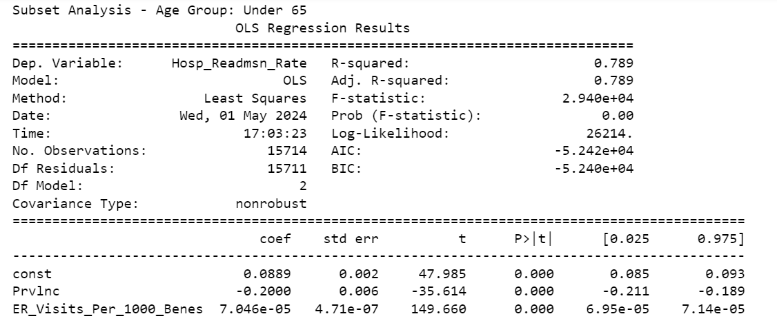
RESULTS
ROBUSTNESS CHECKS (SUBSET ANALYSIS):

Slide 17
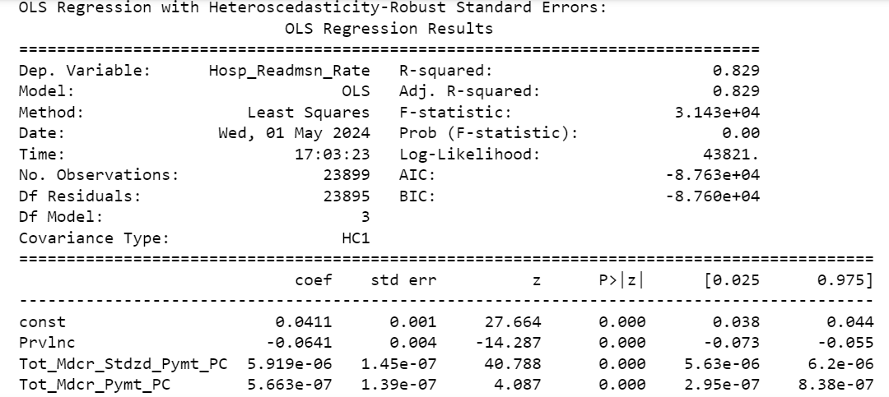
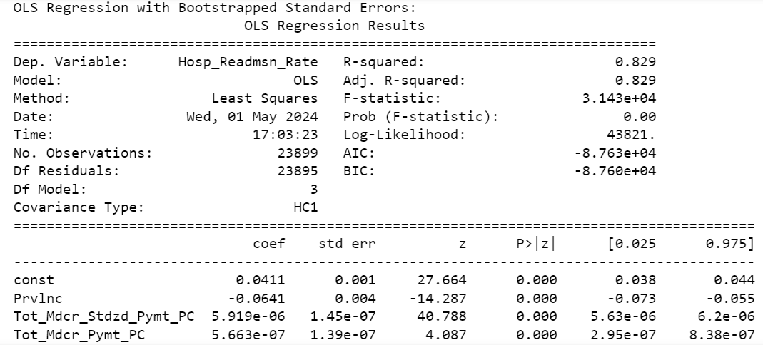
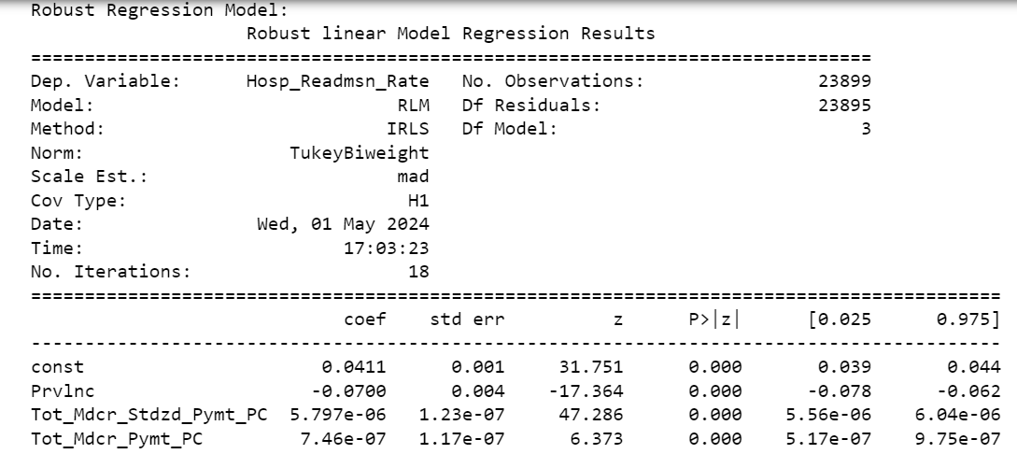
RESULTS
ROBUSTNESS CHECKS (HETEROSCEDASTICITY, BOOTSTRAPPING AND ROBUST REG):

Slide 18

CONCLUSION
The project aimed to analyze Medicare data for multiple chronic conditions to forecast healthcare payments, prevalence of chronic conditions, and hospital readmission rates.
Significant relationships among demographics, age, and chronic conditions were identified through data preprocessing and visualization.
Performance evaluation using metrics like Mean Squared Error (MSE) guided the selection of appropriate modeling techniques for accurate predictions.
The findings can inform policy decisions and healthcare interventions to enhance care quality and efficiency for Medicare beneficiaries with complex health needs.

Slide 19

future DIRECTIONS
Explore additional variables or datasets to enhance the predictive models and gain deeper insights into healthcare utilization and outcomes.
Implement advanced machine learning algorithms for more accurate forecasting.
Conduct sensitivity analyses to assess model robustness and address potential biases in estimates.
Collaborate with healthcare providers and policymakers to translate research findings into actionable strategies.
Continuously monitor and evaluate the impact of interventions to refine predictive models and optimize healthcare delivery.

Slide 20

THANK YOU!

