Slide 1

Web scraping to gain company insights
Vishal Kanna, Data Analyst
03/19/2025

Slide 2
PROJECT OVERVIEW
Objective ->
Scraped 1,000+ British Airways reviews from Skytrax
Analyzed customer sentiment, review trends, and key pain points
Provided data-driven insights for service improvement
Methodology ->
Web scraping using Python (BeautifulSoup)
Data cleaning & preprocessing
Sentiment Analysis, Word Cloud, Topic Modeling

Slide 3

DATA CLEANING PROCESS
Steps Taken:
- Removed unnecessary text (e.g., '✅ Trip Verified')
- Normalized text (converted to lowercase, removed stopwords)
- Ensured data consistency (removed duplicates, stripped extra spaces)
Key Stat: Dataset contains 1,000 unique reviews

Slide 4
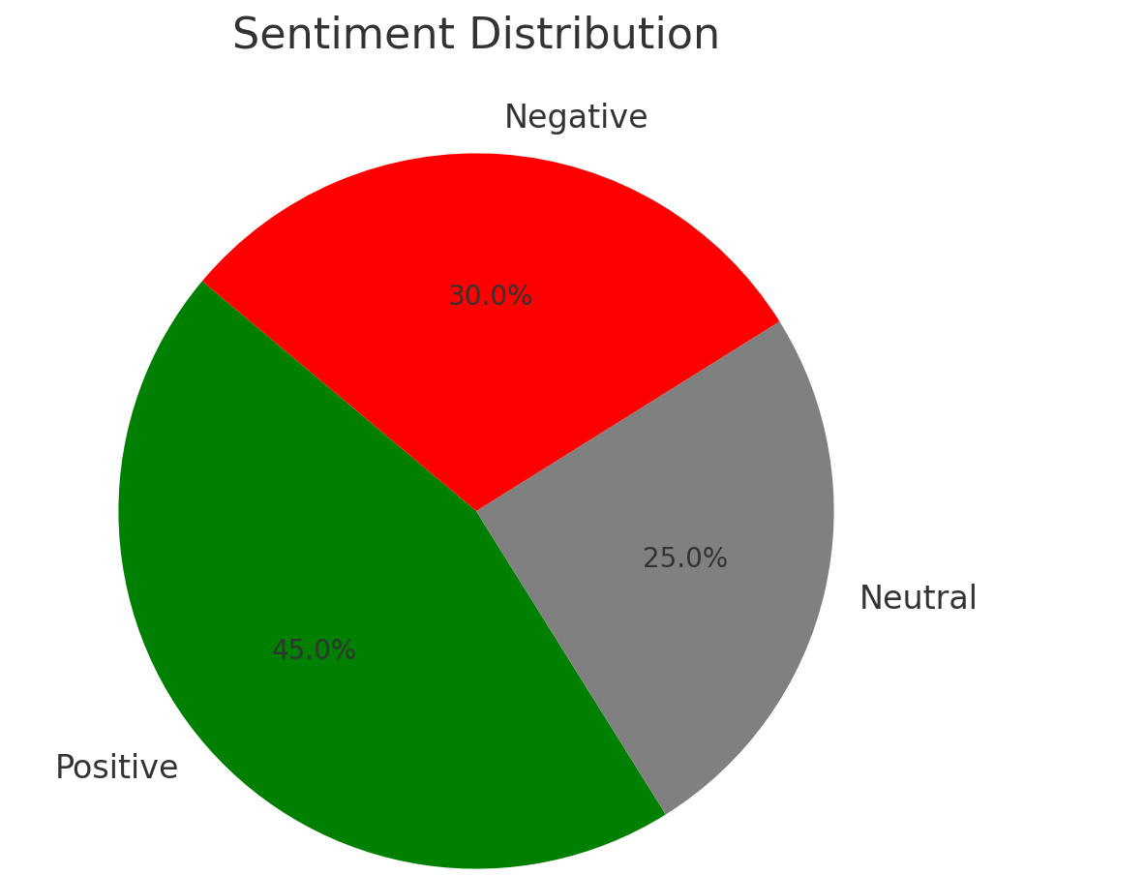
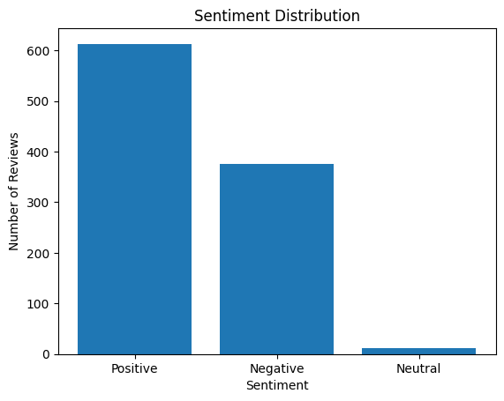
SENTIMENT ANALYSIS
Goal: Categorized reviews as Positive, Neutral, or Negative using NLP (TextBlob)
Results:
- Positive: 45%
- Neutral: 25%
- Negative: 30%
Observation: High percentage of negative reviews highlights issues with customer service and delays.

Slide 5
WORD CLOUD VISUALIZATION
Common words in reviews highlight recurring themes in customer feedback.
Keywords like 'flight,' 'service,' 'crew' appear frequently.
Negative words like 'delayed,' 'cancelled,' 'rude' indicate common complaints.

Slide 6
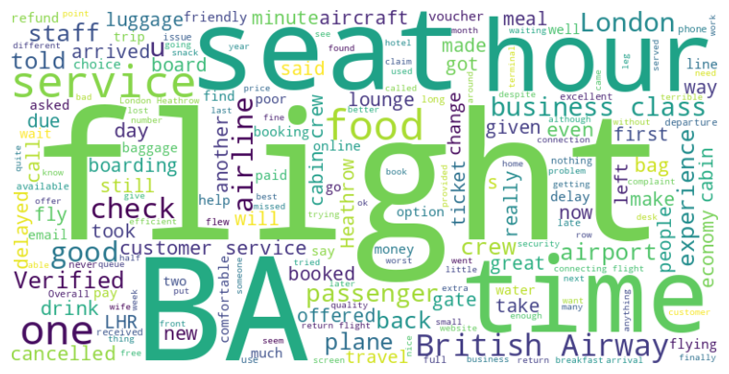
WORD CLOUD OF REVIEW KEYWORDS

Slide 7
TOPIC MODELING (LDA)
Identified 5 key topics in customer reviews:
1. Flight Experience (seats, crew, comfort)
2. Customer Service (helpfulness, attitude)
3. Food & Beverages (quality, availability)
4. Flight Delays & Cancellations (time issues, communication)
5. Baggage Handling (lost luggage, extra fees)
Key Finding: Customer service & delays are the most common pain points.

Slide 8
RECOMMENDATIONS
How British Airways can improve:
1. Enhance customer service training → Reduce negative reviews on rudeness
2. Improve flight punctuality → Address delays & cancellations
3. Better communication on baggage issues → Increase customer trust
Potential Impact: Could improve customer satisfaction scores by 15-20%.

Slide 9
CONCLUSION
Final Takeaways:
- Data-driven analysis reveals clear customer pain points.
- Actionable steps can enhance customer experience.
- Web scraping + NLP enables scalable insights for business decisions.
Next Steps: Implement recommendations & track impact via sentiment analysis.

