Slide 1

SQL
DDL, DCL, DML, Joins, Subqueries and Functions

Slide 2


MY SQL
DDL, DCL, DML, Joins, Subqueries and Functions
Insert, Create, Delete and Update Statements
Operators
Joins & Union
Aggregation Fun / Date Fun / String Fun / Numeric Fun
Sub Query / CTE – Common Table Expression
Stored Procedure
Functions
Triggers / Cursor
Index

Slide 3
WHAT IS SQL?
SQL – Structured Querying Language is a scripting language to access databases
It includes database creation, deletion, fetching rows, modifying rows, etc.
It helps in manipulating and retrieving data stored in a relational database like MySQL, MS Access, Oracle, Sybase, Informix, Postgres and SQL Server as these serves use SQL as their standard database language.

Slide 4
WHAT IS A RELATIONAL DATABASE?
A relational database is a type of database that stores and provides access to data points that are related to one another.
Relational databases are based on the relational model, an intuitive, straightforward way of representing data in tables.
In a relational database, each row in the table is a record with a unique ID called the key.
The columns of the table hold attributes of the data, and each record usually has a value for each attribute, making it easy to establish the relationships among data points.

Slide 5
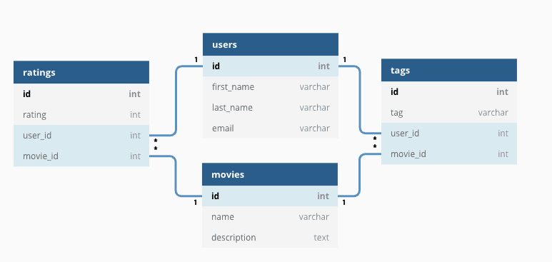
WHAT IS A RELATIONAL DATABASE?

Slide 6
DIFFERENCE BETWEEN MySQL, PostgreSQL and SQL SERVER
PostgreSQL, MySQL, and Microsoft SQL Server (MS SQL) are three popular relational database management systems (RDBMS), each with its own strengths and capabilities. Let's compare these three databases in terms of various factors
Licensing and Cost:
PostgreSQL: PostgreSQL is open-source and released under the PostgreSQL License, which is similar to the MIT License. It is free to use, and there are no licensing costs.
MySQL: MySQL is also open-source and available under the GNU General Public License (GPL), but it also offers commercial licenses for additional features and support.
MS SQL: Microsoft SQL Server is a commercial database and requires licensing fees, which can vary based on the edition and features.

Slide 7
Features and Capabilities:
PostgreSQL: PostgreSQL is known for its advanced features and extensibility. It supports complex queries, data types, indexing options, and offers support for JSON, XML, and geospatial data. It has a reputation for data integrity and offers support for advanced indexing techniques.
MySQL: MySQL is known for its simplicity and ease of use. It provides a good balance between performance and features, with a focus on web applications and small to medium-sized databases. It offers various storage engines, including InnoDB and MyISAM.
MS SQL: Microsoft SQL Server offers a wide range of features including comprehensive business intelligence, data analysis, and reporting tools. It is often chosen for enterprise-level applications that require advanced analytics and reporting capabilities.

Slide 8
Performance:
PostgreSQL: PostgreSQL is known for its extensibility and support for complex queries. It can handle large amounts of data and is suitable for complex transactions.
MySQL: MySQL is known for its fast read operations and is often used for web applications. It performs well for simple to moderately complex queries and is well-suited for read-heavy workloads.
MS SQL: SQL Server is optimized for high-performance and scalability, making it suitable for large-scale databases and complex workloads.

Slide 9
Community and Support:
PostgreSQL: PostgreSQL has a strong open-source community and offers extensive documentation, forums, and resources for support.
MySQL: MySQL also has a strong community and offers a wide range of resources for support, including documentation and forums.
MS SQL: SQL Server benefits from Microsoft's extensive support and resources, including official documentation, forums, and paid support plans.

Slide 10
Platform Compatibility:
PostgreSQL: PostgreSQL is cross-platform and supports various operating systems including Windows, Linux, and macOS.
MySQL: MySQL is also cross-platform and supports various operating systems including Windows, Linux, and macOS.
MS SQL: While primarily associated with Windows, there is a version of SQL Server (SQL Server for Linux) that allows it to run on Linux systems as well.

Slide 11
Normal Forms
What is Normalization?
Normalization is the process of organizing the data in the database.
Normalization is used to minimize the redundancy from a relation or set of relations. It is also used to eliminate the undesirable characteristics like Insertion, Update and Deletion Anomalies.
Normalization divides the larger table into the smaller table and links them using relationship.
The normal form is used to reduce redundancy from the database table.

Slide 12
Normal Forms
List of normal forms in database:
1NF (First Normal Form)
2NF (Second Normal Form)
3NF (Third Normal Form)
BCNF (Boyce-Codd Normal Form)
4NF (Fourth Normal Form)
5NF (Fifth Normal Form)
6NF (Sixth Normal Form)

Slide 13
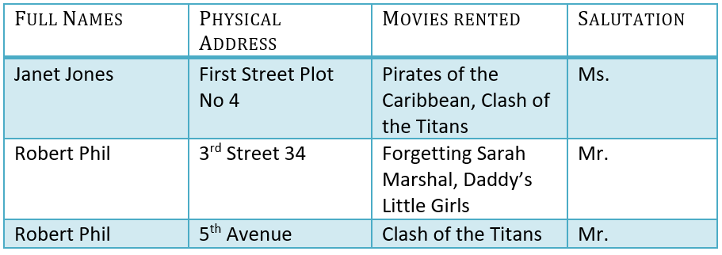
Normal Forms
Normalization examples:
No Normalisation

Slide 14
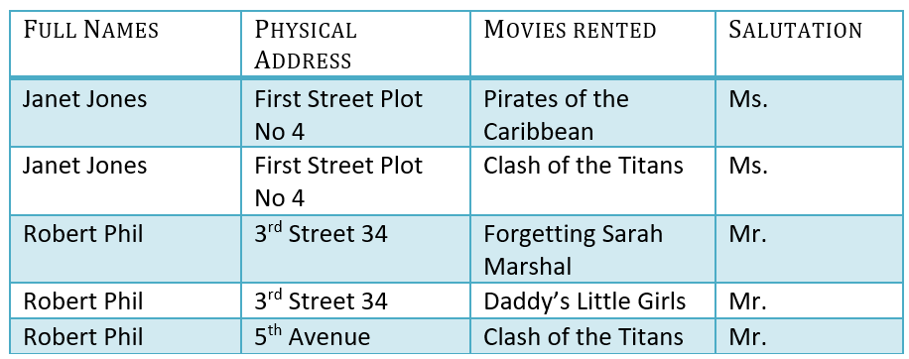
Normal Forms
Normalization examples:
Rules for1NF (First Normal Form):
Each cell in the table should contain only one single value.
Every record in the table should be unique (no duplicate records allowed)

Slide 15
Normal Forms
Normalization examples:
Rules for 1NF (First Normal Form):
Each cell in the table should contain only one single value.
Every record in the table should be unique (no duplicate records allowed)

Slide 16
Normal Forms
Basic understanding of primary key, composite key and foreign key:
A primary key is a single column in a database which contains unique values in each row to represent each records respectively.
A composite key is a primary key where multiple columns may be used to identify a record uniquely. Every composite key is a primary key but every primary key may or may not be composite key.
Foreign key is the column values in database which references the primary key of other table. This way we can connect our tables to create relationships between them.

Slide 17

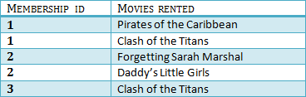
Normal Forms
Normalization examples:
Rules for 2NF (Second Normal Form):
It should be 1NF.
Single column primary key.

Slide 18
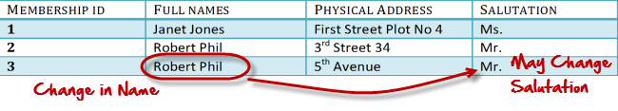
Normal Forms
Normalization examples:
Rules for 3NF (Third Normal Form):
It should be 2NF.
Has no transitive functional dependencies
What are transitive functional dependencies?
A transitive functional dependency is when changing a non-key column, might cause any of the other non-key columns to change. (key column is column with primary, foreign or composite key).

Slide 19

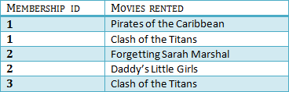

Normal Forms
Normalization examples:
Rules for 3NF (Third Normal Form):
It should be 2NF.
Has no transitive functional dependencies

Slide 20
SQL CLASSIFICATION
SQL
DCL
Data Control Language
DDL
Data Definition Language
TCL
Transaction
Control
Language
DML
Data manipulation Language

Slide 21
DDL - DATA DEFINITION LANGUAGE
DDL or Data Definition Language consists of the SQL commands that can be used to define the database schema.
DDL allows to add / modify / delete the logical structures which contain the data or which allow users to access / maintain the data
CREATE - to create a database and its objects
ALTER - alters the structure of the existing databases
DROP - delete objects from the databases
TRUNCATE - remove all records from a table, including memory allocated for the records are removed

Slide 22
DML- DATA MANIPULATION LANGUAGE
DML commands enable us to work with data that goes into the database such as INSERT, SELECT, UPDATE and DELETE records
SELECT - Retrieves data from a Table/Database
INSERT - Insert data into a Table/Database
UPDATE - Updates existing data within a Table/Database
DELETE - Deletes all records from a database Table/Database

Slide 23
DCL - DATA CONTROL LANGUAGE
DCL commands allow us to give permission on the particular database or table such as GRANT & REVOKE
GRANT – Allows user to access privileges to the database/table
REVOKE - withdraw users access privileges given by using the GRANT command

Slide 24
TCL - TRANSACTION CONTROL LANGUAGE
TCL Commands lets to commit and revoke changes in the server. Also, it allows us to save points wherever it is appropriate.
COMMIT– Saves all the changes done in the last transaction permanently.
ROLLBACK - Cancels all the modifications done in the last transaction.
SAVEPOINTS - Rollback operation will be performed on a part of transaction. The save points commands sets a name transaction save-point by the name of identifier. At the same time the present transaction has a save point with the similar name, then the old save point is deleted and a new one is assigned.

Slide 25
WORKING ON DATABASE
CREATE DATABASE statement is used to create a new SQL database.
The database name must be unique within the server instance.
If you try to create a database with a name that already exists, MySQL throws an error.
Syntax
CREATE DATABASE DatabaseName
Create Database
Drop Database
Manage Database
©

Slide 26
WORKING ON DATABASE
DROP DATABASE statement is used to delete an existing database in the instance.
The DROP DATABASE statement deletes all tables in the database permanently.
Create Database
Drop Database
Manage Database
Syntax
DROP DATABASE database_name

Slide 27
WORKING ON DATABASE
When you have multiple databases in your SQL Schema, then before starting your operation, you should select a database where all the operations would be performed.
The SQL USE statement is used to select any existing database.
Create Database
Syntax
USE DatabaseName
Drop Database
Manage Database
Once a database is created, you can check it in the list of databases by SQL command SHOW DATABASE
Syntax
SHOW DATABASES

Slide 28
DATA TYPES
Data Types are attributes that specifies the type of data of any object.
Each column, variable and expression has a related data type in SQL.
We can use these data types while creating our tables.
Data Types
Numeric
Binary
Character Strings
Unicode Char
Strings
Date and Time

Slide 29
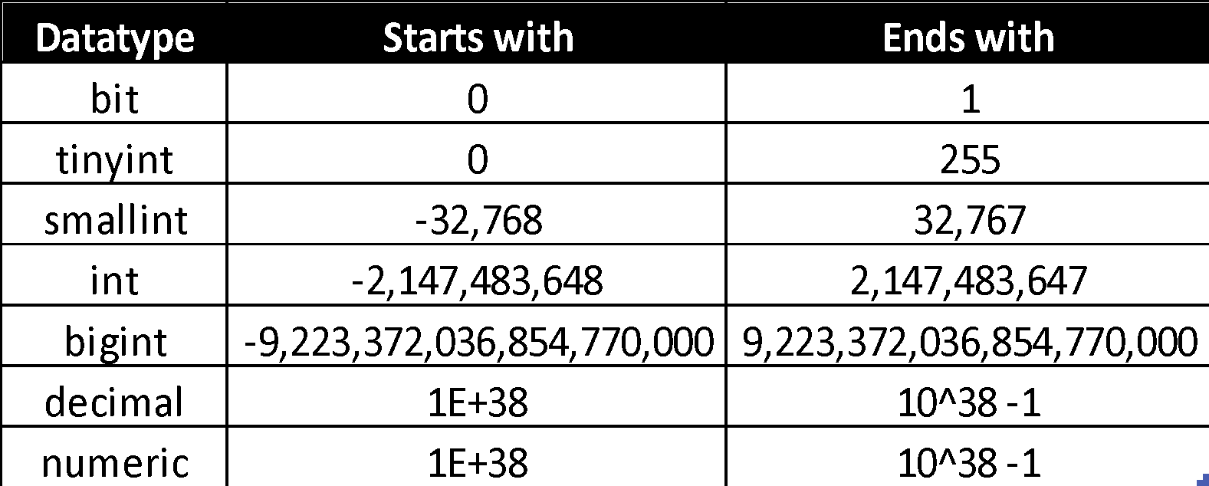
DATA TYPES
Numeric Data Types
Approximate Numeric
Data Types
Date and Time
Data Types
Character Strings
Data Types
Unicode Character Strings Data Types
Binary Data Types

Slide 30
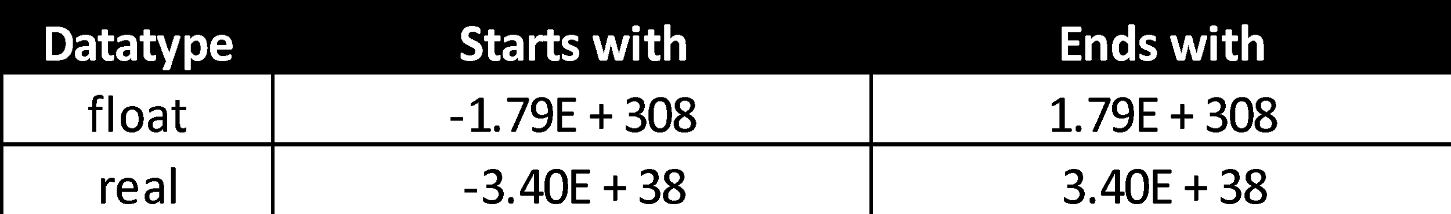
DATA TYPES
Numeric Data Types
Approximate Numeric
Data Types
Date and Time
Data Types
Character Strings
Data Types
Unicode Character Strings Data Types
Binary Data Types

Slide 31
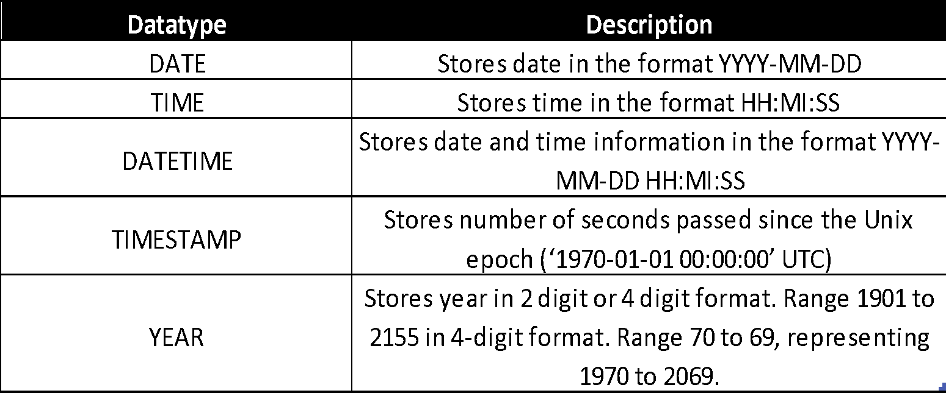
DATA TYPES
Numeric Data Types
Approximate Numeric
Data Types
Date and Time
Data Types
Character Strings
Data Types
Unicode Character Strings Data Types
Binary Data Types

Slide 32
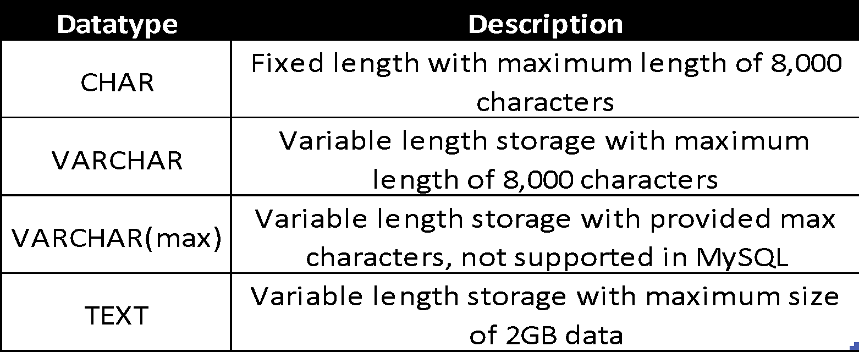
DATA TYPES
Numeric Data Types
Approximate Numeric
Data Types
Date and Time
Data Types
Character Strings
Data Types
Unicode Character Strings Data Types
Binary Data Types

Slide 33
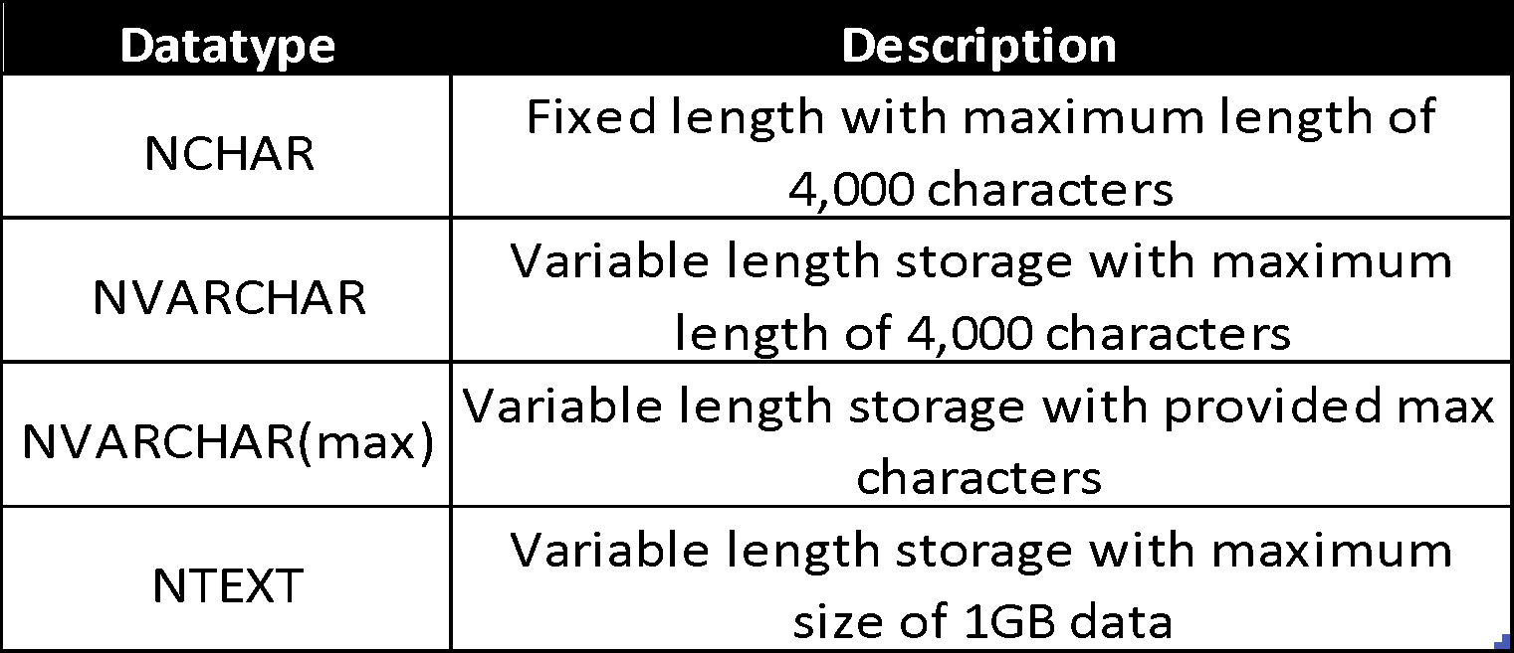
DATA TYPES
Numeric Data Types
Approximate Numeric
Data Types
Date and Time
Data Types
Character Strings
Data Types
Unicode Character Strings Data Types
Binary Data Types

Slide 34
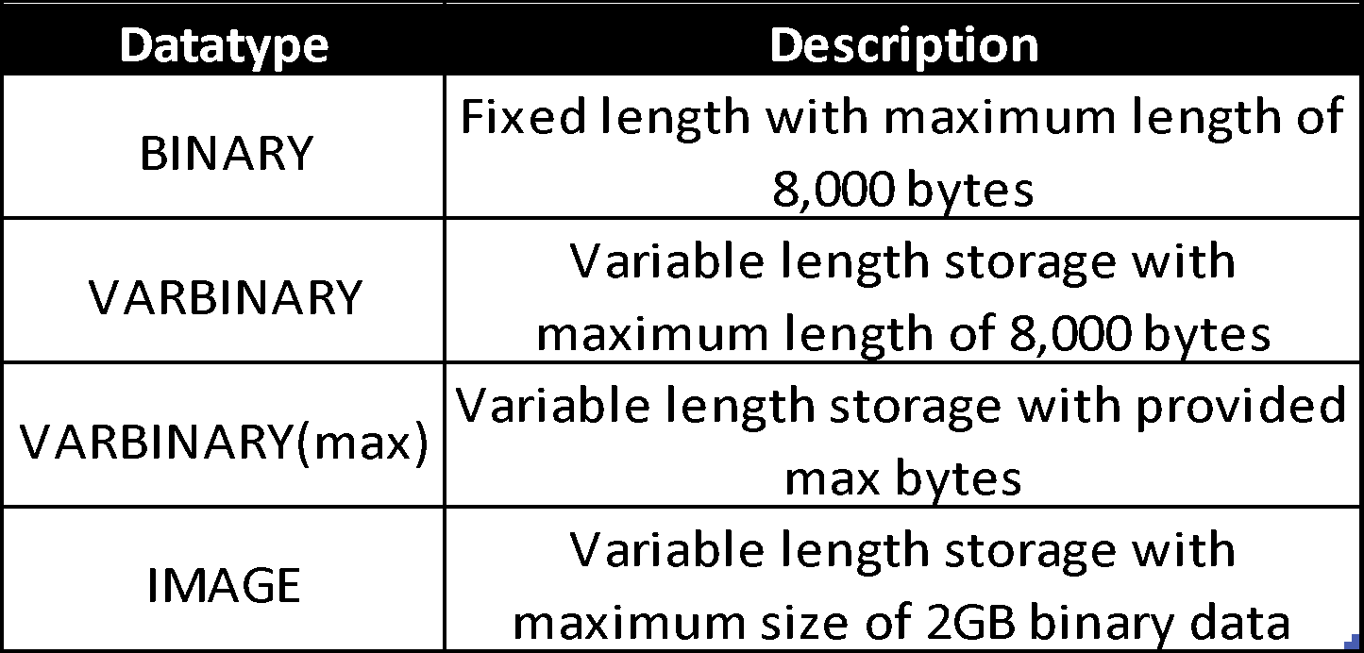
DATA TYPES
Numeric Data Types
Approximate Numeric
Data Types
Date and Time
Data Types
Character Strings
Data Types
Unicode Character Strings Data Types
Binary Data Types

Slide 35
TABLE CONSTRAINTS
PRIMARY
KEY
CHECK
UNIQUE
FOREIGN
KEY
NOT NULL
Constraints are the rules enforced on the data columns of a table.
These are used to limit the type of data that can go into a table.
This ensures the accuracy and reliability of the data in the database.

Slide 36
TABLE CONSTRAINTS
By default, a column can hold NULL values. If we do not want a column to have any EMPTY value, then we need to define such a constraint on this column specifying that EMPTY SPACE is now not allowed for that column.
Example
CREATE TABLE CUSTOMERS(
ID INT NOT NULL,
NAME VARCHAR (20) NOT NULL,
AGE INT NOT NULL,
ADDRESS CHAR (25),
SALARY DECIMAL (18, 2))
Not Null
Unique
Primary Key
Foreign Key
Check

Slide 37
TABLE CONSTRAINTS
Ensures that all values in a column are different.
The UNIQUE Constraint prevents two records from having identical values in a column.
Example
CREATE TABLE CUSTOMERS(
ID INT NOT NULL,
NAME VARCHAR (20) NOT NULL,
AGE INT NOT NULL UNIQUE,
ADDRESS CHAR (25),
SALARY DECIMAL(18,2) DEFAULT 5000.00)
Not Null
Unique
Primary Key
Foreign Key
Check

Slide 38
TABLE CONSTRAINTS
A primary key is a field in a table which uniquely identifies each row/record in a database table.
Primary keys must contain unique values.
A primary key column cannot have NULL values.
A table can have only one primary key.
Example
CREATE TABLE CUSTOMERS(
ID INT NOT NULL,
NAME VARCHAR (20) NOT NULL,
AGE INT NOT NULL UNIQUE,
ADDRESS CHAR (25),
SALARY DECIMAL(18,2) DEFAULT 5000.00)
PRIMARY KEY (ID))
Not Null
Unique
Primary Key
Foreign Key
Check

Slide 39
TABLE CONSTRAINTS
A foreign key is a key used to link two tables together. This is sometimes also called as a referencing key.
A Foreign Key is a column whose values match a Primary Key in a different table.
Example
CREATE TABLE CUSTOMERS(
ID INT NOT NULL,
NAME VARCHAR (20) NOT NULL,
AGE INT NOT NULL UNIQUE,
ADDRESS CHAR (25),
SALARY DECIMAL(18,2) DEFAULT 5000.00)
FOREIGN KEY (ID))
Not Null
Unique
Primary Key
Foreign Key
Check

Slide 40
TABLE CONSTRAINTS
The CHECK Constraint enables a condition to check the value being entered into a record.
If the condition evaluates to false, the record violates the constraint and will not be entered into the table.
Example CREATE TABLE New_table (ID INT NOT NULL,
NAME VARCHAR (20) NOT NULL,
AGE INT NOT NULL CHECK (AGE >= 18),
ADDRESS CHAR(25),
SALARY DECIMAL (18, 2), PRIMARY KEY (ID) )
Not Null
Unique
Primary Key
Foreign Key
Check

Slide 41
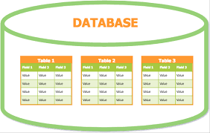
WORKING WITH TABLES
Inside databases, working with tables becomes essential.
Creating tables, Accessing values from them, modifying and deleting them are part of this module.

Slide 42
WORKING WITH TABLES
Create Table
Creating a basic table involves naming the table and defining its columns and each column's data type.
While creating, it is necessary to specify the data type, constraints to the table.
Syntax
CREATE TABLE <table_name>(column1 datatype <const>, column2 datatype,…)
Example
CREATE TABLE CUSTOMERS(
ID INT ,
NAME VARCHAR (20), AGE INT,
ADDRESS CHAR (25),
SALARY DECIMAL (18, 2))
INSERT Query
UPDATE Query
ALTER Table
DELETE Query
DROP Table
Delete Table
Truncate Table

Slide 43
WORKING WITH TABLES
INSERT INTO Statement is used to add new rows of data to a table in the database.
Multiple rows of data can be added at an instance.
Syntax
INSERT INTO TABLE_NAME (column1, column2, column3,...columnN)
VALUES (value1, value2 , value3,...valueN)
Or
INSERT INTO TABLE_NAME VALUES (value1,value2,value3,...valueN)
Example
INSERT INTO CUSTOMERS (SALARY,ID,NAME,AGE,ADDRESS)
VALUES (2000.00 , 1, 'Ramesh ', 32, 'Ahmedabad' )
Or
INSERT INTO CUSTOMERS VALUES (7, 'Muffy', 24, 'Indore', 10000.00)
Create Table
INSERT Query
UPDATE Query
ALTER Table
DELETE Query
DROP Table
Delete Table
Truncate Table

Slide 44
WORKING WITH TABLES
UPDATE Query is used to modify the existing records in a table. This can be used with the WHERE clause to update the selected rows, otherwise all the rows would be affected.
Syntax
UPDATE table_name
SET column1 = value1, column2 = value2...., columnN = valueN
WHERE [condition]
Example
UPDATE CUSTOMERS
SET ADDRESS = 'Pune'
WHERE ID = 6
Create Table
INSERT Query
UPDATE Query
ALTER Table
DELETE Query
DROP Table
Delete Table
Truncate Table

Slide 45
WORKING WITH TABLES
Create Table
Alter Table statement helps in modifying tables, the values in it and manipulate the same.
1. To add a Column:
Syntax:
ALTER TABLE table_name
ADD new_column_name column_definition [FIRST | AFTER column_name]
2. To Rename a Column:
Syntax:
ALTER TABLE table_name
CHANGE COLUMN original_name new_name column_definition [FIRST | AFTER column_name]
INSERT Query
UPDATE Query
ALTER Table
DELETE Query
DROP Table
Delete Table
Truncate Table

Slide 46
WORKING WITH TABLES
DELETE Query is used to delete the existing records from a table.
You can use the WHERE clause with a DELETE query to delete the selected rows, otherwise all the records would be deleted.
Syntax
DELETE FROM table_name
Or
DELETE FROM table_name WHERE [condition]
Example
DELETE FROM CUSTOMERS
Or
DELETE FROM CUSTOMERS WHERE ID = 6
Create Table
INSERT Query
UPDATE Query
ALTER Table
DELETE Query
DROP Table
Delete Table
Truncate Table

Slide 47
WORKING WITH TABLES
Create Table
DROP TABLE statement is used to remove a table definition and all the data, indexes, triggers, constraints and permission specifications for that table.
Syntax
DROP TABLE table_name
Example
DROP TABLE CUSTOMERS
INSERT Query
UPDATE Query
ALTER Table
DELETE Query
DROP Table
Delete Table
Truncate Table

Slide 48
WORKING WITH TABLES
Create Table
DELETE TABLE statement is used to remove a table’s data but all the definations, indexes, triggers, constraints and permission specifications for that table exists.
Syntax
DELETE TABLE table_name
Example
DELETE TABLE CUSTOMERS
INSERT Query
UPDATE Query
ALTER Table
DELETE Query
DROP Table
Delete Table
Truncate Table

Slide 49
WORKING WITH TABLES
Create Table
TRUNCATE TABLE command is used to delete complete data from an existing table.
You can also use DROP TABLE command to delete complete table but it would remove complete table structure form the database and you would need to re-create this table once again if you wish you store some data.
Syntax
TRUNCATE TABLE table_name
Example
TRUNCATE TABLE CUSTOMERS
INSERT Query
UPDATE Query
ALTER Table
DELETE Query
DROP Table
Delete Table
Truncate Table

Slide 50
SQL STATEMENTS
Select
From
SQL statements are used to perform tasks such as update data on a database, or retrieve data from a database.
Most of the data accessing/retrieval you need to perform on a database are done with these statements.
These statements are not case sensitive. For ex., select is the same as SELECT
Where
Group By
Having
Order By
Distinct
Limit

Slide 51
ORDER OF OPERATIONS
SQL Select statements follow an order in which the queries will be executed as follows.
FROM, including JOINs
WHERE
GROUP BY
HAVING
WINDOW functions
SELECT
DISTINCT
UNION
ORDER BY
LIMIT and OFFSET

Slide 52
SQL STATEMENTS
Select
SELECT statement is used to fetch the data from a database table which returns this data in the form of a result table. These result tables are called result-sets.
This statement also works as a print statement enabling us to customize the output. It will allow arithmetic, logical and aggregational operations to perform on the selected columns.
Syntax
SELECT * FROM table_name
Or
SELECT column1, column2, columnN FROM table_name
Example
SELECT * FROM CUSTOMERS
Or
SELECT ID, NAME, SALARY FROM CUSTOMERS
From
Where
Group By
Having
Order By
Distinct
Limit

Slide 53
SQL STATEMENTS
Select
FROM clause is used to access the tables in the respective databases.
It is the first statement that will get executed amongst all the other statements.
Syntax
SELECT column1, column2
FROM table_name
Example
SELECT NAME, SUM(SALARY)
FROM CUSTOMERS
From
Where
Group By
Having
Order By
Distinct
Limit

Slide 54
SQL STATEMENTS
Select
WHERE clause is used to specify a condition while fetching the data from a single table or by joining with multiple tables.
If the given condition is satisfied, then only it returns a specific value from the table.
Syntax
SELECT column1, column2, columnN
FROM table_name
WHERE [condition]
Example
SELECT ID, NAME, SALARY FROM CUSTOMERS WHERE SALARY > 2000
Or
SELECT ID, NAME, SALARY FROM CUSTOMERS WHERE NAME ='Hardik’
From
Where
Group By
Having
Order By
Distinct
Limit

Slide 55
SQL STATEMENTS
Select
GROUP BY clause is used in collaboration with the SELECT statement to arrange identical data into groups.
Helps in categorizing elements in the column value.
Syntax
SELECT column1, column2
FROM table_name
GROUP BY column1
Example
SELECT NAME, SUM(SALARY)
FROM CUSTOMERS
GROUP BY NAME
From
Where
Group By
Having
Order By
Distinct
Limit

Slide 56
SQL STATEMENTS
Select
HAVING clause is used to filter the data from the already grouped data.
To use Having Clause, we have to use Group By Clause. It is because this is applied after the Group by clause.
Syntax
SELECT [Column1],...[ColumnN] Aggregate_Function(Column_Name)
FROM [Source]
WHERE [Conditions] -- Optional
GROUP BY [Column1],...[ColumnN]
HAVING [Conditions] -- Condition is on Aggregate Function(Column_Name)
From
Where
Group By
Having
Order By
Distinct
Limit

Slide 57
SQL STATEMENTS
Select
ORDER BY clause is used to sort the data in ascending or descending order, based on one or more columns.
Some databases sort the query results in an ascending order by default. MySQL does the same.
Syntax
SELECT * FROM table_name [ORDER BY Column1 ][ASC | DESC]
Example
SELECT * FROM CUSTOMERS ORDER BY NAME
Or
SELECT * FROM CUSTOMERS ORDER BY NAME DESC
From
Where
Group By
Having
Order By
Distinct
Limit

Slide 58
SQL STATEMENTS
Select
Distinct Statement helps in retrieving unique records from the column value.
Syntax
SELECT DISTINCT column1 FROM table_name
Example
SELECT DISTINCT SALARY FROM CUSTOMERS
From
Where
Group By
Having
Order By
Distinct
Limit

Slide 59
SQL STATEMENTS
Select
From
LIMIT clause is used to restrict the output to any given number so as to fetch limited number of records.
Syntax
SELECT * FROM table_name LIMIT
Example
SELECT * FROM CUSTOMERS LIMIT 3
Where
Group By
Having
Order By
Distinct
Limit

Slide 60
SQL OPERATORS
ARITHMETIC
OPERATORS
LOGICAL
Operators are used to specify conditions in an SQL statement and to serve as conjunctions for multiple conditions in a statement.

Slide 61
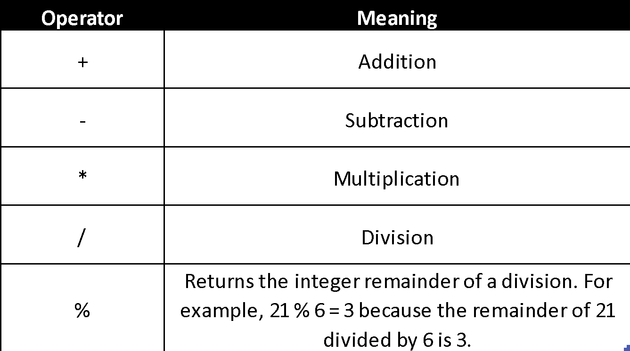
ARITHMETIC OPERATORS

Slide 62
LOGICAL OPERATORS
AND
AND operator is generally used in the WHERE Clause to apply multiple filters on the records returned by SELECT Statement.
This operator returns values only if all the conditions are satisfied.
Syntax:
AND()
Example:
SELECT First_Name
FROM customers
WHERE Profession LIKE '%Developer'
AND Yearly_Income > 75000
OR
NOT
BETWEEN
LIKE
NOT LIKE
IFNULL
IN
IS
NOT IN
ISNULL
IS NOT NULL

Slide 63
LOGICAL OPERATORS
AND
OR operator is generally used in the WHERE Clause to apply multiple filters on the records returned by SELECT Statement.
This operator returns values even if any one of the condition is satisfied.
Syntax:
OR()
Example:
SELECT First_Name
FROM customers
WHERE Profession LIKE '%Developer’
OR Yearly_Income > 75000
OR
NOT
BETWEEN
LIKE
NOT LIKE
IFNULL
IN
IS
NOT IN
ISNULL
IS NOT NULL

Slide 64
LOGICAL OPERATORS
AND
NOT operator is generally used in the WHERE clause along with AND & OR operator to retrieve the opposite of the specified condition.
Syntax:
NOT()
Example:
SELECT First_Name
FROM customers
WHERE NOT(Profession LIKE '%Developer’
OR Yearly_Income > 75000)
OR
NOT
BETWEEN
LIKE
NOT LIKE
IFNULL
IN
IS
NOT IN
ISNULL
IS NOT NULL

Slide 65
LOGICAL OPERATORS
AND
BETWEEN operator retrieves values or strings between a range as specified by the user.
It can also extract range of dates from the given input.
Syntax:
BETWEEN Value1 AND Value2
Example:
SELECT First_Name
FROM customers
WHERE Income BETWEEN 50000 AND 80000
OR
NOT
BETWEEN
LIKE
NOT LIKE
IFNULL
IN
IS
NOT IN
ISNULL
IS NOT NULL

Slide 66
LOGICAL OPERATORS
AND
LIKE operator is used to perform a wildcard search on tables.
This operator uses Wildcards to extract the records matching the specified pattern.
Syntax:
LIKE Wildcard_Expression
Example:
SELECT First_Name
FROM customers
WHERE First_Name LIKE 'R%'
OR
NOT
BETWEEN
LIKE
NOT LIKE
IFNULL
IN
IS
NOT IN
ISNULL
IS NOT NULL

Slide 67
LOGICAL OPERATORS
AND
NOT LIKE operator is used as an antonym to like operator to perform wildcard searches on tables.
This operator uses Wildcards to extract the records matching the specified pattern.
Syntax:
NOT LIKE Wildcard_Expression
Example:
SELECT First_Name
FROM customers
WHERE First_Name NOT LIKE 'R%'
OR
NOT
BETWEEN
LIKE
NOT LIKE
IFNULL
IN
IS
NOT IN
ISNULL
IS NOT NULL

Slide 68
LOGICAL OPERATORS
AND
IFNULL operator is used to replace the NULLs with custom values or custom text.
Can replace only one static value in the place of nulls.
Syntax:
IFNULL(expression1, expression2)
Example:
SELECT CustomerKey, FirstName,
IFNULL(MiddleName, 'No Middle Name') AS Name1
FROM customers
OR
NOT
BETWEEN
LIKE
NOT LIKE
IFNULL
IN
IS
NOT IN
ISNULL
IS NOT NULL

Slide 69
LOGICAL OPERATORS
AND
IN Operator checks the given expression against the Values inside the IN operator.
If there is at least one match, then SELECT Statement returns the records
Syntax:
IN (Value1,...., ValueN)
Example:
SELECT First_Name
FROM customers
WHERE Income IN (80000, 90000,70000)
OR
NOT
BETWEEN
LIKE
NOT LIKE
IFNULL
IN
IS
NOT IN
ISNULL
IS NOT NULL

Slide 70
LOGICAL OPERATORS
AND
OR
IS Operator is useful to test the given expression or value against a Boolean value - True, False and Unknown.
Syntax:
IS ()
Example:
SELECT First_Name IS True, Last_Name is False
FROM customers
NOT
BETWEEN
LIKE
NOT LIKE
IFNULL
IN
IS
NOT IN
ISNULL
IS NOT NULL

Slide 71
LOGICAL OPERATORS
AND
OR
NOT IN Operator checks the given expression against the Values inside the NOT IN operator.
An antonym for IN operator.
Syntax:
NOT IN (Value1,...., ValueN)
Example:
SELECT First_Name
FROM customers
WHERE Income NOT IN (80000, 90000)
NOT
BETWEEN
LIKE
NOT LIKE
IFNULL
IN
IS
NOT IN
ISNULL
IS NOT NULL

Slide 72
LOGICAL OPERATORS
AND
OR
IS NULL Operator is used to test whether the user given expression or column value is NULL or not.
The same can be used under both Select and Where statements.
Syntax:
IS NULL
Example:
SELECT First_Name
FROM customers
WHERE MiddleName IS NULL
NOT
BETWEEN
LIKE
NOT LIKE
IFNULL
IN
IS
NOT IN
ISNULL
IS NOT NULL

Slide 73
LOGICAL OPERATORS
AND
IS NOT NULL Operator is used to test whether the user given expression or column value is NULL or not.
The same can be used under both Select and Where statements.
Syntax:
IS NOT NULL
Example:
SELECT First_Name
FROM customers
WHERE MiddleName IS NOT NULL
OR
NOT
BETWEEN
LIKE
NOT LIKE
IFNULL
IN
IS
NOT IN
ISNULL
IS NOT NULL

Slide 74
AGGREGATION FUNCTIONS
An aggregate function performs a calculation on a set of values, and returns a single value. Except for COUNT, aggregate functions ignore null values.
Aggregate functions are often used with the GROUP BY clause of the SELECT statement.
All aggregate functions are deterministic. In other words, aggregate functions return the same value each time that they are called, when called with a specific set of input values.

Slide 75
AGGREGATION FUNCTIONS
Sum
SUM function returns the total sum of a numeric column.
Syntax
SELECT SUM(column_name) FROM table_name
Example
SELECT SUM(salary) FROM CUSTOMERS
Average
Minimum
Maximum
Count
STD Population
STD Sample
Var Population
Var Sample

Slide 76
AGGREGATION FUNCTIONS
Sum
AVG function returns the average value of a numeric column.
Syntax
SELECT AVG(column_name) FROM table_name
Example
SELECT AVG(salary) FROM CUSTOMERS
Average
Minimum
Maximum
Count
STD Population
STD Sample
Var Population
Var Sample

Slide 77
AGGREGATION FUNCTIONS
Sum
MIN function returns the smallest value of the selected column.
Syntax
SELECT MIN(column_name) FROM table_name
Example
SELECT MIN(salary) FROM CUSTOMERS
Average
Minimum
Maximum
Count
STD Population
STD Sample
Var Population
Var Sample

Slide 78
AGGREGATION FUNCTIONS
Sum
MAX function returns the largest value from the selected column.
Syntax
SELECT MAX(column_name) FROM table_name
Example
SELECT MAX(salary) FROM CUSTOMERS
Average
Minimum
Maximum
Count
STD Population
STD Sample
Var Population
Var Sample

Slide 79
AGGREGATION FUNCTIONS
Sum
COUNT function returns the number of rows that matches a specified criteria.
Syntax
SELECT COUNT(column_name) FROM table_name
Or
SELECT COUNT(*) FROM table_name
Example
SELECT COUNT(salary) FROM CUSTOMERS
or
SELECT COUNT(*) FROM CUSTOMERS
Average
Minimum
Maximum
Count
STD Population
STD Sample
Var Population
Var Sample

Slide 80
AGGREGATION FUNCTIONS
Sum
The Standard deviation Population function is used to retrieve the variance in the entire dataset rather than calculating it from sample.
The denominator here will consider the entire count of values unlike Standard deviation Sample.
Syntax
STDDEV_POP(Column_Name)
Example
SELECT STDDEV_POP(Income)
Average
Minimum
Maximum
Count
STD Population
STD Sample
Var Population
Var Sample

Slide 81
AGGREGATION FUNCTIONS
Sum
The Standard deviation Sample function is used to retrieve the variance in the randomly sampled data.
Every time the sampling changes, the range gets deflected as well.
Syntax
STDDEV_SAMP(Column_Name)
Example
SELECT STDDEV_SAMP(Income)
Average
Minimum
Maximum
Count
STD Population
STD Sample
Var Population
Var Sample

Slide 82
AGGREGATION FUNCTIONS
Sum
The Var Population function is used to retrieve the variance in the entire dataset rather than calculating it from sample.
The denominator here will consider the entire count of values unlike Var Sample.
Syntax
VAR_POP(Column_Name)
Example
SELECT VAR_POP(Income)
Average
Minimum
Maximum
Count
STD Population
STD Sample
Var Population
Var Sample

Slide 83
AGGREGATION FUNCTIONS
Sum
The Var Sample function is used to retrieve the variance in the randomly sampled data.
Every time the sampling changes, the variance gets deflected as well.
Syntax
VAR_SAMP(Column_Name)
Example
SELECT VAR_SAMP(Income)
Average
Minimum
Maximum
Count
STD Population
STD Sample
Var Population
Var Sample

Slide 84
DATE FUNCTIONS
In SQL, dates are complicated, since while working with database, the format of the date in table must be matched with the input date in order to insert.
SQL server’s date functions provide you set of functions that you can use to manipulate dates.
The function are used for a wide variety of operation such as adding weeks to a date, calculating the difference between two dates, or to decompose a date into its fundamental parts.

Slide 85
DATE FUNCTIONS
ADDDATE
ADDDATE function helps in adding date parts to a date or an expression.
It can take only two date datatypes as arguments for performing this operation.
Syntax:
ADDDATE(Date, INTERVAL expression Unit)
Example:
SELECT ADDDATE('2019-02-28 23:59:59', INTERVAL 31 DAY)
SELECT ADDDATE('2019-02-28 23:59:59', INTERVAL 16 WEEK)
SELECT ADDDATE('2019-02-28 23:59:59', INTERVAL 18 MONTH)
ADDTIME
CURRENT_DATE
CURRENT_TIME
CURRENT_TIMESTAMP
DATE
DATE_ADD
DATEDIFF
DAY
DAYNAME
HOUR
MAKEDATE

Slide 86
DATE FUNCTIONS
ADDDATE
ADDTIME function helps in adding time parts to a date or an expression.
It can take only two time datatypes as arguments for performing this operation.
Syntax:
ADDTIME(DateTime1 or Time_Expression1, Time_Expression2)
Example:
SELECT ADDTIME('10:11:22', '12:10:12')
ADDTIME
CURRENT_DATE
CURRENT_TIME
CURRENT_TIMESTAMP
DATE
DATE_ADD
DATEDIFF
DAY
DAYNAME
HOUR
MAKEDATE

Slide 87
DATE FUNCTIONS
ADDDATE
CURRENT_DATE function retrieves the current date without time values in it.
This is a dynamic function and returns the values in either YYYY-MM-DD or YYYYMMDD string format.
It takes no argument
Syntax:
CURRENT_DATE()
ADDTIME
CURRENT_DATE
CURRENT_TIME
CURRENT_TIMESTAMP
DATE
DATE_ADD
DATEDIFF
DAY
DAYNAME
HOUR
MAKEDATE

Slide 88
DATE FUNCTIONS
ADDDATE
CURRENT_TIME function retrieves the current time without date values in it.
This is a dynamic function and returns the values in either HH:MM:SS or HHMMSS string format.
It takes no argument
Syntax:
CURRENT_TIME()
ADDTIME
CURRENT_DATE
CURRENT_TIME
CURRENT_TIMESTAMP
DATE
DATE_ADD
DATEDIFF
DAY
DAYNAME
HOUR
MAKEDATE

Slide 89
DATE FUNCTIONS
ADDDATE
CURRENT_TIMESTAMP function helps in creating a timestamp for the current timeperiod.
This is a dynamic function and returns the values in YYYY-MM-DD HH:MM:SS format.
It takes no argument
Syntax:
CURRENT_TIMESTAMP()
ADDTIME
CURRENT_DATE
CURRENT_TIME
CURRENT_TIMESTAMP
DATE
DATE_ADD
DATEDIFF
DAY
DAYNAME
HOUR
MAKEDATE

Slide 90
DATE FUNCTIONS
ADDDATE
DATE function extracts the date part from a given date or Date Time expression.
Syntax:
DATE(date or DateTime expression)
Example:
SELECT DATE('2017-10-25 01:05:22')
ADDTIME
CURRENT_DATE
CURRENT_TIME
CURRENT_TIMESTAMP
DATE
DATE_ADD
DATEDIFF
DAY
DAYNAME
HOUR
MAKEDATE

Slide 91
DATE FUNCTIONS
ADDDATE
DATE_ADD function adds the user-specified intervals to a given date and returns the date or Date Time.
Syntax:
DATE_ADD(Date, INTERVAL expression Unit)
Example:
SELECT DATE_ADD('2018-12-31 23:30:15', INTERVAL 30 SECOND)
ADDTIME
CURRENT_DATE
CURRENT_TIME
CURRENT_TIMESTAMP
DATE
DATE_ADD
DATEDIFF
DAY
DAYNAME
HOUR
MAKEDATE

Slide 92
DATE FUNCTIONS
ADDDATE
DATEDIFF function which is useful to find the difference between two dates and returns the number of days.
It takes two arguments and both must be date datatype.
Syntax:
DATEDIFF(Expression1, Expression2)
Example:
SELECT DATEDIFF('2019-02-28', '2019-01-01')
ADDTIME
CURRENT_DATE
CURRENT_TIME
CURRENT_TIMESTAMP
DATE
DATE_ADD
DATEDIFF
DAY
DAYNAME
HOUR
MAKEDATE

Slide 93
DATE FUNCTIONS
ADDDATE
DAY function returns the day part from any date or an expression.
It always returns the values from 1 to 31.
Syntax:
DAY(date or expression)
Example:
SELECT DAY('2016-11-25')
ADDTIME
CURRENT_DATE
CURRENT_TIME
CURRENT_TIMESTAMP
DATE
DATE_ADD
DATEDIFF
DAY
DAYNAME
HOUR
MAKEDATE

Slide 94
DATE FUNCTIONS
ADDDATE
DAYNAME function simply returns the full name of the day for a given date or an expression.
Syntax:
DAYNAME(date or expression)
Example:
SELECT DAYNAME('2019-03-05')
ADDTIME
CURRENT_DATE
CURRENT_TIME
CURRENT_TIMESTAMP
DATE
DATE_ADD
DATEDIFF
DAY
DAYNAME
HOUR
MAKEDATE

Slide 95
DATE FUNCTIONS
ADDDATE
Hour function returns hour from the passed column value or an expression.
It returns value from 0 to 23.
Syntax:
HOUR(Time or DateTime expression)
Example:
SELECT HOUR('23:12:33')
ADDTIME
CURRENT_DATE
CURRENT_TIME
CURRENT_TIMESTAMP
DATE
DATE_ADD
DATEDIFF
DAY
DAYNAME
HOUR
MAKEDATE

Slide 96
DATE FUNCTIONS
ADDDATE
MAKEDATE function helps in creating date from the different time arguments given by the user.
It takes year and day arguments.
Syntax:
MAKEDATE(year, day-of-year)
Example:
SELECT MAKEDATE(2017, 25)
ADDTIME
CURRENT_DATE
CURRENT_TIME
CURRENT_TIMESTAMP
DATE
DATE_ADD
DATEDIFF
DAY
DAYNAME
HOUR
MAKEDATE

Slide 97
DATE FUNCTIONS
MAKETIME
MAKETIME function helps in creating time from the different time arguments given by the user.
It takes minutes, hours and seconds.
Syntax:
MAKETIME(hour, minutes, seconds)
Example:
SELECT MAKETIME(11, 10, 25)
MINUTE
MONTH
MONTHNAME
YEAR
NOW
SECOND
QUARTER
STR_TO_DATE
TIME
TIMEDIFF
WEEK

Slide 98
DATE FUNCTIONS
MAKE TIME
MINUTE function returns the minute time part from any date or an expression.
It always returns the values from 0 to 59.
Syntax:
MINUTE(Time or DateTime expression)
Example:
SELECT MINUTE('2016-12-22 12:23:45')
MINUTE
MONTH
MONTHNAME
YEAR
NOW
SECOND
QUARTER
STR_TO_DATE
TIME
TIMEDIFF
WEEK

Slide 99
DATE FUNCTIONS
MAKE TIME
MONTH function returns the month date part from any date or an expression.
It always returns the values from 1 to 12 for all the 12 months respectively.
Syntax:
MONTH(date or expression)
Example:
SELECT MONTH('2016-12-22')
MINUTE
MONTH
MONTHNAME
YEAR
NOW
SECOND
QUARTER
STR_TO_DATE
TIME
TIMEDIFF
WEEK

Slide 100
DATE FUNCTIONS
MAKE TIME
MONTHNAME function simply returns the full name of the Month for a given date or an expression.
Syntax:
MONTHNAME(date or expression)
Example:
SELECT MONTHNAME('2016-12-22')
MINUTE
MONTH
MONTHNAME
YEAR
NOW
SECOND
QUARTER
STR_TO_DATE
TIME
TIMEDIFF
WEEK

Slide 101
DATE FUNCTIONS
MAKE TIME
YEAR function returns the Year from the given date or expression.
This function returns value range from 1000 to 9999.
Syntax:
YEAR(date or expression)
Example:
SELECT YEAR('2016-11-25')
MINUTE
MONTH
MONTHNAME
YEAR
NOW
SECOND
QUARTER
STR_TO_DATE
TIME
TIMEDIFF
WEEK

Slide 102
DATE FUNCTIONS
MAKE TIME
NOW function always returns the current Date and Time.
By default, it returns the date in YYYY-MM-DD HH:MM:SS or YYYYMMDDHHMMSS.uuu format.
Since it does not take any argument, it can be simply called as below.
Syntax:
NOW()
MINUTE
MONTH
MONTHNAME
YEAR
NOW
SECOND
QUARTER
STR_TO_DATE
TIME
TIMEDIFF
WEEK

Slide 103
DATE FUNCTIONS
MAKE TIME
SECOND function is used to return the Seconds value from a given time.
This function returns integer value range from 0 to 59.
Syntax:
SECOND(Time or expression)
Example:
SELECT SECOND('2019-02-05 10:20:12')
MINUTE
MONTH
MONTHNAME
YEAR
NOW
SECOND
QUARTER
STR_TO_DATE
TIME
TIMEDIFF
WEEK

Slide 104
DATE FUNCTIONS
MAKE TIME
QUARTER function returns the quarter of the year number from a given date.
This function always returns integer range from 1 to 4.
Syntax:
QUARTER(date or expression)
Example:
SELECT QUARTER('2016-07-15')
MINUTE
MONTH
MONTHNAME
YEAR
NOW
SECOND
QUARTER
STR_TO_DATE
TIME
TIMEDIFF
WEEK

Slide 105
DATE FUNCTIONS
MAKE TIME
STR_TO_DATE function takes a string as an input and converts the same into Date or DateTime or Time values based on the format given by the user.
Both date and time parts can be printed as output.
Syntax:
STR_TO_DATE(string_expression, format)
Example:
SELECT STR_TO_DATE(‘12-31-2019', ‘%m %d %Y')
MINUTE
MONTH
MONTHNAME
YEAR
NOW
SECOND
QUARTER
STR_TO_DATE
TIME
TIMEDIFF
WEEK

Slide 106
DATE FUNCTIONS
MAKE TIME
TIME function helps in extracting the Time part from the given time or DateTime.
It handles all three arguments of time.
Syntax:
TIME(Time or DateTime or expression)
Example:
SELECT TIME('2016-05-19 11:14:34')
MINUTE
MONTH
MONTHNAME
YEAR
NOW
SECOND
QUARTER
STR_TO_DATE
TIME
TIMEDIFF
WEEK

Slide 107
DATE FUNCTIONS
MAKE TIME
TIMEDIFF function is used to find the difference between two time expressions and it eventually returns the time value as output.
Syntax:
TIMEDIFF(Expression1, Expression2)
Example:
SELECT TIMEDIFF('10:12:22', '02:05:11')
MINUTE
MONTH
MONTHNAME
YEAR
NOW
SECOND
QUARTER
STR_TO_DATE
TIME
TIMEDIFF
WEEK

Slide 108
DATE FUNCTIONS
MAKE TIME
WEEK function returns the Week number of the given date. This function accepts two arguments.
The first one is date and the second argument decides whether the week should start with Sunday or Monday. Finally, it returns value in the range of 0 to 53 or 1 to 53.
Syntax:
Week(date, Mode)
Example:
SELECT WEEK('2019-02-21', 0)
SELECT WEEK('2019-02-21', 1)
MINUTE
MONTH
MONTHNAME
YEAR
NOW
SECOND
QUARTER
STR_TO_DATE
TIME
TIMEDIFF
WEEK

Slide 109

NUMERIC FUNCTIONS
Numeric functions are primarily used for data manipulation and/or mathematical calculations.
All numeric functions return values of data type SQL_FLOAT except for ABS, ROUND, TRUNCATE, SIGN, FLOOR, and CEILING, which return values of the same data type as the input parameters.

Slide 110
NUMERIC FUNCTIONS
CEILING
CEILING function rounds up your value irrespective of the decimals.
Even if the decimal is .01, it rounds up the value to the next highest integer.
Syntax:
SELECT CEILING (Numeric_Expression)
Example:
SELECT CEILING('712.17')
FLOOR
EXP
LOG
LN
MOD
PI
POWER
RAND
SIGN
SQRT
ROUND

Slide 111
NUMERIC FUNCTIONS
CEILING
FLOOR function rounds down your value irrespective of the decimals.
Even if the decimal is .99, it rounds up the value to the next highest integer.
Syntax:
SELECT FLOOR (Numeric_Expression)
Example:
SELECT FLOOR('712.89')
FLOOR
EXP
LOG
LN
MOD
PI
POWER
RAND
SIGN
SQRT
ROUND

Slide 112
NUMERIC FUNCTIONS
CEILING
EXP function is used to return E raised to the power of given value.
By default, E is the base of natural logarithm.
Syntax:
SELECT EXP()
Example:
SELECT EXP(100)
FLOOR
EXP
LOG
LN
MOD
PI
POWER
RAND
SIGN
SQRT
ROUND

Slide 113
NUMERIC FUNCTIONS
CEILING
LOG function helps in returning the natural logarithmic value for a given number.
If we specify the base value, then it returns the log value with base.
Syntax:
SELECT LOG()
SELET LOG(Base, X)
Example:
SELECT LOG(10)
SELECT LOG(2,10)
FLOOR
EXP
LOG
LN
MOD
PI
POWER
RAND
SIGN
SQRT
ROUND

Slide 114
NUMERIC FUNCTIONS
CEILING
LN function is useful in returning the natural logarithmic value of a given number with base E.
LN(0) will always be null.
Syntax:
SELECT LN()
Example:
SELECT LN(10)
FLOOR
EXP
LOG
LN
MOD
PI
POWER
RAND
SIGN
SQRT
ROUND

Slide 115
NUMERIC FUNCTIONS
CEILING
MOD function is helpful in finding the Modulus from a division.
This function finds the remainder of different values as a result of division.
Syntax:
SELECT MOD(X, Y)
Example:
SELECT MOD(26, 5)
FLOOR
EXP
LOG
LN
MOD
PI
POWER
RAND
SIGN
SQRT
ROUND

Slide 116
NUMERIC FUNCTIONS
CEILING
PI function is always used to return the Pi value which is 3.141593.
Please note that it will not take any arguments.
Syntax:
PI()
FLOOR
EXP
LOG
LN
MOD
PI
POWER
RAND
SIGN
SQRT
ROUND

Slide 117
NUMERIC FUNCTIONS
CEILING
POWER function calculates the power for a specified value in the expression.
POW can be used as an alternative for this function.
Syntax:
SELECT POWER (Float_Expression, Value)
Example:
SELECT POWER(5, 4)
FLOOR
EXP
LOG
LN
MOD
PI
POWER
RAND
SIGN
SQRT
ROUND

Slide 118
NUMERIC FUNCTIONS
CEILING
RAND function is used to return random numbers between 0 to 1.
This function cannot return values greater than 1 or lesser than 0.
It takes no argument.
Syntax:
RAND()
FLOOR
EXP
LOG
LN
MOD
PI
POWER
RAND
SIGN
SQRT
ROUND

Slide 119
NUMERIC FUNCTIONS
CEILING
SIGN function returns only three outputs. If the number in the column is positive, it returns (1). If the same is in negative, it returns (-1).
In other cases, it returns (0).
Syntax:
SIGN (Numeric_Expression)
Example:
SELECT SIGN(-240.75)
SELECT SIGN(240.75)
SELECT SIGN(0)
FLOOR
EXP
LOG
LN
MOD
PI
POWER
RAND
SIGN
SQRT
ROUND

Slide 120
NUMERIC FUNCTIONS
CEILING
SQRT returns the square root for any number.
It always works with Integers. This can return the square root for a negative integer as well.
Syntax:
SQRT(Numeric_Expression)
Example:
SELECT SQRT(265)
FLOOR
EXP
LOG
LN
MOD
PI
POWER
RAND
SIGN
SQRT
ROUND

Slide 121
NUMERIC FUNCTIONS
CEILING
ROUND function rounds up your value to a given decimal basis the input.
It can round the value without decimals as well.
Syntax:
ROUND (Numeric_Expression, length)
Example:
SELECT ROUND(1252.12757, 2)
FLOOR
EXP
LOG
LN
MOD
PI
POWER
RAND
SIGN
SQRT
ROUND

Slide 122

STRING FUNCTIONS
The built in String functions make it possible for you to find and alter text values, such as VARCHAR and CHAR datatypes in the server.
A string function is a function that takes a string value as an input regardless of the data type of the returned value
These scalar functions perform an operation on a string input value and return a string or numeric value.

Slide 123
STRING FUNCTIONS
CONCAT
Concat function helps in grouping two or more strings together either using an arithmetic expression or the function itself.
To use a delimiter between strings, make sure that it is specified inside the function.
Syntax:
SELECT CONCAT (String 1, String 2,.., String N)
Example:
SELECT CONCAT('Learn', ' MySQL Server')
FIND_IN_SET
INSTR
LCASE
LEFT
LENGTH
LOWER
LTRIM
REPEAT

Slide 124
STRING FUNCTIONS
CONCAT
FIND_IN_SET helps in identifying the position of a substring within a string list (N number of string separated by comma) and returns those positions.
It takes a string and a string_in_list argument
Syntax:
FIND_IN_SET(Str, String_List)
Example:
SELECT FIND_IN_SET('c', 'a,b,c,d,e,f')
FIND_IN_SET
INSTR
LCASE
LEFT
LENGTH
LOWER
LTRIM
REPEAT

Slide 125
STRING FUNCTIONS
CONCAT
INSTR returns the first occurrence of a specified substring from a given string.
It will always retrieve you the index position of the first character of the substring that we are looking for.
Syntax:
INSRT (String, Sub_String)
Example:
SELECT INSTR('We are working at ABC company', ‘ABC')
FIND_IN_SET
INSTR
LCASE
LEFT
LENGTH
LOWER
LTRIM
REPEAT

Slide 126
STRING FUNCTIONS
CONCAT
LCASE function returns the lowercase values for a supplied string.
This function is a synonym for LOWER function
Syntax:
LCASE(Expression)
Example:
LCASE(‘SQLSEVER’)
FIND_IN_SET
INSTR
LCASE
LEFT
LENGTH
LOWER
LTRIM
REPEAT

Slide 127
STRING FUNCTIONS
CONCAT
LEFT function retrieves ‘N’ number of characters from the left side/beginning of the values.
The arguments are the column in which you have to subset the data and the length of the characters you need.
Syntax:
LEFT (String_Expression, value)
Example:
SELECT LEFT('Learn MySQL Server', 11)
FIND_IN_SET
INSTR
LCASE
LEFT
LENGTH
LOWER
LTRIM
REPEAT

Slide 128
STRING FUNCTIONS
CONCAT
LENGTH function counts the number of characters that are present in the supplied column value.
The output will always be an integer.
Syntax:
LENGTH (String_Expression)
Example:
SELECT LENGTH ('Learn MySQL Server')
FIND_IN_SET
INSTR
LCASE
LEFT
LENGTH
LOWER
LTRIM
REPEAT

Slide 129
STRING FUNCTIONS
CONCAT
LOWER function converts the entire string into lowercase.
Syntax:
LOWER (Expression)
Example:
Select Lower(‘SQLSERVER’)
FIND_IN_SET
INSTR
LCASE
LEFT
LENGTH
LOWER
LTRIM
REPEAT

Slide 130
STRING FUNCTIONS
CONCAT
LTRIM removes extra spaces from the left side of the string.
However, if there are any extra spaces at the end or the middle of the values, it will be unaffected.
Syntax:
LTRIM(String_Expression)
Example:
SELECT LTRIM(' Hi')
FIND_IN_SET
INSTR
LCASE
LEFT
LENGTH
LOWER
LTRIM
REPEAT

Slide 131
STRING FUNCTIONS
CONCAT
REPEAT function, as the name suggests, repeats a character or string ‘N’ number of times.
The column and the number of times repetition needs to happen are asked to be supplied.
Syntax:
REPEAT (Expression, int_Expression)
Example:
SELECT REPEAT('MySQL ', 4)
FIND_IN_SET
INSTR
LCASE
LEFT
LENGTH
LOWER
LTRIM
REPEAT

Slide 132
STRING FUNCTIONS
REPLACE
REPLACE helps you update the values in a column/cell with just three arguments.
The column, the old string and the replacement for it are supposed to be supplied as arguments.
Syntax:
REPLACE (Expression, Change_String, Replace_String)
Example:
SELECT REPLACE('123456', 34, 75)
REVERSE
RIGHT
RTRIM
SPACE
SUBSTR
SUBSTR_INDEX
TRIM
UPPER

Slide 133
STRING FUNCTIONS
REPLACE
REVERSE function simply reverses the order of characters of strings or numbers to give you a palindrome.
This will retain the cases as it is. i.e., Lower case will be lower and vice versa.
Syntax:
REVERSE (String_Expression)
Example:
SELECT REVERSE('Learn MySQL Server')
REVERSE
RIGHT
RTRIM
SPACE
SUBSTR
SUBSTR_INDEX
TRIM
UPPER

Slide 134
STRING FUNCTIONS
REPLACE
RIGHT function retrieves ‘N’ number of characters from the right side/end of the values.
The arguments are the column in which you have to subset the data and the length of the characters you need.
Syntax:
RIGHT (String_Expression, value)
Example:
SELECT RIGHT('Learn MySQL Server', 12)
REVERSE
RIGHT
RTRIM
SPACE
SUBSTR
SUBSTR_INDEX
TRIM
UPPER

Slide 135
STRING FUNCTIONS
REPLACE
RTRIM removes extra spaces from the right side of the string.
However, if there are any extra spaces at the beginning or the middle of the values, it will be unaffected.
Syntax:
RTRIM(String_Expression)
Example:
SELECT RTRIM('MySQL ')
REVERSE
RIGHT
RTRIM
SPACE
SUBSTR
SUBSTR_INDEX
TRIM
UPPER

Slide 136
STRING FUNCTIONS
REPLACE
SPACE function creates ‘N’ number of spaces between values.
The only argument it will take is the number of spaces to create, which should always be an Integer.
Syntax:
SPACE(Integer)
Example:
SELECT CONCAT(‘First Name', SPACE(5), ‘Last Name')
REVERSE
RIGHT
RTRIM
SPACE
SUBSTR
SUBSTR_INDEX
TRIM
UPPER

Slide 137
STRING FUNCTIONS
REPLACE
SUBSTR helps is retrieving a particular length of characters from a string.
The index position to subset the data can also be specified.
Syntax:
SELECT SUBSTRING (String, Position, Length)
Example:
SELECT SUBSTRING('Learn MySQL’, 3, 7)
REVERSE
RIGHT
RTRIM
SPACE
SUBSTR
SUBSTR_INDEX
TRIM
UPPER

Slide 138
STRING FUNCTIONS
REPLACE
SUBSTR_INDEX helps to subset a substring from the occurrence of delimiter count.
Any type of delimiter can be accessed using this function.
Syntax:
SUBSTRING_INDEX(String_Expression, Delimiter, Count)
Example:
SELECT SUBSTRING_INDEX('www.google.co.in', '.’, 2)
REVERSE
RIGHT
RTRIM
SPACE
SUBSTR
SUBSTR_INDEX
TRIM
UPPER

Slide 139
STRING FUNCTIONS
REPLACE
TRIM function simply chops off the extra spaces that are present in your cells, be it numbers, be it strings.
Syntax:
TRIM('String_Expression')
Example:
SELECT TRIM(' Hello World ')
REVERSE
RIGHT
RTRIM
SPACE
SUBSTR
SUBSTR_INDEX
TRIM
UPPER

Slide 140
STRING FUNCTIONS
REPLACE
UPPER function converts the entire string to upper case
Syntax:
UPPER (Expression)
Example:
SELECT UPPER(‘sqlserver’)
REVERSE
RIGHT
RTRIM
SPACE
SUBSTR
SUBSTR_INDEX
TRIM
UPPER

Slide 141
WINDOW FUNCTIONS
Non-Aggregate Functions.
For each row it forms a query and performs a calculation using rows related to that row.
Window functions are performed on the result set after all JOIN, WHERE, GROUP BY, and HAVING clauses and before the ORDER BY, LIMIT and SELECT DISTINCT.

Slide 142
WINDOW FUNCTIONS
Returns the value of expr from the row that leads (follows) the current row by N rows within its partition. If there is no such row, the return value is default.
For example, if N is 3, the return value is default for the last two rows. If N or default are missing, the defaults are 1 and NULL, respectively.
N must be a literal nonnegative integer. If N is 0, expr is evaluated for the current row.
LEAD
LAG
ROW_NUMBER
RANK
DENSE_RANK
Syntax:
LEAD(expr [, N[, default]]) [null_treatment] over_clause
Example:
SELECT t, val, LEAD(val) OVER w AS 'lEAD', FROM series
WINDOW w AS (ORDER BY t);

Slide 143
WINDOW FUNCTIONS
Returns the value of expr from the row that lags (precedes) the current row by N rows within its partition.
If there is no such row, the return value is default. For example, if N is 3, the return value is default for the first two rows.
If N or default are missing, the defaults are 1 and NULL, respectively.
LEAD
LAG
ROW_NUMBER
RANK
DENSE_RANK
Syntax:
LAG(expr [, N[, default]]) [null_treatment] over_clause
Example:
SELECT t, val, LAG(val) OVER w AS 'lag', FROM series
WINDOW w AS (ORDER BY t);

Slide 144
WINDOW FUNCTIONS
Returns the number of the current row within its partition. Rows numbers range from 1 to the number of partition rows.
ORDER BY affects the order in which rows are numbered. Without ORDER BY, row numbering is nondeterministic.
LEAD
LAG
ROW_NUMBER
RANK
Syntax:
ROW_NUMBER() over_clause
Example:
SELECT val, ROW_NUMBER() OVER w AS 'row_number',
FROM numbers WINDOW w AS (ORDER BY val);
DENSE_RANK

Slide 145
WINDOW FUNCTIONS
Returns the rank of the current row within its partition, with gaps. Peers are considered ties and receive the same rank.
This function does not assign consecutive ranks to peer groups if groups of size greater than one exist; the result is non contiguous rank numbers.
This function should be used with ORDER BY to sort partition rows into the desired order. Without ORDER BY, all rows are peers.
LEAD
LAG
ROW_NUMBER
RANK
DENSE_RANK
Syntax:
RANK() over_clause
Example:
SELECT val, RANK() OVER w AS 'Rank’,
FROM numbers WINDOW w AS (ORDER BY val);

Slide 146
WINDOW FUNCTIONS
Returns the rank of the current row within its partition, without gaps. Peers are considered ties and receive the same rank.
This function assigns consecutive ranks to peer groups; the result is that groups of size greater than one do not produce non contiguous rank numbers.
LEAD
LAG
ROW_NUMBER
RANK
Syntax:
DENSE_RANK() over_clause
Example:
SELECT val, DENSE_RANK() OVER w AS 'Dense Rank’,
FROM numbers WINDOW w AS (ORDER BY val);
DENSE_RANK

Slide 147
SQL JOINS
The SQL Joins clause is used to combine records from two or more tables in a database.
A JOIN is a means for combining fields from two tables by using values common to each.
Filter and search in combination result and also tables data. Reduce duplicate records in combination result.
Types of Joins
Inner
Left
Right
Cross

Slide 148

JOINS
INNER JOIN creates a new result table by combining column values of two tables (table1 and table2) based upon the common column that is present in both these tables.
The query compares each row of table1 with each row of table2 to find all pairs of rows which satisfy the join-predicate.
When the join-predicate is satisfied, column values for each matched pair of rows of A and B are combined into a result row.
Syntax
SELECT table1.column1, table2.column2...
FROM table1 INNER JOIN table2
ON table1.common_field = table2.common_field
Example
SELECT ID, NAME, AMOUNT, DATE
FROM CUSTOMERS INNER JOIN ORDERS
ON CUSTOMERS.ID = ORDERS.CUSTOMER_ID
Inner
Left
Right
Cross

Slide 149

JOINS
LEFT JOIN returns all rows from the left table, even if there are no matches in the right table.
This means that if the ON clause matches 0 (zero) records in the right table; the join will still return a row in the result, but with NULL in each column from the right table.
This means that a left join returns all the values from the left table, plus matched values from the right table or NULL in case of no matching join predicate.
Syntax
SELECT table1.column1, table2.column2...
FROM table1 LEFT JOIN table2
ON table1.common_field = table2.common_field
Example
SELECT ID, NAME, AMOUNT, DATE
FROM CUSTOMERS LEFT JOIN ORDERS
ON CUSTOMERS.ID = ORDERS.CUSTOMER_ID
Inner
Left
Right
Cross

Slide 150

JOINS
RIGHT JOIN returns all rows from the right table, even if there are no matches in the left table.
This means that if the ON clause matches 0 (zero) records in the left table; the join will still return a row in the result, but with NULL in each column from the left table.
This means that a right join returns all the values from the right table, plus matched values from the left table or NULL in case of no matching join predicate.
Syntax
SELECT table1.column1, table2.column2...
FROM table1 RIGHT JOIN table2
ON table1.common_field = table2.common_field
Example
SELECT ID, NAME, AMOUNT, DATE
FROM CUSTOMERS RIGHT JOIN ORDERS
ON CUSTOMERS.ID = ORDERS.CUSTOMER_ID
Inner
Left
Right
Cross

Slide 151
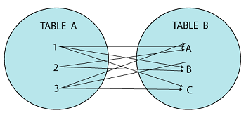
JOINS
CROSS JOIN creates a cartesian product by fetching records from both the tables for every single line item.
The query fetches record for each row of table1 with each row of table2 to yield a cartesian product even if it is not matching.
The Cartesian product means Number of Rows present in Table 1 Multiplied by Number of Rows present in Table 2.
Syntax
SELECT table1.column1, table2.column2...
FROM table1 CROSS JOIN table2
Example
SELECT ID, NAME, AMOUNT, DATE
FROM CUSTOMERS CROSS JOIN ORDERS
Inner
Left
Right
Cross

Slide 152
SET OPERATORS
The UNION clause/operator is used to combine the results of two or more SELECT statements without returning any duplicate rows.
To use this UNION clause, each SELECT statement must have
The same number of columns selected
The same number of column expressions
The same data type and
Have them in the same order
Syntax
SELECT column1, column2 FROM table1 [WHERE condition]
UNION
SELECT column1, column2 FROM table2 [WHERE condition]
Union
Union ALL

Slide 153
SET OPERATORS
The UNION ALL operator is used to combine the results of two SELECT statements including duplicate rows.
The same rules that apply to the UNION clause will apply to the UNION ALL operator.
More than 2 tables of same structure can be aligned together with the help of set operators.
Syntax
SELECT column1, column2 FROM table1 [WHERE condition]
UNION ALL
SELECT column1, column2 FROM table2 [WHERE condition]
Union
Union ALL

Slide 154
SUB - QUERIES
A Subquery or an Inner query or a Nested query is a query within another SQL query which is embedded within the WHERE/FROM clause.
Subqueries can be used with the SELECT, INSERT, UPDATE, and DELETE statements along with the operators like =, <, >, >=, <=, IN, BETWEEN, etc.
Syntax
SELECT [Column_Name ] FROM table WHERE column_name OPERATOR
(SELECT [Column_Name ] FROM table [WHERE])
Example
SELECT * FROM CUSTOMERS WHERE ID =
(SELECT ID FROM CUSTOMERS WHERE SALARY > 4500)

Slide 155
SUB - QUERIES
Using WHERE clause, multiple operators can be bought into considerations while writing queries on multiple levels.
It can accommodate the membership operators like IN and NOT IN.
Example:
SELECT CustomerName, CheckNo, Sales FROM Payroll
WHERE Sales =
(SELECT MAX(Sales) FROM Payroll)
Where Clause
ANY & ALL
FROM Statement
Exists Method
Correlated

Slide 156
SUB - QUERIES
The ANY operator returns true if any of the subquery values satisfy the condition.
Example
SELECT * FROM Customers
WHERE age = ANY (SELECT age
FROM customers
where salary > 2500)
The All operator returns true if all of the subquery values satisfy the condition.
Example
SELECT * FROM Customers
WHERE age = ALL (SELECT age
FROM customers
Where salary > 2500)
Where Clause
ANY & ALL
FROM Statement
Exists Method
Correlated

Slide 157
SUB - QUERIES
FROM clause can be used as a bracket to retrieve values from another table and subset to supply as input for the superset table.
Example:
SELECT MAX(Sales), MIN(Sales), FLOOR(AVG(Sales))
FROM
(SELECT OrdNo, SUM(OrdNo) AS Sales from table)
Where Clause
ANY & ALL
FROM Statement
Exists Method
Correlated

Slide 158
SUB - QUERIES
The EXISTS operator is used to test for the existence of any record in the subquery.
The EXISTS operator returns true if the subquery returns one or more records.
Syntax
SELECT column_name FROM table_name WHERE EXISTS
(SELECT column_name FROM table_name WHERE condition)
Example
SELECT * FROM Customers WHERE age EXISTS
(SELECT age FROM customers where salary > 2500)
Where Clause
ANY & ALL
FROM Statement
Exists Method
Correlated

Slide 159
SUB - QUERIES
A Correlated sub-query is dependent on each and every query written within.
It takes output from each and every query and supply the same as input to the above queries as it follows Bottom-up approach.
Example:
SELECT Products, MRP
FROM products P
WHERE Sales >
(SELECT AVG(Sales) FROM products WHERE
Products = P.Products)
Where Clause
ANY & ALL
FROM Statement
Exists Method
Correlated

