Slide 1
forensic exercise

Slide 2
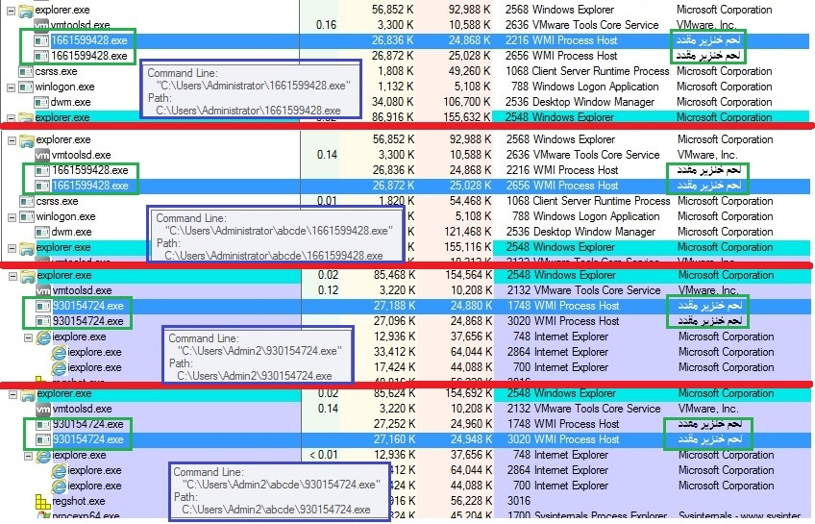
Malware Hunting with the Sysinternals Tools
Process Explorer and Sigcheck
Here we can find 4 processes
(WMI Process Host) and
even not suspicious company name
bacon = لحم خنزير مقدد
(according to google translate)
Total 2 *.exe files in 4 different directories with the same
MD5:
8961E5EE1A151A3A09023F55CE3995B5
each one of them.
(Sigcheck tool)

Slide 3
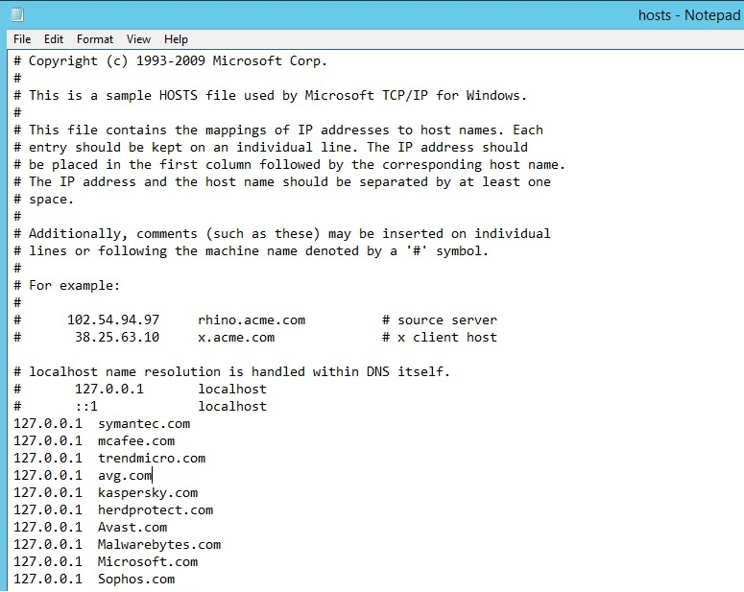
Additional check
Temporary I suspend 4 suspicious processes.
In additional check of the system, found hosts file…
Could be Malware activity or “special setup”…
No conclusion for now.

Slide 4
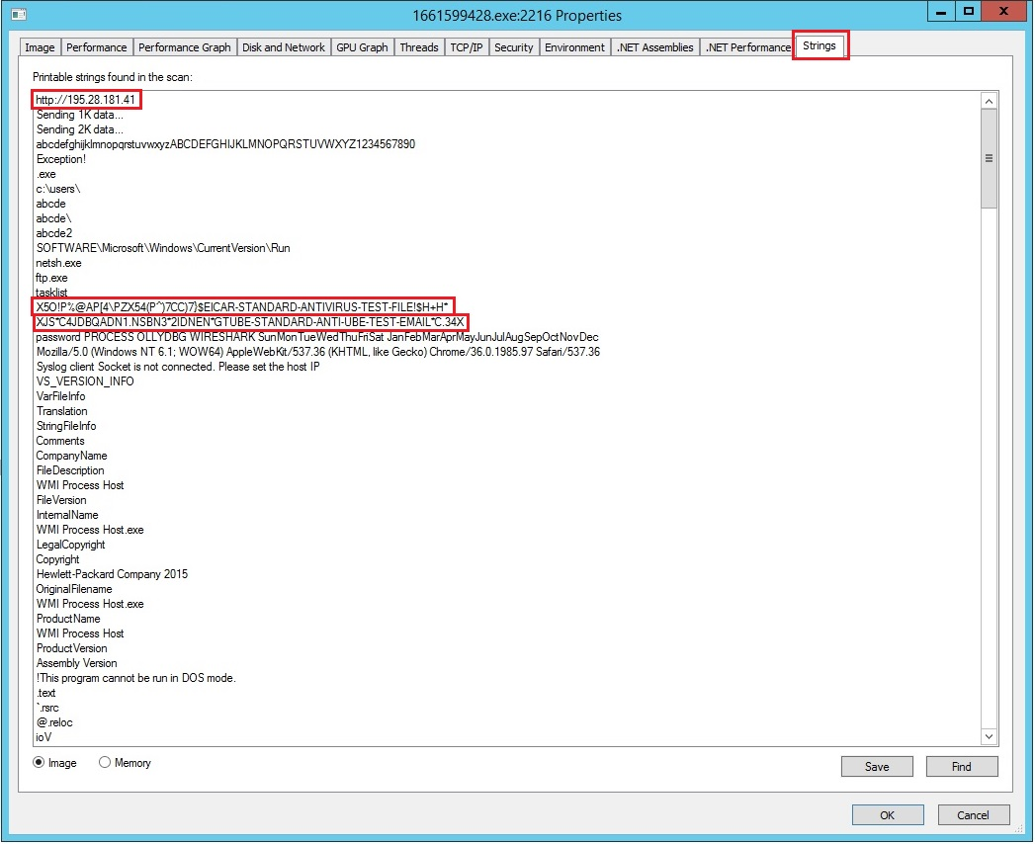
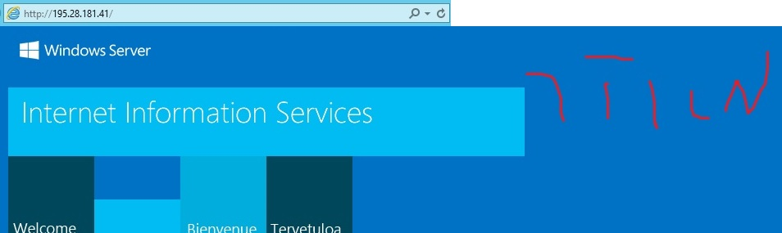
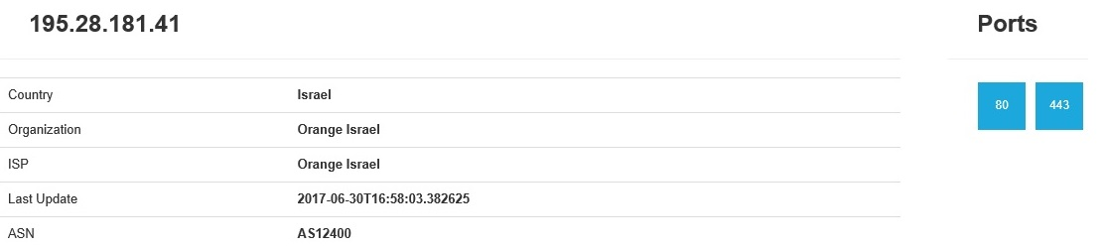
Process Properties -> Strings tab (analysis)
http://195.28.181.41
https://www.shodan.io/

Slide 5
Process Properties -> Strings tab (analysis)
2. X5O!P%@AP[4\PZX54(P^)7CC)7}$EICAR-STANDARD-ANTIVIRUS-TEST-FILE!$H+H*
https://support.kaspersky.com/viruses/general/459
EICAR is a 68-byte .com file detected as "EICAR-Test-File". This IS NOT a virus. The test file simply displays a text message and returns the control to the operating system.
3. XJS*C4JDBQADN1.NSBN3*2IDNEN*GTUBE-STANDARD-ANTI-UBE-TEST-EMAIL*C.34X
The GTUBE ("Generic Test for Unsolicited Bulk Email") is a 68-byte test string used to test anti-spam
systems, in particular those based on SpamAssassin. In SpamAssassin, it carries an antispam score
of 1000 by default, which would be sufficient to trigger any installation.
and other strings…
\\10.90.11.50\wesecure\Admin\Team Management\
AWS\WMI Process Host\WMI Process Host\obj\Release\WMI Process Host.pdb

Slide 6
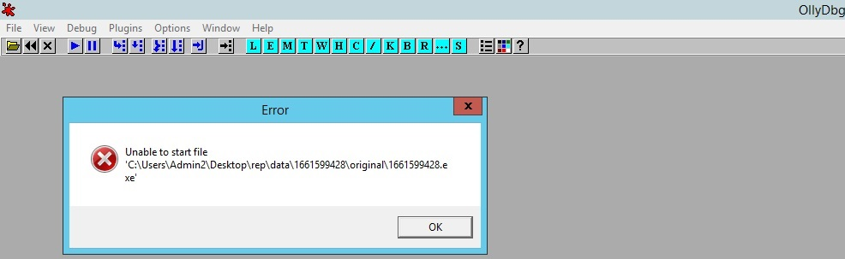
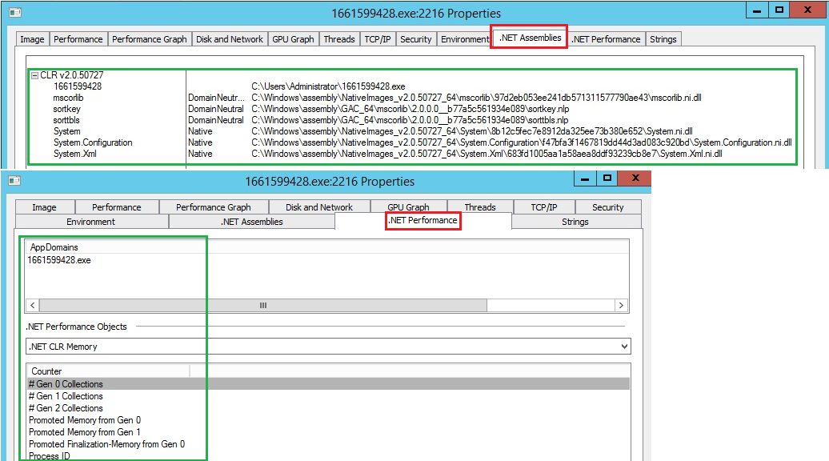
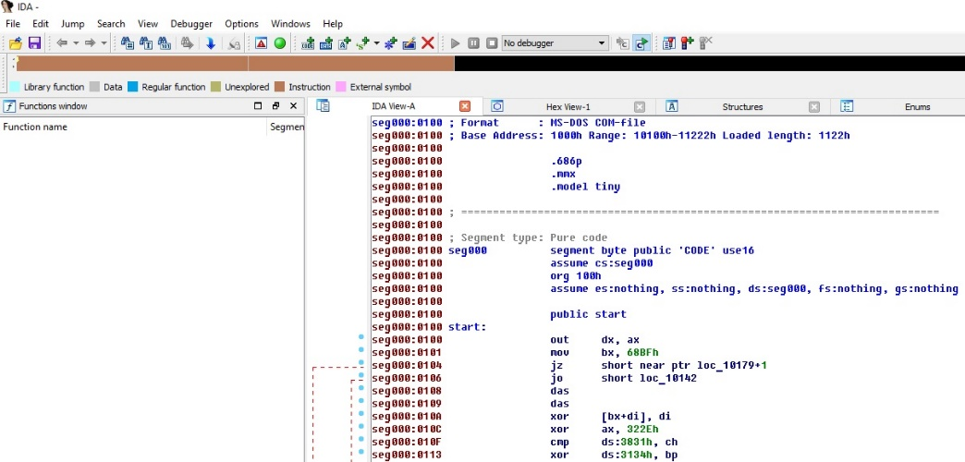
Teardown suspicious *.exe file
1. Ollydbg
2. IDA Pro
Doesn’t look like it is intended to be disassembled in Ollydbg or IDA Pro.
So I checked process properties and seems like source code in .NET

Slide 7
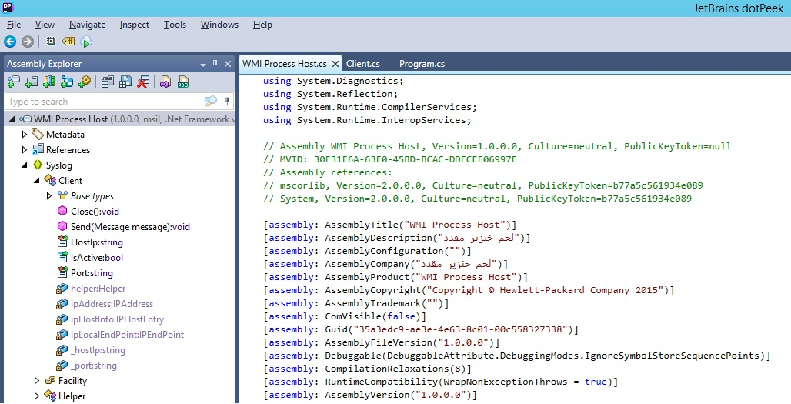
Teardown suspicious *.exe file with dotPeek .NET decompiler
Now it looks much more better

Slide 8
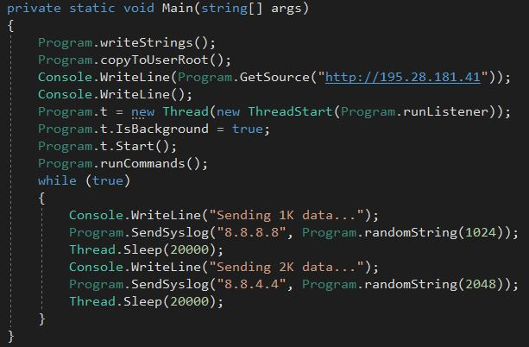
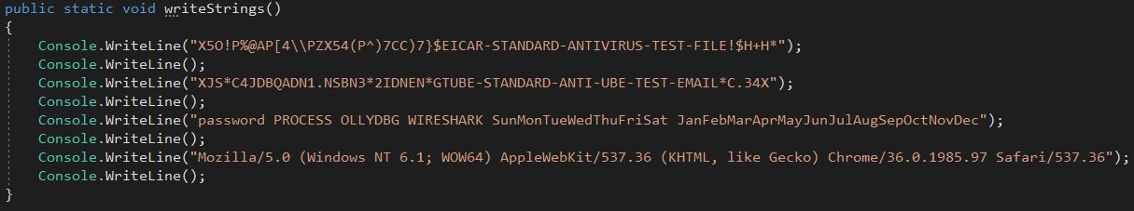
Program.cs -> Main
writeStrings();
Prints those strings:
"X5O!P%@AP[4\\PZX54(P^)7CC)7}$EICAR-STANDARD-ANTIVIRUS-TEST-FILE!$H+H*"
"XJS*C4JDBQADN1.NSBN3*2IDNEN*GTUBE-STANDARD-ANTI-UBE-TEST-EMAIL*C.34X"
"password PROCESS OLLYDBG WIRESHARK SunMonTueWedThuFriSat JanFebMarAprMayJunJulAugSepOctNovDec"
"Mozilla/5.0 (Windows NT 6.1; WOW64) AppleWebKit/537.36 (KHTML, like Gecko) Chrome/36.0.1985.97 Safari/537.36"

Slide 9
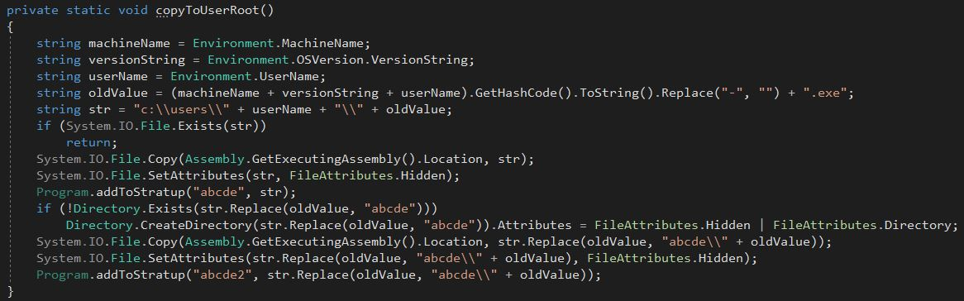
Program.cs -> Main
copyToUserRoot();

Slide 10
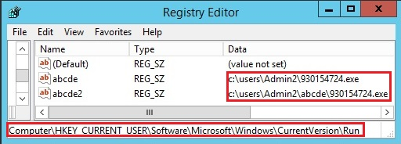
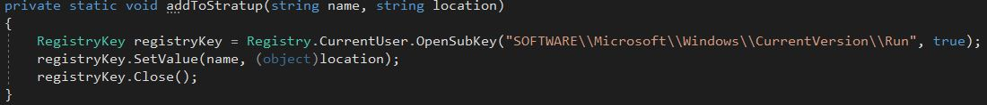
copyToUserRoot();
This function creates and uses 3 variables for various operations: machineName, versionString and userName.
Then it concatenates 3 values of this variables and calculates HashCode of string without “-” and adds “.exe” to the end.
In our example it’s:
machineName = WIN-N8MKQKUTJOV
versionString = Microsoft Windows NT 6.2.9200.0
userName = Admin2
String = HashCode(machineName+versionString+username) + ‘.exe’ = 930154724.exe
After that creates file in this directory:
"c:\\users\\" + userName + "\\" + oldValue; with FileAttributes.Hidden
Then adds file path to startup by adding key to the registry.
This happening in function addToStratup(string name, string location).
After that creates directory "abcde“ in "c:\\users\\" + userName + "\\" + oldValue;
with the same file at the same rules.

Slide 11
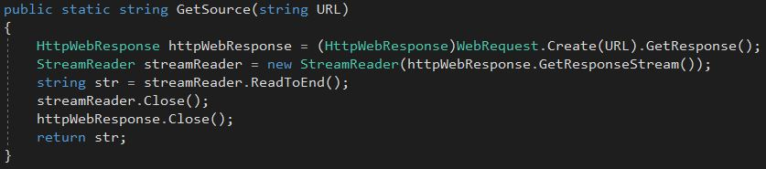
Program.cs -> Main
GetSource(string URL)
Sending request to http://195.28.181.41 and
waiting for response.

Slide 12
GetSource(string URL) -> HttpWebResponse Getting response from http://195.28.181.41
<!DOCTYPE html PUBLIC "-//W3C//DTD XHTML 1.0 Strict//EN" "http://www.w3.org/TR/xhtml1/DTD/xhtml1-strict.dtd">
<html xmlns="http://www.w3.org/1999/xhtml">
<head>
<meta http-equiv="Content-Type" content="text/html; charset=iso-8859-1" />
<title>IIS Windows Server</title>
<style type="text/css">
<!--
body {
color:#000000;
background-color:#0072C6;
margin:0;
}
#container {
margin-left:auto;
margin-right:auto;
text-align:center;
}
a img {
border:none;
}
-->
</style>
</head>
<body>
<div id="container">
<a href="http://go.microsoft.com/fwlink/?linkid=66138&amp;clcid=0x409"><img src="iis-85.png" alt="IIS" width="960" height="600" /></a>
</div>
</body>
</html>

Slide 13
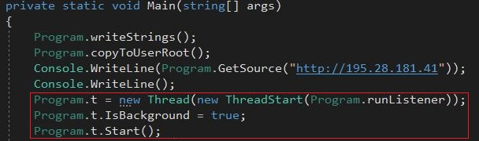
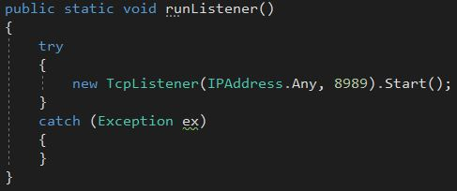
Program.cs -> Main
runListener()
runListener creates TcpListener with ip 0.0.0.0 and port 8989
Listening for client requests.
Created in new thread and runs in background.
https://msdn.microsoft.com/en-us/library/system.net.sockets.tcplistener(v=vs.110).aspx

Slide 14
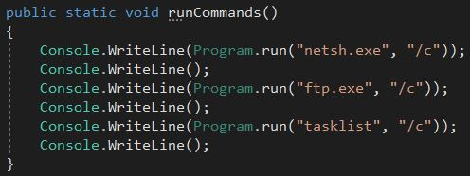
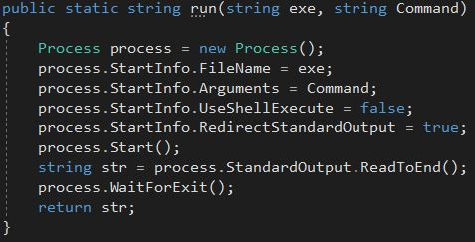
Program.cs -> Main
runCommands();
run(string exe, string Command)

Slide 15
runCommands();
This Function starts 3 processes:
1. Netsh is a command-line scripting utility that allows you to, either locally or remotely, display or modify the network configuration of a computer that is currently running.
2. FTP - Transfers files to and from a computer running a File Transfer Protocol (FTP) server service.
3. Tasklist - Displays a list of applications and services with their Process ID (PID) for all tasks running on either a local or a remote computer.
run(string exe, string Command)
This function is creating new process, where parameter “exe” is an executable file to run and parameter “Command” is an argument. This function redirects process’s STDOUT to himself, waits until process is exits and returns STDOUT as a string to caller method.

Slide 16
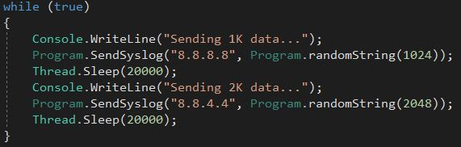
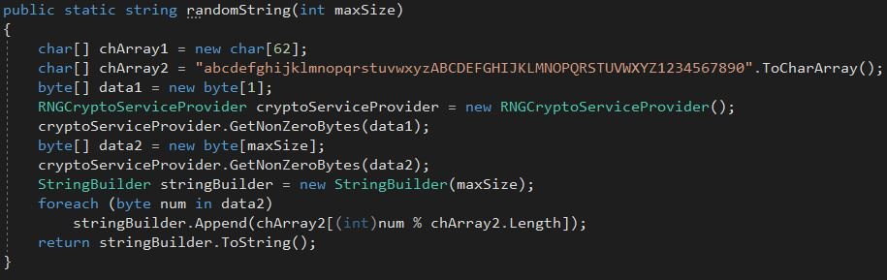
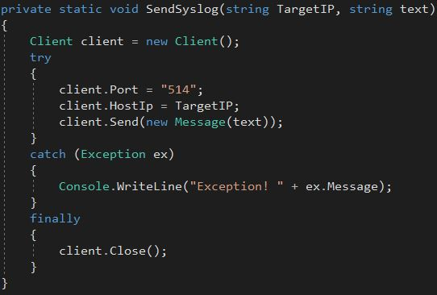
Program.cs -> Main
randomString(int maxSize)
SendSyslog(string TargetIP, string text)

Slide 17
randomString(int maxSize) https://www.dotnetperls.com/rngcryptoserviceprovider https://msdn.microsoft.com/en-us/library/system.security.cryptography.rngcryptoserviceprovider(v=vs.110).aspx
Implements a cryptographic Random Number Generator (RNG) using the implementation provided by the cryptographic service provider (CSP).
randomString generates highly random string from chArray2 char set where maxSize parameter is a string length.
chArray2 = "abcdefghijklmnopqrstuvwxyzABCDEFGHIJKLMNOPQRSTUVWXYZ1234567890"

Slide 18
SendSyslog(string TargetIP, string text) Custom implementation of syslog protocol over UDP
Creates Client object, populates properties:
Port = 514
HostIp = 8.8.8.8 or 8.8.4.4 (depends on specific line in code)
ipHostInfo = DNS resolve for local host name
ipAddress = local ip address
ipLocalEndPoint = IPEndPoint object with local ip address
function SendSyslog, after creating Client object sends 1K or 2K random string
to 8.8.8.8 or 8.8.4.4 accordingly

Slide 19
Client()
public Client()
{
this.ipHostInfo = Dns.Resolve(Dns.GetHostName());
this.ipAddress = this.ipHostInfo.AddressList[0];
this.ipLocalEndPoint = new IPEndPoint(this.ipAddress, 0);
this.helper = new Helper(this.ipLocalEndPoint);
}
ipHostInfo – does dns resolve on host name
ipAddress – your ip
ipLocalEndPoint – your ip and port 0
Helper – created endpoint on your local ip

Slide 20
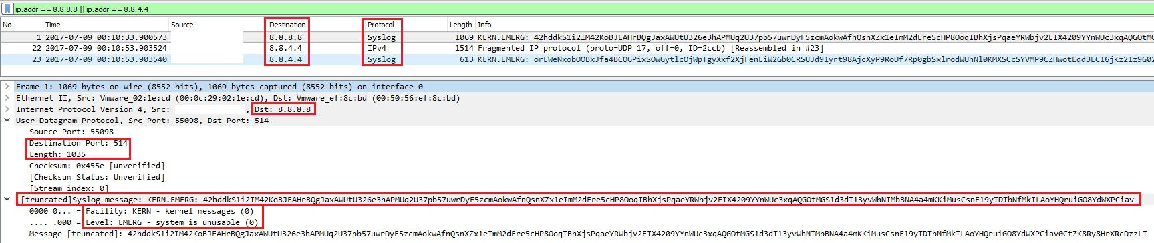
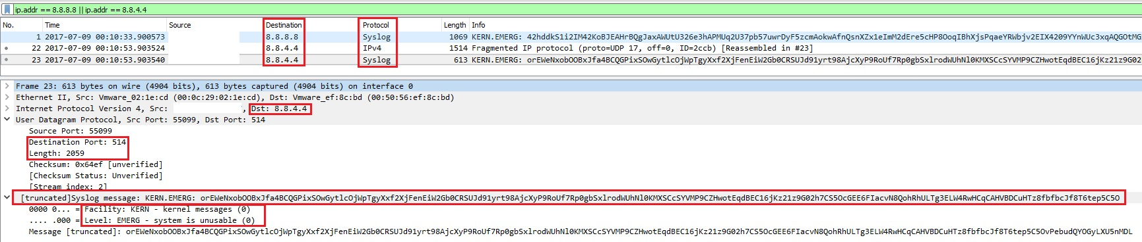
wireshark

Slide 21
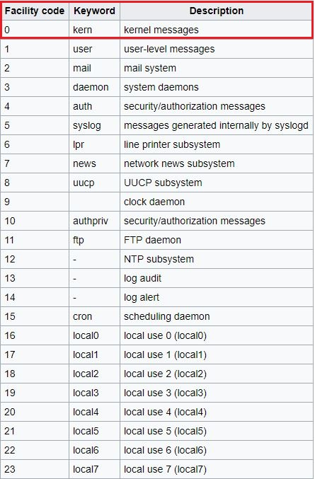
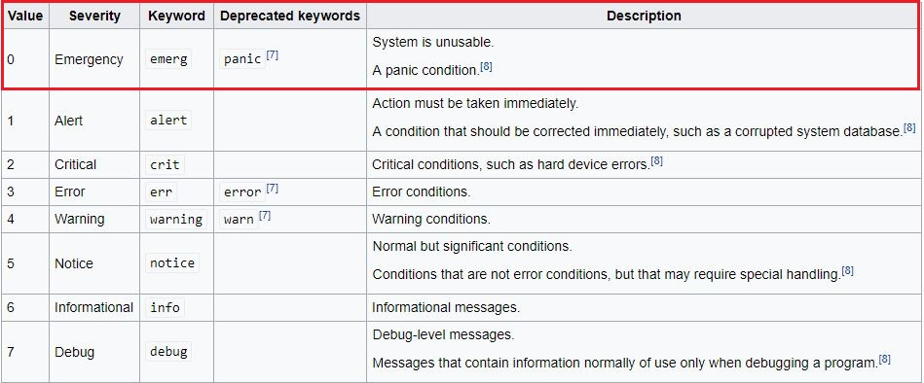
Syslog codes https://en.wikipedia.org/wiki/Syslog
A facility code is used to specify the type of program that is logging the message.
Messages with different facilities may be handled differently.
The meaning of severity levels other than Emergency and Debug are relative
to the application. For example, if the purpose of the system is to process transactions
to update customer account balance information, an error in the final step should
be assigned Alert level.

Slide 22
Full RUN
X5O!P%@AP[4\PZX54(P^)7CC)7}$EICAR-STANDARD-ANTIVIRUS-TEST-FILE!$H+H*
XJS*C4JDBQADN1.NSBN3*2IDNEN*GTUBE-STANDARD-ANTI-UBE-TEST-EMAIL*C.34X
password PROCESS OLLYDBG WIRESHARK SunMonTueWedThuFriSat JanFebMarAprMayJunJulAugSepOctNovDec
Mozilla/5.0 (Windows NT 6.1; WOW64) AppleWebKit/537.36 (KHTML, like Gecko) Chrome/36.0.1985.97 Safari/537.36
<!DOCTYPE html PUBLIC "-//W3C//DTD XHTML 1.0 Strict//EN" "http://www.w3.org/TR/xhtml1/DTD/xhtml1-strict.dtd">
<html xmlns="http://www.w3.org/1999/xhtml">
<head>
<meta http-equiv="Content-Type" content="text/html; charset=iso-8859-1" />
<title>IIS Windows Server</title>
<style type="text/css">
<!--
body {
color:#000000;
background-color:#0072C6;
margin:0;
}
#container {
margin-left:auto;
margin-right:auto;
text-align:center;
}
a img {
border:none;
}
-->
</style>
</head>
<body>
<div id="container">
<a href="http://go.microsoft.com/fwlink/?linkid=66138&amp;clcid=0x409"><img src="iis-85.png" alt="IIS" width="960" height="600" /></a>
</div>
</body>
</html>
The following command was not found: /c.
Sending 1K data...
Sending 2K data...

Slide 23
Conclusion
Malware creates 2 identical files in 2 different directories and adding keys to the registry for future startup.
(Trojan horse trying to establish persistence on attacked host)
Sending request to http://195.28.181.41 and getting response.
(Could be commands from C&C servers)
Run 3 processes: Netsh, FTP and Tasklist
(Spying or surveillance)
Sending data to 8.8.8.8 and 8.8.4.4 every 20sec.
(Sending spying results to attacker servers)

Slide 24
Tools used:
https://www.youtube.com/watch?v=Wuy_Pm3KaV8&index=1&list=PLV2GM8n1QT929Fo061-BzMpIIGf0sSck0
Process Explorer
Sigcheck
https://www.shodan.io/
Registry Editor
dotPeek
VisualStudio
Wireshark

