Slide 1
Colour change and behavioural choice facilitate chameleon prawn camouflage against different seaweed backgrounds
A reproducibility and GRP analysis
Clint, Mati, Timo
BME 321

Slide 2
Outline
Introduction to Study & Design
Transparency and Reproducibility
Soundness of Analyses
Fulfillment of GRP principles

Slide 3
Introduction into study
Summary, etc…

Slide 4
Causal Reasoning
DAGs, etc…

Slide 5
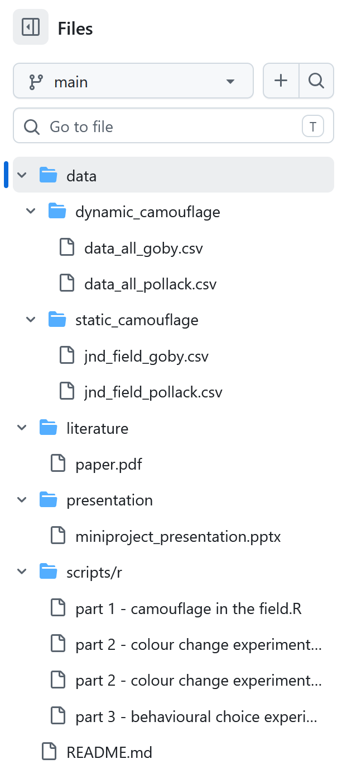
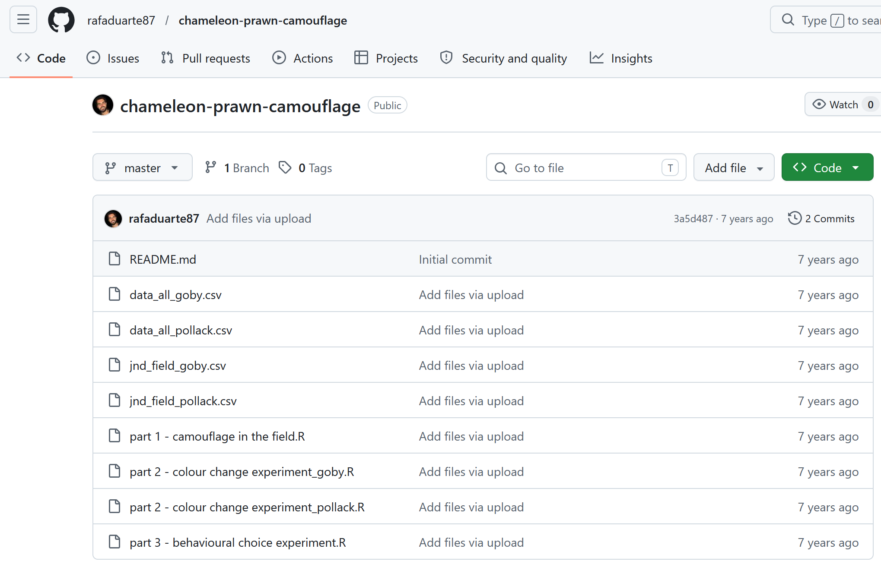
Transparency and Reproducibility
Note: the above illustration is just to show what I want to include in this slide, screenshots need to be taken again

Slide 7
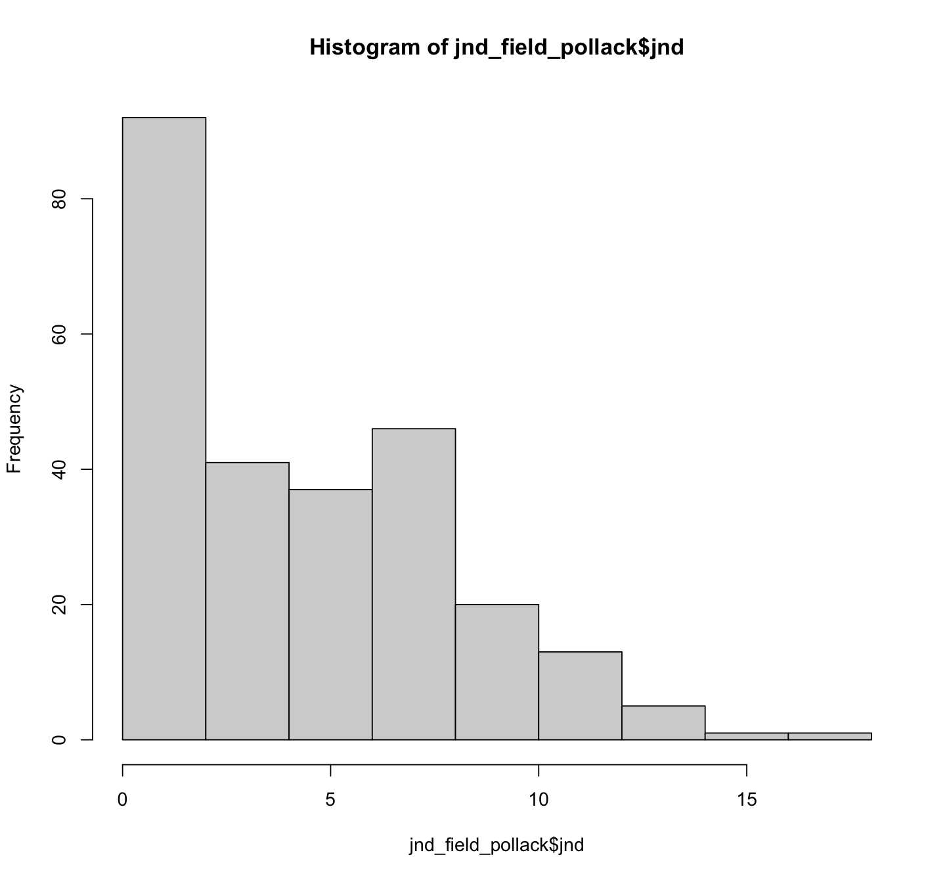
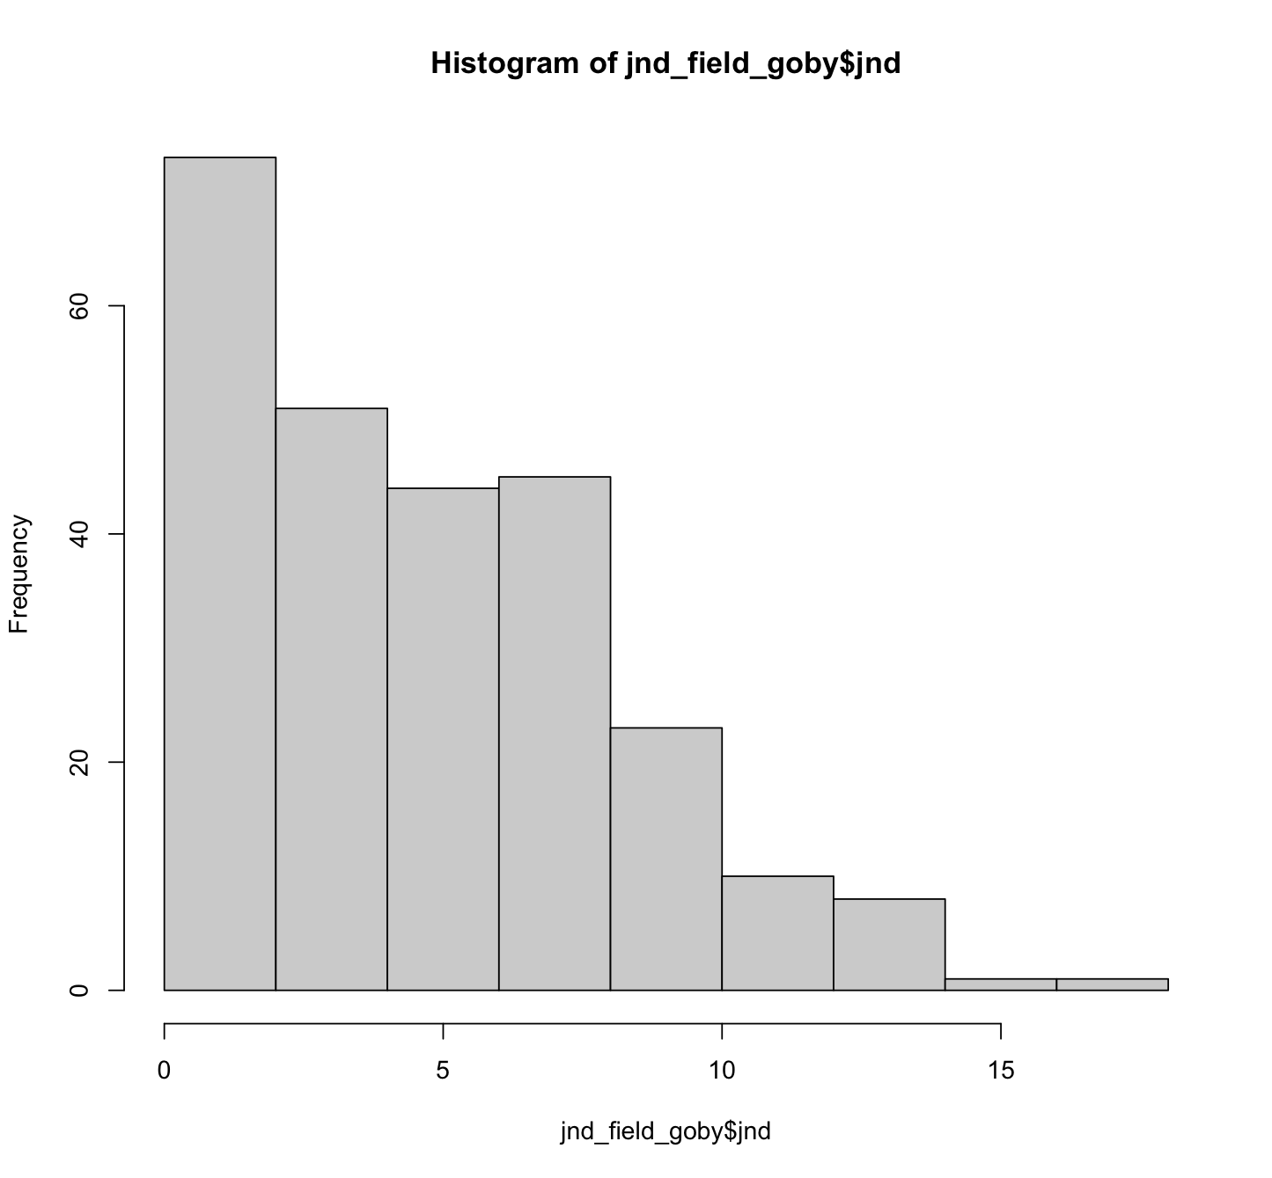
Chromatic Camouflage Effectiveness of Green and Red Chameleon Prawns Against Natural Seaweed Substrates as Perceived by Fish Predators
Reproducibility!
There was no numerical or graphical exploration before model fitting…so we did it ourselves.
Numerical Exploration suggested Non-normality of the response variable (Shapiro-wilk test).

Slide 8
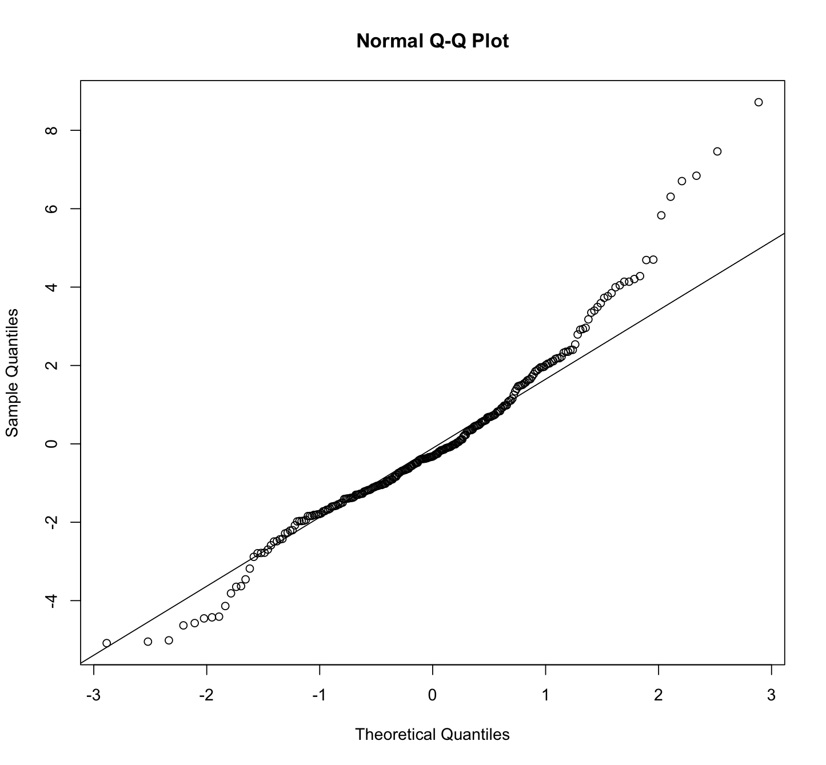
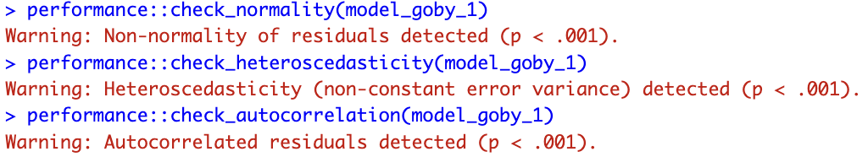

Chromatic Camouflage Effectiveness of Green and Red Chameleon Prawns Against Natural Seaweed Substrates as Perceived by Fish Predators
jnd ~ morph * seaweed + (1 | ID)
Are the model assumptions met, and did they check them…

Slide 9
Soundness of Analyses
Comments_on_analyses/timo.md
Comments_on_analyses/mati.md
→ Comparison
etc

Slide 10
Fulfillment of GRP principles

