Slide 1
Hello! We are the team “Flash”
Sascha Gaudlitz
HU Berlin
Konstantins Starovoitovs
HU Berlin
Sascha Gaudlitz
Mike
Nguyen
TU Braunschweig
Tim
Sieker
CAU Kiel
Tim
Sieker
Eric
Ziebell
HU Berlin
02/02/2023

Slide 2
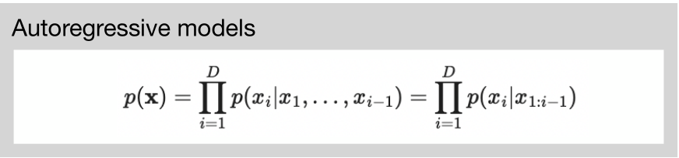
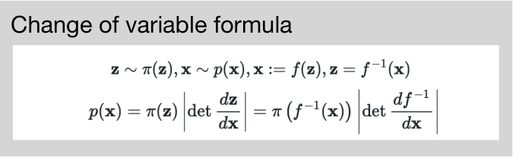
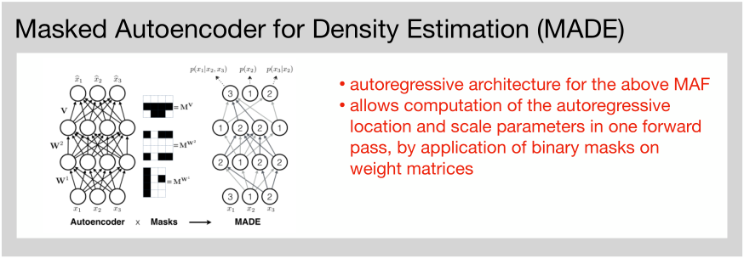
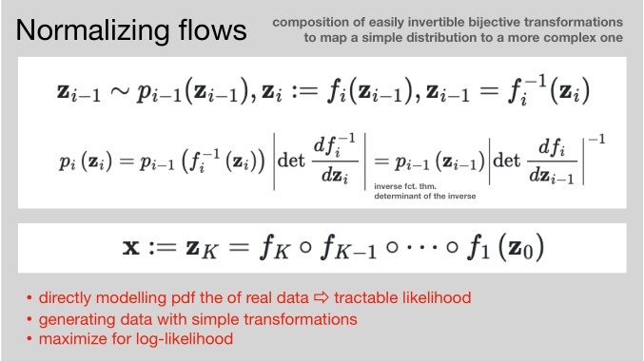
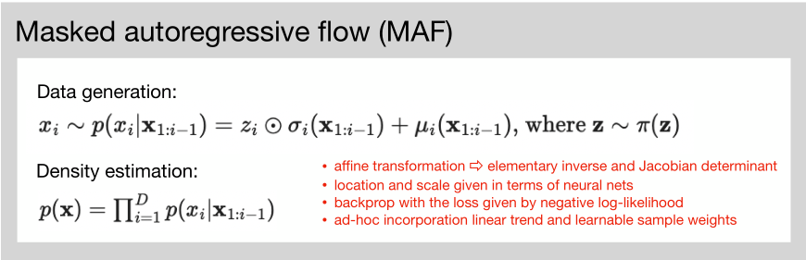
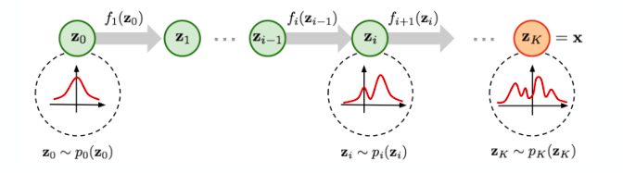
Part 1: Normalising Flows – Theory
02/02/2023

Slide 3
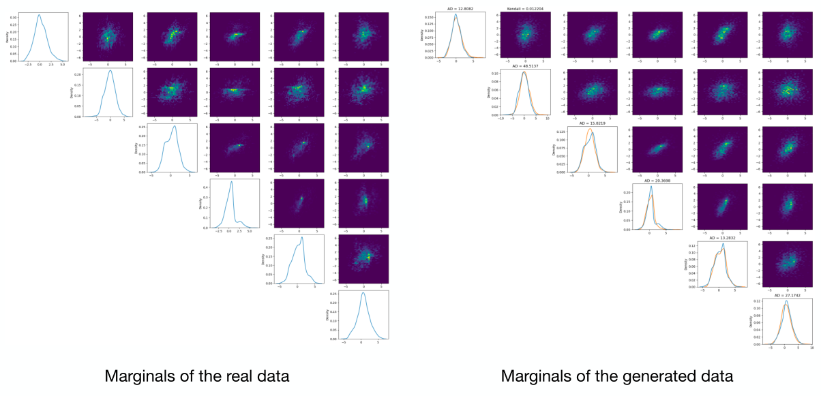
Part 1: Normalising Flows – Results
02/02/2023

Slide 4
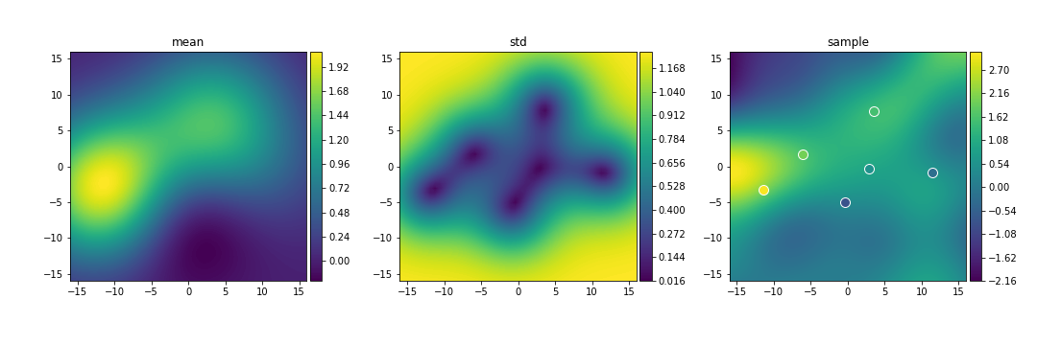
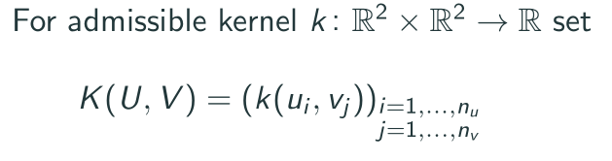
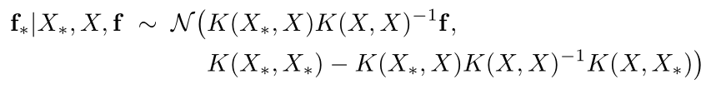
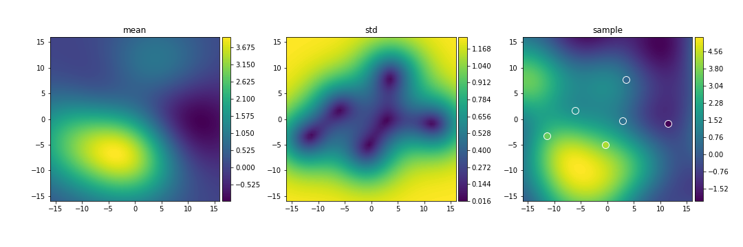
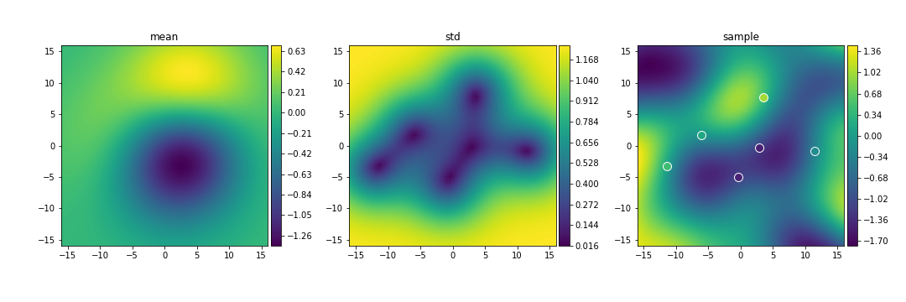
Part 2: Gaussian Process Regression (Kriging)
01-01-2012
01-01-2016
01-01-2008
02/02/2023

