Slide 1
Streaming Spiking Neural Networks
for Real-Time Fault Detection
LIF Neurons · Surrogate Gradient · TBPTT · Edge Deployment
Artificial Neural Networks · Final Report · 2026
mem(t) = β · mem(t−1) + W · spike(t) · fire if mem ≥ θ · 97 parameters

Slide 2
ANN Course · SNN Predictive Maintenance
From ANN to Spiking Neural Network
Property | Traditional ANN | Spiking Neural Network (SNN)
Activation | Continuous (0.0 – 1.0) | Binary spikes (0 or 1)
Communication | Dense float vectors (all active) | Sparse events (only firing)
Temporal State | Stateless (no memory) | Membrane potential (persistent)
Gradient Method | Standard backprop (differentiable) | Surrogate gradient (non-diff. spike)
Edge Efficiency | Heavy (float multiply per step) | Light (binary: add only, no multiply)

Slide 3
ANN Course · SNN Predictive Maintenance
Leaky Integrate-and-Fire Neuron
mem(t) = β · mem(t−1) + W · spike(t)
if mem(t) ≥ θ : emit spike ; mem(t) −= θ ← soft reset (not zero)
Parameter
Value / Range
Role
β (beta)
(0, 1) — LEARNED
leak factor · controls decay speed
mem rises → fires at θ=1.0 soft reset → rises again
θ (threshold)
1.0 — fixed
fire level · soft reset preserves energy
W (weights)
[32,1] matrix
synaptic · learned via surrogate BPTT
x(t)
{0, 1} binary
delta modulation of accelerometer
Soft reset (mem−=θ) preserves sub-threshold energy — more info than hard zero

Slide 4
ANN Course · SNN Predictive Maintenance
Delta Modulation — Spike Encoding
Biological Inspiration: retinal ganglion cells fire on luminance CHANGE, not absolute level
spike(t) = 1 if |Δaccel| > θ = 0.05
NORMAL Bearing
FAULT Bearing
Spike Rate 0.185
Spike Rate 0.854
4.6× difference → directly classifiable

Slide 5
ANN Course · SNN Predictive Maintenance
Windowed SNN vs Streaming SNN
❌ Windowed (old approach)
✓ Streaming (this work)
Buffer: [ x₁, x₂, ..., x₁₂₈ ]
one spike scalar per timestep
must wait 128 samples before first output
instant output, no buffer needed
FC1: Linear(128 → 32)
FC1: Linear(1 → 32)
WINDOW size baked into weight matrix!
no window dependency, scalar input
VS
Problems:
Key Innovation:
• Changing window = full retrain
• mem₁ never reset between samples
• Waits 128 samples before output
• Temporal context spans entire stream
• Window boundary artifacts
• Decision every 200 steps (≈1 second)
Params: 128×32 + 32×2 = 4,160 · 16 KB
Params: 32 + 64 + 1 = 97 · 0.38 KB
43× fewer parameters · truly real-time · no window coupling

Slide 6
ANN Course · SNN Predictive Maintenance
Network Architecture
cur₁ = FC1(spike) → spk₁, mem₁ = LIF1(cur₁, mem₁) → logit += FC2(spk₁)
spike(t)
FC1 Linear
LIF1 Leaky
FC2 Linear
Σ logit
argmax
{0,1} δ-mod
W₁:[32,1] no bias
β learned mem persists
W₂:[2,32] no bias
+= FC2(spk₁) 200 steps
Normal Fault
// Per timestep (5 ms, 200 Hz on ESP32):
spike = (|az−prev| > θ) ? 1.0 : 0.0
if dec_count ≥ 200: classify = argmax(out_acc)
for j in 0..31:
mem1[j] = β·mem1[j] + spike·W1[j]
if mem1[j]≥θ: { mem1[j]−=θ; out+=W2[j]; } // no matrix multiply for binary input
W₁(32) + W₂(64) + β(1) = 97 params total

Slide 7
ANN Course · SNN Predictive Maintenance
Surrogate Gradient
Problem: ∂H(mem−θ)/∂mem = 0 everywhere → zero gradient → no learning!
Forward Pass
Backward Pass (Surrogate)
spike = H(mem − θ) (Heaviside)
grad ≈ σ'(slope·(mem−θ))
peak
H(x)
grad=0
1
→ replace gradient
smooth everywhere
grad=0
0
mem−θ
mem−θ
σ'(x) = slope / (2·(1 + |slope·x|)²) slope=5 → peak=1.25 at x=0

Slide 8
ANN Course · SNN Predictive Maintenance
Truncated BPTT (TBPTT)
Full BPTT: O(T) memory, T=120,000 → impractical
TBPTT: unroll C=256 steps · detach at boundary
∂L/∂W
∂L/∂W
Training: stream divided into chunks (T=256 each)
chunk 1 T=256
chunk 2 T=256
chunk 3 T=256
chunk 4 T=256
chunk 5 T=256
...
✂
✂
✂
✂
mem₁ persistent → carries temporal context across ALL chunks during INFERENCE
Training code:
Trade-offs
for chunk in chunks:
✓
Memory: O(256) not O(120,000)
mem1 = mem1.detach() # stop gradient
✓
Stable on long sequences
out, mem1 = model(chunk, mem1)
loss = criterion(out, label)
✗
Loses dependencies > 256 steps
loss.backward(); optimizer.step()
→
mem₁ bridges long context at inference

Slide 9
Machine Learning · SNN Predictive Maintenance
Training Results
100%
Loss: 1.47 → 0.50 → 0.09 → 0.01 → 0.0001 (converges in 5 epochs)
Test Accuracy
285 test chunks
Fault: P=1.00 R=1.00 F1=1.00 (102 chunks) Normal: P=1.00 R=1.00 F1=1.00 (183 chunks)

Slide 10
ANN Course · SNN Predictive Maintenance
Edge Deployment — ESP32
ESP32 NodeMCU-32S
// firmware/src/main.cpp (-DINFERENCE_MODE)
static float mem1[SNN_HIDDEN] = {}; // never reset
Xtensa LX6 240 MHz · 520 KB RAM Flash: 4 MB
static float out_acc[2] = {}; // fault/normal
void loop() {
float az = mpu.getAccelZ();
// ─ delta encode ─
float spike = (|az-prev|>THRESH) ? 1.0f : 0.0f;
MPU6050 I2C·200Hz
G · R · B LEDs
// ─ FC1 + LIF1 (mem never zeroed) ─
for (int j=0; j<SNN_HIDDEN; j++) {
mem1[j] = BETA*mem1[j] + spike*W1[j];
if (mem1[j]>=THRESH1) {
Serial 115200 → Dashboard
mem1[j] -= THRESH1; // soft reset
out_acc[0] += W2[0*H+j]; // fault
out_acc[1] += W2[1*H+j]; // normal
● Green = Normal ● Red flash = Fault
}
}
// ─ classify every 200 samples ─
if (++dec >= INTERVAL) { classify(); reset(); }
}
// Model: 0.38 KB · binary input = no matrix multiply

Slide 11
ANN Course · SNN Predictive Maintenance
ANN vs SNN — Full Comparison
Property | Traditional ANN (MLP) | Streaming SNN (this work)
Activation | float32 ∈ [0, 1] | binary {0, 1} (spike)
FC1 input size | WINDOW = 128 ← fixed! | 1 (one spike per timestep)
Parameters | 128×32 + 32×2 = 4,160 | 32 + 64 + 1 = 97
Temporal Memory | none (per-window, stateless) | mem₁ persistent across all t
Training | Standard BPTT | Surrogate grad + TBPTT
Real-time capable | windowed only (batch) | true streaming (per-sample)
Test Accuracy | ~99% (4160 params) | 100% (97 params)

Slide 12
ANN Course · SNN Predictive Maintenance
Conclusion
SNN Contributions
Key Insights
✓
LIF neuron: built-in temporal integration
▶
Neuromorphic ≠ just biological
sparse spikes → real computational benefit
✓
Surrogate gradient enables BPTT on spikes
▶
Delta mod as feature engineering
✓
Streaming: one weight per hidden unit
maps domain knowledge to spike rates
✓
TBPTT: scalable training on long streams
▶
Persistent state = temporal context
replaces explicit window or LSTM cell
✓
Edge deployment: 97 params in C on ESP32
100% test accuracy on CWRU benchmark
▶
Soft reset preserves energy
✓
more info than hard reset to zero
Streaming SNN: neuromorphic principles yield practical efficiency gains — 97 params, 100% accuracy

Slide 13
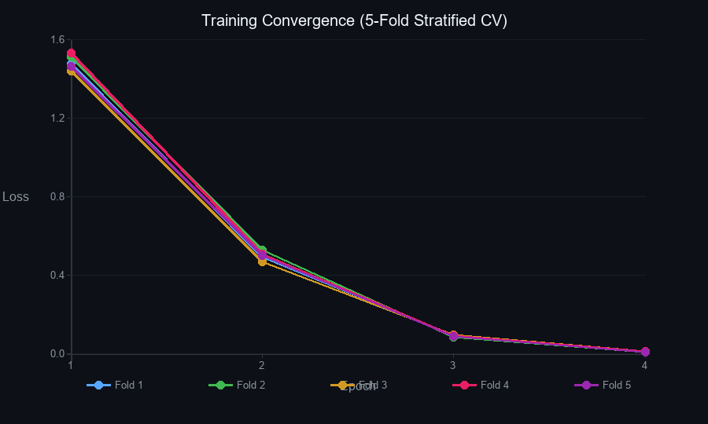
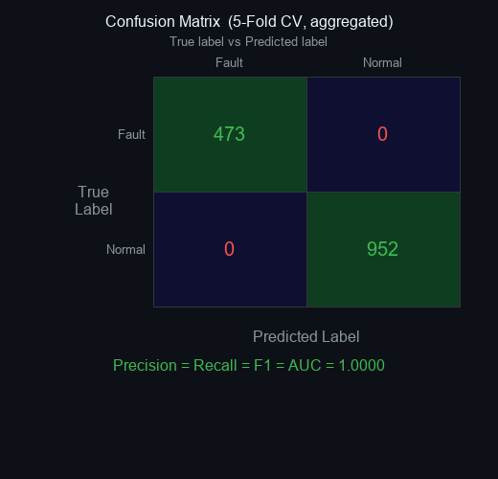
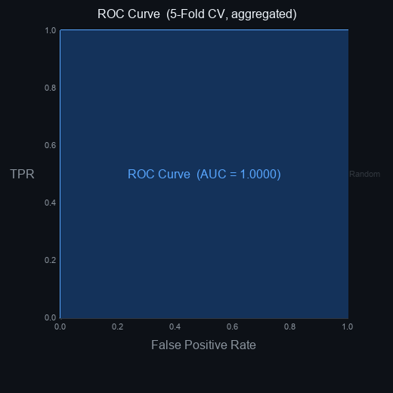
Machine Learning · SNN Predictive Maintenance
5-Fold Cross-Validation Results
Summary (mean ± std across 5 folds)
Accuracy
1.0000 ± 0.0000
Precision
1.0000 ± 0.0000
Recall
1.0000 ± 0.0000
F1 Score
1.0000 ± 0.0000
ROC-AUC
1.0000 ± 0.0000
All 1425 chunks · 473 fault · 952 normal
Training Convergence
fault P=1.00 R=1.00 F1=1.00 (473 chunks)
normal P=1.00 R=1.00 F1=1.00 (952 chunks)

