Slide 1
Predictive Maintenance
via Spiking Neural Networks
on Bearing Vibration Data
Normal signal ←—— sparse spikes
Fault signal ←—— dense spikes
Machine Learning · Final Report · 2026

Slide 2
Machine Learning · SNN Predictive Maintenance
Motivation
Unplanned Downtime
Manual Inspection
Early Faults Missed
No warning before failure
Expensive, error-prone
Below detection threshold
▼
Data-Driven SNN Classifier
Learn fault signatures from vibration data · <1 KB model · Real-time on microcontroller
Constraint: model size < 1 KB · No fixed input window · 200 Hz sensor

Slide 3
Machine Learning · SNN Predictive Maintenance
Problem Formulation
INPUT
Constraints
Accelerometer Z-axis
✓ Normal
• Unbounded input (streaming)
• Model size < 1 KB
continuous time-series stream (unbounded)
Model
• Real-time inference
──────►
12 kHz · CWRU benchmark
• No fixed window size
✗ Fault
• Binary output per interval

Slide 4
Machine Learning · SNN Predictive Maintenance
CWRU Bearing Dataset
Case Western Reserve University · Public Benchmark
Sample Count
NORMAL
97.mat — Normal baseline · 243,938 samples
INNER RACE FAULT
105.mat — fault diameter 0.007 in.
118.mat — fault diameter 0.014 in.
130.mat — fault diameter 0.021 in.
243,938
121,265
Normal
Fault
Sampling Rate: 12,000 Hz · Drive-End Accelerometer · scipy.io.loadmat()

Slide 5
Machine Learning · SNN Predictive Maintenance
Delta Modulation → Spike Encoding
spike(t) = 1 if |accel(t) − accel(t−1)| > θ θ = 0.05
NORMAL Bearing
FAULT Bearing (Inner Race)
Raw signal (small amplitude oscillation)
Raw signal (large amplitude impulses)
Spike train (sparse)
Spike train (dense)
Spike Rate
Spike Rate
0.185
0.854
4.6× difference → directly classifiable by spike rate

Slide 6
Machine Learning · SNN Predictive Maintenance
Model Architecture — Streaming SNN
Spike Input
FC1 Linear
LIF1 Leaky
FC2 Linear
Σ Accum. 200 steps
argmax Classify
1 scalar per step
1 → 32 no bias
β learned persistent mem
32 → 2 no bias
≈1 second rate coding
Normal or Fault
mem = β·mem + W·x fire if mem ≥ θ; mem −= θ
Total: 97 parameters · 0.38 KB (float32)
⟵ mem₁ never reset between samples — persistent temporal memory ⟶

Slide 7
Machine Learning · SNN Predictive Maintenance
Leaky Integrate-and-Fire Neuron
mem(t) = β · mem(t−1) + W · spike(t)
if mem(t) ≥ θ : spike! mem(t) −= θ (soft reset)
Parameters
β (beta)
leak factor ∈ (0,1)
controls decay speed — LEARNED
↗ membrane rises → fires at θ=1.0 → soft reset → rises again
θ (threshold)
fire threshold = 1.0
fixed; soft reset: mem −= θ (not zeroed)
W (weights)
synaptic weights
learned via surrogate BPTT, no bias terms
x(t)
binary spike {0, 1}
from delta modulation of accelerometer
threshold θ = 1.0 (dashed line on chart)

Slide 8
Machine Learning · SNN Predictive Maintenance
Training Pipeline
CWRU .mat
Delta Mod
Chunks T=256
Streaming SNN
Cross- Entropy
Adam
Early Stop
12 kHz raw
θ=0.05 binary
TBPTT boundary
97 params FC+LIF+FC
surrogate grad
lr=1e−3 optimizer
patience =10
Truncated BPTT
Data Split
• Unroll C=256 steps per chunk
80% train → 1,140 chunks
• Detach gradient at chunk boundary (stop grad)
20% test → 285 chunks
• mem₁ persists across all chunks during INFERENCE

Slide 9
Machine Learning · SNN Predictive Maintenance
Training Results
100%
Loss: 1.47 → 0.50 → 0.09 → 0.01 → 0.0001 (converges in 5 epochs)
Test Accuracy
285 test chunks
Fault: P=1.00 R=1.00 F1=1.00 (102 chunks) Normal: P=1.00 R=1.00 F1=1.00 (183 chunks)

Slide 10
Machine Learning · SNN Predictive Maintenance
Why Does It Work?
Spike Rate per Sample
① Delta Modulation
Fault impulses → |Δaccel| exceeds θ nearly every step → dense spikes
0.854
② LIF as Temporal Integrator
4.6×
mem(t) accumulates spike rate → robust, persistent memory, noise-resistant
0.185
③ Rate Coding Output
Logits summed over 200 steps → argmax → robust to single-step noise
Normal
Fault

Slide 11
Machine Learning · SNN Predictive Maintenance
Model Efficiency
Parameter Count Comparison
1D-CNN
10,000
LSTM
5,000
SNN (ours)
97
97
parameters · 0.38 KB
100× fewer parameters than a typical CNN · no multiplications for binary input

Slide 12
Machine Learning · SNN Predictive Maintenance
Conclusion
Achieved
Future Work
✓
100% test accuracy on CWRU benchmark
▶
Multi-class fault detection
ball fault · outer race fault · combined
✓
Only 97 parameters · 0.38 KB model
▶
Real motor data at 200 Hz
✓
True streaming — no fixed window size
validate vs CWRU 12 kHz performance
✓
Delta modulation: effective spike-rate feature
▶
INT8 quantization
4× compression · faster MCU inference
✓
Persistent LIF memory = temporal integration
▶
Multi-axis + current sensor
richer vibration feature space
97-parameter streaming SNN achieves fault detection on par with much larger models

Slide 13
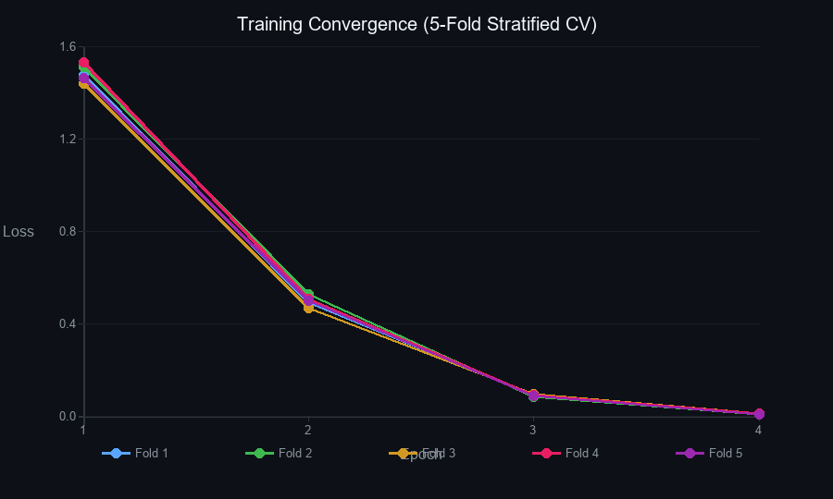
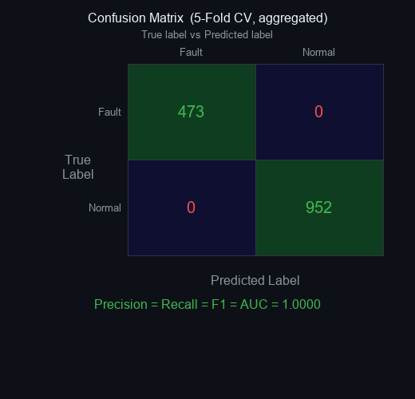
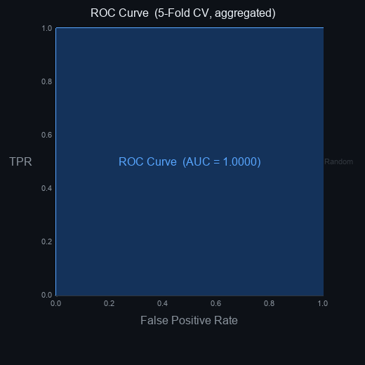
Machine Learning · SNN Predictive Maintenance
5-Fold Cross-Validation Results
Summary (mean ± std across 5 folds)
Accuracy
1.0000 ± 0.0000
Precision
1.0000 ± 0.0000
Recall
1.0000 ± 0.0000
F1 Score
1.0000 ± 0.0000
ROC-AUC
1.0000 ± 0.0000
All 1425 chunks · 473 fault · 952 normal
Training Convergence
fault P=1.00 R=1.00 F1=1.00 (473 chunks)
normal P=1.00 R=1.00 F1=1.00 (952 chunks)

