Slide 1


Near Field Scanner: measurement optimization & room correction
Presented by Chloé Corno
IMDEA 2nd year internship defence at Klippel GmbH

Slide 2
Contents
Introduction
Baffle measurements
Measurement time optimization
Room compensation
Conclusion

Slide 3
Introduction

Slide 4
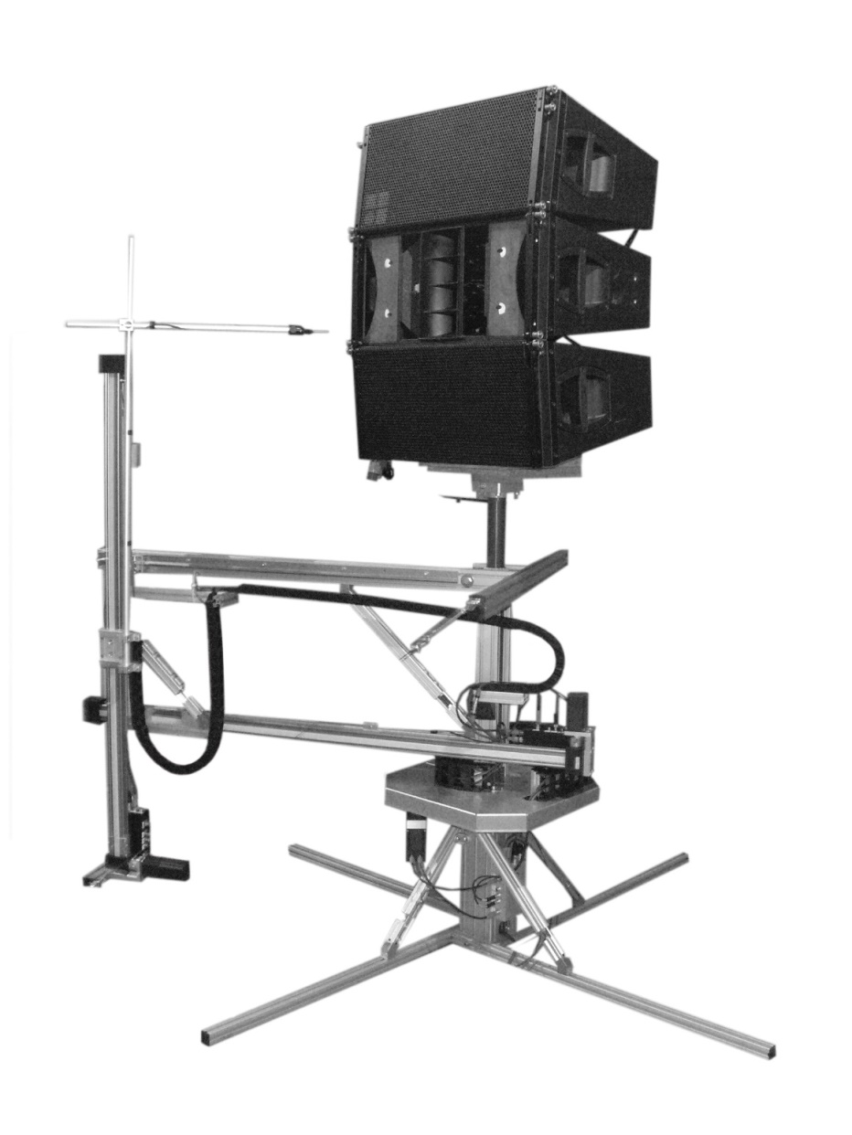
Near Field Scanner
Measurements in the Near Field of devices.
Uses Field Separation to remove the boundaries effects on the measurement.
Visualization of results at any point on the 3D space in the Far Field of the device.
Microphone moves thanks to a robotic arm.
Constant interaction between the acoustic boundaries and the system.
Klippel Near Field Scanner

Slide 5
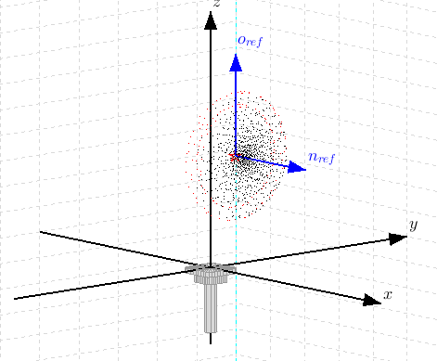
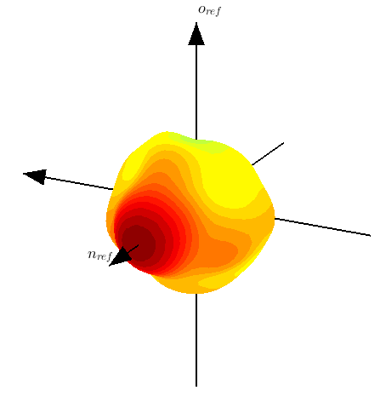
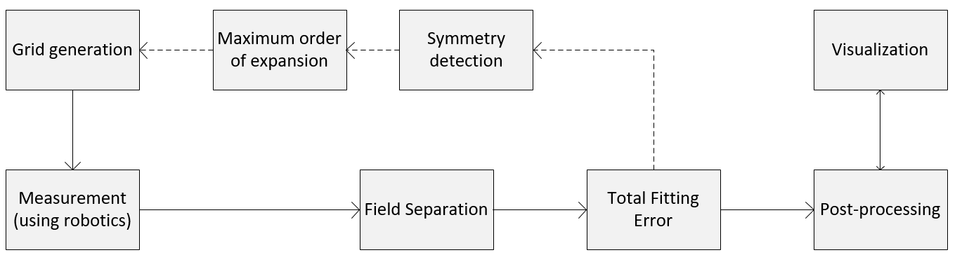
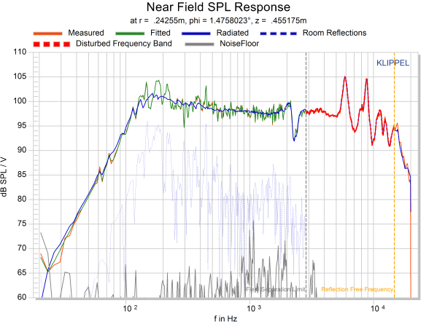
Near Field Scanner – Measurement flowchart

Slide 6
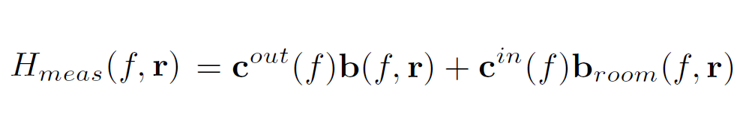
Field Separation - Principle
General expression of sound field in spherical coordinates (wave expansion):
Outgoing sound field
(DUT contribution)
Incoming sound field
(boundaries contribution)
Simplified form:
How to separate the outgoing and incoming contributions?

Slide 7
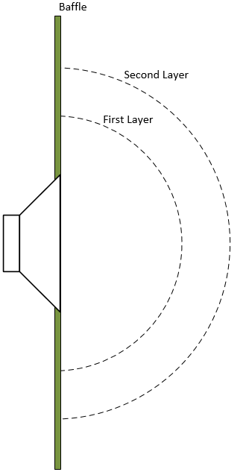
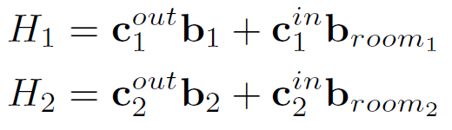
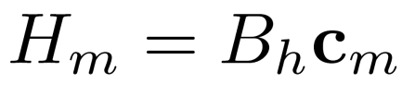
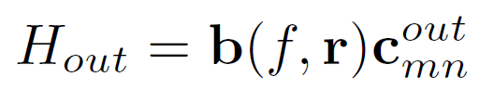
Field Separation - Principle
Scanning on 2 layers yields
In matrix form:
Results vector
Base functions
Coefficient matrix (out and in)
Performing the inversion leads to the
outgoing sound field:
Field Separation principle

Slide 8
Baffle measurements

Slide 9
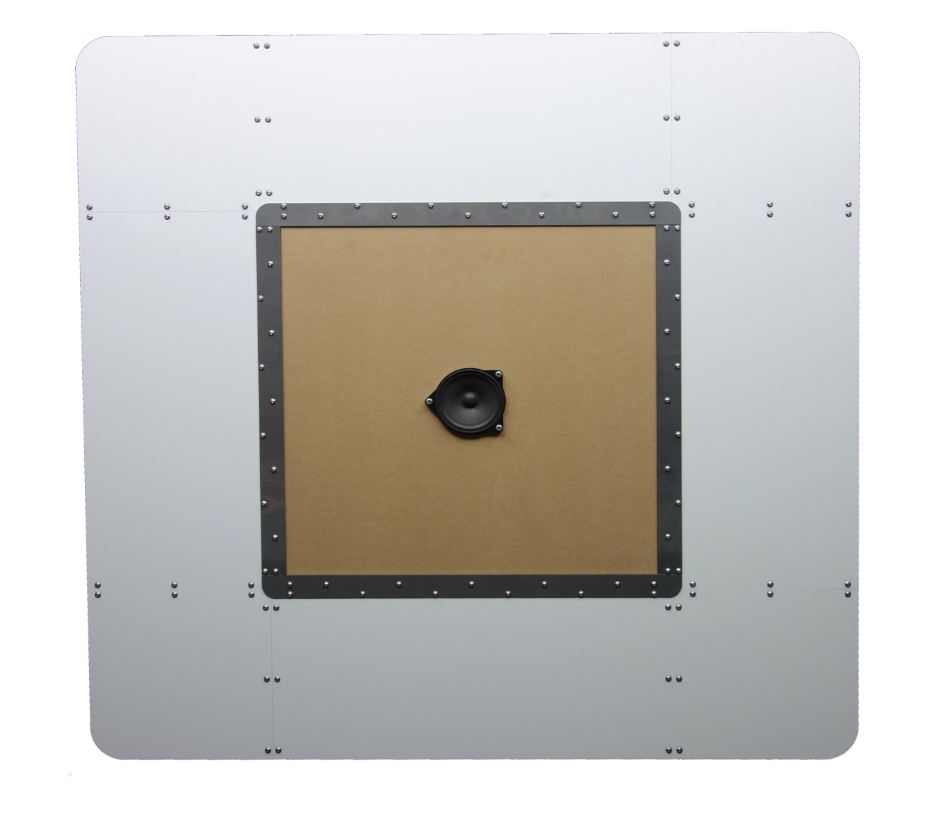
Baffle prototype
Aim: critical evaluation of the prototype.
Influence of the baffle isn’t important, since it will be removed by field separation.
Does the wooden plate have an impact on the measurement?
Baffle
Wooden plate
Speaker
Baffle prototype

Slide 10
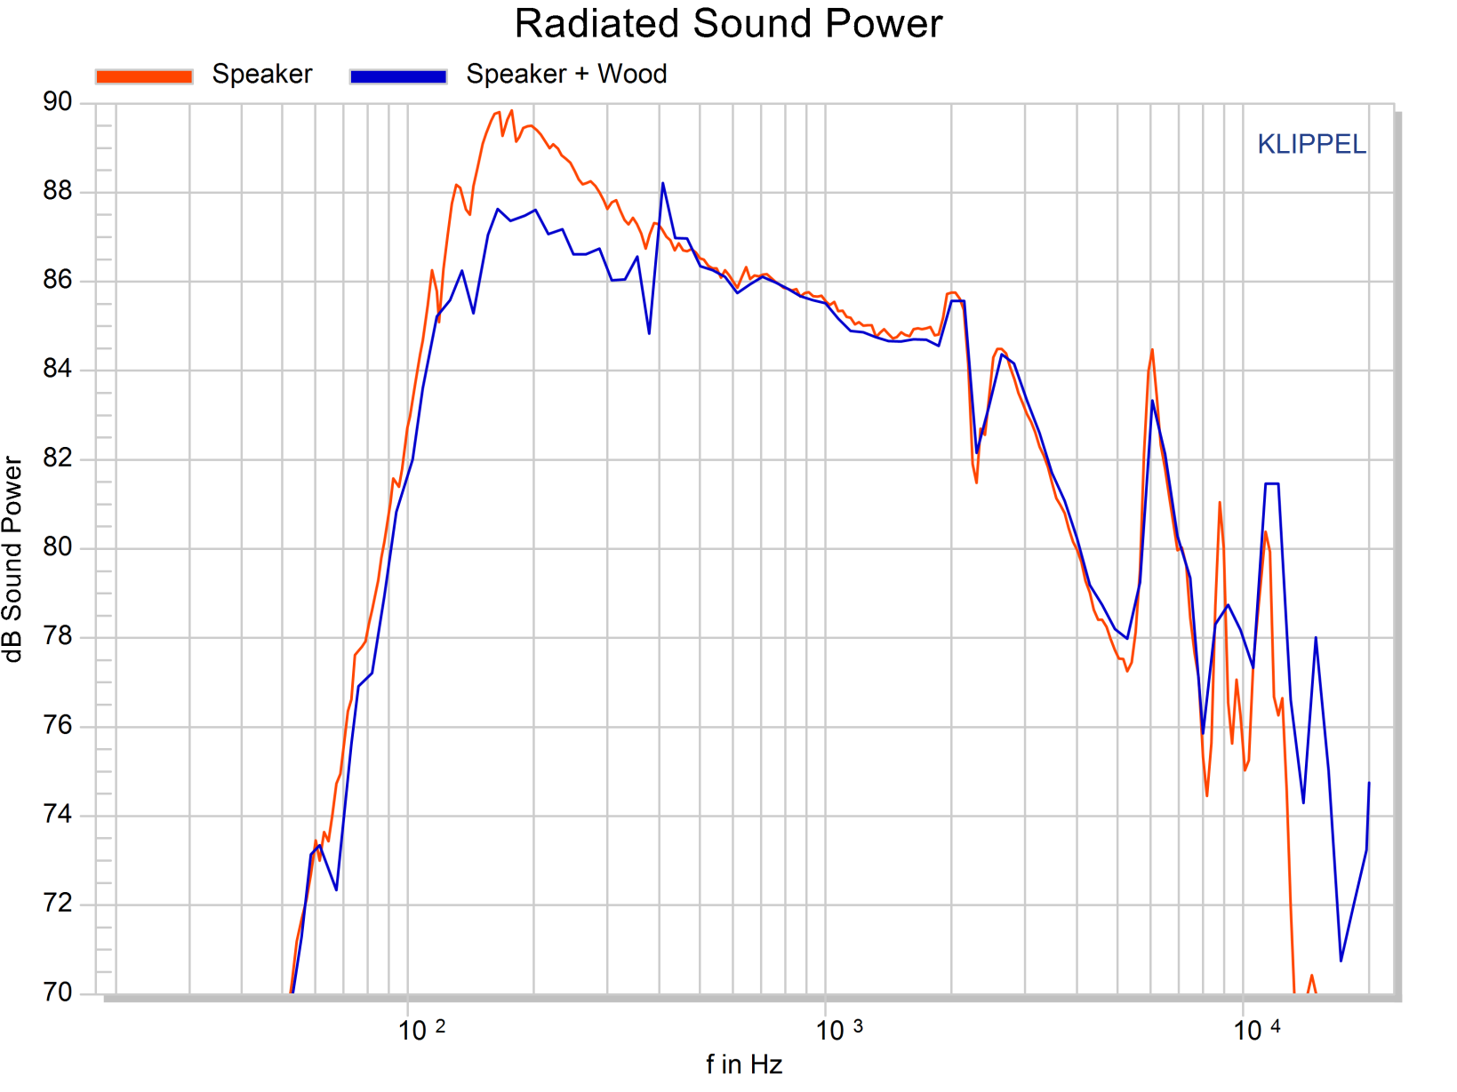
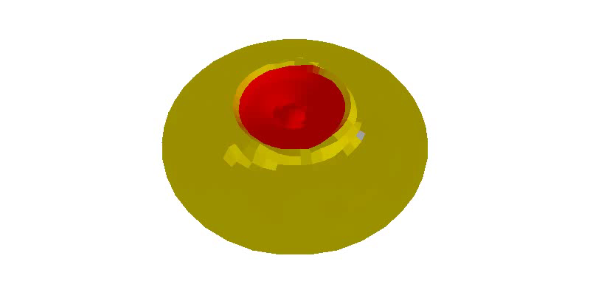
Influence of the baffle
The baffle vibration’s create cancellation effects.
At the first resonance, there is 3 dB difference between the measurements.
3 dB difference
Scan evidences how the plate vibrates in anti-phase with the speaker.
Comparison of radiated sound power for different measurement conditions

Slide 11
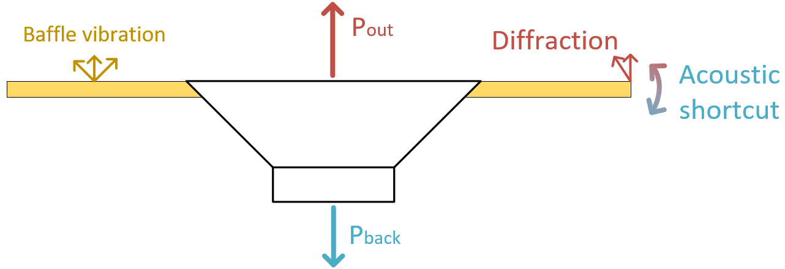
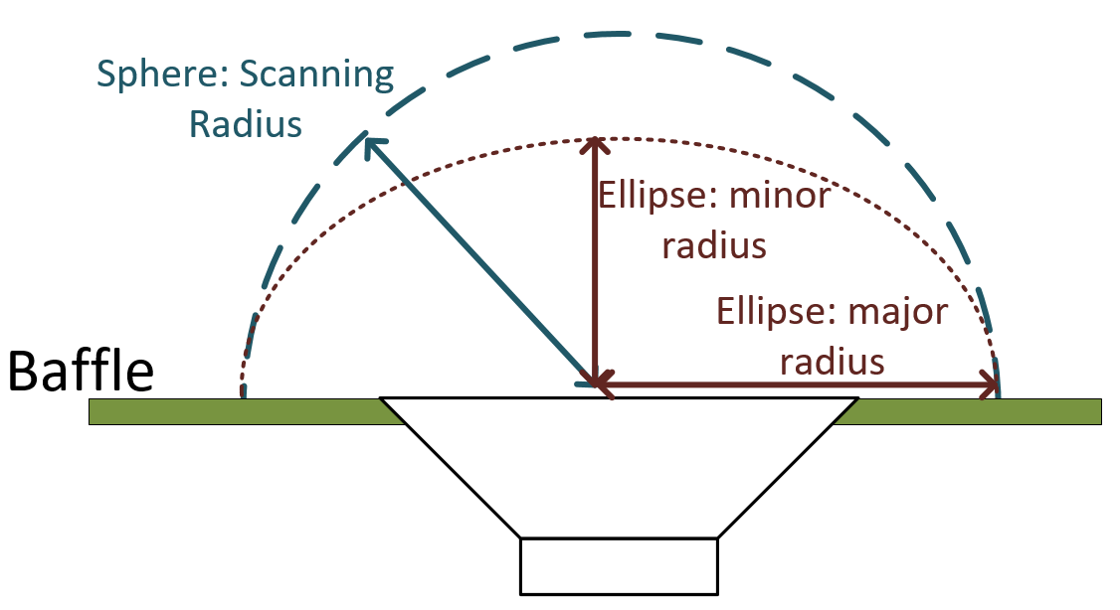
Grid optimization
Problems with baffle:
Vibration
Acoustic shortcut
Diffraction at edges
If the field separation cannot be applied, using an elliptical measurement grid allows to ease off the baffle effect.

Slide 12
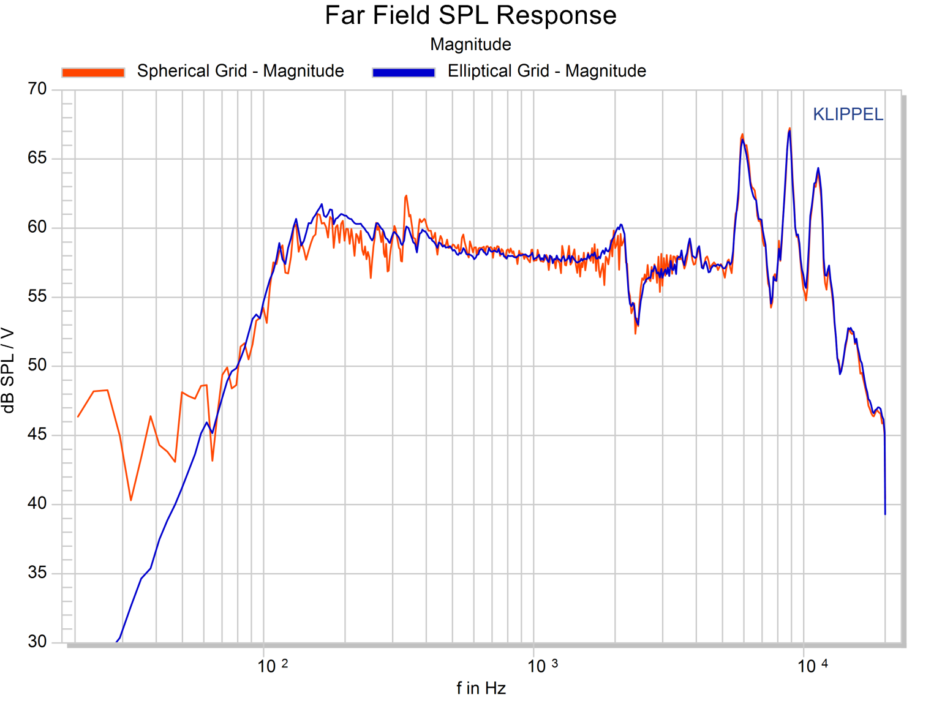
Grid optimization
Elliptical grid leads to smoother results in low frequency.
After the first cone breakup, the spherical & elliptical grids give the same results.
Measuring closer to the driver allows to avoid most boundaries effect.
Comparison of spherical and elliptical grids

Slide 13
Measurement time optimization

Slide 14
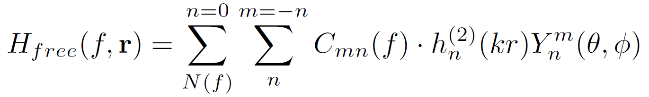
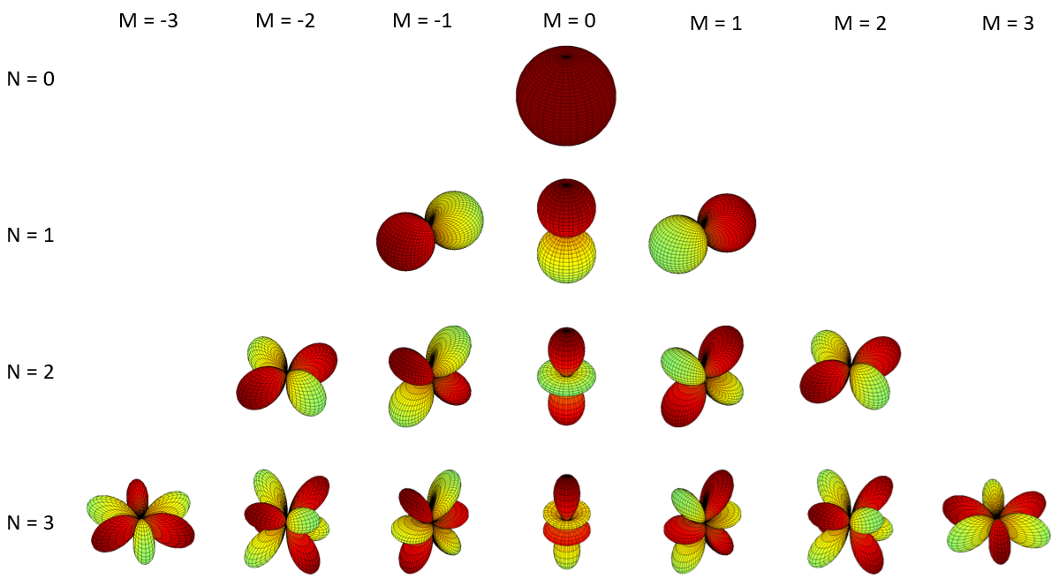
Principle
Symmetries on the Device Under Test geometry yield symmetries on its emitted sound field, thus on the coefficients weighting the spherical harmonics in the spherical wave expansion.
Representation of the first spherical harmonics

Slide 15
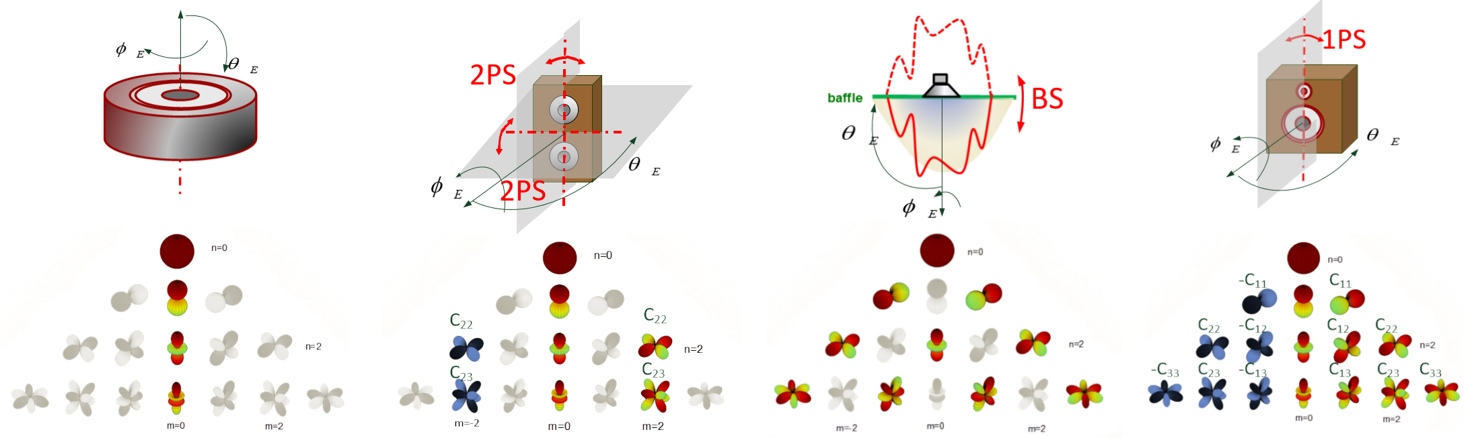
Principle
Symmetries under study

Slide 16
Principle

Slide 17
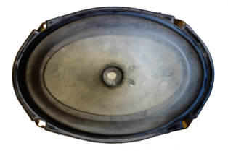
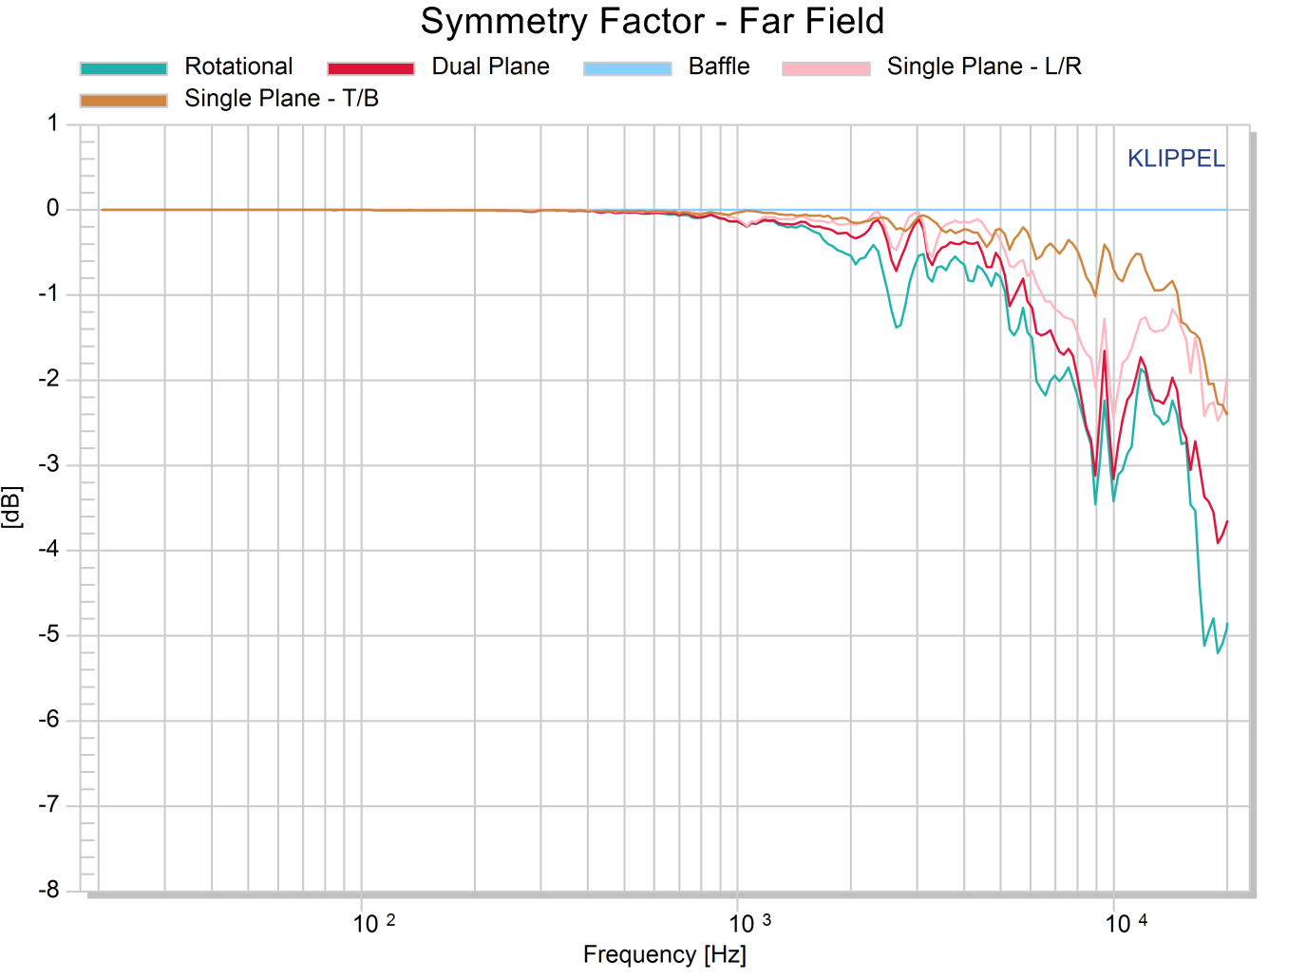
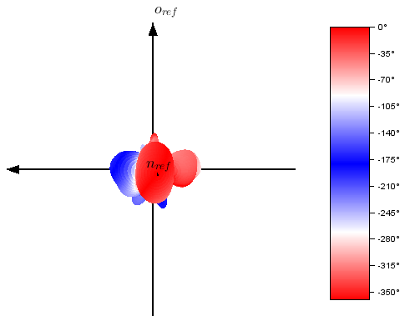
Measurements – oval speaker
Top/Bottom symmetry dominant
Left/Right single plane symmetry is spoiled by the rocking modes
f = 950 Hz
- +

Slide 18
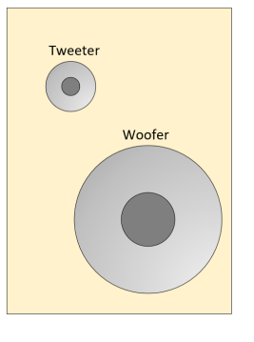
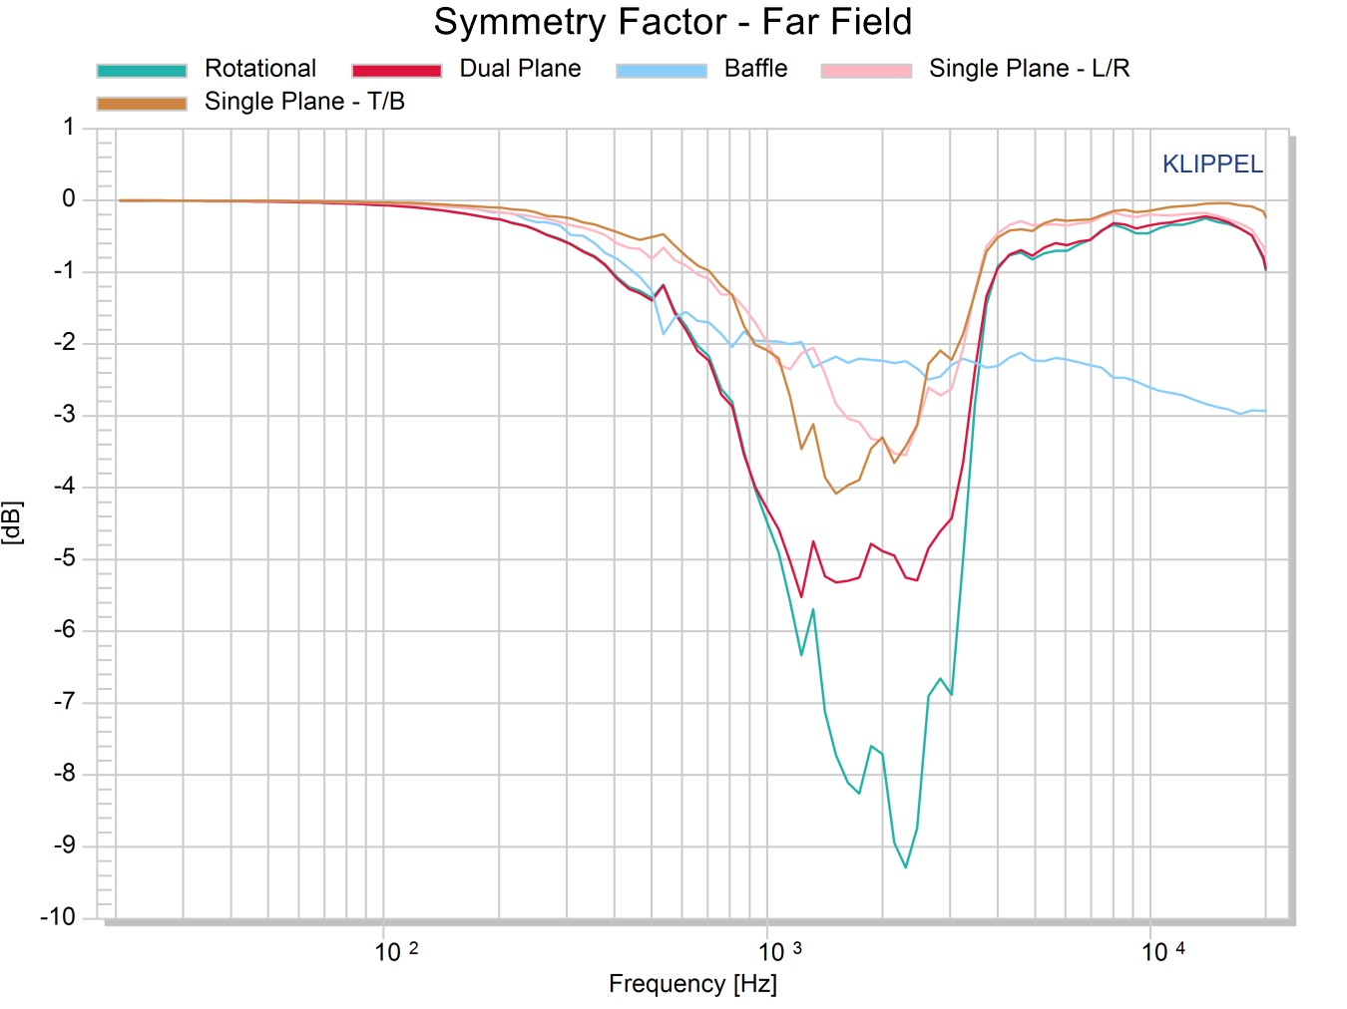
Measurements – diagonal speaker
Dip in symmetry factors at the crossover range.
Single plane symmetries are dominant.

Slide 19
Room compensation

Slide 20
Principle

Slide 21
Compensation by a Near Field measurement

Slide 22
Compensation by a NFS scan

Slide 23
Tetrahedral box

Slide 24
Tetrahedral box

Slide 25
Tetrahedral box

Slide 26
Tetrahedral box

Slide 27
Conclusion

Slide 28
Conclusion

