Slide 1
轻量游戏服务器框架

Slide 2
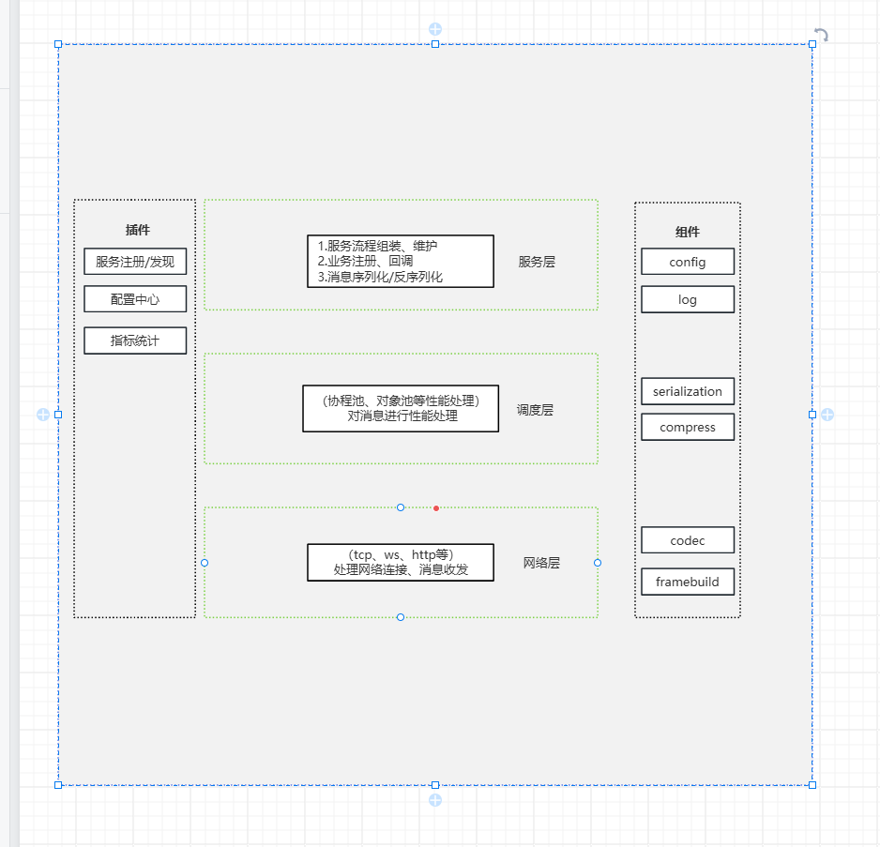
框架图
https://www.processon.com/diagraming/6824824e903228249e9ca48c

