Slide 1

ACR-QA
Automated Code Review & Quality Assurance
The trust layer for AI-written code — exploit-verified, cryptographically attested
Ahmed Mahmoud Abbas
Supervisor: Dr. Samy AbdelNabi
Faculty of Computer Science & Engineering · CSE494 Graduation Project 2 · 2026

Slide 2
AI now writes a third of new code.
And 45% of AI-written code ships a known flaw (Veracode '25) —
while vulnerabilities per codebase jumped +107% in a year (Black Duck OSSRA '26).
Your scanner flags 1,900 issues. Which one breaches you?
Nobody can review that. So teams ship blind — or pay $50k/year and still don't trust the output.

Slide 3
The Problem
Three reasons teams can't trust automated code review today
Quality variance
Manual review is inconsistent — expertise and attention vary. The SQL injection on line 47 slips through on the 50th PR of the day.
Cost barrier
Enterprise tools cost $10k–50k/year. Unaffordable for universities and startups — so they run a basic linter, or nothing.
Hallucination
AI explainers invent plausible-but-wrong guidance. A developer gets burned once and never trusts the tool again.

Slide 4
The Solution: ACR-QA
● A trust layer on top of your scanners — answers one question at merge time:
– "Is this finding real enough to block automatically?"
● Two modes, one scan: Confirmed Tier (96.4% precision, auto-block) vs Full Output (91% recall, triage)
● RAG-grounded AI — cites the rule, entropy filter rejects hallucinated explanations
● Exploit verification — fires a real payload in an isolated Docker sandbox
● ECDSA-P256 + post-quantum attestation — every scan signed, tamper-evident
● Self-hosted · zero recurring cost · full data privacy

Slide 5
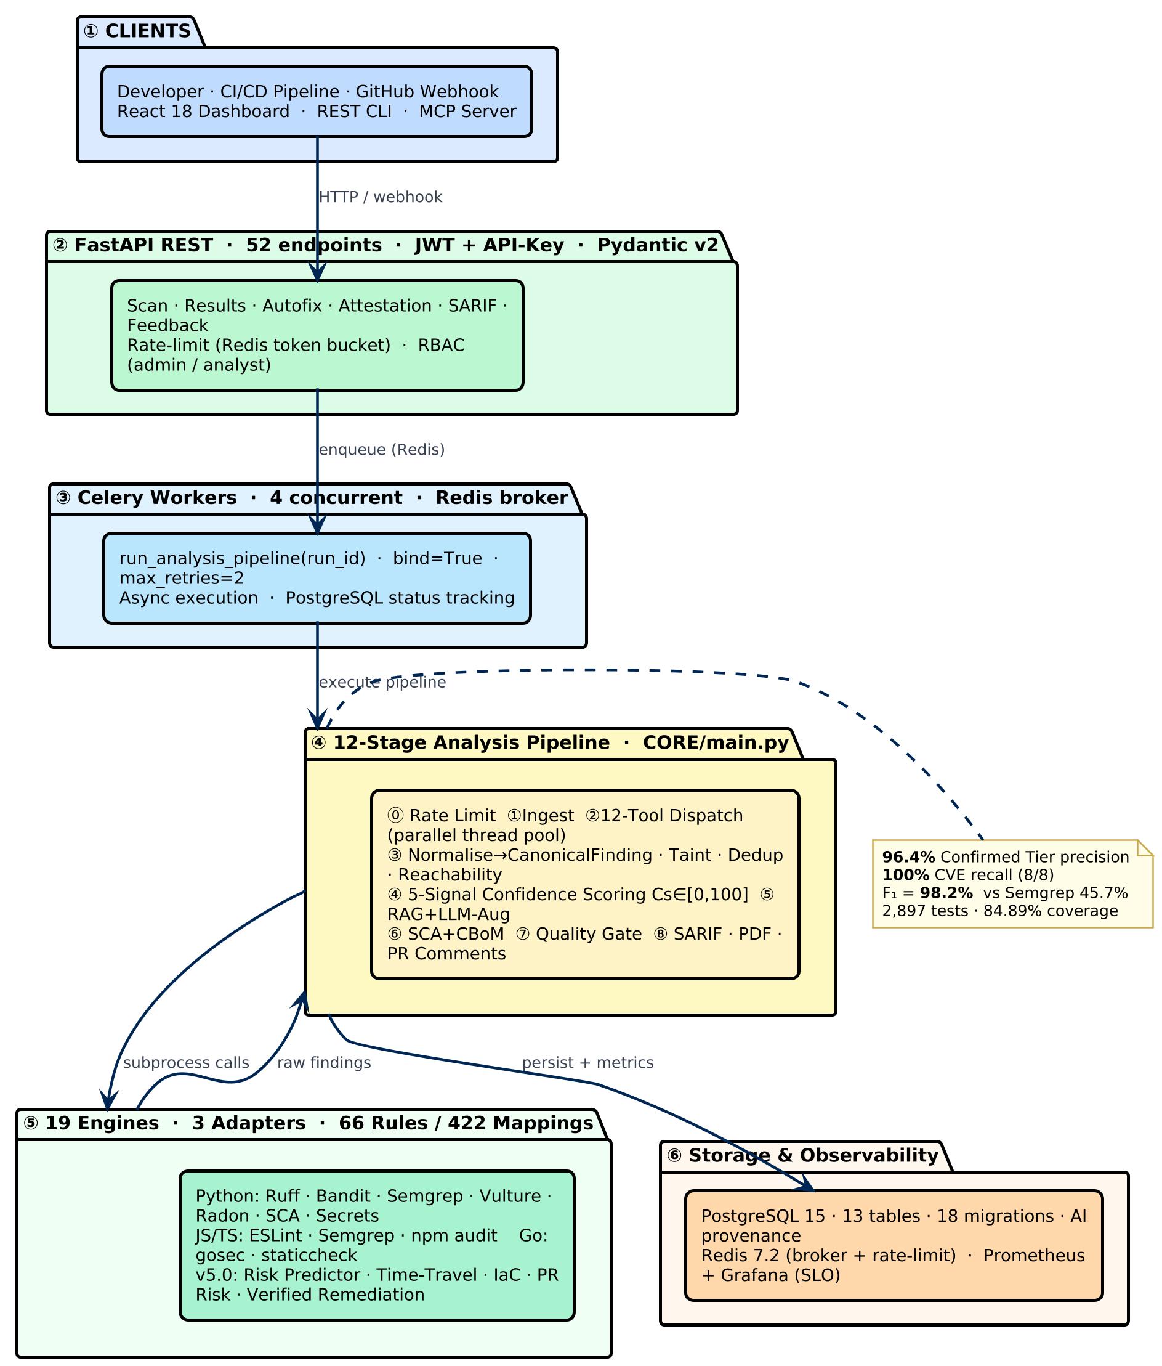
System Architecture
19 engines · 3 language adapters · 12-stage async pipeline · 52-endpoint FastAPI
Push triggers a Celery worker: 12 tools run in parallel, every output normalised to CanonicalFinding, trust gates applied, results signed and persisted. End-to-end: 14–90 s.

Slide 6
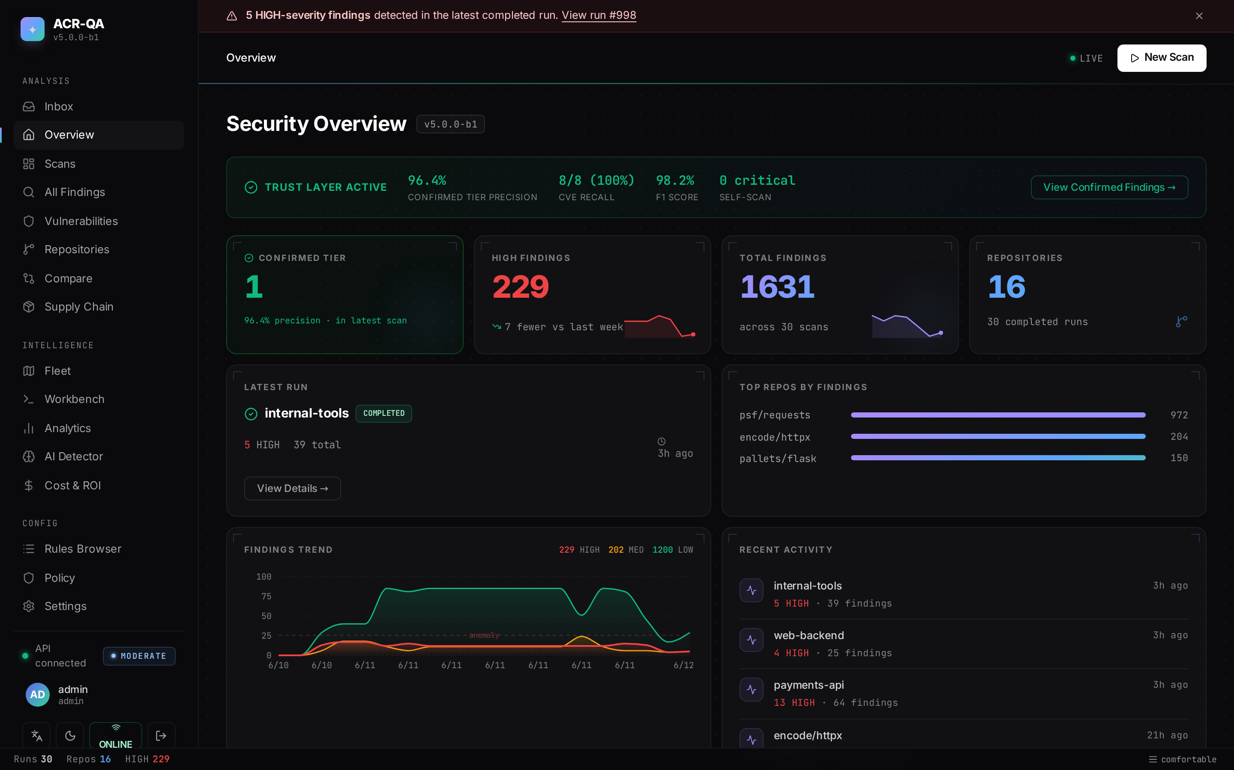
Live Dashboard — Fleet Overview
Real scans on real repos — psf/requests · encode/httpx · FastAPI · Flask
Confirmed Tier tile fetches live from the API — never estimated. Trust Layer banner shows precision, recall, F1, and self-scan result in real time.

Slide 7
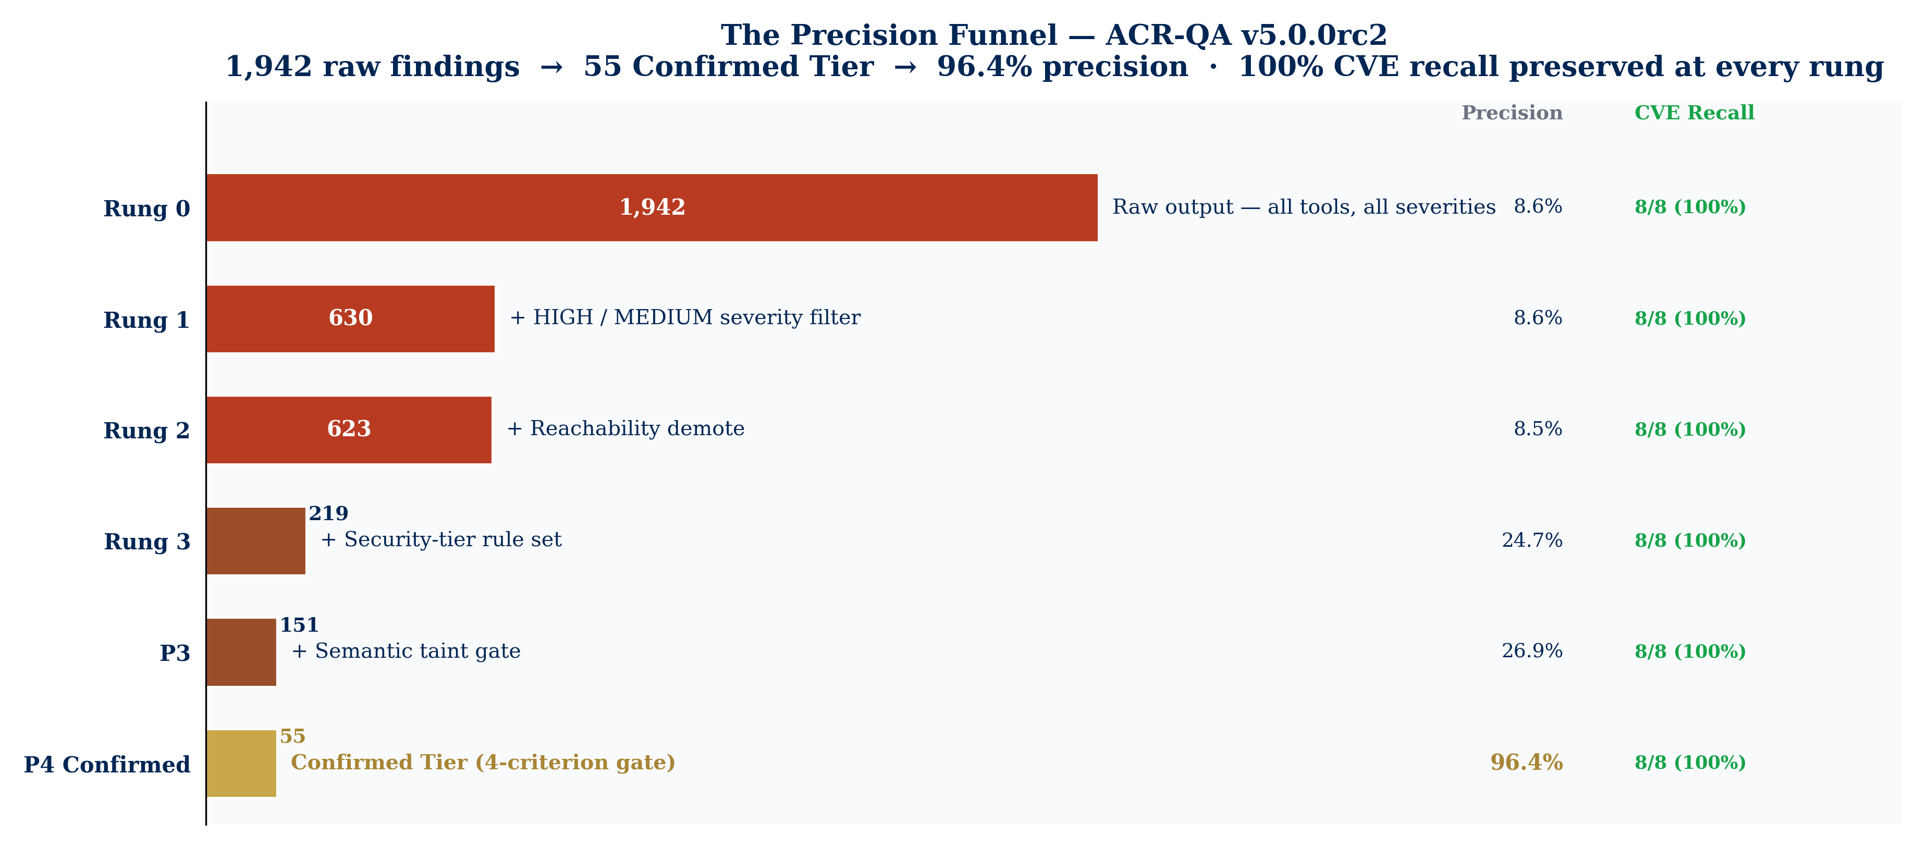
The Precision Funnel — From Noise to Trust
24-repo adversarial corpus · 1,942 raw findings → 55 Confirmed Tier · >52 pp precision over Semgrep CE
Note: these numbers are the full evaluation corpus (24 repos). The live demo scans one app and produces proportionally fewer confirmed findings. Same filter — smaller input.

Slide 8
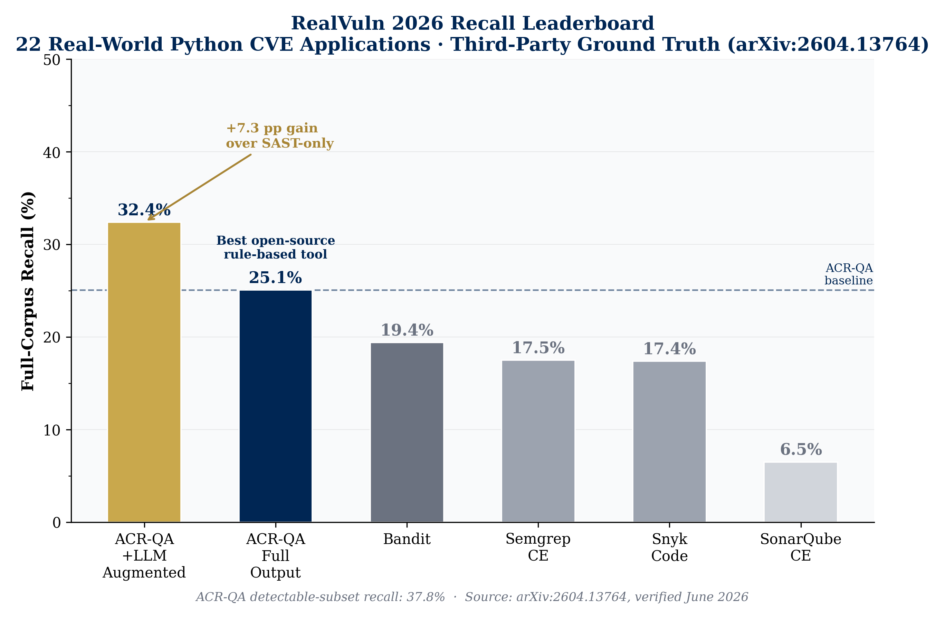
RealVuln 2026 — Real-World Recall Leaderboard
22 real-world Python CVE apps · third-party ground truth (arXiv:2604.13764) · strict CWE+file+line±10 matching
ACR-QA Full Output: 25.1% beats Bandit (19.4%), Semgrep CE (17.5%), Snyk (17.4%), SonarQube (6.5%). +LLM augmented: 32.4%. ACR-QA detectable-subset recall: 37.8%.

Slide 9
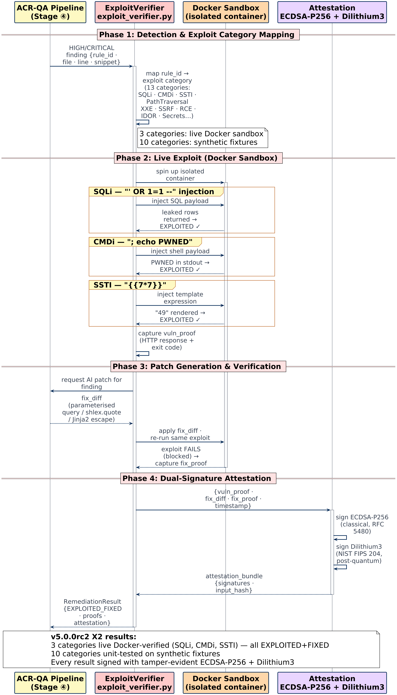
Exploit Verification — Proven, Not Claimed
4-phase chain: detect → detonate → patch → re-detonate · ECDSA-signed bundle at every stage
Phase 1: rule→exploit category mapping (13 categories). Phase 2: Docker sandbox fires real payload (SQLi ' OR 1=1, CMDi ; echo PWNED, SSTI {{7*7}}). Phase 3: AI patch applied, exploit re-fired → must fail. Phase 4: (vuln_proof, fix_diff, fix_proof) signed as one attestation bundle.

Slide 10
Live Demo
Real repo · real finding · real exploit · signed receipt

Slide 11
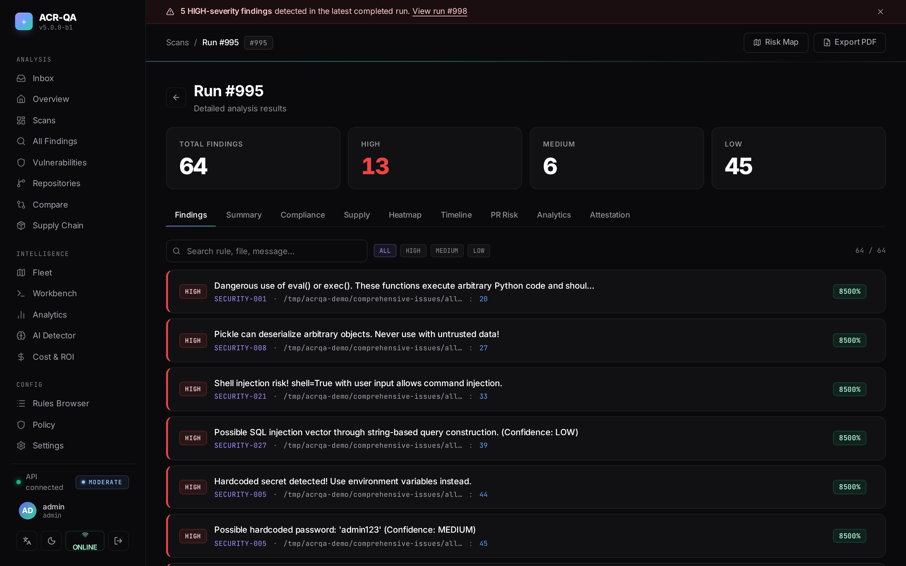
Run Detail — payments-api
64 findings · 13 HIGH · 4 Confirmed Tier — SQL injection, eval, hardcoded secrets
Each finding: canonical rule ID, severity, confidence score, taint-confirmed flag. Tabs: compliance mapping, attestation, PR risk score.

Slide 12
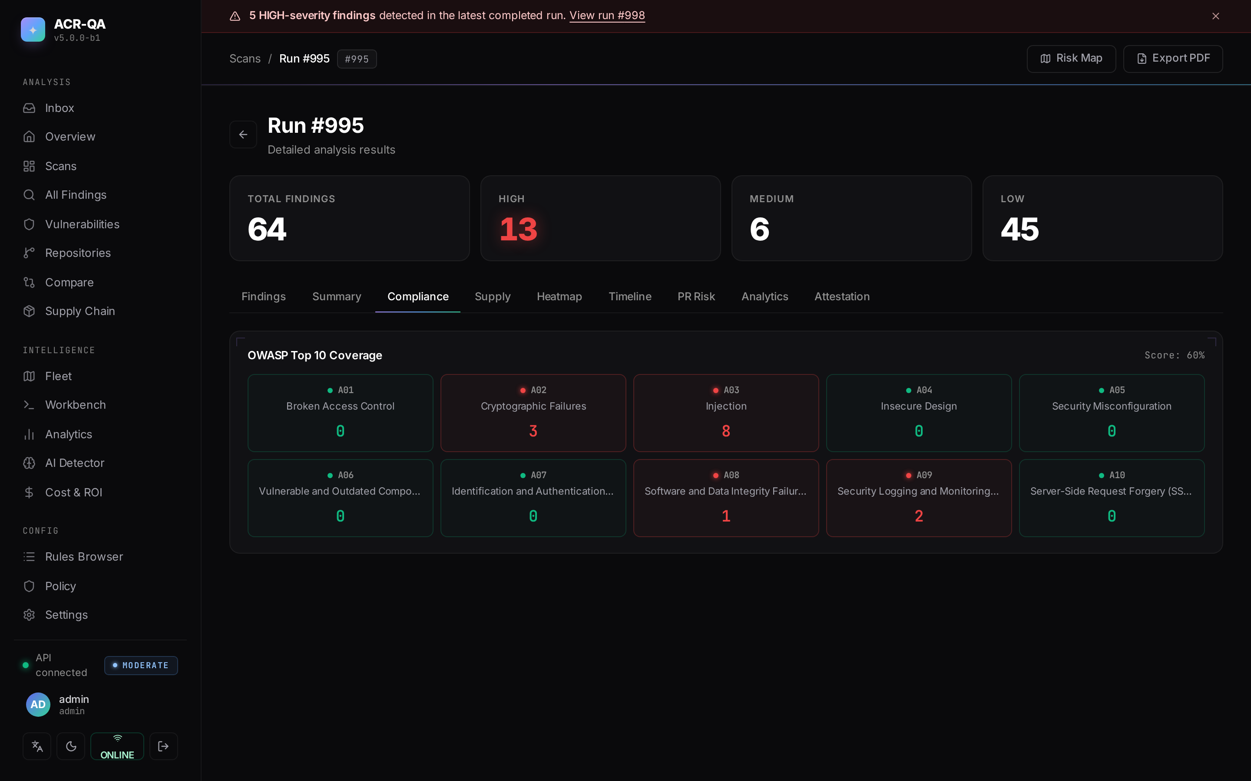
OWASP Top 10 — Compliance View
A03 Injection: 8 findings · A02 Crypto: 3 · 9/10 categories covered
Score calculated from passed categories. On numpy, pandas, pydantic, requests — 0 HIGH findings reported (0.0% false-positive rate on clean, mature code).

Slide 13
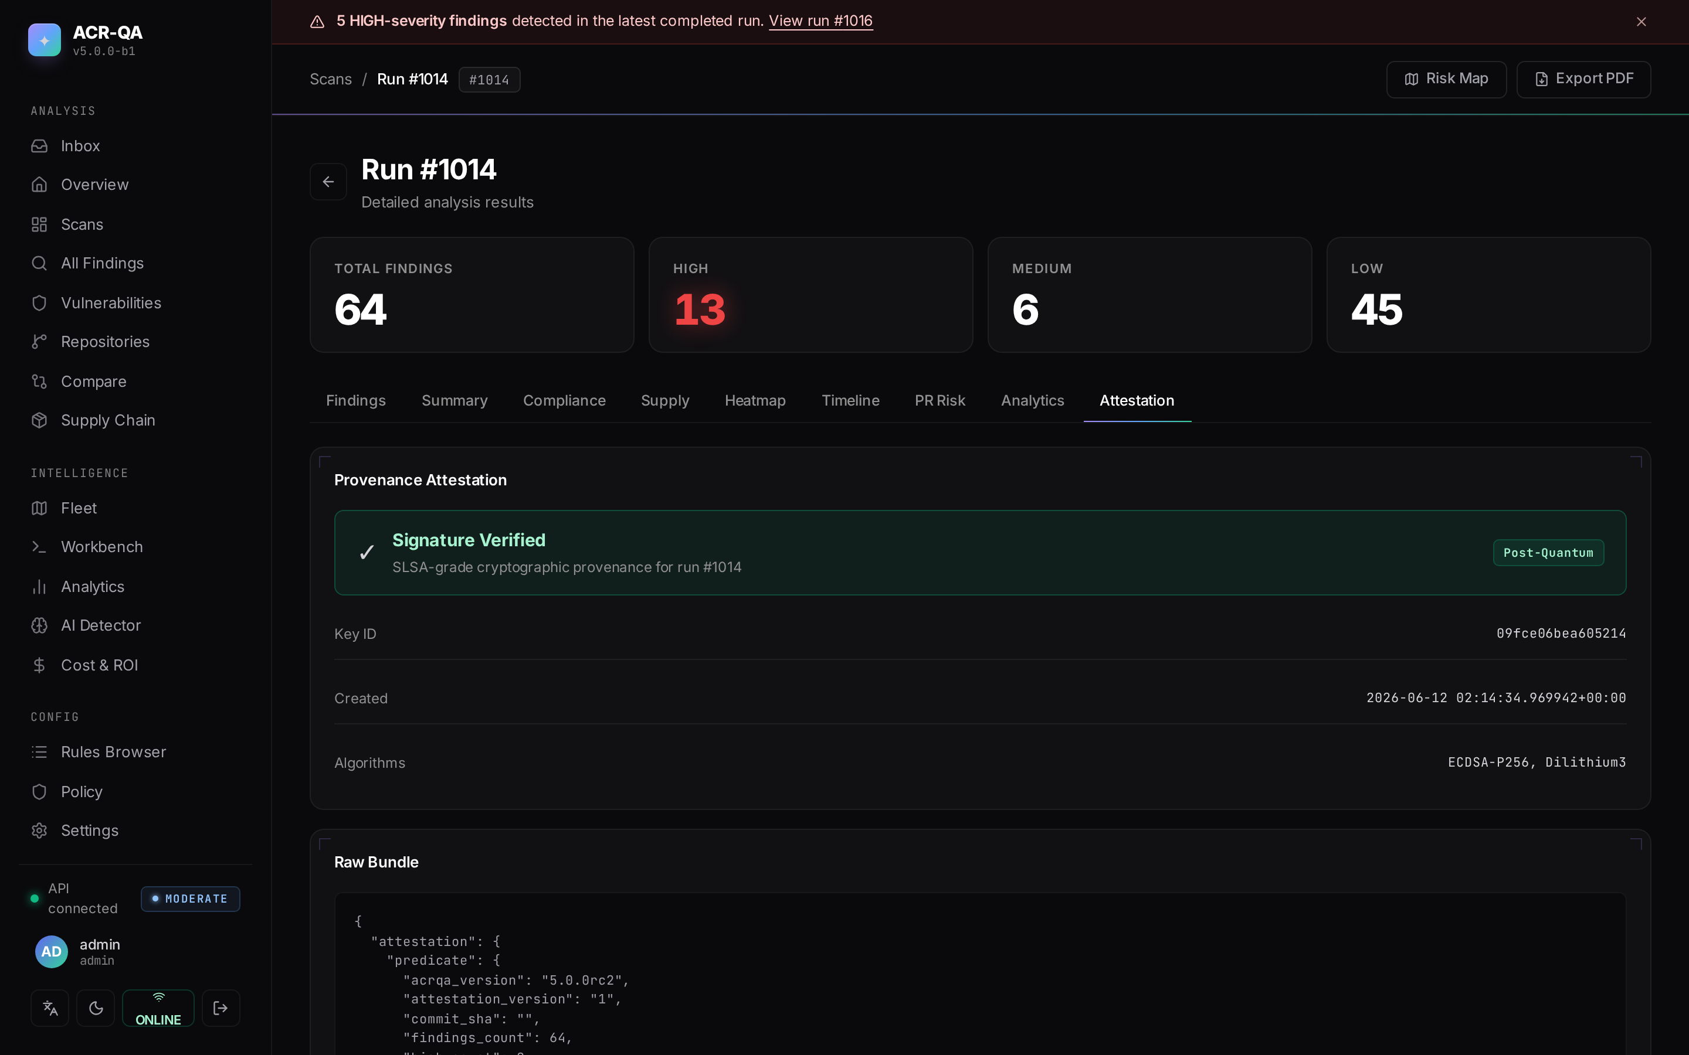
Cryptographic Attestation — Signature Verified
ECDSA-P256 primary · Dilithium3 post-quantum · public key embedded in bundle
Tamper-evident: alter any finding and verification fails instantly. Verify in one command: python scripts/verify_attestation.py <bundle.json>. EU CRA Sept 2026 requires this class of provenance.

Slide 14
Competitive Position
The one quadrant the market leaves open: open-source, first-party, in-CI, attested, at $0
Capability | Snyk | Semgrep | GHAS | ACR-QA
Exploit verification (Docker) | ✗ | ✗ | ✗ | ✓
Re-exploit to verify the fix | ✗ | ✗ | ✗ | ✓
Cryptographic attestation | ✗ | ✗ | ✗ | ✓
Confirmed Tier (auto-block) | ✗ | ✗ | ✗ | ✓ 96.4%
Self-hosted / $0 recurring | ✗ | ✗ | ✗ | ✓

Slide 15
What ACR-QA Delivers
Trust
96.4% Confirmed-Tier precision — high enough to auto-block a merge
Proof
Exploit-verified in a sandbox + cryptographically signed — not guesses
Reach
19 engines · Python / JS / Go · 9/10 OWASP · 100% CVE recall
Price
Self-hosted, your data never leaves, $0 recurring — vs $10–50k/year
Detection you can trust, exploit-proof you can verify, a signed record of all of it — on any machine, at zero cost.

