Slide 1

Prepping for the Zero Day Attack
Prepping for the Zombie Apocalypse

Slide 2

Eric Starr
DevOps Transformation Enterprise Architect / DevOps Evangelist
Senior Principal Engineer (TLCP)
Primary Focus:
  To describe the “North Star” of DevOps maturity and help guide both technical and non-technical professionals across UHG to understand the DevOps goals and the principals and practices required to achieve those goals.

Slide 3
What is a Zero Day Attack
A zero-day vulnerability, at its core, is a flaw. It is an unknown exploit in the wild that exposes a vulnerability in software or hardware and can create complicated problems well before anyone realizes something is wrong. In fact, a zero-day exploit leaves NO opportunity for detection.
Quote from FireEye: https://www.fireeye.com/current-threats/what-is-a-zero-day-exploit.html#dismiss-lightbox

Slide 4
Steps Necessary to be Attacked
Developers unknowingly create software that contains a vulnerability
Hackers discover the vulnerability
Hacker Sells Vulnerability Information To a Broker
Broker Sells Exploits to Attackers
Attackers use Exploits to Customize an Attack
Attack is launched.
Which of these 6 steps do you have any control over?
Notes:
These vulnerabilities in software could be in 3rd party or open source dependencies.

Slide 5
Healthcare.gov
  Initial Launch Date: October 01, 2013
Notes:
QSSI - https://www.washingtonpost.com/national/health-science/healthcaregov-fixes-wont-be-done-until-end-of-november/2013/10/25/22df29ba-3d93-11e3-b7ba-503fb5822c3e_story.html
New Delivery Date: November 30, 2013

Slide 6
HealthCare.gov
Launched: October 1st of 2013
Delivered: on-time, with all functionality

Slide 7

HealthCare.gov – Initial Launch
Embarrassment
Humiliation
Exhaustion
Blame
Fear
0.38% Success Rate
Website Was Frequently Down
Customers Could Not Register
Users Could Not Login
Users Could not Enroll
Notes:
QSSI - https://www.washingtonpost.com/national/health-science/healthcaregov-fixes-wont-be-done-until-end-of-november/2013/10/25/22df29ba-3d93-11e3-b7ba-503fb5822c3e_story.html
New Delivery Date: November 30, 2013

Slide 8

Optum was asked to
help with the Massive Rescue Effort!
  New Launch Date: Nov 30, 2013
Notes:
QSSI - https://www.washingtonpost.com/national/health-science/healthcaregov-fixes-wont-be-done-until-end-of-november/2013/10/25/22df29ba-3d93-11e3-b7ba-503fb5822c3e_story.html
New Delivery Date: November 30, 2013

Slide 9
HealthCare.gov
Poor Engineering Practices
Unit Tests were disabled
No Automated Functional Tests
Security Scan results ignored
Production Servers manually monitored
….to increase speed of delivery and complete all the functionality
Notes:
0.3% Success Rate
Operations had no idea when servers were down.
All Hands on Deck WAR Rooms with Engineers logging into hundreds of servers and reading logfiles.

Slide 10
Spent Millions of dollars in a rescue effort, after production release, rather than spending a far less amount up front via Engineering Excellence

Slide 11
Software Delivery Priorities
Do you care more about delivering on time and with all of the functionality?
OR
Do you value more Quality, Security, Reliability, Cost, and your Customer’s Experience?
Notes:
Imagine if you were in charge and you could begin developing this entire application again from the beginning?

Slide 12
People, Process, Technology
They will not have the Skills, Culture, or Tools to achieve Engineering Excellence and DevOps maturity.
If your People ignore good Processes and Technologies…
People
Skills
Culture
DevOps
Technology
Process
Tools
Notes:
Its all about the people or better said, It’s all about having the right leadership to create the right environment where the people, processes and technology can flourish.

Slide 13
Security at Healthcare.gov
  2013-2018
Notes:
QSSI - https://www.washingtonpost.com/national/health-science/healthcaregov-fixes-wont-be-done-until-end-of-november/2013/10/25/22df29ba-3d93-11e3-b7ba-503fb5822c3e_story.html
New Delivery Date: November 30, 2013

Slide 14
Security Timeline for Healthcare.gov
Nov 2013
Static Code Analysis Security Scan
results were getting ignored

Slide 15
Security Timeline for Healthcare.gov
Nov 2013
Static Code Analysis Security Scan
results were getting ignored
The Obama administration said a breach had occurred but that no personal consumer information was stolen.
2014

Slide 16
Security Timeline for Healthcare.gov
Nov 2013
Static Code Analysis Security Scan
results were getting ignored
The Obama administration said a breach had occurred but that no personal consumer information was stolen.
2014
A report by the Heath and Human Services inspector general said that sensitive data on millions of consumers was being stored in a system with fundamental security risks.
2015

Slide 17
Security Timeline for Healthcare.gov
Nov 2013
Static Code Analysis Security Scan
results were getting ignored
The Obama administration said a breach had occurred but that no personal consumer information was stolen.
2014
A report by the Heath and Human Services inspector general said that sensitive data on millions of consumers was being stored in a system with fundamental security risks.
2015
Oct 2018
An estimated 75,000 files compromised; officials say open enrollment starting Nov. 1 will not be impacted

Slide 18
People
  Shared Vision: Technology and Business with a Shared Vision of what is acceptable and what is not.
  Continuous Learning for everyone (Business, Executives, Developers, Agile Coaches, etc…)
  Developers: Deep Technical Training on Source Code Security Vulnerabilities (OWASP TOP 10) and the X as Code (e.g. Building Secure Docker containers, Networking, etc…)
Processes
  Engineering Excellence: DevOps, Agile, etc…
  Automate everything
Tools
  What Tools are within the strategic long term direction of the company and which are required today.
  Everything as Code

Slide 19
Developers – The First Line of Defense
With the “everything as code” movement Developers become more responsible for protecting against vulnerabilities than ever before. They become the 1st line of defense.
Application Code
Infrastructure as Code/Configuration/Networking
Pipeline as Code

Slide 20
Security in the Pipeline
Notes:
This is not the total solution. To properly address Security to avoid a Zero Day Attack would take a 3-4 week, 8 hour a day training that still probably wouldn’t be complete.
I confess, the title “Prepping for a Zero Day Attack” was a little but of “Click Bait”.
I do; however, have a solution for part of the problem that I see getting ignored all the time.
The security challenges are enormous
The knowledge necessary to prevent security breaches is vast and changing daily.
Automation, Tooling and a solid repeatable process are critical.

Slide 21
Automation with a Pipeline
(CICD)

Slide 22
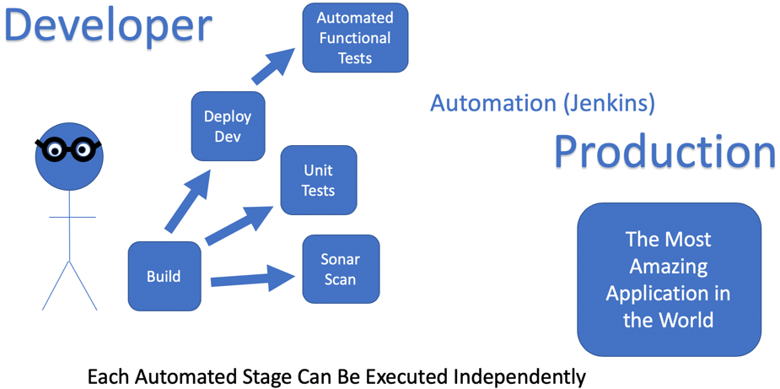
DevOps Beginners Discover the
Power of Automation

Slide 23
Automation without a Pipeline
Notes:
Have you ever been on a team that decided to delay their security scan or their security scan results until right before you deploy to Production?

Slide 24
Automation with a Pipeline
Notes:
Every Commit runs through the pipeline
Only commits to “master” deploy to production

Slide 25
What Security Scans are important in your CICD Pipeline?

Slide 26
Pipeline CICD Phases
Source Code Build
Container Build
Runtime
(deployments)
Non-Prod >Prod
Developer
Production
The Most Amazing Application in the World
Injecting security checks into the pipeline
code
container
runtime
Notes:
CI = Continuous Integration
CD = Continuous Delivery

Slide 27
Source Code Build
Developer
SAST
Production
The Most Amazing Application in the World
Injecting security checks into the pipeline
Unit Tests
Compile Code
Sonar Scan
Code Coverage
Fortify Scan
OWASP SAST Tools: https://www.owasp.org/index.php/Source_Code_Analysis_Tools

Slide 28
Docker Container Build
Developer
Production
The Most Amazing Application in the World
Injecting security checks into the pipeline
Container Build
Docker Scan
Upload to Repo
Docker Container Scanning Tools: https://sysdig.com/blog/20-docker-security-tools/

Slide 29
Runtime – Pre-Prod
Developer
IAST or DAST
Production
The Most Amazing Application in the World
Injecting security checks into the pipeline
Automated Tests
Performance Tests
Deploy to Prod
Deploy to Non-Prod
Contrast Results are
generated and uploaded
  OWASP DAST Tools: https://www.owasp.org/index.php/Category:Vulnerability_Scanning_Tools

Slide 30
Skipping Security Steps to go Faster
Developer
Source Code Build
skip
skip
Build
Code
Unit Tests
Sonar
Fortify
Container Build
skip
Build Container
Scan Container
Upload to Repo
Production
Runtime
skip
The Most
Amazing
Embarrassing Application
in the World
Deploy to non-prod
Auto Tests
Performance Tests
Adding Speed to a Delivery with Poor Quality, Security or Reliability = Continuous Delivery Failure!
Notes:
Automating a Process with Poor CICD Security enables you to deliver Vulnerabilities very quickly
Every Commit runs through the pipeline
Only commits to “master” deploy to production

Slide 31
CICD with High Security
Developer
Source Code Build
Build
Code
Unit Tests
Sonar
Fortify
Container Build
Build Container
Scan Container
Upload to Repo
Production
Runtime
The Most
Amazing Application
in the World
Deploy to non-prod
Auto Tests
Performance Tests
Adding Speed to a Delivery with Quality, Security or Reliability = Continuous Delivery Success!
Notes:
Automating a Process with Poor CICD Security enables you to deliver Vulnerabilities very quickly
Every Commit runs through the pipeline
Only commits to “master” deploy to production

Slide 32
What About Container Security

Slide 33
Container Security
Eliminate All Potential Attack Vectors
  Small and light weight containers
    SSH
  Service Account can only do exactly what is required (no root)
Notes:
I am not covering this well enough.
1 – Security in the Pipeline is Step 1
2 – There are other areas that need to be addressed to have adequate security

Slide 34
What About Network Security

Slide 35
Network Security
Castle with Moat – Trust Everything Behind the Firewall
  No TLS/SSL/HTTPS (no encryption)
firewall
VS
App 1
App 2
Zero Trust – Assume the Attacker
has already breached the Network
  Everything Requires TLS/SSL/HTTPS (encryption)
App 3
Notes:
There is more work to do with Network Security
Ex – SonarQube with no SSL

Slide 36
What Else Can We Do?

Slide 37
Have I Left Anything Out?
Automate the Security Scan in your Pipeline.
  Guarantee that it is impossible to deploy to production without running through all security scan tools in your pipeline
Docker Container Security
Network Security
What Else Can We Do?
  Teach Developers OWASP Top Ten Security Vulnerabilities and How to Avoid Them
  Anything Else?

Slide 38
3 DevOps Principles

Slide 39
DevOps North Star
Speed
Cost
Security
Engineering Excellence
Reliability
Quality
Notes:
The description needs help – explain the “Why”
Speed – How to Delivering Application (code, infrastructure, database, etc..) changes quickly to customers

