Slide 1
Cloud at 30,000 ft

Slide 2
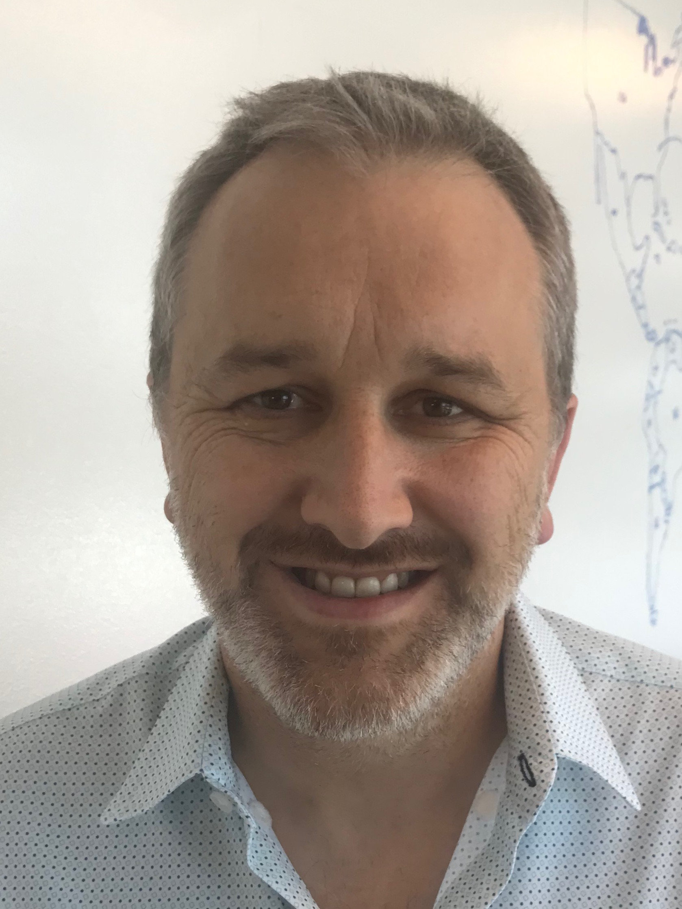
Eric Starr
DevOps Architect &
DevOps Evangelist
Senior Principal Engineer (TLCP)
Primary Focus:
  To help Agile Coaches learn DevOps
  Basics and how to help their
  Application teams achieve maturity
  in their CICD pipelines.

Slide 3
Cloud at 30k
Pre-Requisites
DevOpsAt50k.pptx
Other
  DevOps-SecurityAt30k.pptx

Slide 4
Do you Agree?
Premise #1:
Continuously Delivering Applications to servers that often crash should be avoided!

Slide 5
Do you Agree?
Premise #2:
Everything is Going to the Cloud!

Slide 6
Cloud at 30k – Agenda
Agenda
Reminder of a Pipeline
Infrastructure
Our Data Center or Theirs
Enterprise PADU
Azure Over AWS Over Google
What is Kubernetes
What is OpenShift
Kubernetes Over OpenShift

Slide 7
Building a Pipeline
“The Shortest Distance Between Any Two Points is a Straight Line”
Archimedes
Developer
Production
The Most Amazing Application in the World
delivering

Slide 8
Building a Pipeline
“The Shortest Distance Between Any Two Points is a Straight Line”
Archimedes
Developer
Production
The Most Amazing Application in the World
delivering application

Slide 9
Building a Pipeline
“The Shortest Distance Between Any Two Points is a Straight Line”
Archimedes
Developer
Production
The Most Amazing Application in the World
delivering application all the way

Slide 10
Building a Pipeline
“The Shortest Distance Between Any Two Points is a Straight Line”
Archimedes
Developer
Production
The Most Amazing Application in the World
delivering application all the way to production

Slide 11
Infrastructure - Environments
Build Env
Developer
DEV Env
QA Env
Developer Environment
Staging Env
Production Env
Env X

Slide 12
Infrastructure – Environments - Local
Developer
GitHub
Artifactory
VMs
Rally
Jenkins
OpenShift
Azure
FlowDock
Developer Laptop
Sonar
Kubernetes
AWS
HubConnect
Fortify
Contrast
Sauce Labs
WIKI
Many more
The Developer Must Connect with Numerous Servers/Services to Perform Their Work

Slide 13
Infrastructure – Environments – Build
Developer
Steps 5 –> Prod deploy
2
Jenkins Master
GitHub
Sonar
1
3
Developer Laptop
4
Fortify
Jenkins Build Slave/Agent
git push
- Jenkinsfile
- Dockerfile
- Optumfile.yml
- pom.xml
/src
Artifactory
Developer pushes changes to github
GitHub tells (triggers) Jenkins Master to kick off build
Jenkins Master sends build instructions to Jenkins Slave
Jenkins Slave pulls files from GitHub & runs instructions in Jenkinsfile
Steps 5 –> Prod deploy
Deployment Servers
Dev
QA
Stage
Prod

Slide 14
Infrastructure – Environments – Deployment
Developer
GitHub
Jenkins Build Slave/Agent
git push
deployment
Dev
Developer Laptop
QA
Stage
Prod
Developer pushes changes to github
Question: Are these Deployment Servers in our Data Center or Theirs?

Slide 15
Infrastructure – Environments – Deployment
Developer
GitHub
Jenkins Build Slave/Agent
git push
Dev
Developer Laptop
QA
Stage
Prod
Developer never deploys directly to any environment.
Question: Are there ever exceptions to this rule?

Slide 16
Data Center
Think of a Data Center as just a bunch of servers in a huge warehouse
Optum Data Centers
  ELK River, MN: VMs + Containers
  Chaska, MN: VMs + Containers
  Plymouth, MN: VMs + Containers
Optum M&A Data Centers: could be anywhere
Azure, AWS and Google Cloud
  Everywhere: VMs + Containers

Slide 17
Data Center – VMs versus Containers
VM: Virtual Machine
  heavier
  less flexible
  less secure
  more difficult to maintain
  more difficult to scale
Container (Docker + Kubernetes)
  lighter
  more flexible
  more secure
  easier to maintain
  easier to scale

Slide 18
Data Center – VM & Container Questions
How long would it take you to spin up a brand new Environment?
  If the answer is more than 15 minutes, you probably have some improvements that could be made
Is it possible to switch to a Docker Container?
What is the level of effort to switch?
What is OpenShift and what is Kubernetes?
I’m on OpenShift, Is that Good Enough?
  See next slide.

Slide 19
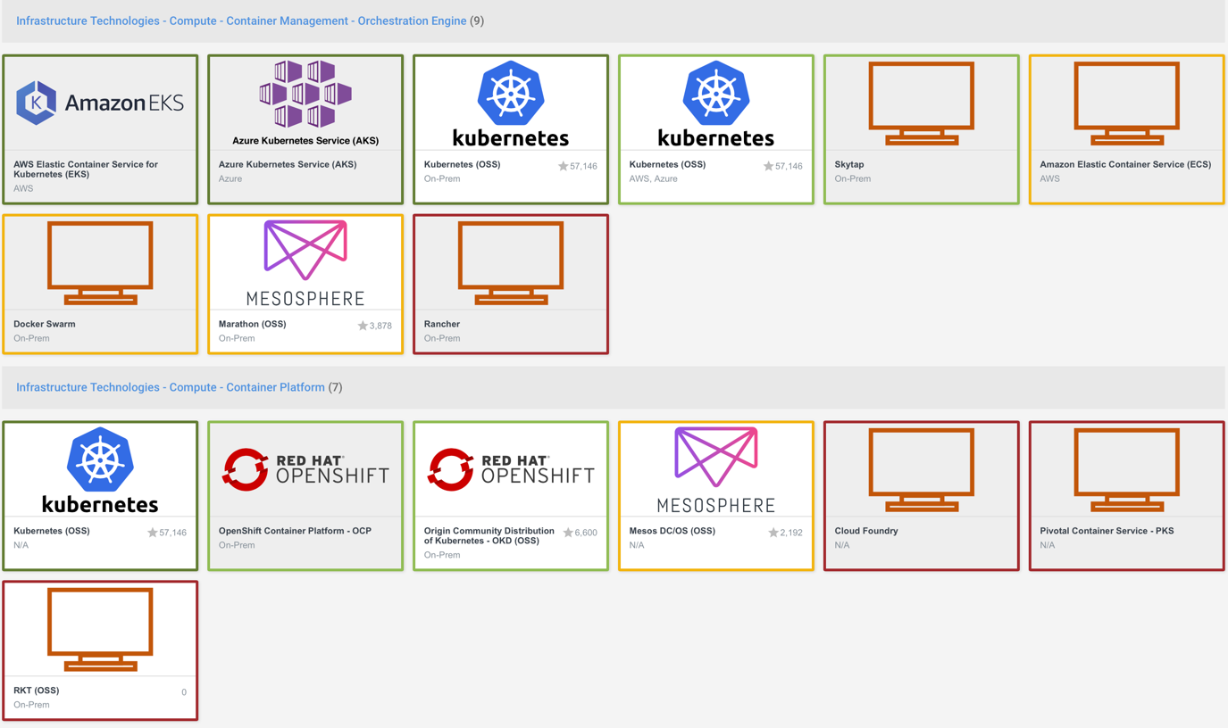
Enterprise PADU
http://technology.optum.com/landscape=container-management,orchestration-engine,container-platform,paa-s

Slide 20
Enterprise PADU
Public Cloud vs Private Cloud
  Azure
  AWS
  Google
Kubernetes vs OpenShift
  Kubernetes
  Openshift Origin
  OpenShift OCP
  http://technology.optum.com/landscape=container-management,orchestration-engine,container-platform,paa-s

Slide 21
Public Cloud
Azure over AWS over Google Cloud
Azure
  Containers over VMs
  Kubernetes
AWS
  Containers over VMs
  Kubernetes
Google Cloud
  Containers over VMs
  Kubernetes

Slide 23
Additional Resources
Where To Learn More
Developers Can
  Join the relevant technology FlowDock Flows
  Join the Communities
  Join the Office Hours
  Contribute to Inner-Source CICD Efforts (JPaC GPL)
Agile Coaches Can
  Join the FlowDock Flow ???
  Join the DevOps Office Hours for Agile Coaches
  Learn the various DevOps presentations created by Eric Starr
  Present this DevOps presentations to others (Eric can back you up)

Slide 24
STOP – OLD SLIDES BELOW THIS POINT

Slide 26
Continuous Delivery with Security
Developer
Production
The Most Amazing Application in the World
Injecting security checks into the pipeline
security
security
security

Slide 27
Pipeline Security
→ Source Code
→ Container Build
→ Runtime (Pre-Production Environment)
Developer
Production
The Most Amazing Application in the World
Injecting security checks into the pipeline
code
container
runtime

Slide 28
Pipeline Security – Source Code Build
Developer
Production
The Most Amazing Application in the World
Compile Code
Sonar Scan
Unit Tests
Fortify Scan
Code Coverage

Slide 29
Pipeline Security – Sonar
sonar.optum.com
Source Code Scan Triggered by SCM Commit (GitHub)
Discovers Issues
  Security Vulnerabilities
  Application Bugs
  Code Smells
New vs Legacy
Uploads Results
  Sonar scan results
  Unit Test Code Coverage results
A Failed Scan Must Break the Build
Maximize Efficiency with Sonar Plugin into IDE (moving further left)

Slide 30
Pipeline Security – Fortify
Fortify
Source Code Scan Triggered by SCM Commit (GitHub)
Occurs After Sonar Scan (or in parallel)
  Security Vulnerabilities (in depth)
Uploads Results to SCAR
A Failed Scan Must Break the Build (High or Critical Issues)
Maximize Efficiency with Fortify Plugin in IDE (moving further left)

Slide 31
Pipeline Security – Source Code Build – Q&A
Sonar & Fortify
Q & A
Next Up: Container Build Security

Slide 32
Pipeline Security – Container Build
Developer
Production
The Most Amazing Application in the World
Injecting security checks into the pipeline
code
container
runtime

Slide 33
Pipeline Security – Container Build
Developer
Production
The Most Amazing Application in the World
Build Docker Image
Upload to Artifactory
Security Scan for Docker Image

Slide 34
Pipeline Security – Security Scan for Docker
TwistLock
Source Code Scan Triggered by SCM Commit (GitHub)
Occurs Immediately After a Successful Container Build
Issues
  Security Vulnerabilities
Uploads Results ???
A Failed Scan Must Break the Build
Occurs Immediately Before Uploading the Docker Image to Artifactory
Maximize Efficiency with TwistLock Plugin??? into IDE (moving further left)

Slide 35
Pipeline Security – Container Build – Q&A
TwistLock
Q & A
Next Up: Runtime Security

Slide 36
Pipeline Security – Runtime
Developer
Production
The Most Amazing Application in the World
Injecting security checks into the pipeline
code
container
runtime

Slide 37
Pipeline Security – Runtime
Developer
Production
The Most Amazing Application in the World
Deploy to non-Prod
Deploy to Prod?
Performance Tests
Automated Functional Tests
Contrast Results are generated and uploaded)

Slide 38
Pipeline Security – Security Scan for Runtime
Contrast
Source Code Scan Triggered by SCM Commit (GitHub)
Occurs as part of Automated Function Tests
  Contrast Instruments the code during Source Code Compile
  Contrast Security results are generated and uploaded during execution of Automated Functional Tests
Issues
  Security Vulnerabilities
Uploads Results to Contrast Server
Fetching Contrast Results from Contrast Server
A Failed Scan Must Break the Build
Maximize Efficiency with Contrast Plugin??? into IDE (moving further left)

Slide 39
Pipeline Security – Container Build – Q&A
Contrast
Q & A
Next Up: Conclusions

Slide 40
Reminder
Pipeline Security is One Piece of the Puzzle
Developer
Production
The Most Amazing Application in the World
quality
security
quality
quality
security
reliability
security
reliability
reliability

Slide 41
Pipeline Security – Resources
Where To Find Help
FlowDock Flows
  ???
Documentation
  ???
Agile Coach Groups
  ???
Agile Coaching Office Hours
  ???
Mojo Engagement
  ???

