Slide 2
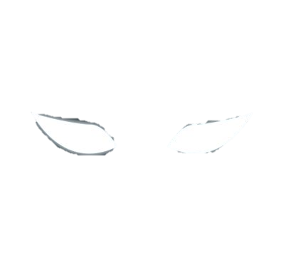

誰
43545
Notes:
Evil eyes appear and blink out as lyrics come into play: (Unseen and unknown by anyone)
Fog particles drift around too

Slide 3
100845
Notes:
Triangles decay except for some red center or some cool pattern of red/evil
Use floodfill collision detection (edit the floodfill function to make the color a different mode and have the triangles exit instead as a cool effect)

