Slide 1

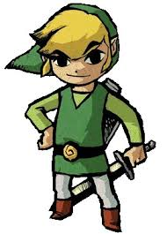

The Game Advisor
By Valencia Starr

Slide 2
The Game Advisor
Have you ever had those moments when you were trying to solve a puzzle in a game and you get stuck?
Well turn to The Game Advisor for help.

Slide 3
The Game Advisor
It displays common hard video game puzzles and their solutions.
You can also insert your own problems and solutions for future reference.
Hopefully you will find the advise helpful and enable you to continue on your quests.

Slide 4
The Game Advisor
How was it done?
Use JSOUP library.
References:
http://jsoup.org
Download the jsoup-1.8.2 jar file
Import it into Android Studio by adding the following to dependencies in build.gradle (Module:app) file:
compile files('libs/jsoup-1.8.2.jar')
rebuild project.

Slide 5
The Game Advisor
Coming in the future:
All users can add their game advise to a web site through their mobile device using the app or website using desktop and all users will be able to share and access game advise.

Slide 6
The Game Advisor
Have fun and enjoy!!

