Slide 1
L
？
D
S
S

Slide 2
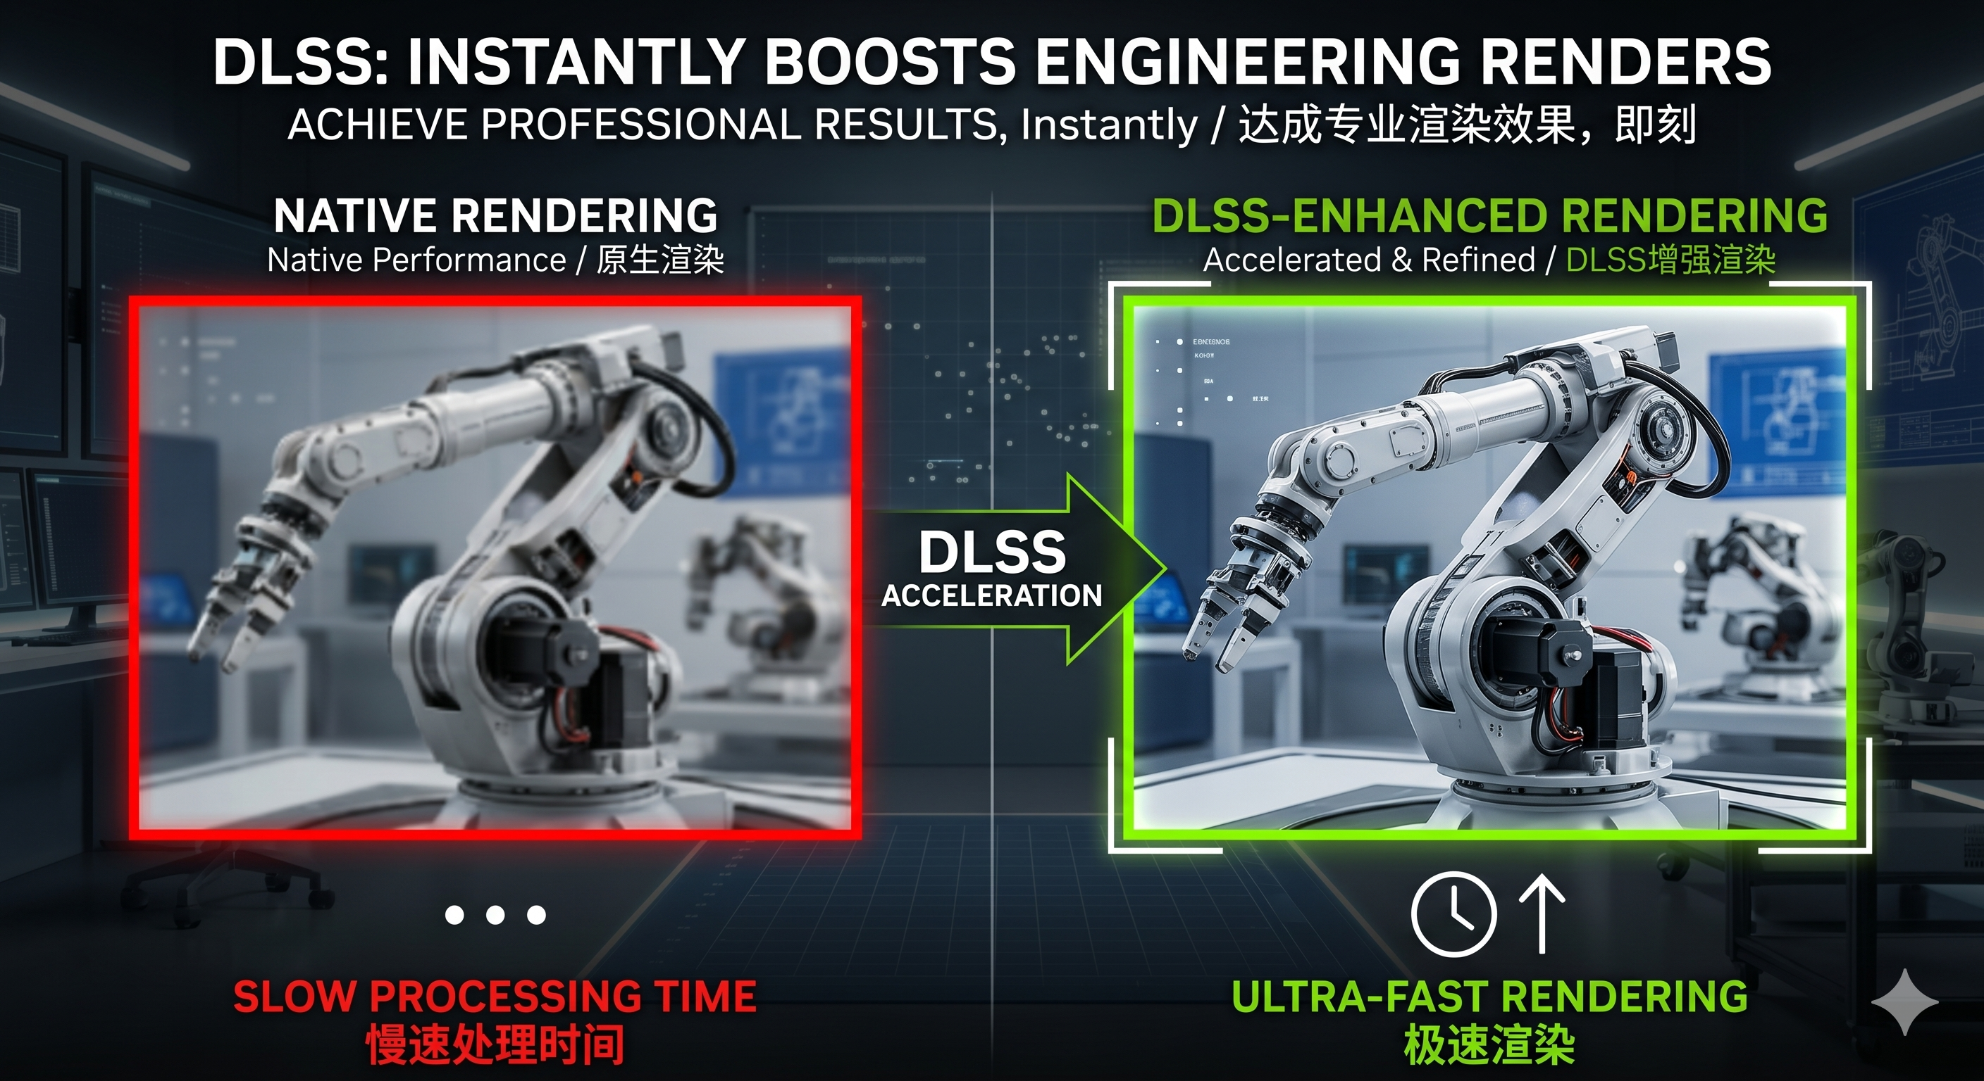

L
D
e e p
帧率↑ 画质↑
e a r n i n g
S
u p e r
S
a m p l i n g

Slide 3
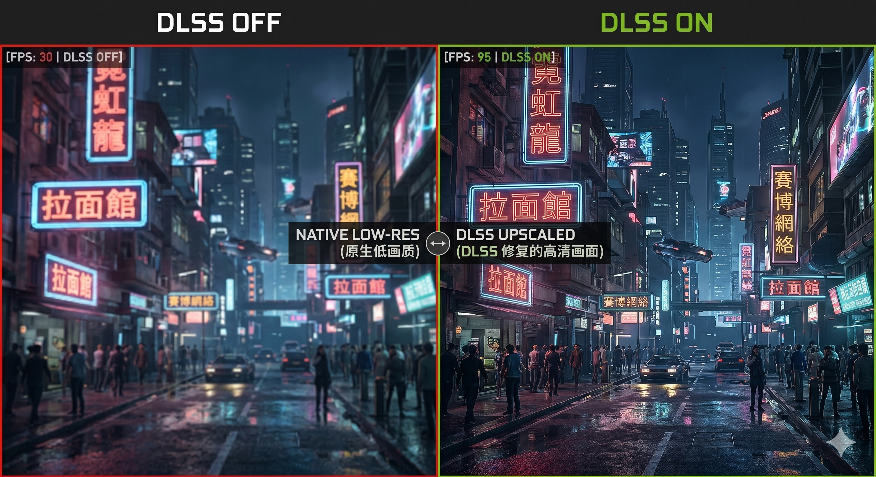


Slide 4
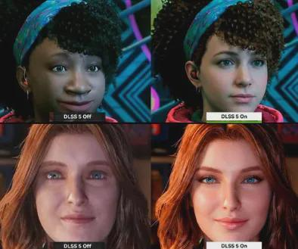
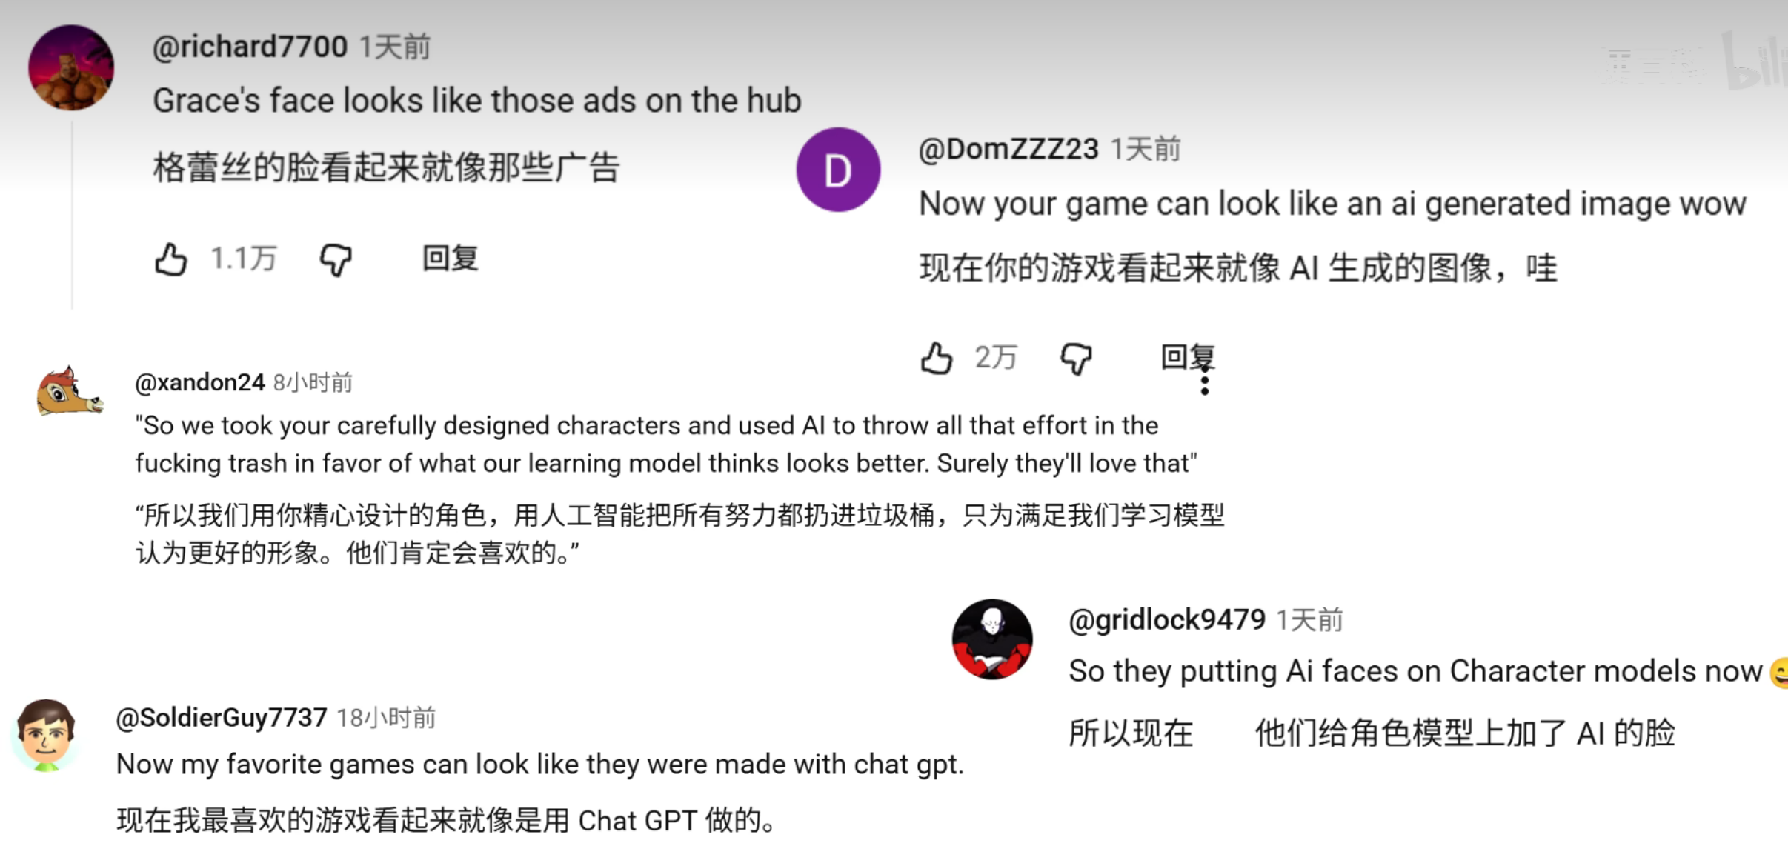
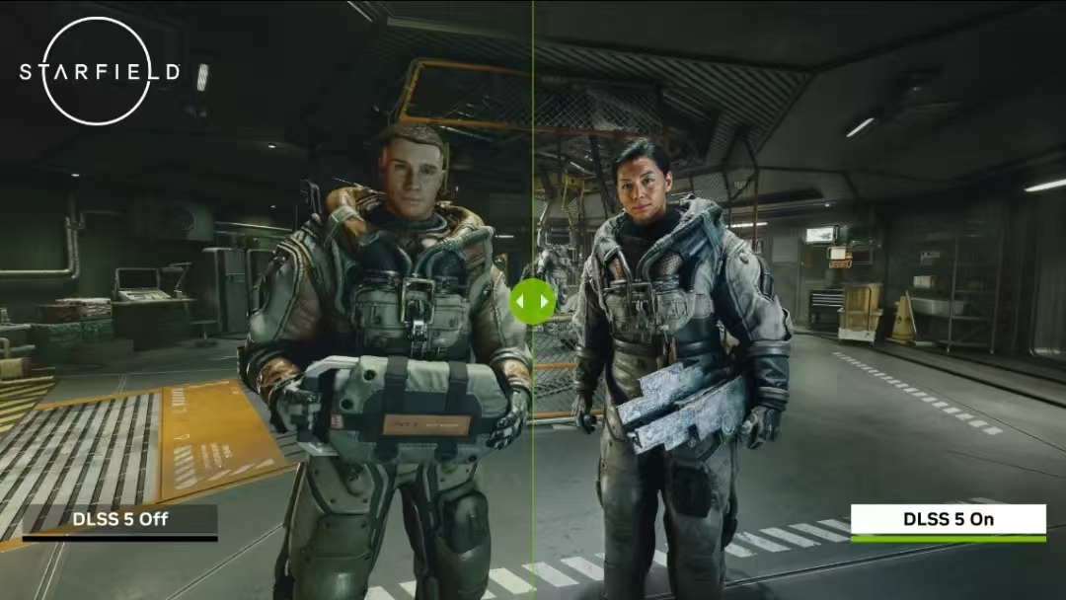
Does DLSS always bring benefits?

Slide 5
I
.
Image distortion
画面失真

Slide 6
I
.
Technological Laziness
技术惰性

