Slide 1
（三）典型逻辑部件_描述方式
数据选择器
译码器
优先编码器
数据比较器

Slide 2
3:8 译码器
module decode3_8 (data_out, data_in, enable) ;
input [2:0] data_in;
input enable;
output [7:0] data_out;
reg [7:0] data_out;
always @(data_in or enable)
begin
if (enable == 1 )
if(data_in == 3'b000)
data_out = 8'b11111110;
else if(data_in == 3'b001)
data_out = 8'b11111101;
else if(data_in == 3'b010)
data_out = 8'b11111011;
else if(data_in == 3'b011)
data_out = 8'b11110111;
else if(data_in == 3'b100)
data_out = 8'b11101111;
else if(data_in == 3'b101)
data_out = 8'b11011111;
else if(data_in == 3'b110)
data_out = 8'b10111111;
else if(data_in == 3'b111)
data_out = 8'b01111111;
else
data_out = 8'b11111111;
else
data_out = 8'b11111111;
end
endmodule
设计文件2
module decode3_8 (data_out, data_in, enable) ;
input [2:0] data_in;
input enable;
output [7:0] data_out;
reg [7:0] data_out;
always @(data_in or enable)
begin
if (enable == 1)
case (data_in )
3'b000: data_out = 8'b11111110;
3'b001: data_out = 8'b11111101;
3'b010: data_out = 8'b11111011;
3'b011: data_out = 8'b11110111;
3'b100: data_out = 8'b11101111;
3'b101: data_out = 8'b11011111;
3'b110: data_out = 8'b10111111;
3'b111: data_out = 8'b01111111;
default: data_out = 8'b11111111;
endcase
else
data_out = 8'b11111111;
end
endmodule
设计文件1

Slide 3
3:8 译码器
module test _decode;
reg [2:0] data_in;
reg enable;
wire [7:0] data_out;
Initial
begin
enable = 0; data_in = 3'b000;
#10 enable = 1;
end
always #10 data_in[2] = ~data_in[2];
always #20 data_in[1] = ~data_in[1];
always #40 data_in[0] = ~data_in[0];
decode3_8 my (data_out, data_in, enable);
endmodule
测试文件1
module test _decode;
reg [2:0] data_in;
reg enable;
wire [7:0] data_out;
Initial
begin
enable = 0; data_in = 3'b000;
#10 enable = 1;
end
always #10 data_in = data_in + 1’b1;
decode3_8 my (data_out, data_in, enable);
endmodule
测试文件3
module test _decode;
reg [2:0] data_in;
reg enable;
wire [7:0] data_out;
Initial
begin
enable = 0; data_in = 3'b000;
#10 enable = 1;
#10 data_in = 3'b001;
#10 data_in = 3'b010;
#10 data_in = 3'b011;
#10 data_in = 3'b100;
#10 data_in = 3'b101;
#10 data_in = 3'b110;
#10 data_in = 3'b111;
#10 $stop;
end
decode3_8 my (data_out, data_in, enable);
endmodule
测试文件2

Slide 4
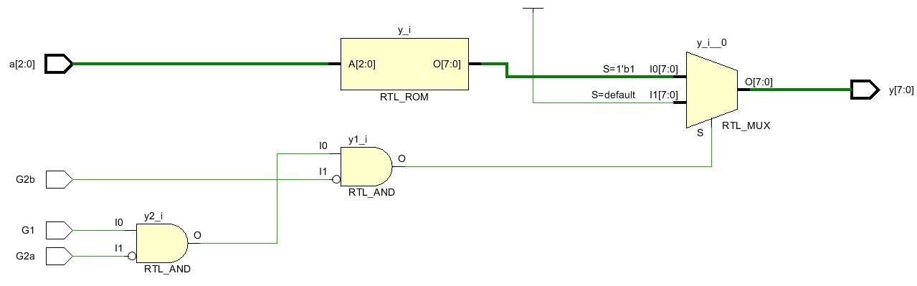

Slide 5
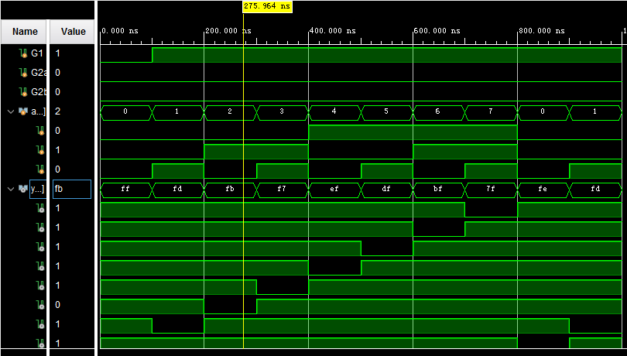

Slide 6
（二）典型逻辑部件_描述方式
数据选择器
译码器
优先编码器
数据比较器

Slide 7
8:3 优先编码器
module encoder ( y, none, i ) ;
input [7:0] i;
output [2:0] y;
output none;
reg [2:0] y;
reg none;
always @( i )
begin
if ( i [7] ) y = 3'b111;
else if ( i [6] ) y = 3'b110;
else if ( i [5] ) y = 3'b101;
else if ( i [4] ) y = 3'b100;
else if ( i [3] ) y = 3'b011;
else if ( i [2] ) y = 3'b010;
else if ( i [1] ) y = 3'b001;
else if ( i [0] ) y = 3'b000;
else y = 3'b111;
if ( i == 0) none = 1;
else none = 0;
end
endmodule
module test_encoder ;
reg [7:0] i;
wire [2:0] y;
wire none;
Initial i = 8'b0000_0001 ;
always #10 i = i << 1 ;
encoder my ( y, none, i ) ;
endmodule
设计文件
测试文件

Slide 8
条件语句 if 与 case 的区别
if生成的电路是串行，是有优先级的编码逻辑；
case生成的电路是并行的，各种判定情况的优先级相同。
因此，if生成的电路延时较大，占用硬件资源少；case生成的电路延时短，但占用硬件资源多。

Slide 9
（二）典型逻辑部件_描述方式
数据选择器
译码器
优先编码器
数据比较器

Slide 10
4位数据比较器
module compare ( Gr, Eq, Sm, A, B ) ;
input [3:0] A, B;
output Gr, Eq, Sm;
Assign Gr = A > B;
Assign Eq = A == B;
Assign Gr = A < B;
endmodule
module test_compare ;
reg [3:0] A, B;
wire Gr, Eq, Sm;
initial
begin
A = 0; B = 0;
#10 A = 4'b0001; B = 4'b0010;
#10 A = 4'b1000; B = 4'b1001;
#10 A = 4'b1010; B = 4'b1010;
#10 A = 4'b0111; B = 4'b0001;
#10 $stop;
end
compare my (Gr, Eq, Sm, A, B);
endmodule
设计文件
测试文件

