Slide 1
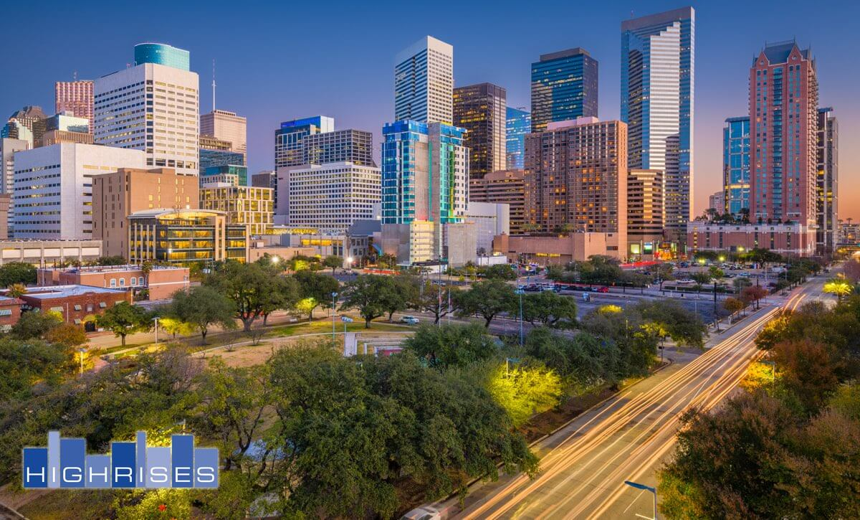
City Spaces are Rice Village
Rosanne Hu

Slide 2
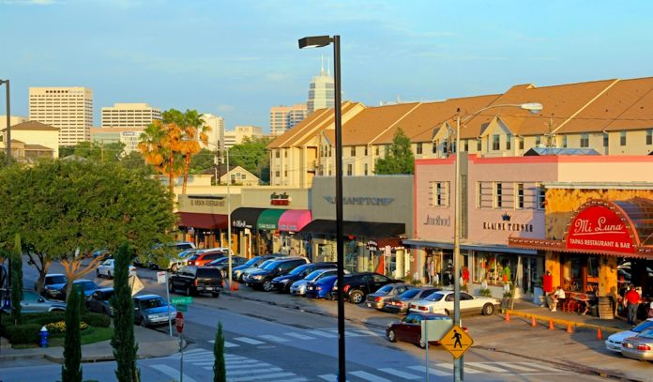
Rice Village as a Cultural center

Slide 3

Shared Experiences
I would like to figure out a way to help businesses understand the foot traffic of their area and how they can better utilize it
Help the problem of congestion by simulating the changing of spaces in cities.

Slide 4
Diagnosis
There are too many possibilities of ways to change up the space.
There are clear inefficiencies that can be addressed

Slide 5

Engagement
My project will allow people with the power to change the system a way to visualize the changes they will determining

Slide 6
Form
My project will take place as an interactive piece of media that allows the user to interact with different elements of the area in order to see the outcome.
Would love to later move the project into p5.js instead of processing for easier viewing.

Slide 7
Future iterations
Zoom
Get data from businesses in the area to put real values for foot traffic
Wandering

