Slide 1
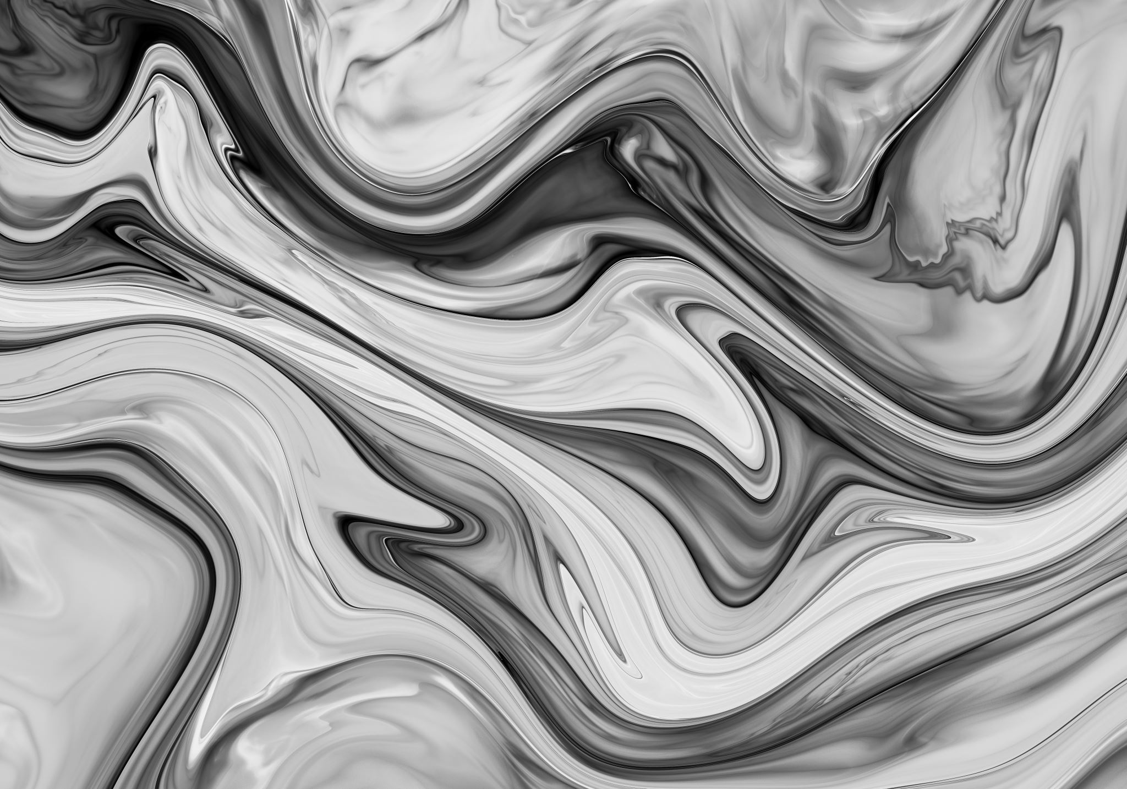
Shadertoy basic Montecarlo shader explanation
by Thy Tran

Slide 2
BASIC MONTECARLO SHADER OVERVIEW
A quick glance

Slide 3
Please refer to video

Slide 4
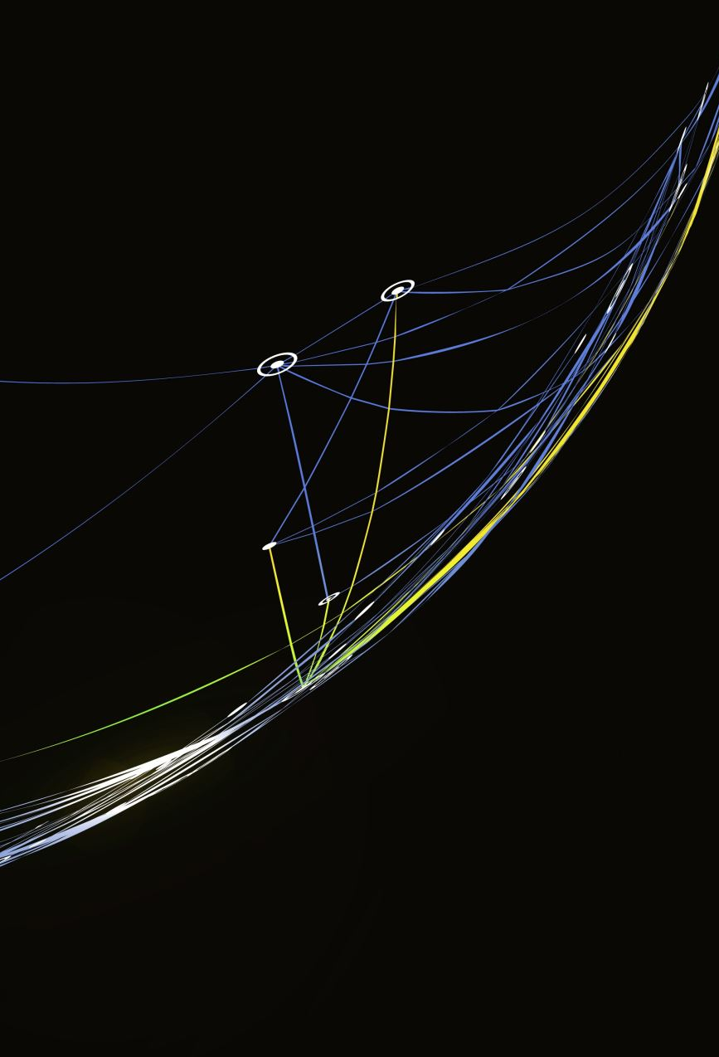
Shader overview
This shader was written in 2016 by Inigo Quilez (ShaderToy co-founder) and is one of his articles in Global Illumination series
This shader includes 3D, Raymarching, Fractal, Global Illumination, Path Tracing, and Monte Carlo.

Slide 5
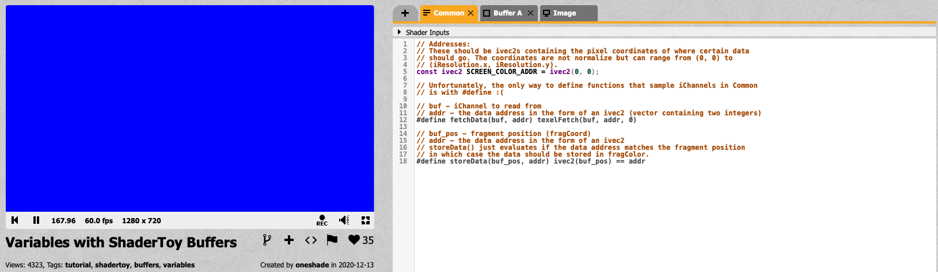
How a shader on shadertoy works
COMMON
Buffer A (B, C,..)
Image

Slide 6
code components
Buffer A:
Utility
Scene Definition and Interaction
Lighting and Shading
Main Rendering
Image (Post-processing layer)
Main Image

Slide 7
code components – buffer a
Buffer A:
Utility:
int rand(void) {}
float frand(void) {}
void srand(ivec2 p, int frame)
vec3 cosineDirection(in vec3 nor)
vec3 uniformVector(void)
float sdBox(vec3 p, vec3 b)
Scene Definition and Interaction
vec2 map(vec3 p)
vec3 calcNormal(in vec3 pos)
vec2 intersect(in vec3 ro, in vec3 rd)
float shadow(in vec3 ro, in vec3 rd)
Lighting and Shading
vec3 light(vec3 surfColor, float surfSpecN, bool surfIsMetal, vec3 pos, vec3 nor, vec3 rd, vec3 ligDir, vec3 ligColor)
const vec3 sunDir = normalize(vec3())
const vec3 sunCol = (12.0 * vec3(_)
const vec3 skyCol = 6.0 * vec3(0.2, 0..5, 0.8)
vec3 calculateColor(vec3 ro, vec3 rd)
Main Rendering:
mat3 setCamera(in vec3 ro, in vec3 rt, in float cr)
void mainImage(out vec4 fragColor, in vec3 fragCoord)

Slide 8
code components – image
mainImage:
Fetching Input Color
Tone Mapping
Gamma Correction
Vignetting

Slide 9
code components – buffer a Utility
Part | Methods | Purpose
Utility | rand(), frand(), srand() | Providing pseudo-random number generation
 | cosineDirection(nor) | Generating a random direction vector weighted towards the given normal vector nor, simulates diffuse reflection.
 | uniformVector() | Generating a uniformly distributed random direction vector within a unit sphere.
 | sdBox(p, b) | Signed distance function for a box. Calculates the distance from point p to the surface of a box with dimensions b.
 | setCamera(ro, rt, cr) | Create a camera matrix. ro is the cam origin, rt is the look-at point, cr is the camera roll.

Slide 10
code components – buffer a scene definition and interaction
Part | Methods | Purpose
Scene definition and interaction | map(p) | Scene distance field function. Defines the objects in the scene using a combination of a repeated box and a sphere. Uses fractal technique to create a repeating pattern. It returns the distance to the closest object and an object ID.
 | calcNormal(pos) | Calculates the surface normal at a given point pos using the distance field.
 | intersect(ro, rd) | Ray-matching function. Casts a ray from origin ro in direction rd and returns the distance to the nearest intersection and the object ID.
 | shadow(ro, rd) | Shadow ray casting. Checks if a ray from ro in direction rd hits any object.

Slide 11
code components – buffer a Lighting and shading
Part | Methods | Purpose
Lighting and Shading | light(surfColor, surfSpecN, surfIsMetal, pos, nor, rd, ligDir, ligColor) | Calculates the contribution of a single light source. Takes into account surface properties, light direction and color, and casts shadow rays.
 | calculateColor(ro, rd) | Recursive path tracing function.

Slide 12
code components – buffer a main rendering
Part | Methods | Purpose
Main Rendering | mainImage(fragColor, fragCoord) | Providing pseudo-random number generation

Slide 13
code components – image main image (post-processing shader)
Part | Variables | Purpose
Fetching Input Color | vec4 data, vec3 col | Fetches the color data from a texture bound to iChannel0, fragCoord represents the pixel’s coordinates, and 0 specifies the mipmap level (0 is the base level).
Tone Mapping | col = col*1.4/(1.0+col); | Essential for displaying HDR images on standard display.
Gamma Correction | col = pow(col, vec3()); | Performing gamma correction. Typically display a non-linear response to input values, meaning that a doubling of the input value does not result in a doubling of the perceived brightness.
Vignetting | vec2 uv = fragCoord / iResolution.xy; | Creates a vignetting effect, which darkens the corners of the image.
Output | fragColor = vec4(col, 1.0) | Processed color is assigned to fragColor, output variable of the shader. Alpha component is set to 1.0.

Slide 14
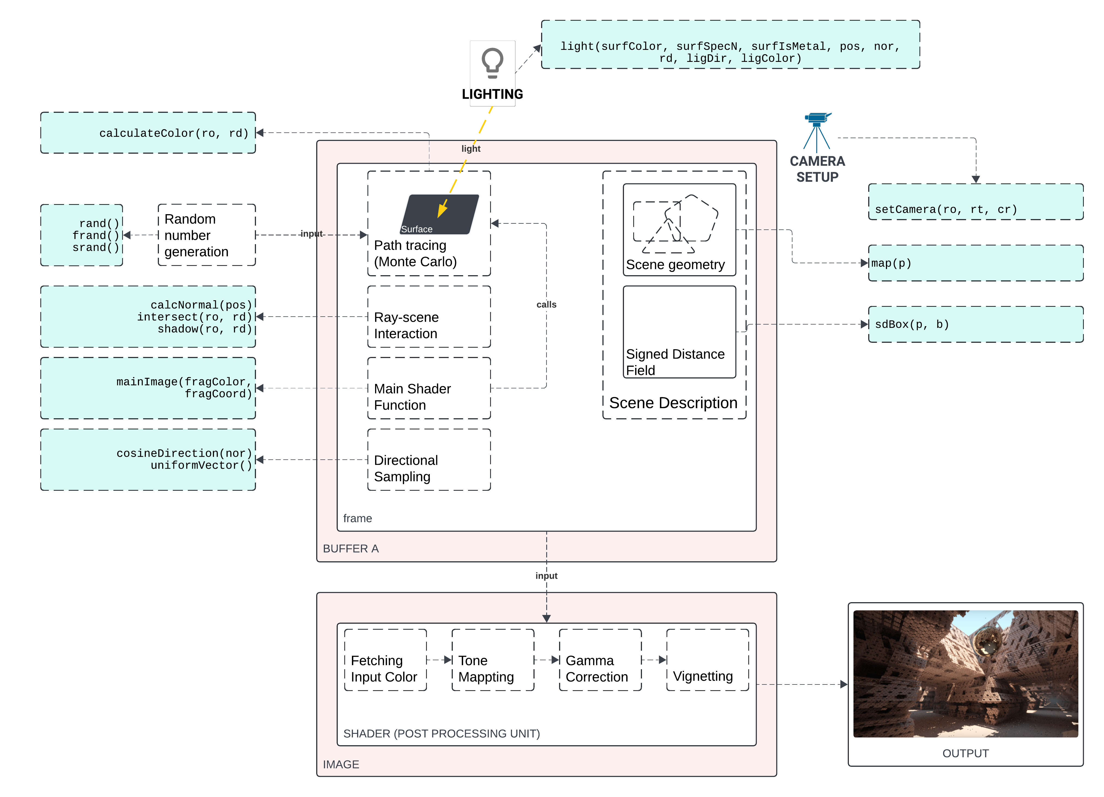
code flow

Slide 15
thank you FOR WATCHING

