Slide 1


How to Prepare a Good Poster?
JUNE 2, 2026
“The more strikingly visual your presentation is, the more people will remember it. And more importantly, they will remember you.”
- Paul Arden

Slide 2
What is a Poster?
A poster is a visual and textual presentation that summarizes a research project, idea, or topic on a single large sheet.
It combines:
Text,
Graphics/Pictures
Structure to communicate the essence of your work quickly and clearly.

Slide 3
Poster vs Talk
Poster | Talk
spatial, self-paced, and interactive | sequential, time-based explanation

Slide 4
Structure and Design
Partition poster into well-defined sections.
Content determines structure.
Flow from top to bottom, left to right.
Common structure: Intro -> Background -> Results -> Discussion/Future Research
Abstract is not necessary for poster

Slide 5
Recommended Poster Sections
Title: Clear and Descriptive
Introduction/Motivation: Why does this topic matter? What question(s) are you askings?
Data: Where did the data come from? How many observations/variables?
Methods: What analysis did you run in R? (e.g. regression, visualization, clustering)
Results: Your key findings
References: Credit your data source and any tools you used
Acknowledgements: Credit your mentors and anyone else you would like to thank

Slide 6
Structure and Design
From up close or afar, the poster should be inviting.
Avoid excessive text.
Aim for approximately 20% text, 40% visuals, and 40% empty space.
Nothing wrong with a little white space. Break up text with figures, pictures and equations.
Use short blocks of text or bullet points.

Slide 7
Structure and Design
Design for readability
Choose sans serif fonts like Arial or Verdana. (No more than two types).
Avoid switching fonts to highlight key points (bold or italics).
Use high contrast between text and background (avoid red/green combinations).
Use no more than 2-3 colors.
Make sure titles and headings stand out by using larger font sizes than the rest of the text
Title: 85 pt
Authors: 56 pt
Sub-headings: 36 pt
Body text: 24 pt
Captions: 18 pt

Slide 8
Using R Visuals in Your Poster
Export directly from R, do not take screenshots (blurry when printed)
Export at high resolution
Make axis labels large enough to read from 3 feet away
Always label axes with clear names and units
Avoid red/green combinations

Slide 9
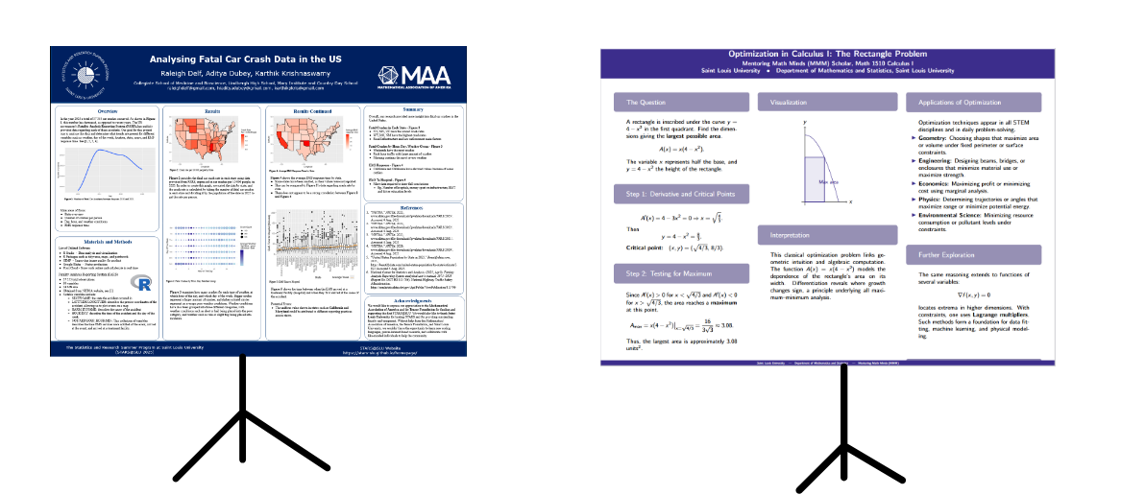
First Impressions
Which of the two presentations would you rather attend? Why?

Slide 10
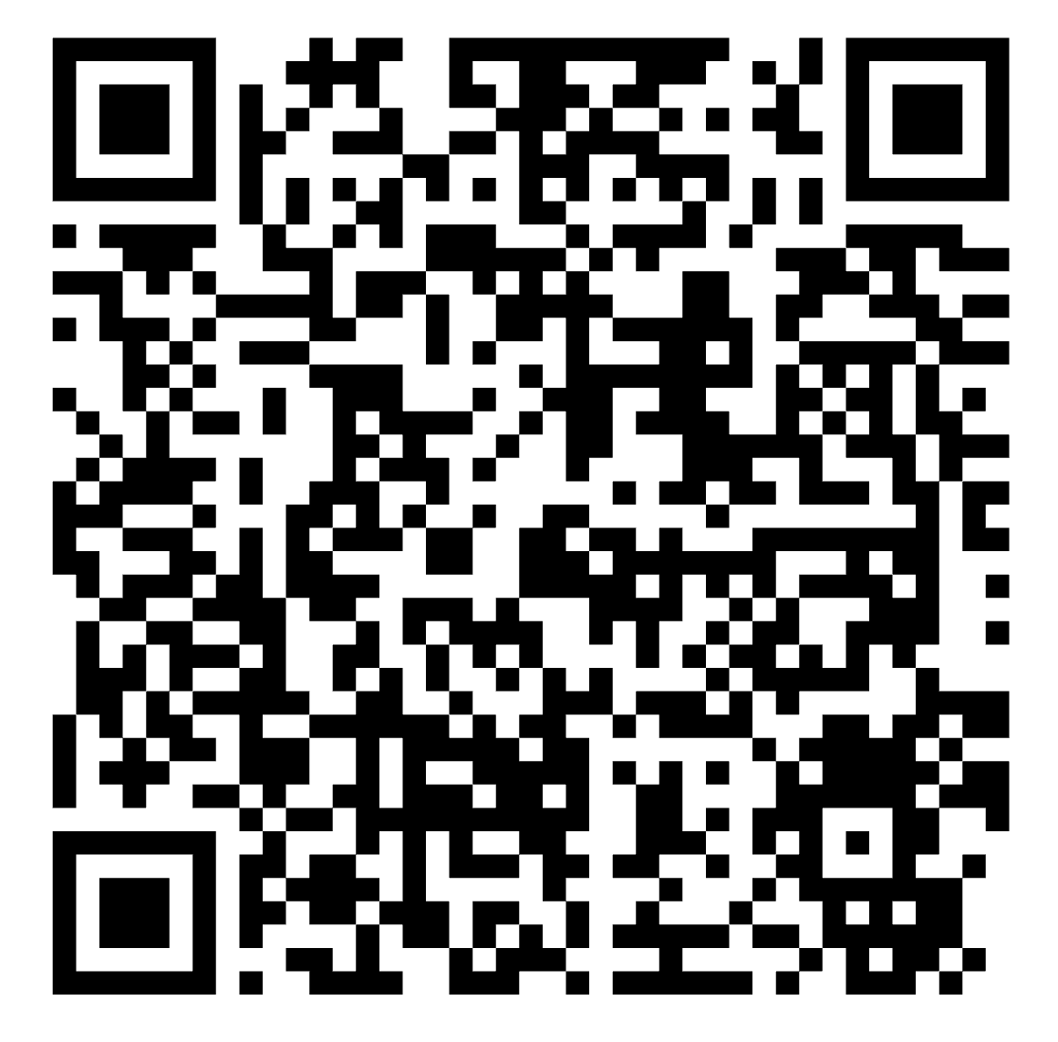
Logistics
●Dimensions: 48” wide x 36” tall (landscape orientation)
●Template: A PowerPoint poster template will be provided, do not change the dimensions
●Preparation Due Date: Make sure to prepare your posters by Thursday, June 11th, 3PM
●Presentation date: Friday, June 12th, 1-2 PM
●Display: You will stand next to your poster and explain your work to audience

Slide 11
Discussion Time
For each of the following posters, ask yourself the following questions:
How does the structure help communicate the work?
Are the sections well-defined?
Does the poster feel cluttered?
Are you interested in reading more after the initial glance?
Is the content effective?
What is the main subject of the poster?
Who is the intended audience for this poster?
Can the poster be easily summarized?

Slide 12
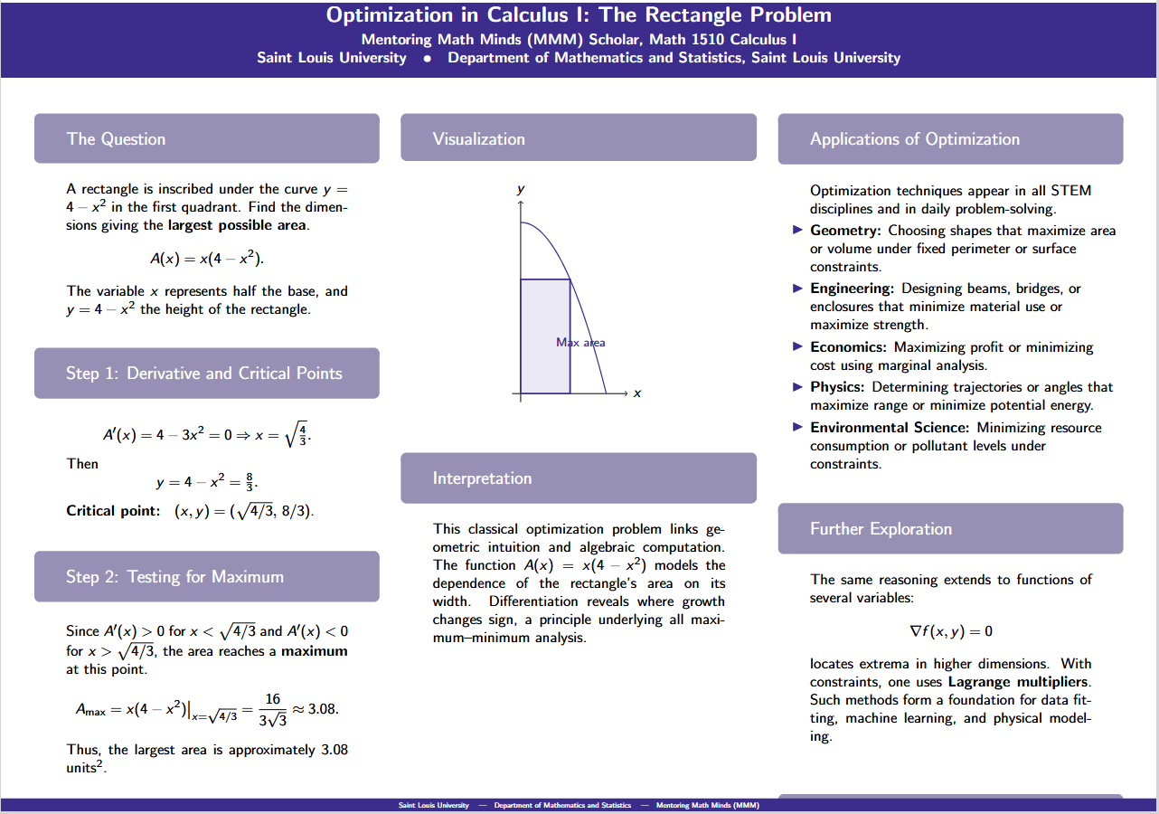

Slide 13
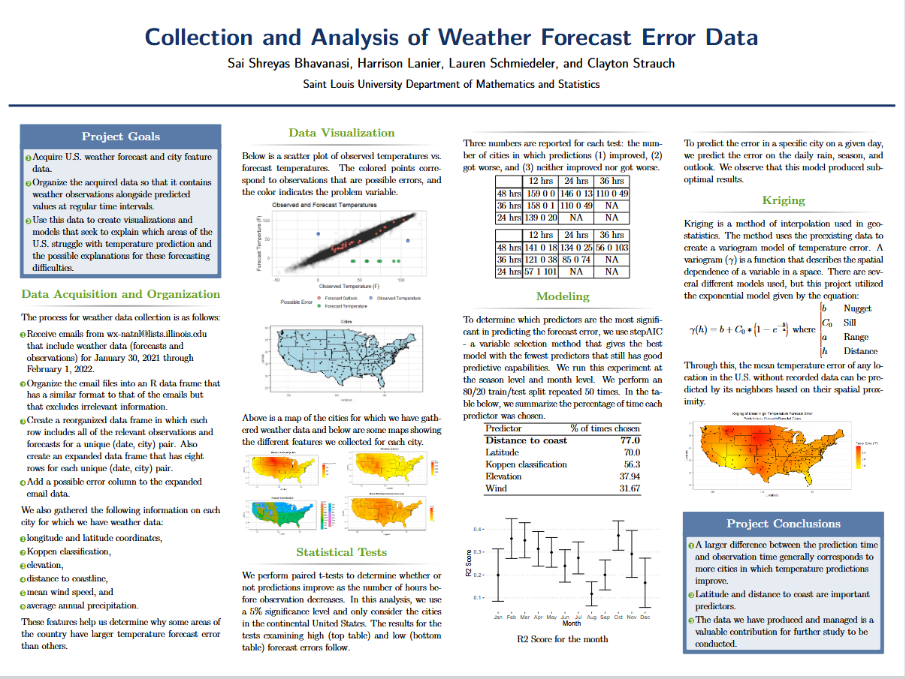

Slide 14
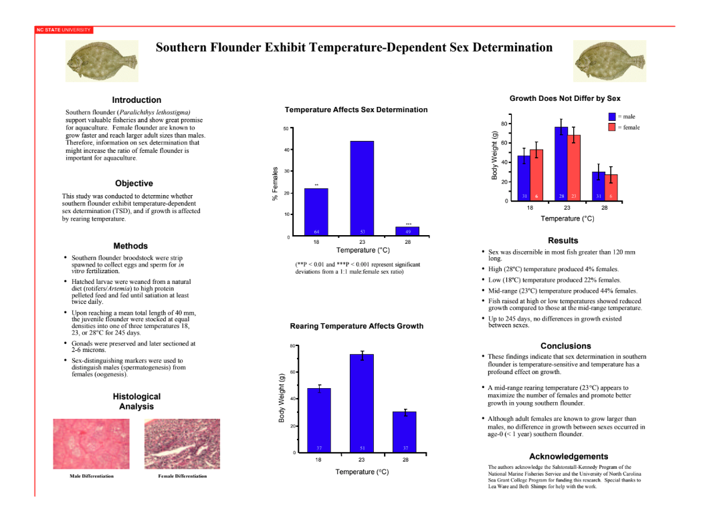

Slide 15
What Makes a Good Poster?
Focus on One Story
Communicate the path of discovery
Logical Structure
Title and Authors, Motivation & Problem, Methods & Key Ideas, Conclusion & Perspectives, Acknowledgments, References
Visual Hierarchy & Readability
Mathematical Content
Show the idea or insight instead of all the algebra/calculation/theory

Slide 16
Presenting Your Poster
Structure your 60 seconds pitch like this:
Motivation: “We looked at [topic] because...”
Question: “Our research question was...”
What you did: “Using R, we analyzed [dataset] and...”
What you found: “The most interesting finding was...”
Why it matters: “This could mean that...”
Tips:
Make eye contact! Don’t just read off the poster
Point to your visuals as you talk through results. But do not block the poster the whole time
Practice out loud at least twice before the event

Slide 17
Thank You!
Poster Template QR Code

