Slide 1

永晝城物語
數學四 梁致銓
數學四 曾煒傑
數學四 黃品瑜

Slide 2
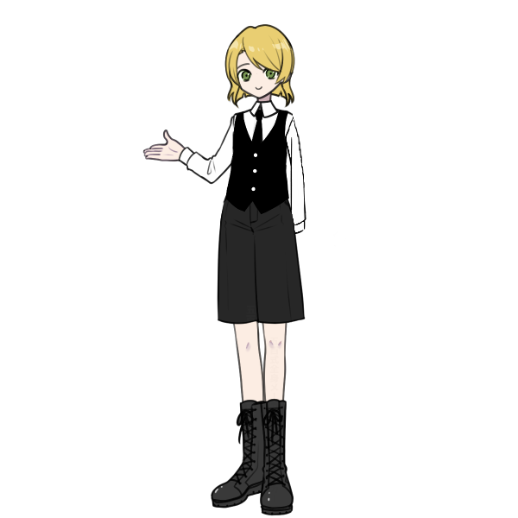
Project goal
這是一個電腦版本的TRPG遊戲，這個遊戲中包含角色移動、戰鬥、瘋狂機制，角色會在不同的地圖中移動，並尋找線索、探尋秘密，根據骰子檢定和你的選擇來決定角色的未來，你可以從神祕學家、考古學家與戰地記者中選擇一個角色，不同的角色會有不同的能力值，根據玩家和骰子的選擇最終會通往超過十個不同的結局。

Slide 3
Project flowchart
initialize
start
manual
choose character
arrow key
what interact?
button
No
arrow key
check?
detect time/place
Yes
move character
checking
apply result
collision
apply result

Slide 4
Class: character
class Character {
public:
char* get_path();
struct position get_position();
void edit_position(int posX, int posY);
struct size get_size();
void edit_size(int Width, int Height);
bool IsEnable();
protected:
char* data_path;
ability ability;
size size;
position pos;
};

Slide 5
Class: NPC (inherent from character)
class NPC :public Character {
public:
NPC(char* picture_path, int str, int dex,...) {
this->ability.STR = str;
this->ability.DEX = dex;
}
};

Slide 6
Class: Player (inherent from character)
class Player:public Character {
public:
Player(char* picture_path, int str, int dex…) {
this->data_path = picture_path;
this->ability.STR = str;
this->ability.DEX = dex;
}
struct skill get_skill();
private:
skill skill;
};

Slide 7
Class: scene
class scene {
public:
scene(char* picture_path) {
this->data_path = picture_path;
}
char* get_path();
struct position get_position();
void edit_position(int posX, int posY);
struct size get_size();
void edit_size(int Width, int Height);
bool IsEnable();
private:
char* data_path;
size siz;
position pos;
};

Slide 8
Key Function: control player motion
bool ProcessCmdKey(Message% msg, Keys keyData) override
{
if (keyData == Keys::Up && player_motion->Location.Y > 180)
{
player_motion->Location = System::Drawing::Point(player_motion->Location.X, player_motion->Location.Y - 10);
return true;
}
else if (keyData == Keys::Down && player_motion->Location.Y < 670)
{
player_motion->Location = System::Drawing::Point(player_motion->Location.X, player_motion->Location.Y + 10);
return true;
}
else if (keyData == Keys::Left && player_motion->Location.X > 0)
{
player_motion->Location = System::Drawing::Point(player_motion->Location.X - 10, player_motion->Location.Y);
return true;
}
else if (keyData == Keys::Right && player_motion->Location.X < 970)
{
player_motion->Location = System::Drawing::Point(player_motion->Location.X + 10, player_motion->Location.Y);
return true;
}
return Form::ProcessCmdKey(msg, keyData);
}

Slide 9
Key Function: roll
class roll {
public:
int success; // 判定結果(0: 失敗, 1: 成功, 2:困難成功, 3:極難成功)
int rolling; // 擲骰結果
void check(int Successful_Rate) {
srand(time(NULL));
rolling = rand() % 100 + 1;
if (rolling > Successful_Rate) {
success = 0; }
else if (rolling <= Successful_Rate/5) {
success = 3; }
else if (rolling <= Successful_Rate / 2) {
success = 2; }
else {
success = 1; }
}
};

Slide 10
Key Function: battle
class battle {
public:
int dmg; // 傷害值
roll character;
roll enemy;
// 攻擊:輸入傷害加值、傷害骰、鬥毆等級、是否穿刺；輸出傷害
void attack(int DB, int Dmg, int Brawl, bool pierce, int Enemy_Brawl, int Enemy_Dmg) {}
// 閃避:輸入閃避等級、敵人鬥毆等級、敵人傷害骰；敵人傷害加成
int evade(int Evade, int Enemy_Brawl, int Enemy_Dmg, int Enemy_DB) {}
// 反擊:輸入鬥毆等級、角色傷害骰、敵人鬥毆等級、敵人傷害骰；敵人傷害加成
int evade(int Brawl, int Dmg, int Enemy_Brawl, int Enemy_Dmg, int Enemy_DB) {}
private:
bool atk_success; // 攻擊是否成功
int db; // DB隨機結果
};

Slide 11
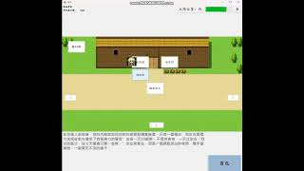
A video demo

Slide 12
