Slide 1
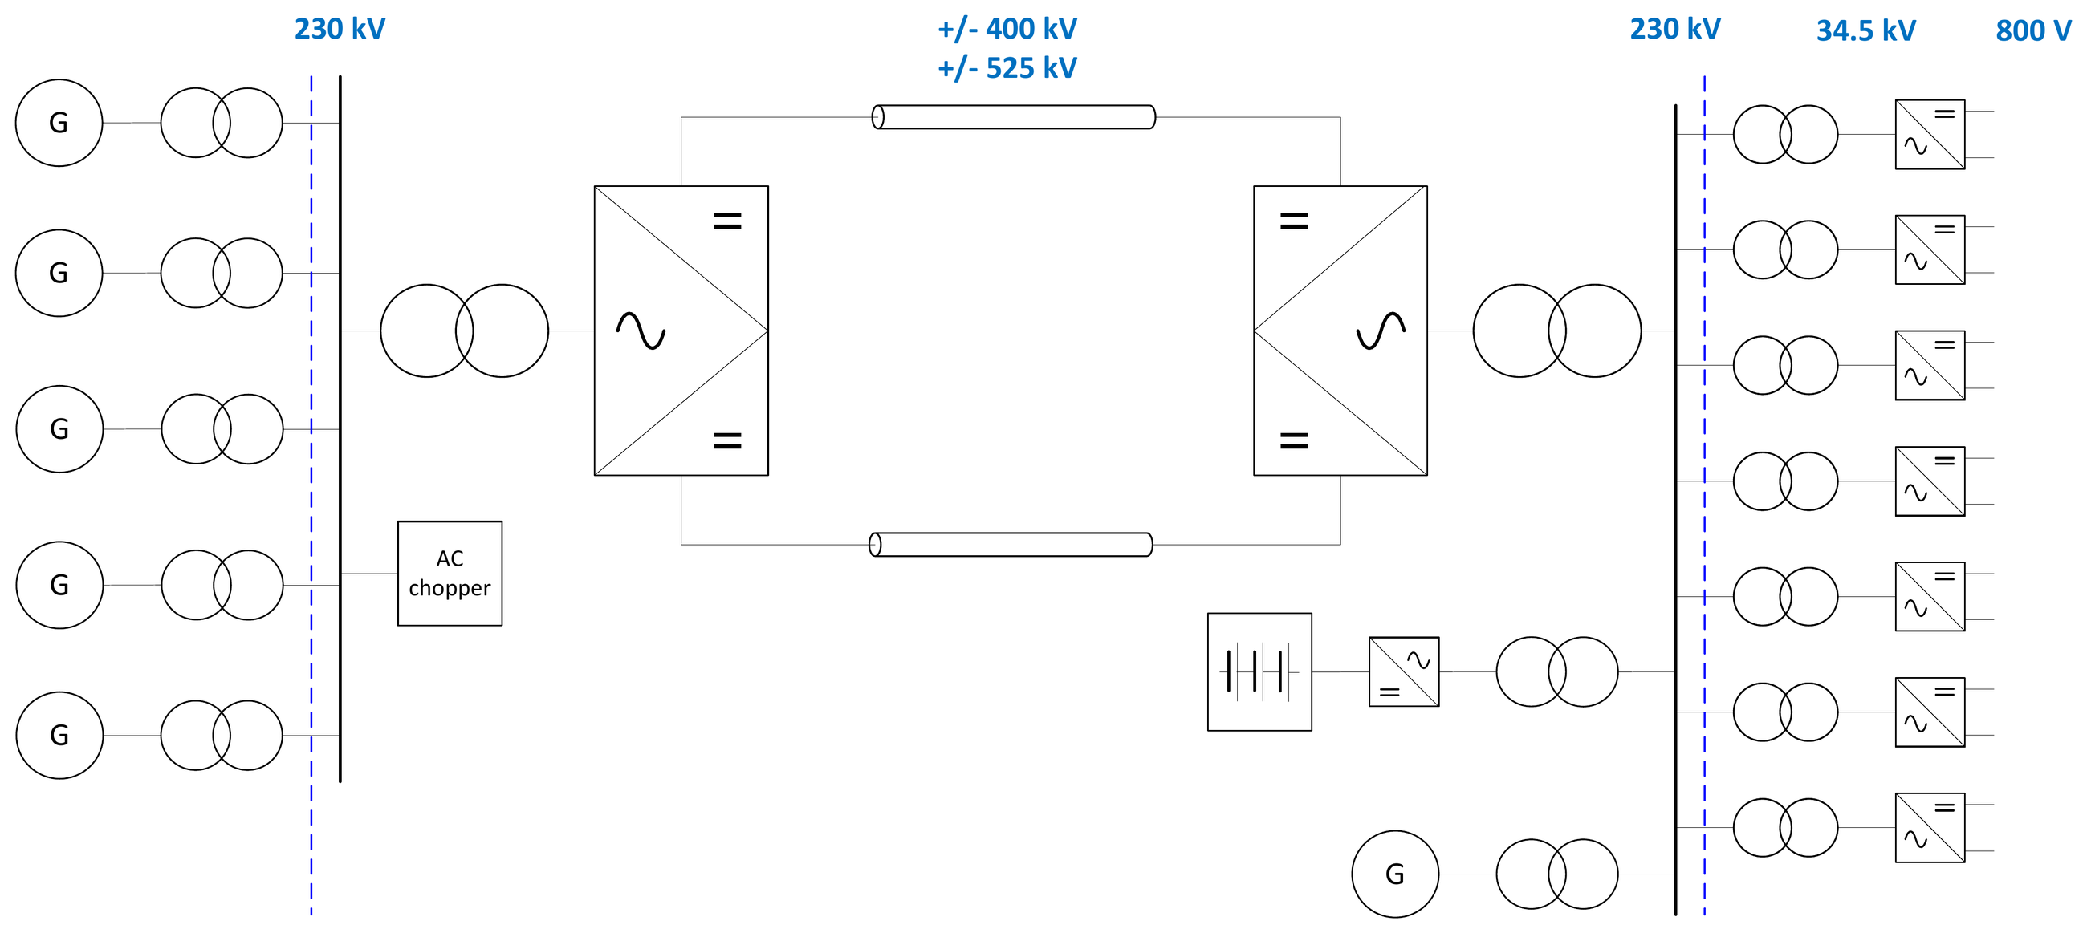
System configuration

Slide 2
System configuration
Power 2 projects with 1000 MW and 2 projects with 3000 MW power transmission requirements
DC line 100–200 miles, with priority to OHL, but cable sections can be implemented to accelerate the permitting process
Generation Geothermal power plants are the main generation source. Additional generation sources might be implemented once the transmission system is established
Load The main load are data centers
BESS Battery storage is assumed for backup and for data center load flicker compensation
AC chopper For fault ride-through, installation of the AC chopper might be required

Slide 3
System configuration
Islanded operation with no interconnection to the AC grid
Generation is built out in 300 MW steps ⇒ staged buildout of the transmission system is beneficial
High reliability requirements by data centers
Standardized hardware design approach to reduce hardware lead times and configuration variations
Building up C&P capabilities for system integration and project execution time reduction
Reduction of execution time is very critical

Slide 4
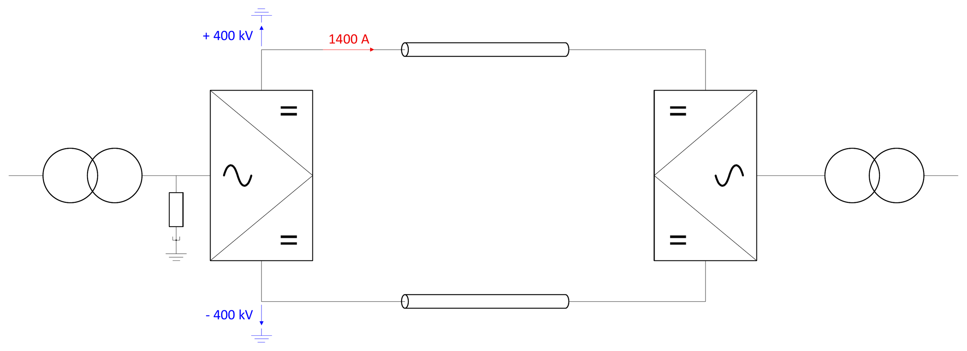
1 GW — Symmetrical Monopole (SMP)
Topology SMP with ±400 kV
DC line Two symmetrical conductors

Slide 5
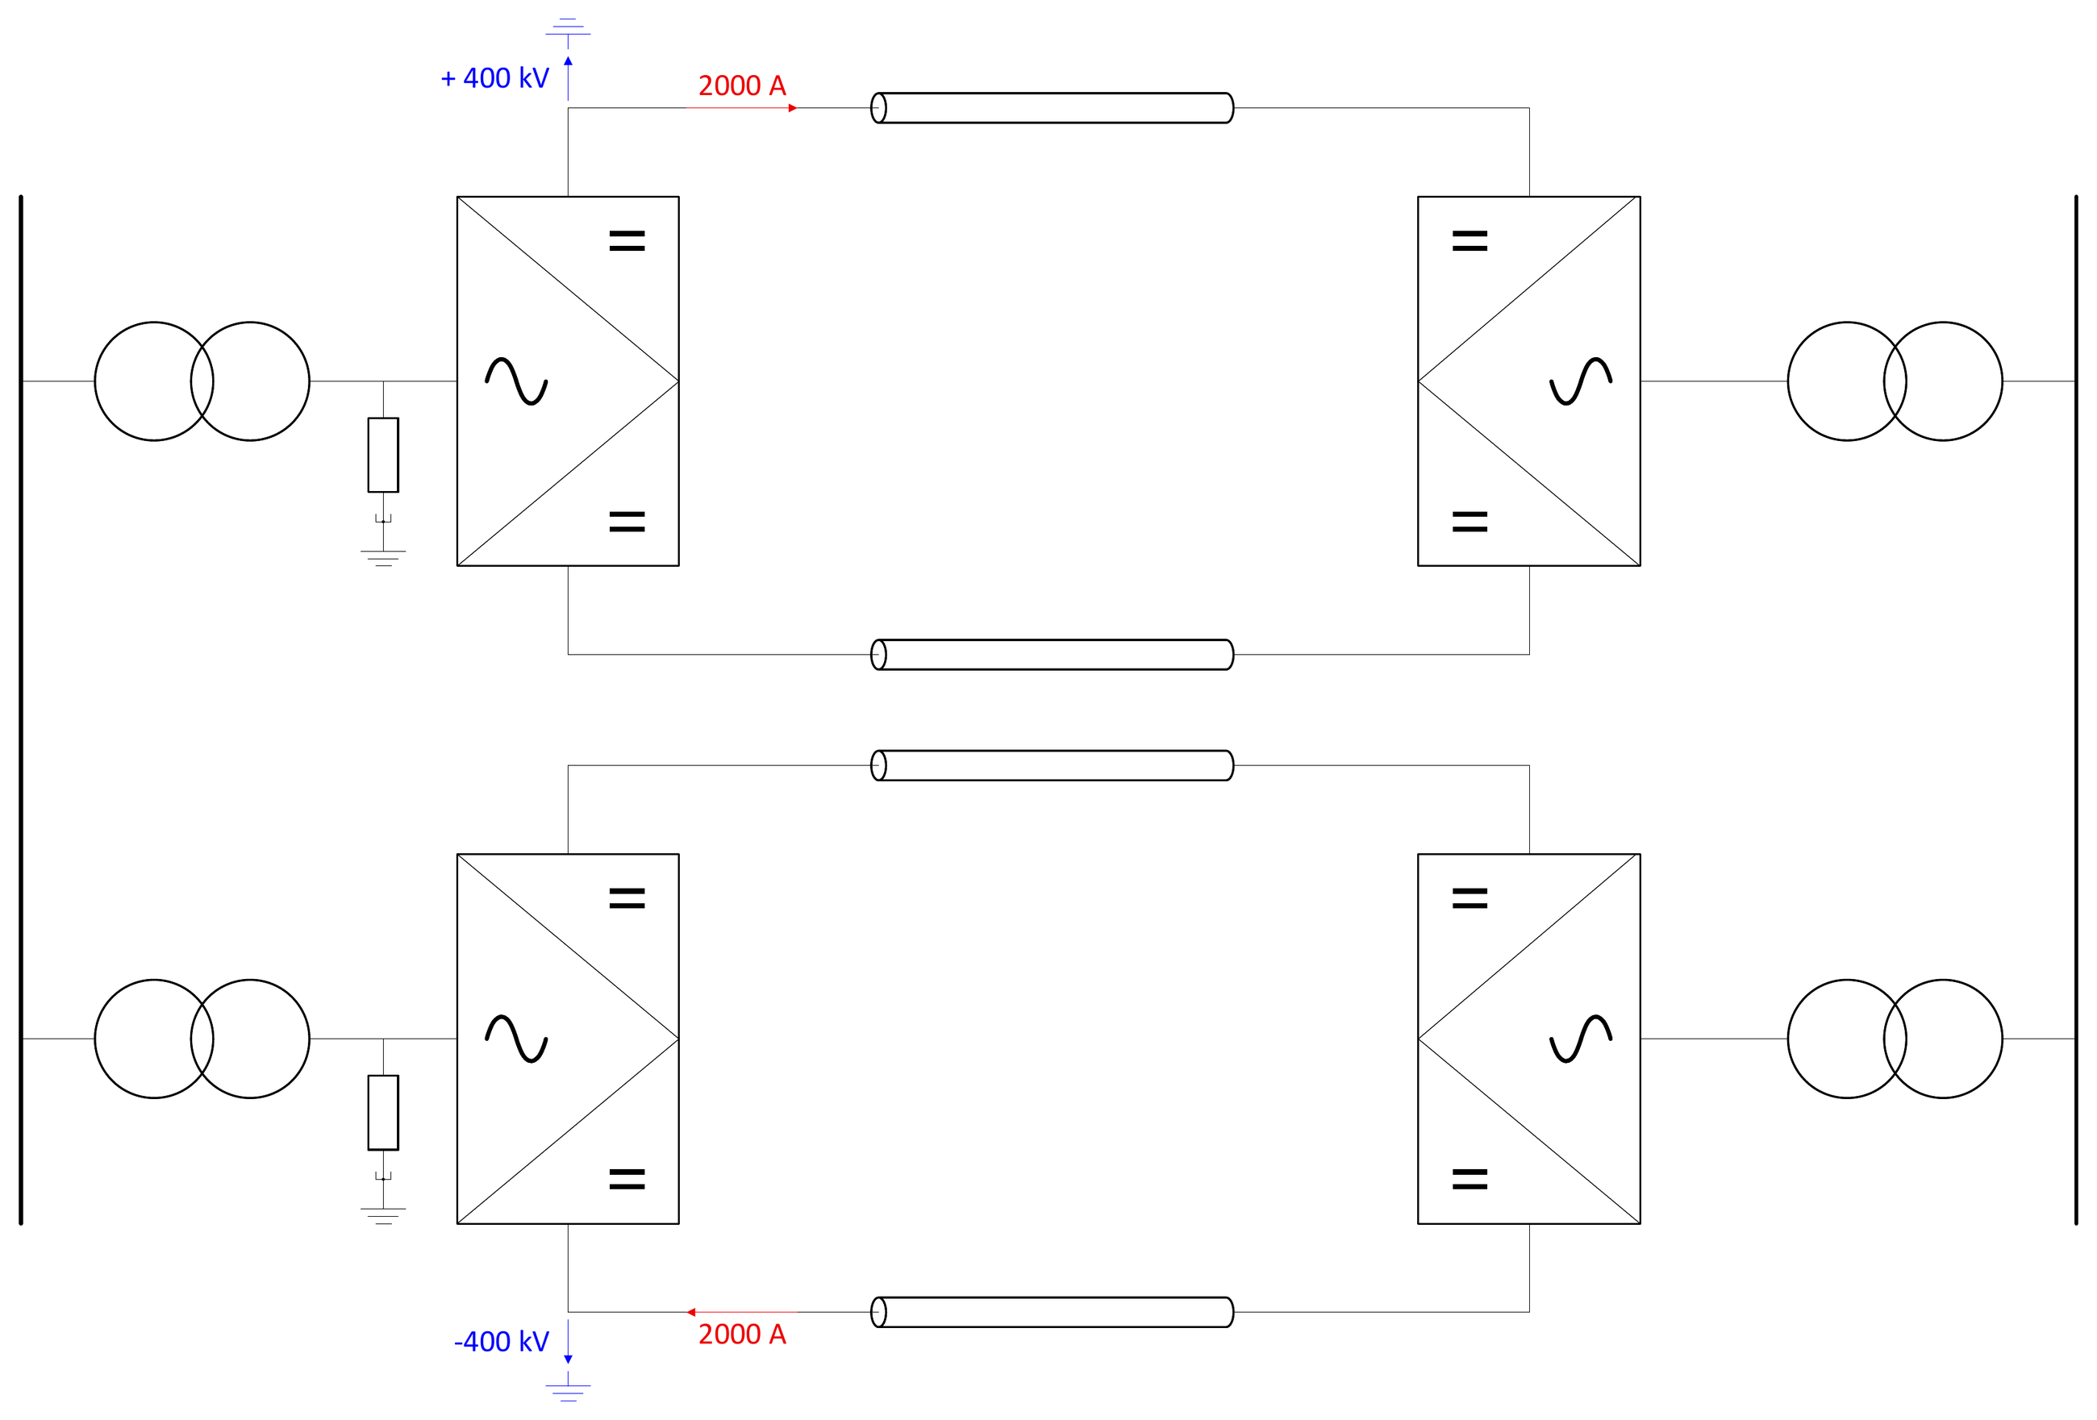
3 GW — Dual Symmetrical Monopole (DSMP)
Topology DSMP with ±400 kV
DC line Four symmetrical conductors
Modularization Same design as for the 1 GW configuration can be used

Slide 6
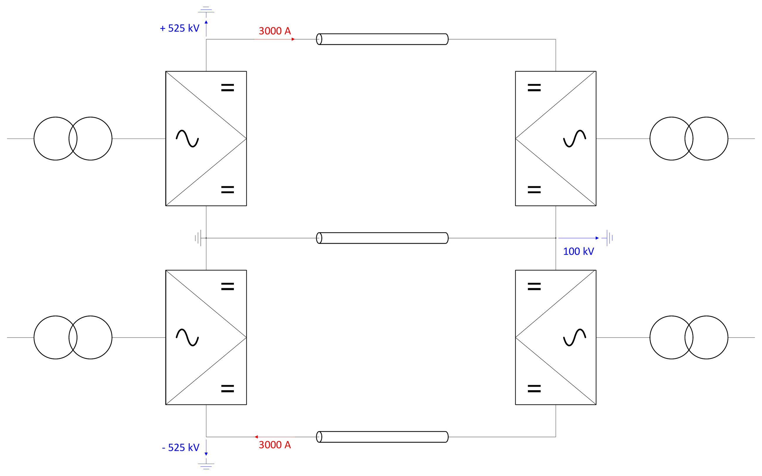
3 GW — Bipole (BIP)
Topology Bipole with ±525 kV
DC line In case of cable applications, parallel cables are required due to the high current rating

Slide 7
Working packages ongoing
DC line
DC route definition and DC line design
Network control & protection
Operation concept definition
Offline studies for concept verification
Development of models for performance design and verification
Definition of performance verification tests and evaluation criteria

