Slide 1
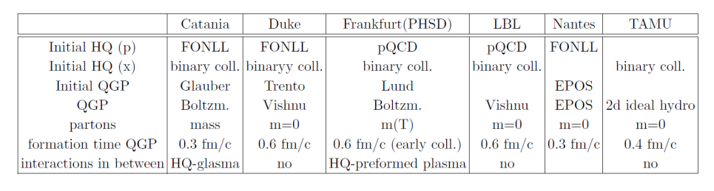
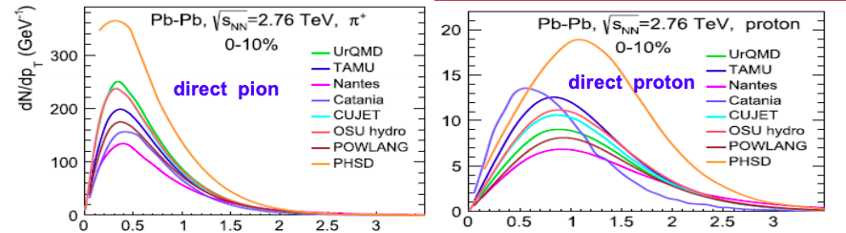
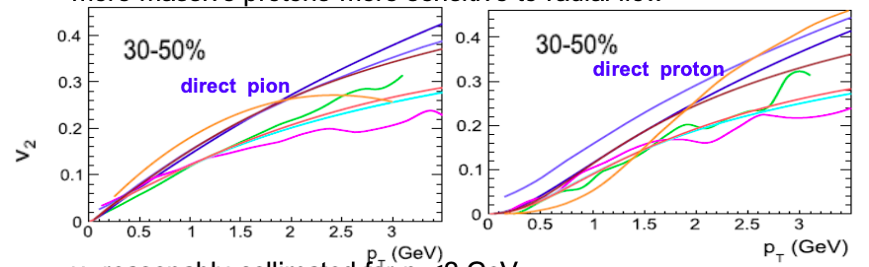
Bulk Evolution
Different groups employ different bulk evolution models
Bulk evolution model has a sizable impact on the final state c/D spectra/RAA
J. Aichelin, Jet-HQ, Monday
spectra/v₂ at T_{c}
M. He, EMMI-RRTF, Monday
EMMI-RRTF Recommendation #2
Employ publicly available hydrodynamic or transport evolution models which have been tuned to data, with a maximal range of viable initial conditions and model parameters; or even a single one with a pre-specified tune as a single point of contact of all approaches.
→ How to proceed?

Slide 2
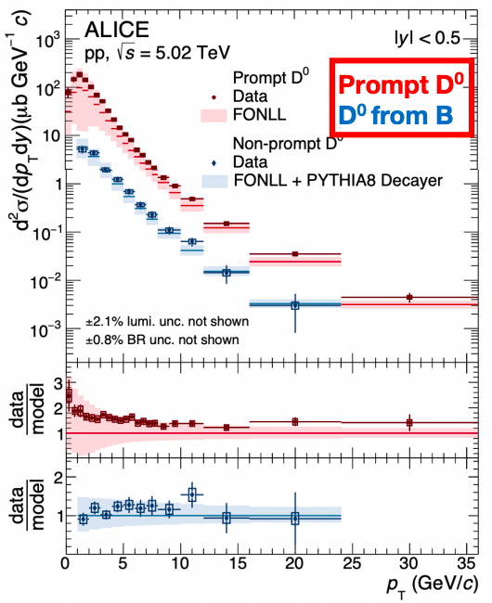
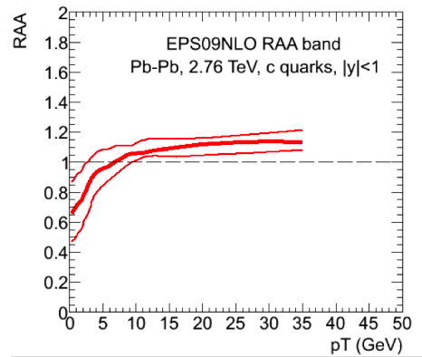
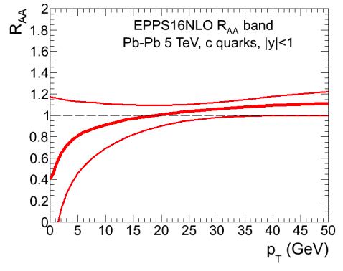
Initial Spectra
pQCD/FONLL describes charm production X-sec in pp (uncertainty, particularly at low pT)
Nuclear PDFs in AA collisions
A. Dainese
M. He, EMMI-RRTF
data vs. FONLL (shape? Uncertainty?)
Use experimental spectra as input
EPS09 vs. EPPS16 ? Uncertainty?
Consistent implementation of nPDFs?

