Slide 1
1) Provide Heavy-Flavor Transport Coefficients (mu_B=0)
----------------------------------------------------
(a) Current best estimate of Ds(2\piT) as function of T over available T-range (both charm and bottom, if available).
(b) Normalized momentum dependence of friction coefficient, A(p;T)/A(p=0;T), for current best estimate.
(c) Table of current best estimates of charm friction and momentum-diffusion coefficients for p=0-40GeV (in steps of dp=0.2GeV) and T=0.16-0.6GeV (steps dT=0.02GeV) for mu_B=0. The idea is to run them through a Langevin simulation in a common hydrodynamic medium evolution.
2) Assess Hadronization and Hadronic Phase (test case: 30-50% 5TeV PbPb collisions)
-------------------------------------------------------------------------
(a) Compute H_AA(pT;T_H) = R_AA^H_Q (pT;T_H) / R_AA^Q(pT;T_H) , the ratio of the R_AA of the heavy meson (H_Q) just after hadronization to the R_AA of the heavy quark (Q) just before hadronization, for H_Q=D,Lambda_c (as available) and Q=c.
(b) The same as (a) but for the elliptic flow, v2: H_v2(pT;T_H) = v2^H_Q (pT;T_H) / v2^Q(pT;T_H).
(c) Compute H_AA and H_v2 ratios for D-meson spectra at kinetic freezeout over those right after hadronization (if applicable).
3) Transport Simulations with Imposed Coefficients
------------------------------------------------
(a) Renormalize the charm-quark transport coefficients with a temperature-dependent but momentum-independent K factor, K(T), as to obtain a temperature-independent value of D_s (2piT) == 4 (for Langevin approaches, D_s = T / [m_Q A(p=0)]); then compute R_AA and v2 of charm quarks right before hadronization for 30-50% 5TeV PbPb collisions within your model.
(b) As an optional assignment (time permitting), to compare transport coefficients from different models: Renormalize current charm-quark transport coefficient, A(p;T), qhat/T^3 for a common R_AA in a fixed brick problem (as in Fig. 7 in Phys. Rev. C99 (2019) 054907); then compute R_AA and v2 of charm quarks right before hadronization for 30-50% 5TeV PbPb collisions within your model.

Slide 2
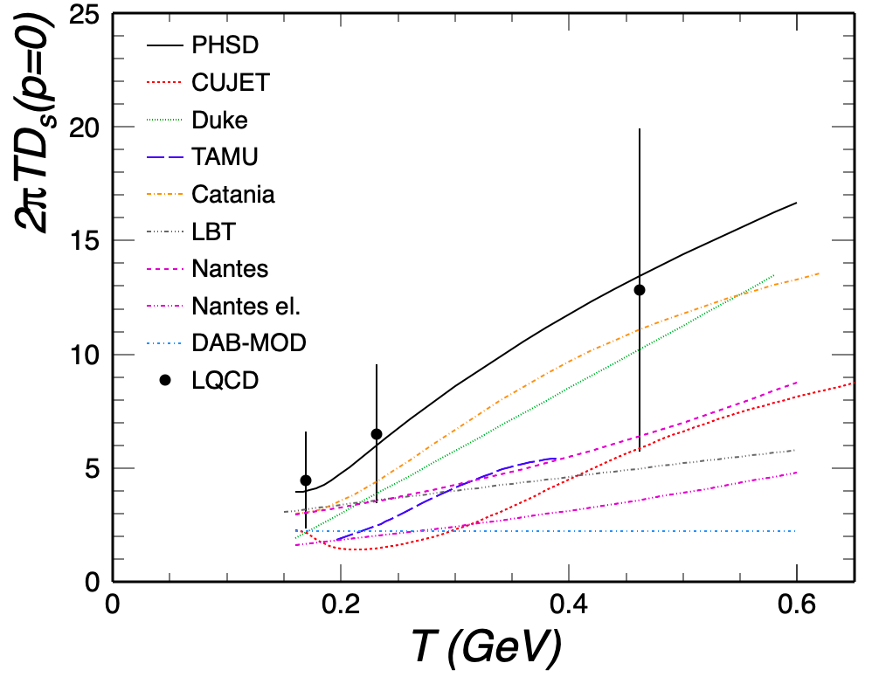
Q1(a) Current best estimate of Ds(2\piT) as function of T over available T-range (both charm and bottom, if available)
Charm

Slide 3
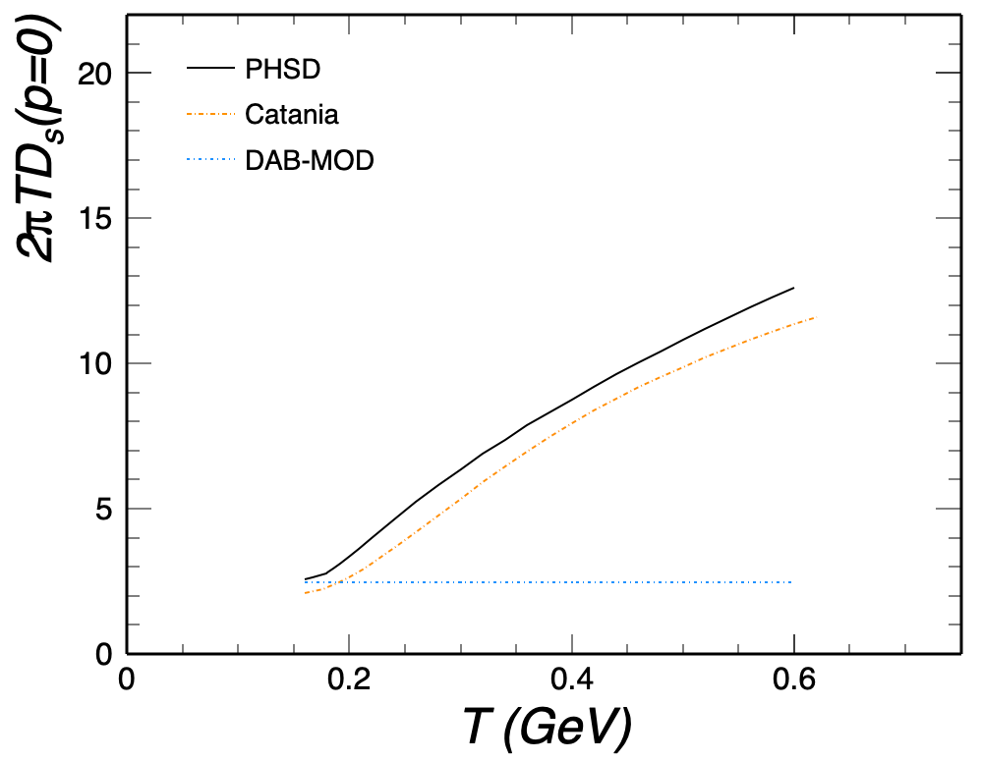
Q1(a) Current best estimate of Ds(2\piT) as function of T over available T-range (both charm and bottom, if available)
Bottom

Slide 4
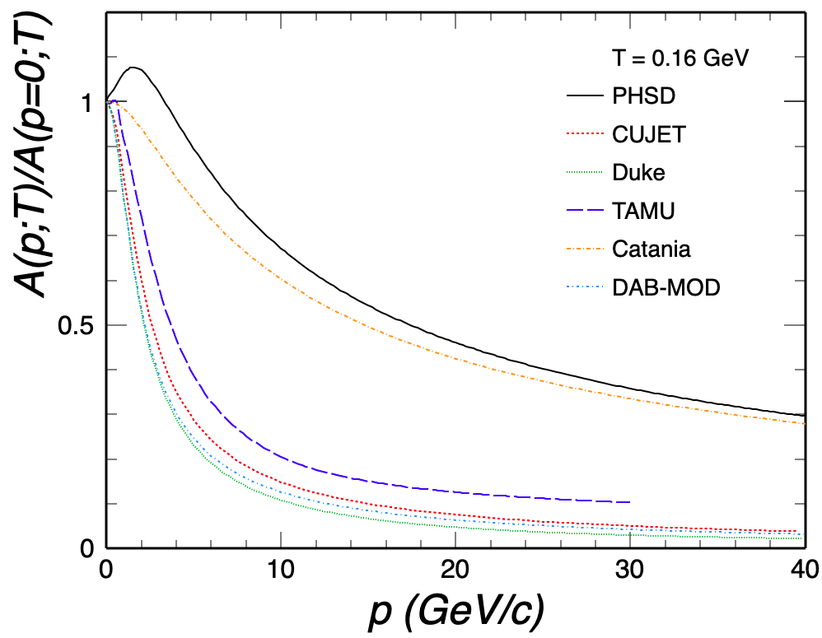
Q1(b) Normalized momentum dependence of friction coefficient, A(p;T)/A(p=0;T), for current best estimate
Charm

Slide 5
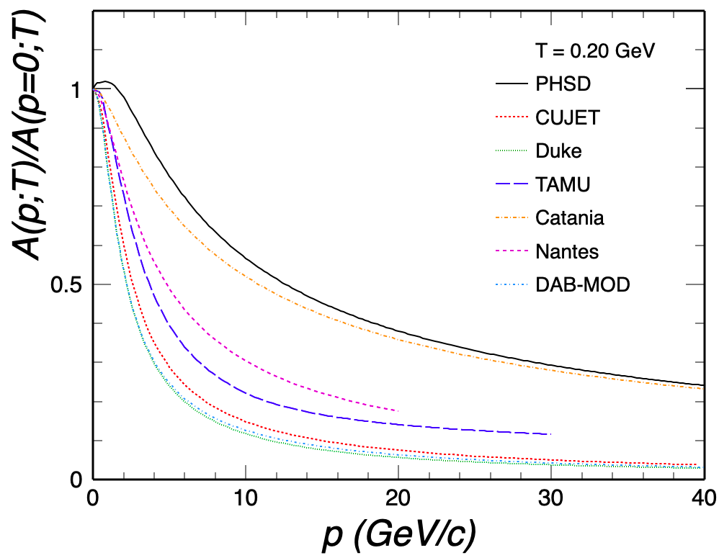
Q1(b) Normalized momentum dependence of friction coefficient, A(p;T)/A(p=0;T), for current best estimate
Charm

Slide 6
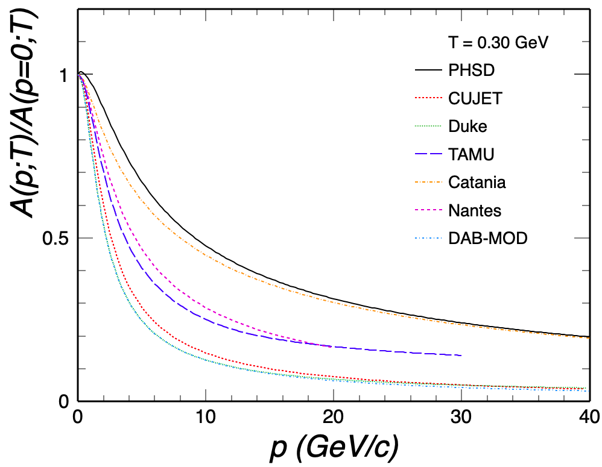
Q1(b) Normalized momentum dependence of friction coefficient, A(p;T)/A(p=0;T), for current best estimate
Charm

Slide 7

Q1(b) Normalized momentum dependence of friction coefficient, A(p;T)/A(p=0;T), for current best estimate
Charm

Slide 8
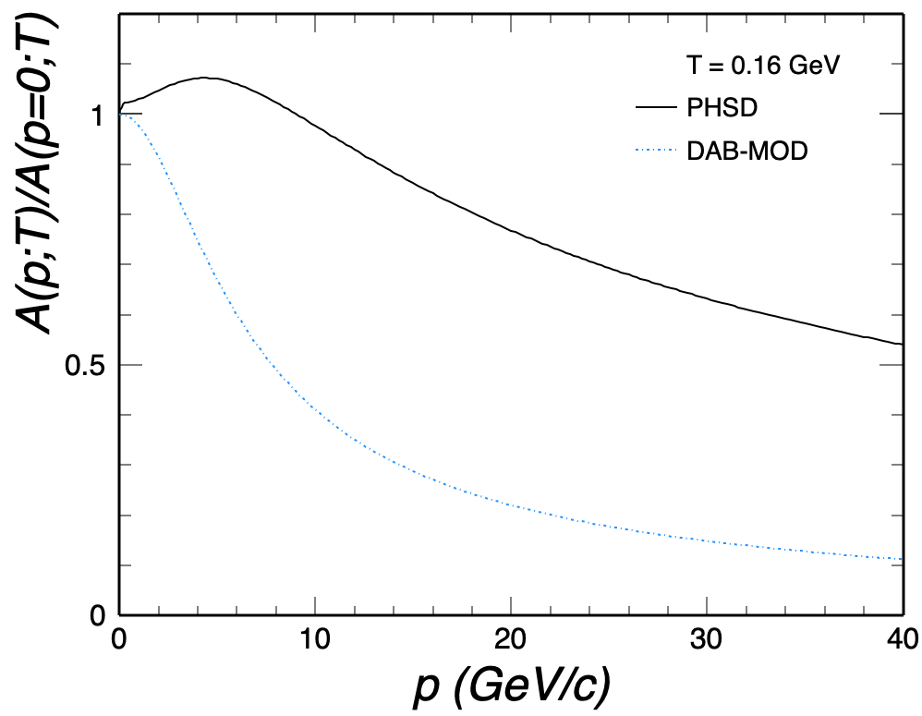
Q1(b) Normalized momentum dependence of friction coefficient, A(p;T)/A(p=0;T), for current best estimate
Bottom

Slide 9
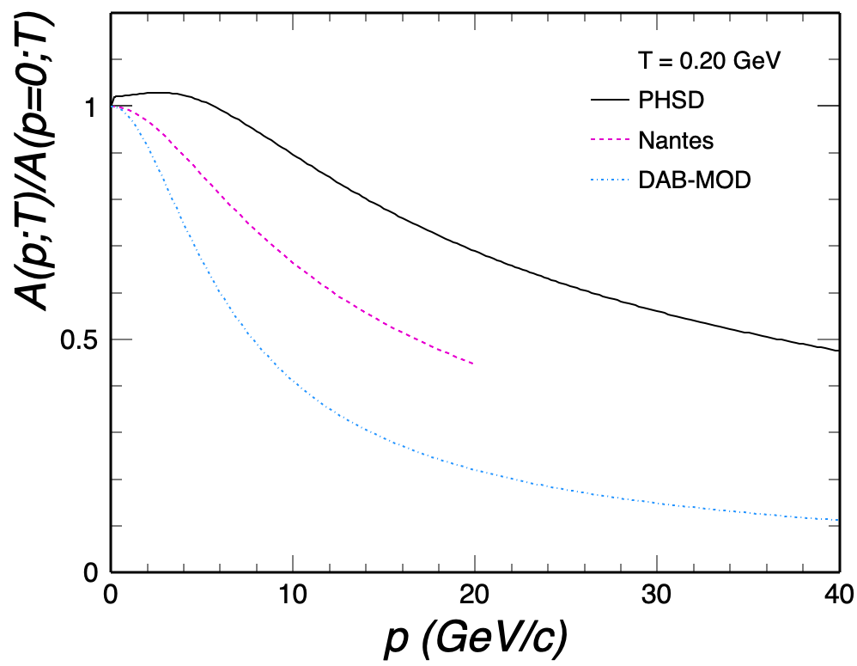
Q1(b) Normalized momentum dependence of friction coefficient, A(p;T)/A(p=0;T), for current best estimate
Bottom

Slide 10
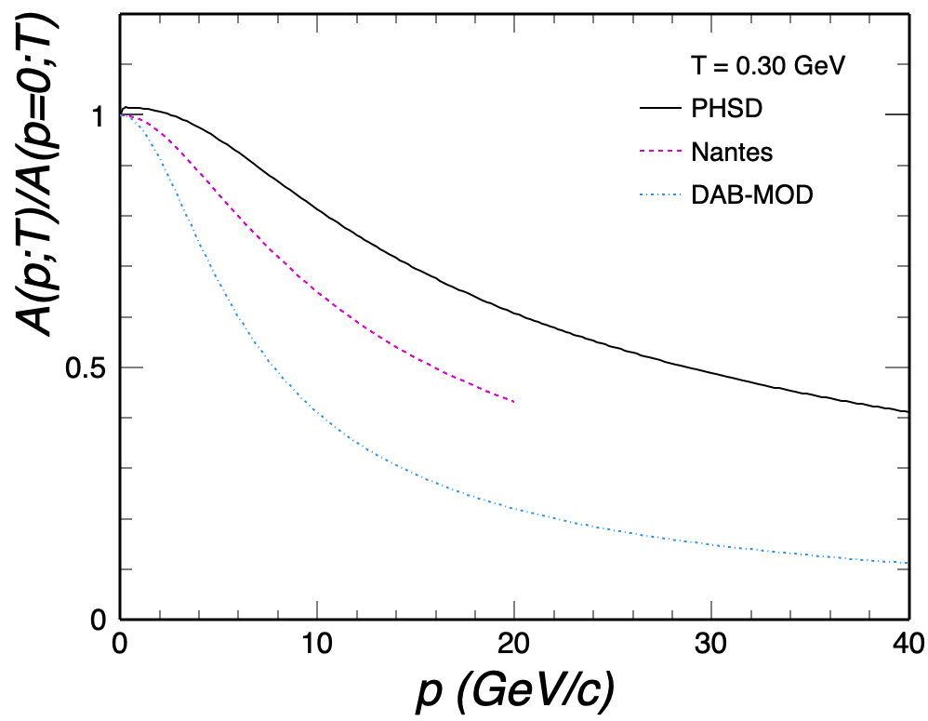
Q1(b) Normalized momentum dependence of friction coefficient, A(p;T)/A(p=0;T), for current best estimate
Bottom

Slide 11
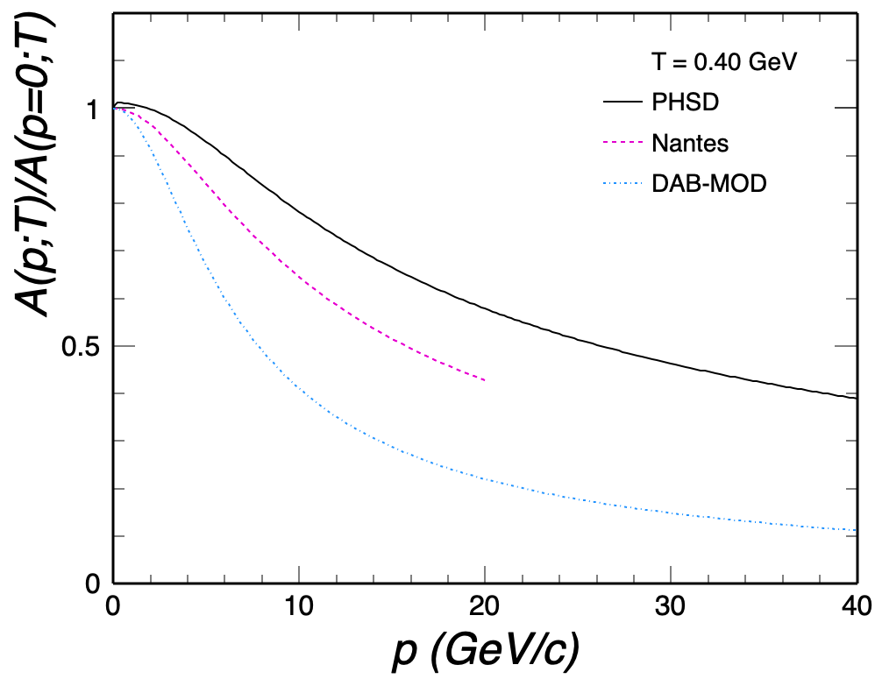
Q1(b) Normalized momentum dependence of friction coefficient, A(p;T)/A(p=0;T), for current best estimate
Bottom

Slide 12
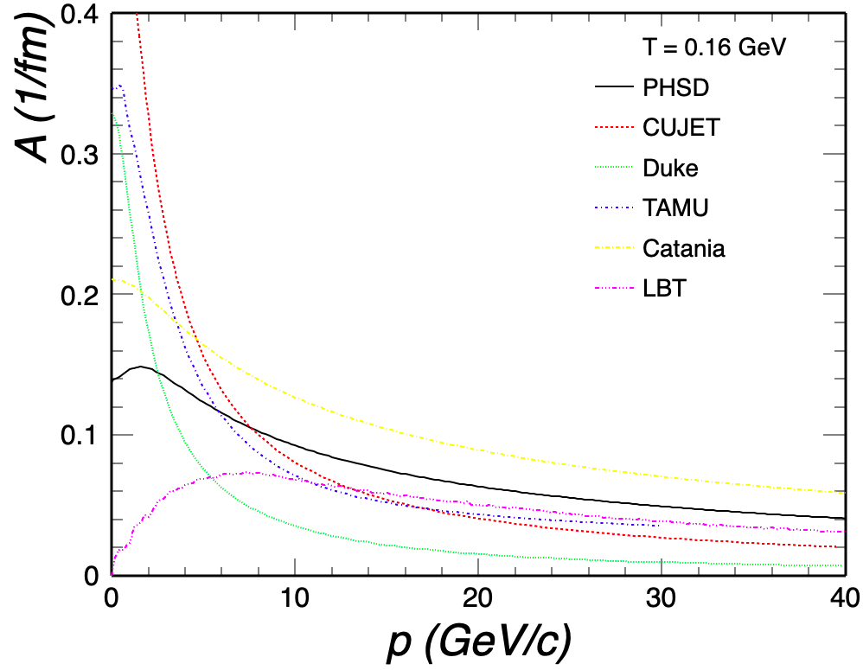
Q1(c) Table of current best estimates of charm friction and momentum-diffusion coefficients for p=0-40GeV and T=0.16-0.6GeV for mu_B=0.
Charm

Slide 13
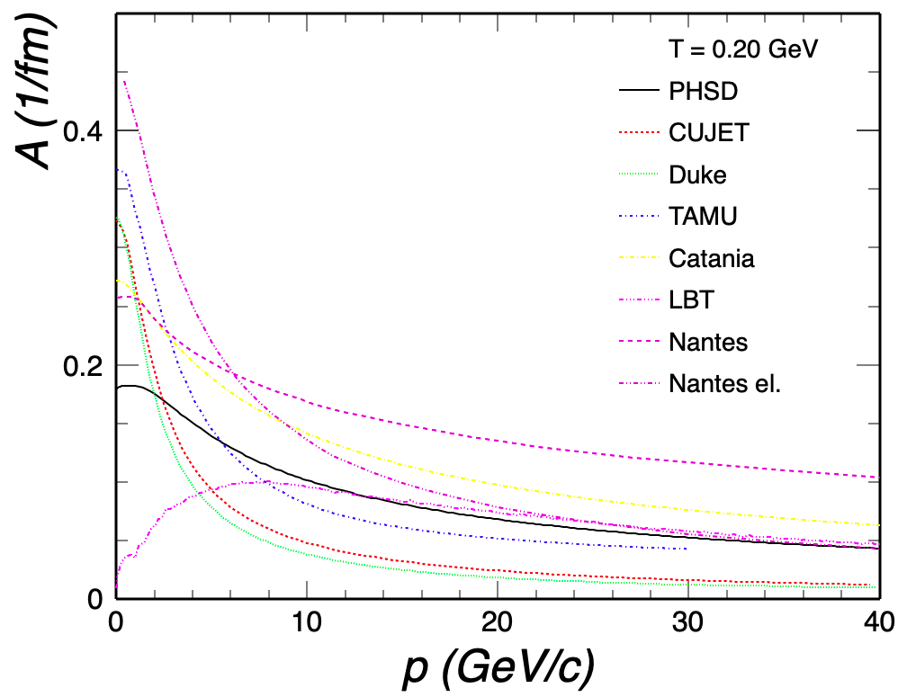
Q1(c) Table of current best estimates of charm friction and momentum-diffusion coefficients for p=0-40GeV and T=0.16-0.6GeV for mu_B=0.
Charm

Slide 14
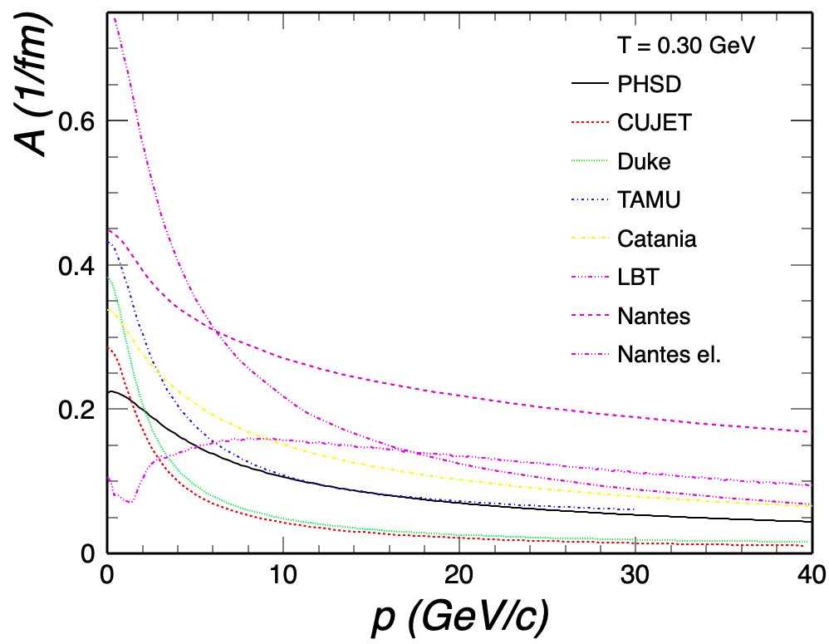
Q1(c) Table of current best estimates of charm friction and momentum-diffusion coefficients for p=0-40GeV and T=0.16-0.6GeV for mu_B=0.
Charm

Slide 15
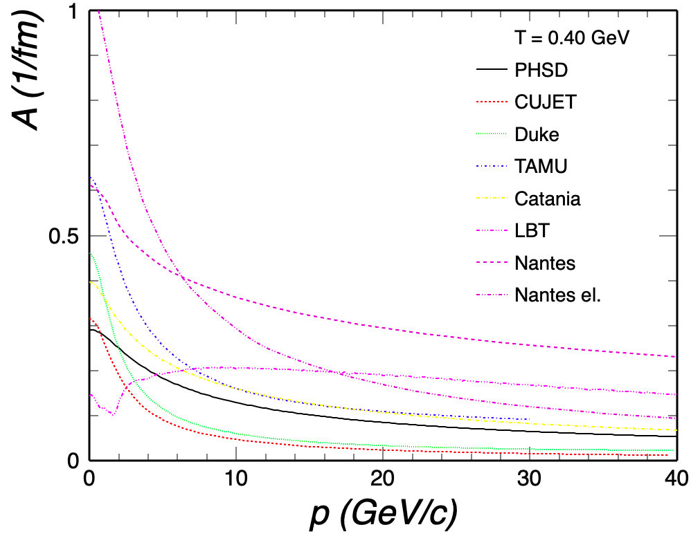
Q1(c) Table of current best estimates of charm friction and momentum-diffusion coefficients for p=0-40GeV and T=0.16-0.6GeV for mu_B=0.
Charm

Slide 16
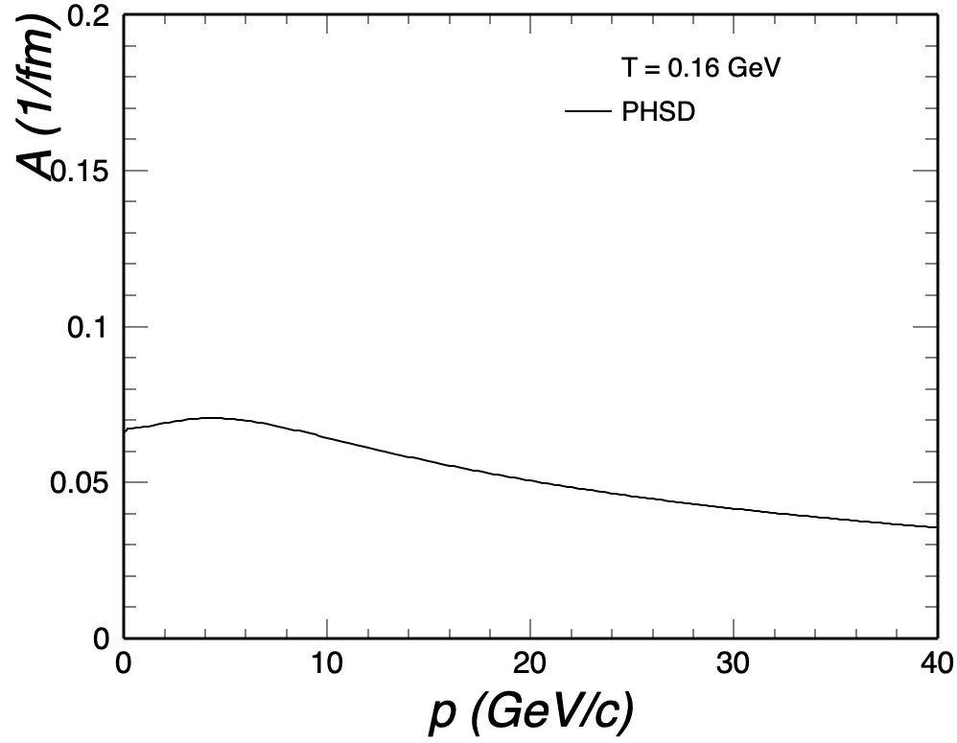
Q1(c) Table of current best estimates of charm friction and momentum-diffusion coefficients for p=0-40GeV and T=0.16-0.6GeV for mu_B=0.
Bottom

Slide 17
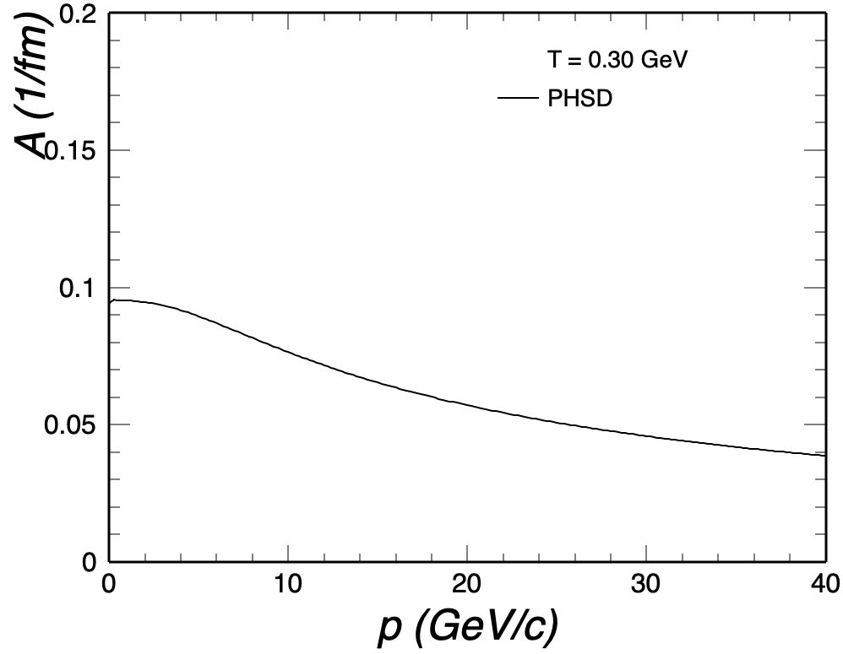
Q1(c) Table of current best estimates of charm friction and momentum-diffusion coefficients for p=0-40GeV and T=0.16-0.6GeV for mu_B=0.
Bottom

Slide 18
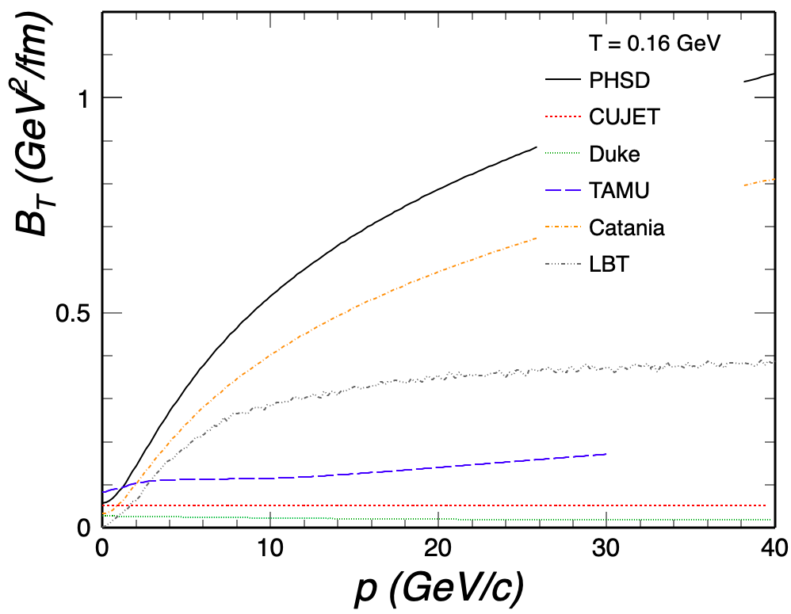
Q1(c) Table of current best estimates of charm friction and momentum-diffusion coefficients for p=0-40GeV and T=0.16-0.6GeV for mu_B=0.
Charm

Slide 19
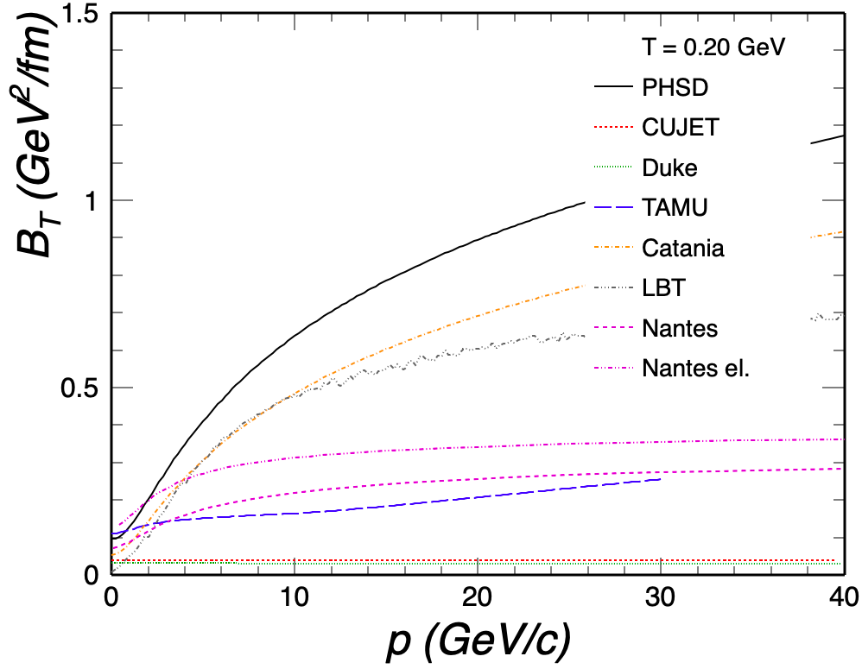
Q1(c) Table of current best estimates of charm friction and momentum-diffusion coefficients for p=0-40GeV and T=0.16-0.6GeV for mu_B=0.
Charm

Slide 20
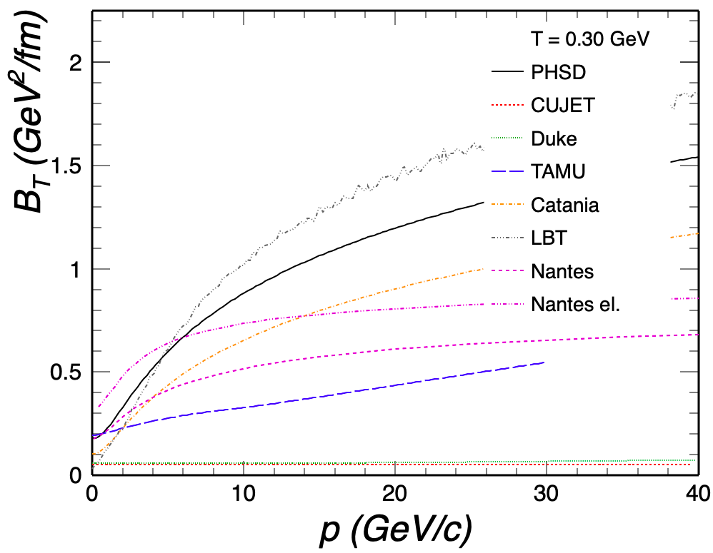
Q1(c) Table of current best estimates of charm friction and momentum-diffusion coefficients for p=0-40GeV and T=0.16-0.6GeV for mu_B=0.
Charm

Slide 21
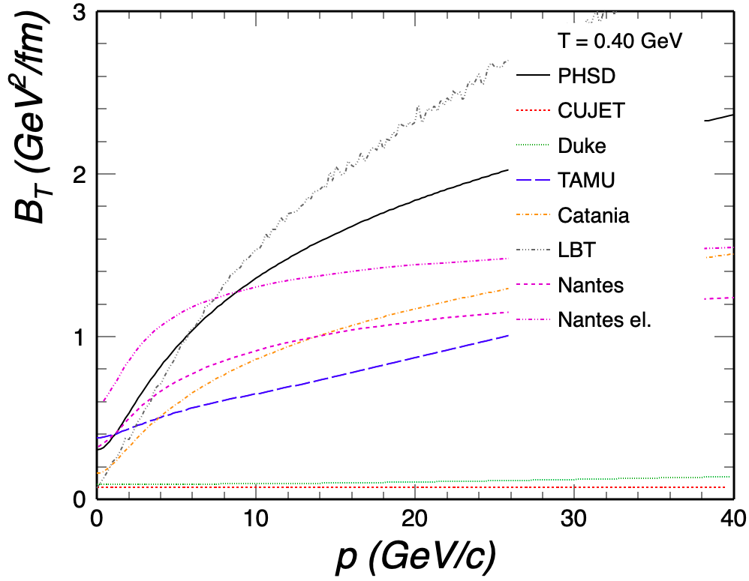
Q1(c) Table of current best estimates of charm friction and momentum-diffusion coefficients for p=0-40GeV and T=0.16-0.6GeV for mu_B=0.
Charm

Slide 22
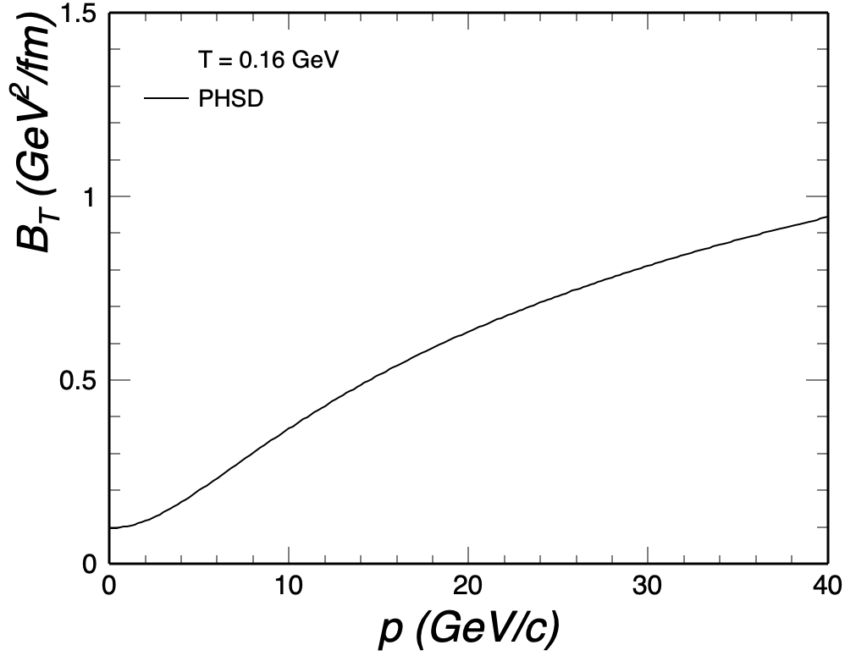
Q1(c) Table of current best estimates of charm friction and momentum-diffusion coefficients for p=0-40GeV and T=0.16-0.6GeV for mu_B=0.
Bottom

Slide 23
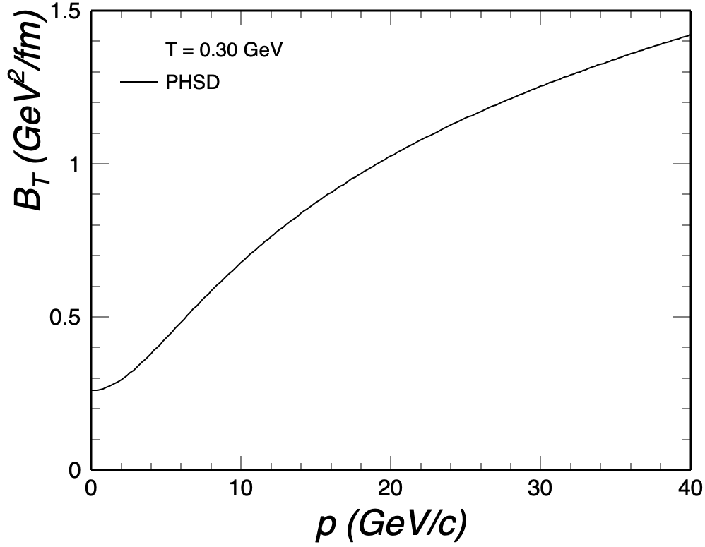
Q1(c) Table of current best estimates of charm friction and momentum-diffusion coefficients for p=0-40GeV and T=0.16-0.6GeV for mu_B=0.
Bottom

Slide 24
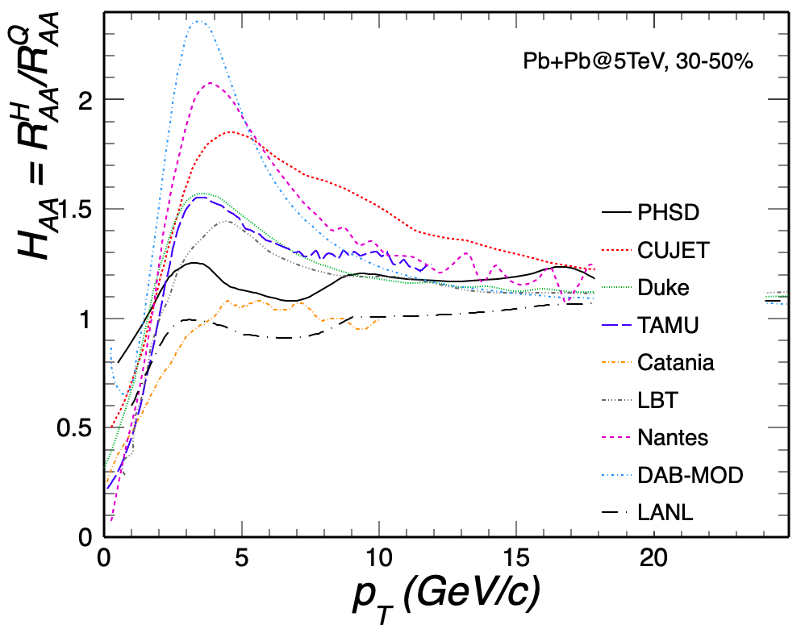
Q2(a) Compute H_AA(pT;T_H) = R_AA^H_Q (pT;T_H) / R_AA^Q(pT;T_H) , the ratio of the R_AA of the heavy meson (H_Q) just after hadronization to the R_AA of the heavy quark (Q) just before hadronization, for H_Q=D,Lambda_c (as available) and Q=c.
D⁰

Slide 25
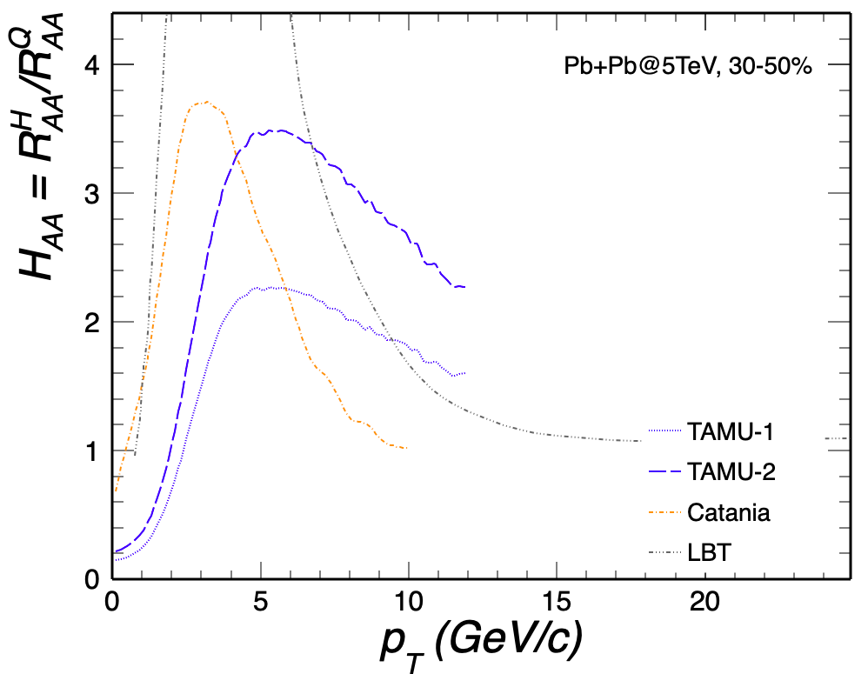
Q2(a) Compute H_AA(pT;T_H) = R_AA^H_Q (pT;T_H) / R_AA^Q(pT;T_H) , the ratio of the R_AA of the heavy meson (H_Q) just after hadronization to the R_AA of the heavy quark (Q) just before hadronization, for H_Q=D,Lambda_c (as available) and Q=c.
Λ_{c}

Slide 26
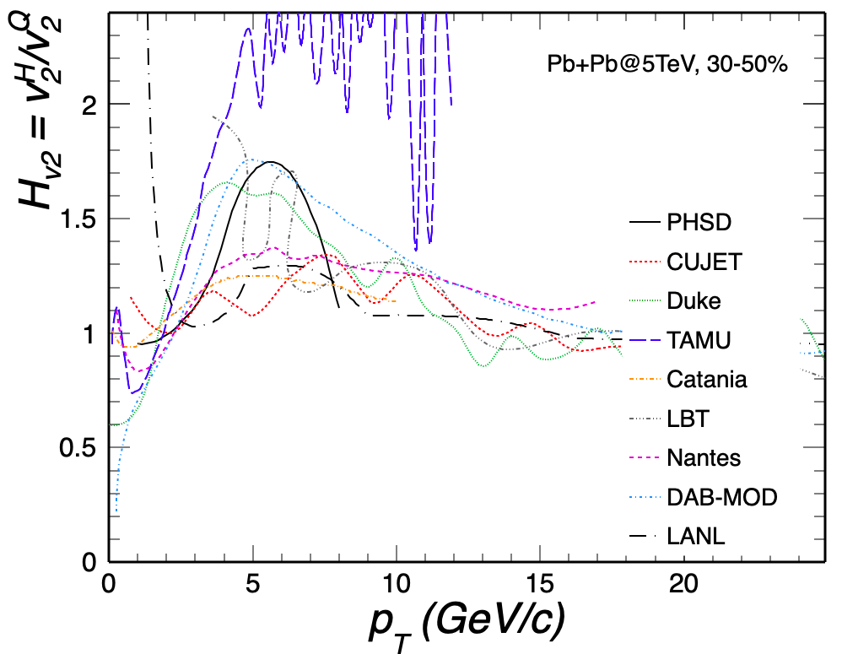
Q2(b) The same as (a) but for the elliptic flow, v2: H_v2(pT;T_H) = v2^H_Q (pT;T_H) / v2^Q(pT;T_H).
D⁰

Slide 27
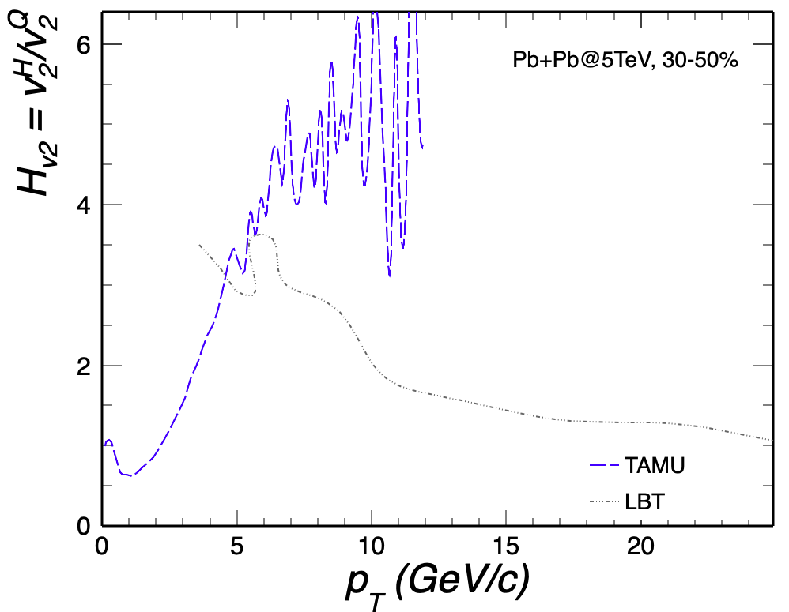
Q2(b) The same as (a) but for the elliptic flow, v2: H_v2(pT;T_H) = v2^H_Q (pT;T_H) / v2^Q(pT;T_H).
Λ_{c}

Slide 28
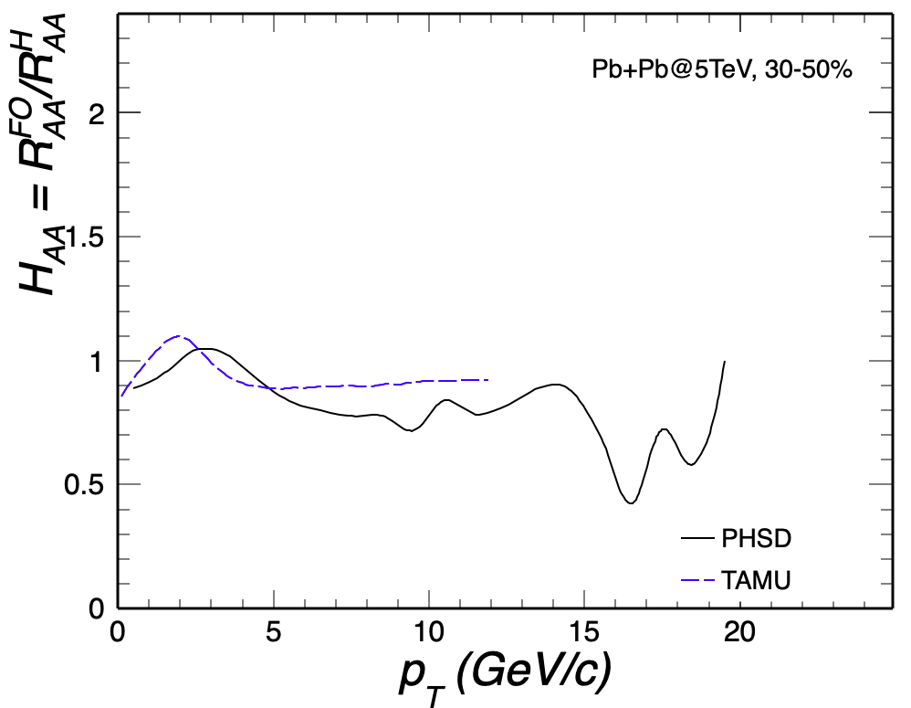
Q2(c) Compute H_AA and H_v2 ratios for D-meson spectra at kinetic freezeout over those right after hadronization (if applicable).
D⁰

Slide 29
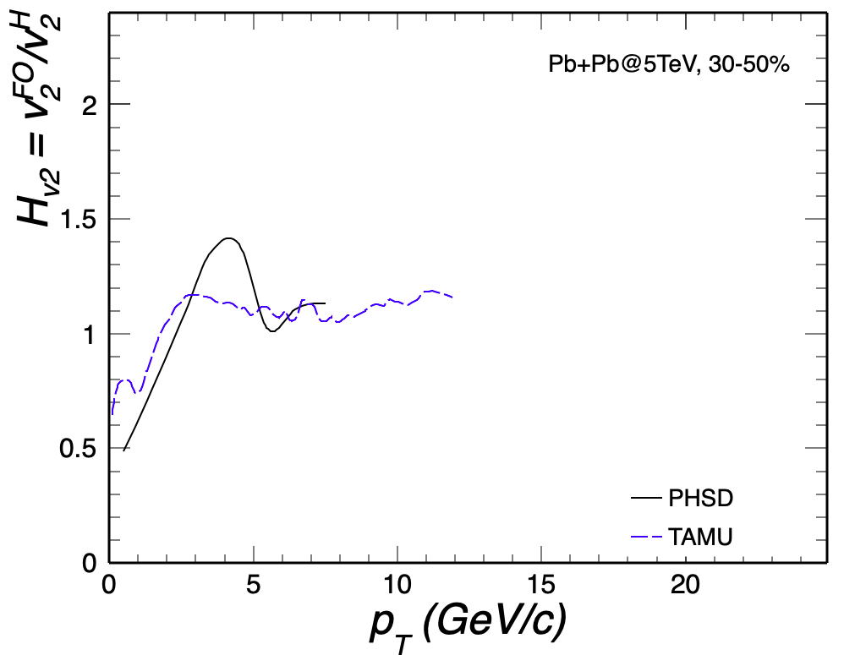
Q2(c) Compute H_AA and H_v2 ratios for D-meson spectra at kinetic freezeout over those right after hadronization (if applicable).
D⁰

Slide 30
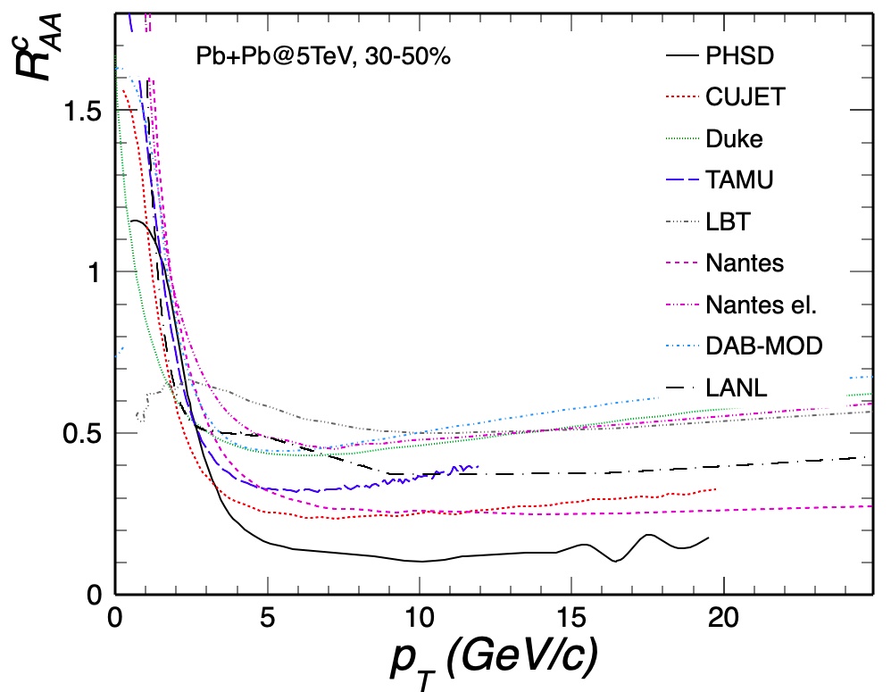
Q3(a) Renormalize the charm-quark transport coefficients with a temperature-dependent but momentum-independent K factor, K(T), as to obtain a temperature-independent value of D_s (2piT) == 4 (for Langevin approaches, D_s = T / [m_Q A(p=0)]); then compute R_AA and v2 of charm quarks right before hadronization for 30-50% 5TeV PbPb collisions within your model.

Slide 31
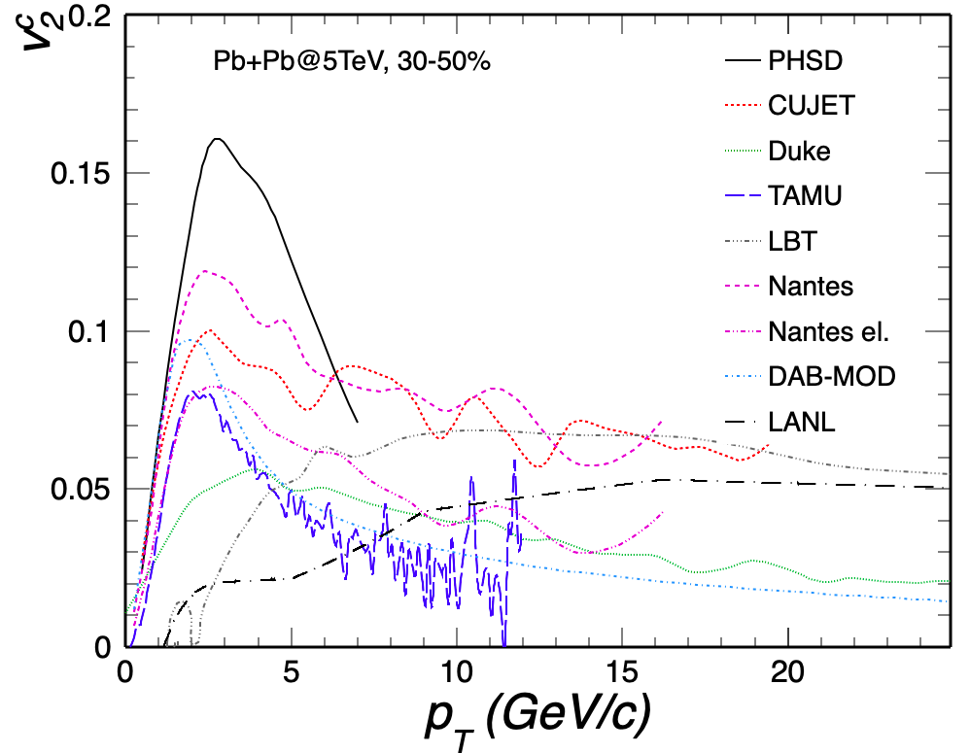
Q3(a) Renormalize the charm-quark transport coefficients with a temperature-dependent but momentum-independent K factor, K(T), as to obtain a temperature-independent value of D_s (2piT) == 4 (for Langevin approaches, D_s = T / [m_Q A(p=0)]); then compute R_AA and v2 of charm quarks right before hadronization for 30-50% 5TeV PbPb collisions within your model.

