Slide 1
2018 |  | 2020 |  | 2022 |  | 2024 |  | 2026 |  | 2028 |  | 2030 |  | 2032 |  | 2034
STAR BES II run |  |  |  | BES II ana
 |  |  |  |  | sPHENIX run |  |  | sPHENIX ana
 |  |  |  |  | CBM preparation? |  |  |  |  | CBM run + ana
 |  |  |  | ALICE ITS2 run |  |  | ALICE ana |  |  |  | ALICE ITS3 run |  |  | ALICE ana
 |  |  |  |  |  |  |  |  |  | ALICE3 preparation? |  |  |  |  | ALICE3 run
 |  |  | JLab 12 GeV run + ana |  |  |  |  |  |  |  |  |  |  |  | JLab ??
 |  |  | EIC preparation/construction |  |  |  |  |  |  |  |  |  |  |  | EIC run

Slide 2
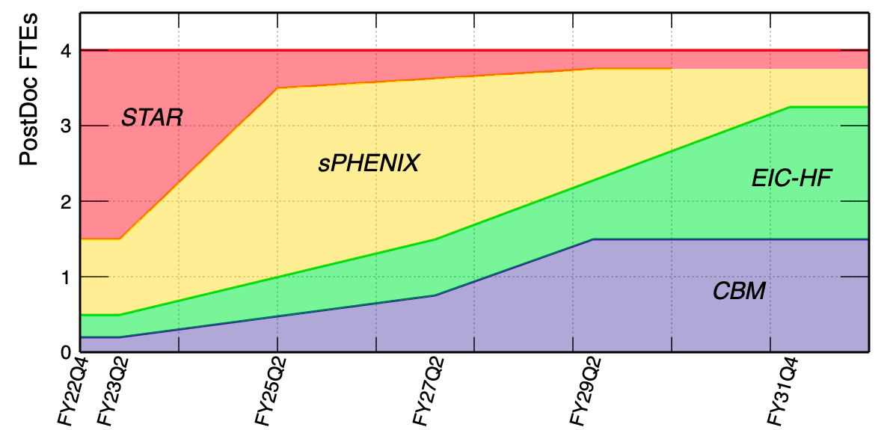
FTE – baseline / minimum
 | STAR |  | sPHENIX |  | CBM |  | EIC-HF |  | Total
 | Staff | PD | Staff | PD | Staff | PD | Staff | PD | Staff | PD
0-2 yr | 1.5 | 2.0 | 0.8 | 1.5 | 0.4 | 0.2 | 0.3 | 0.3 | 3 | 4
3-5 yr | 0.6 | 0.5 | 1.5 | 2.5 | 0.6 | 0.5 | 0.3 | 0.5 | 3 | 4
6-10 yr | 0.3 | 0.3 | 1.2 | 1.5 | 0.9 | 1.2 | 0.6 | 1.0 | 3 | 4

Slide 3
FTE – expanded
CBM funded by DOE
0-2 years: expanded | 1.75 (0.4) | 1 (0.2) | CBM is funded by DOE as part its HI program at high baryon density region. Work on the upgrade of the pixel-tracker at CBM. Physics: (i) QCD CP; (ii) Hyper nuclei program -> connect with Astro-nuclear physics. |  | 1FTE and 1 PD will be needed to work on the pixel-tracker at CBM. | 1.75=0.75 (NX)+1 (XX)
3-5 years: expanded | 2.5 (0.6) | 2 (0.5) | Prepare CBM for data taking. Near the end of the period, physics analysis starts. |  | More effots needed for the installation and calibrtion of the tracker + physics analysis at the end of the period | 2.5=1 (NX) + 1.5 (XX)
6-10 years: expanded | 1.5 (0.9) | 2 (1.2) | (1) Physics analysis starts, search for QCD CP, hypernuclei production at high baryon dnesity and 1st order phase boundary; (2) Deterctor upgrade. |  | Data analysis and calibration. | 1.5=1 (NX) + 0.5 (XX)
black: baseline scenario
Need additional 1-2 staff for instrumentation + 1-1.5 PDs (+ xx students) for instrumentation/physics

Slide 4
1) Examine/correct errors in the assumptions and numbers presented
A: See previous two slides.
2) Identify areas where effort can be reduced with minimal impact on the main science, project goals of the baseline program (i.e. avoid overly-conservative estimates)?
A: Personpower presented in Slide 2 is the baseline also the minimum efforts for RHIC HI physics program as well as in transition towards the EIC/CBM programs in 203x.
3) What physics/outcomes do we give up with further cuts?
Prioritized incremental steps decreasing from “baseline” to “minimal” scenario (with details of lost physics/outcomes for each cut relative to the program presented for the baseline)
A: In case of further cuts, we will have to either reduce the RHIC HI physics program efforts or cut the development for future EIC-HF/CBM efforts which will have significant damage to the scientific output of the group.
4) What do we gain if we expand beyond baseline (at the cost of another program)
Prioritized incremental steps towards “expanded”
A: In the case that CBM program is funded by DOE, we would like to expand the efforts to add 1-2 staff and 1-2 PD FTEs for both instrumentation and physics program (see Slide 3).
5) Options for “new/future” projects in first 2 years
What is minimum required to keep options open, are there decision points before year 2?
A: In the first 2 years, we would like to keep 0.3 staff + 0.3 PD involvement to build the community support for CBM. The decision point is more or less aligned with the next LRP report.
6) Criteria for no / no-go decisions?
A: Same as 5), the CBM program will mostly depend on whether it is included in the next LRP report.

