Slide 1
2018 |  | 2020 |  | 2022 |  | 2024 |  | 2026 |  | 2028 |  | 2030 |  | 2032 |  | 2034
STAR BES II run |  |  |  | BES II ana
 |  |  |  |  | sPHENIX run |  |  | sPHENIX ana
 |  |  |  |  | CBM preparation? |  |  |  |  | CBM run + ana
 |  |  |  | ALICE ITS2 run |  |  | ALICE ana |  |  |  | ALICE ITS3 run |  |  | ALICE ana
 |  |  |  |  |  |  |  |  |  | ALICE3 preparation? |  |  |  |  | ALICE3 run
 |  |  | JLab 12 GeV run + ana |  |  |  |  |  |  |  |  |  |  |  | JLab ??
 |  |  | EIC preparation/construction |  |  |  |  |  |  |  |  |  |  |  | EIC run

Slide 2
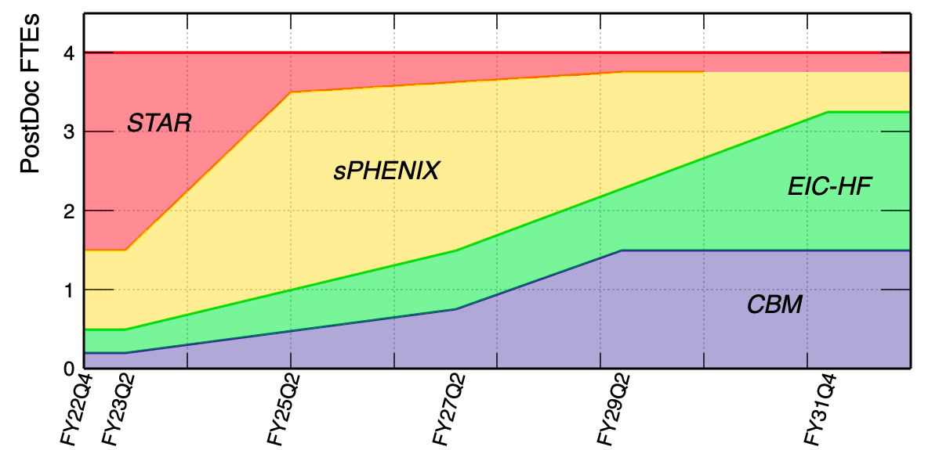
FTE – baseline / minimum
 | STAR |  | sPHENIX |  | CBM |  | EIC-HF |  | Total
 | Staff | PD | Staff | PD | Staff | PD | Staff | PD | Staff | PD
0-2 yr | 1.5 | 2.0 | 0.8 | 1.5 | 0.4 | 0.2 | 0.3 | 0.3 | 3 | 4
3-5 yr | 0.6 | 0.5 | 1.5 | 2.5 | 0.6 | 0.5 | 0.3 | 0.5 | 3 | 4
6-10 yr | 0.3 | 0.3 | 1.2 | 1.5 | 0.9 | 1.2 | 0.6 | 1.0 | 3 | 4

Slide 3
FTE – expanded
CBM funded by DOE
0-2 years: expanded | 1.75 (0.4) | 1 (0.2) | CBM is funded by DOE as part its HI program at high baryon density region. Work on the upgrade of the pixel-tracker at CBM. Physics: (i) QCD CP; (ii) Hyper nuclei program -> connect with Astro-nuclear physics. |  | 1FTE and 1 PD will be needed to work on the pixel-tracker at CBM. | 1.75=0.75 (NX)+1 (XX)
3-5 years: expanded | 2.5 (0.6) | 2 (0.5) | Prepare CBM for data taking. Near the end of the period, physics analysis starts. |  | More effots needed for the installation and calibrtion of the tracker + physics analysis at the end of the period | 2.5=1 (NX) + 1.5 (XX)
6-10 years: expanded | 1.5 (0.9) | 2 (1.2) | (1) Physics analysis starts, search for QCD CP, hypernuclei production at high baryon dnesity and 1st order phase boundary; (2) Deterctor upgrade. |  | Data analysis and calibration. | 1.5=1 (NX) + 0.5 (XX)
black: baseline scenario
Need additional 1-2 staff for instrumentation + 1-1.5 PDs (+ xx students) for instrumentation/physics

Slide 4
1) Examine/correct errors in the assumptions and numbers presented
A: See previous two slides.
2) Identify areas where effort can be reduced with minimal impact on the main science, project goals of the baseline program (i.e. avoid overly-conservative estimates)?
A: Personpower presented in Slide 2 is the baseline also the minimum efforts for RHIC HI physics program as well as in transition towards the EIC/CBM programs in 203x.
3) What physics/outcomes do we give up with further cuts?
Prioritized incremental steps decreasing from “baseline” to “minimal” scenario (with details of lost physics/outcomes for each cut relative to the program presented for the baseline)
A: In case of further cuts, we will have to either reduce the RHIC HI physics program efforts or cut the development for future EIC-HF/CBM efforts which will have significant damage to the scientific output of the group.
4) What do we gain if we expand beyond baseline (at the cost of another program)
Prioritized incremental steps towards “expanded”
A: In the case that CBM program is funded by DOE, we would like to expand the efforts to add 1-2 staff and 1-2 PD FTEs for both instrumentation and physics program (see Slide 3).
5) Options for “new/future” projects in first 2 years
What is minimum required to keep options open, are there decision points before year 2?
A: In the first 2 years, we would like to keep 0.3 staff + 0.3 PD involvement to build the community support for CBM. The decision point is more or less aligned with the next LRP report.
6) Criteria for no / no-go decisions?
A: Same as 5), the CBM program will mostly depend on whether it is included in the next LRP report.

Slide 5
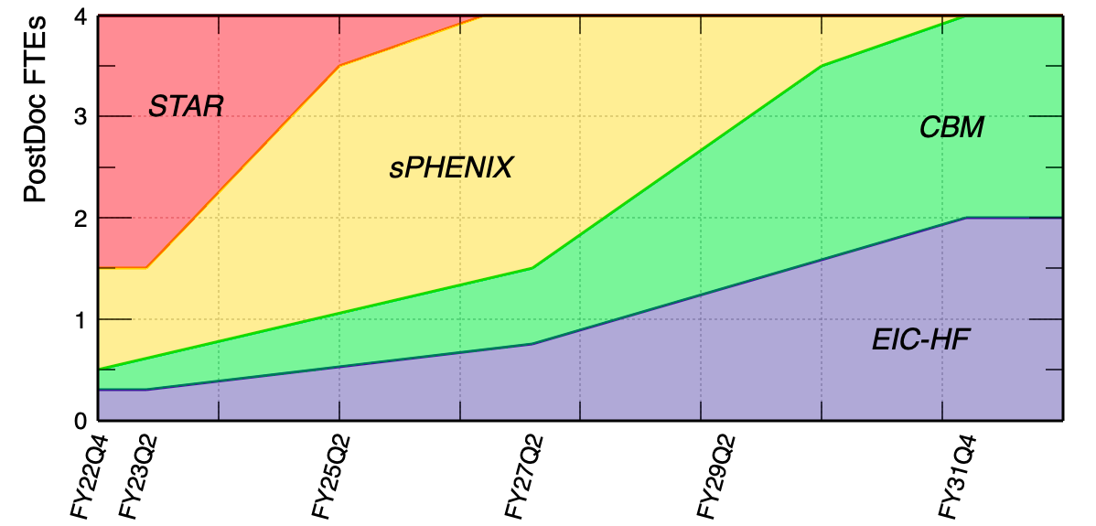
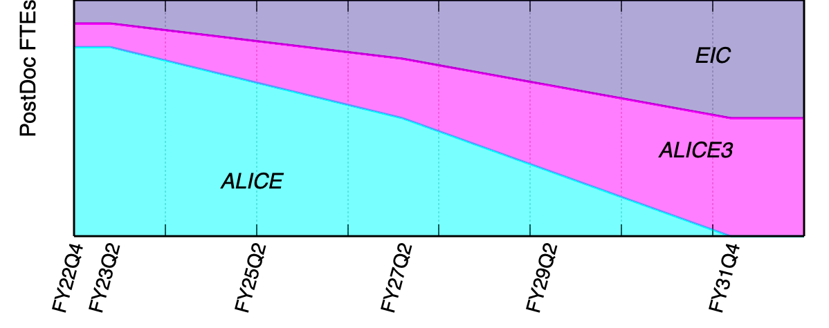

Slide 6
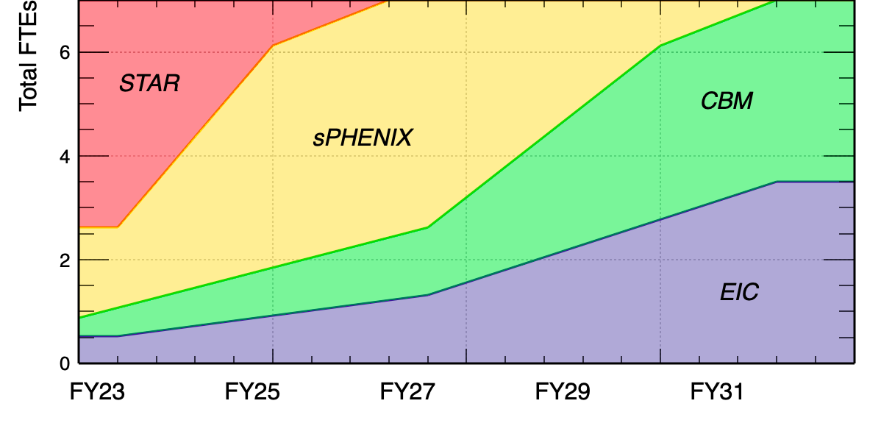
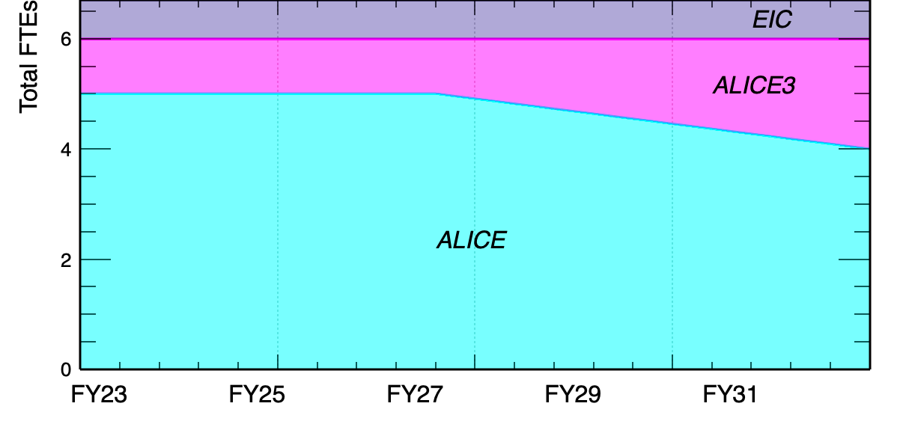

Slide 8
Homework:
1) Walkdowns for STAR, sPHENIX, CBM. There is a significant ramp down of the total effort already factored in, so walkdowns would mainly be for the 0-2 and 3-5 year windows. It may be that the walkdowns are only needed for the scenario where we are at true constant effort, but in the true CE program (which is a worst case scenario), it may be that everything needs to be trimmed.
2) CBM Walkups: The previous homework defined the details for CBM, so that's in pretty good shape. However, it seems unlikely that we would start hardware work for a pixel tracker in years 0-2, since we don't yet know the CBM long term future. How would that impact the FTE needs for 3-5 and 6-10 years if we contribute to the tracker? If it can't happen without work in years 0-2, then it will be important to make the case for the initial work even with the associated uncertainty.
3) STAR/sPHENIX Walkups: There aren't any proposed walkups for STAR or sPHENIX, but there are a couple of options that might(?) be considered strategic options to consider. The current program is focused around completing some of the physics we're most interested in (e.g. BES) and, for example, doesn't include involvement in future STAR runs. But with our contributions to the HFT, are the analyses from upcoming runs that might capitalize on that detector where it would make sense to continue efforts? Similarly, with ECCE having some systems in common with sPHENIX, are there additional sPHENIX topics that might be of interest because of the connection to the EIC? It will be the only US Based HI experiment for some period, so there are potential advantages to a stronger role there (if it's physics we like, even if it's not our top priority).

Slide 9
Walkdowns for STAR, sPHENIX, CBM. There is a significant ramp down of the total effort already factored in, so walkdowns would mainly be for the 0-2 and 3-5 year windows. It may be that the walkdowns are only needed for the scenario where we are at true constant effort, but in the true CE program (which is a worst case scenario), it may be that everything needs to be trimmed.
A: For STAR, the main BES-II analysis is expected to finish by ~2024/2025. The estimated small fraction personpower (0.3) at 3+ years can be merged/shared with sPHENIX, CBM or EIC efforts depending on the final analysis status.
For sPHENIX, our main physics interests are in the heavy flavor physics program utilizing the MVTX efforts including
- open bottom RAA and v2, heavy flavor baryon production., D/Dbar directed flow etc..
Whether and when we can ramp down the efforts will strongly depend on the sPHENIX data calibration/production readiness. The current RHIC computing resource projection for sPHENIX falls short by 50%. This has brought up as strong recommendation to enable sufficient computing resource + key personnels for sPHENIX by the PAC to BNL management. Other connections to the instrumentation/EIC interests will be addressed in 3)

Slide 10
2) CBM Walkups: The previous homework defined the details for CBM, so that's in pretty good shape. However, it seems unlikely that we would start hardware work for a pixel tracker in years 0-2, since we don't yet know the CBM long term future. How would that impact the FTE needs for 3-5 and 6-10 years if we contribute to the tracker? If it can't happen without work in years 0-2, then it will be important to make the case for the initial work even with the associated uncertainty.
A:

Slide 11
3) STAR/sPHENIX Walkups: There aren't any proposed walkups for STAR or sPHENIX, but there are a couple of options that might(?) be considered strategic options to consider. The current program is focused around completing some of the physics we're most interested in (e.g. BES) and, for example, doesn't include involvement in future STAR runs. But with our contributions to the HFT, are the analyses from upcoming runs that might capitalize on that detector where it would make sense to continue efforts? Similarly, with ECCE having some systems in common with sPHENIX, are there additional sPHENIX topics that might be of interest because of the connection to the EIC? It will be the only US Based HI experiment for some period, so there are potential advantages to a stronger role there (if it's physics we like, even if it's not our top priority).
A: For STAR, there are a few interested physics with the 2023-2025 runs: higher order (C5-C8) of net-proton cumulants for cross-over phase transition nature; dielectrons for QGP thermal radiation etc. In case of increased resource in the future, we will be very interested in continuing on these measurements. STAR HFT has been decommissioned, no future runs are planned.
For sPHENIX, the interested topics that can be connected to EIC includes open charm transverse spin asymmetry in p+p collisions, charm baryon spectroscopy in p+p collisions etc. On the HI side, we would be interested in further investigating new observables involving the heavy flavor hadron/jet/correlation measurements towards the precision characterization of the QGP medium properties. These measurements will be complementary to the LHC Run3-4 measurements, and can have legacy for future ALICE3 program. In addition, there are also interested measurements with large statistics MB sample (~200B) from sPHENIX to study the hyperon correlations (e.g. Lambda-Lambda) and (anti-)hypernuclei measurements to investigate the Y-N interaction and look for exotic particles.

