Slide 1
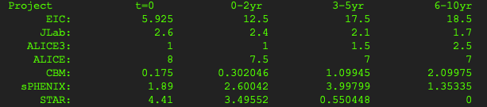
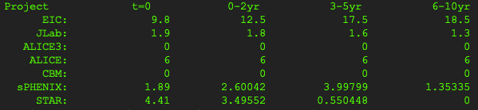
0626 Updates:
STAR/sPHENIX: walkdown efforts reduced (at minimum) – fine adjustment to match xls numbers
Default: CBM default + ALICE default + ALICE3 default + JLab default
Minimum: no CBM + ALICE minimum + no ALICE3 + JLab minimum
EIC kept as default, minimum will be compared

Slide 2
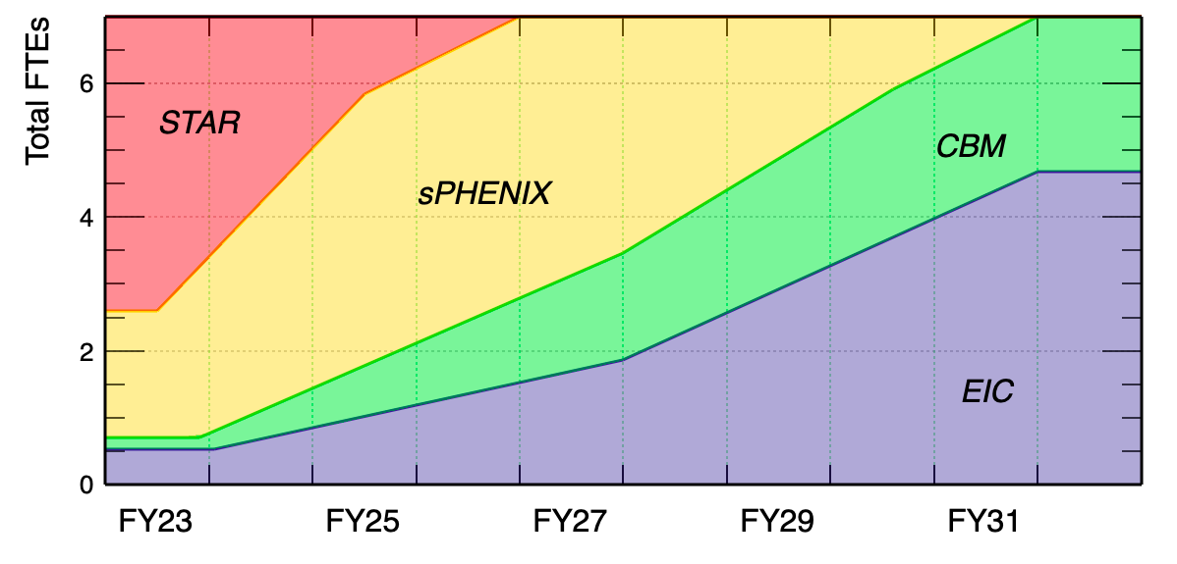
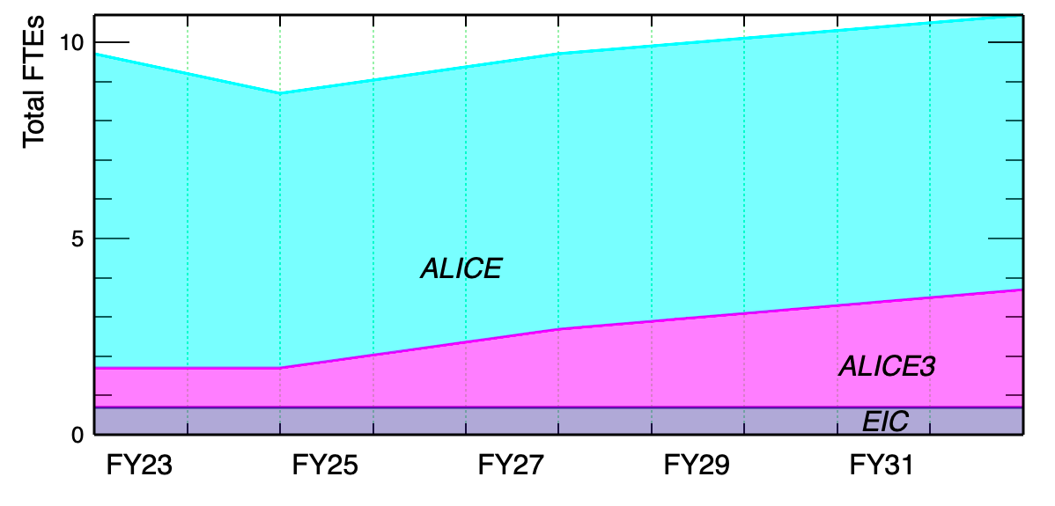
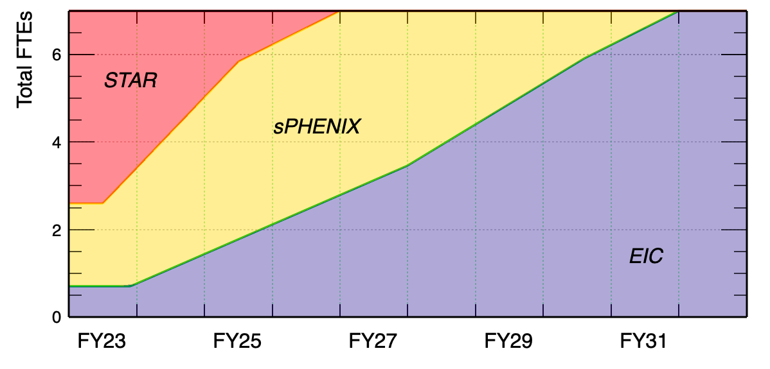
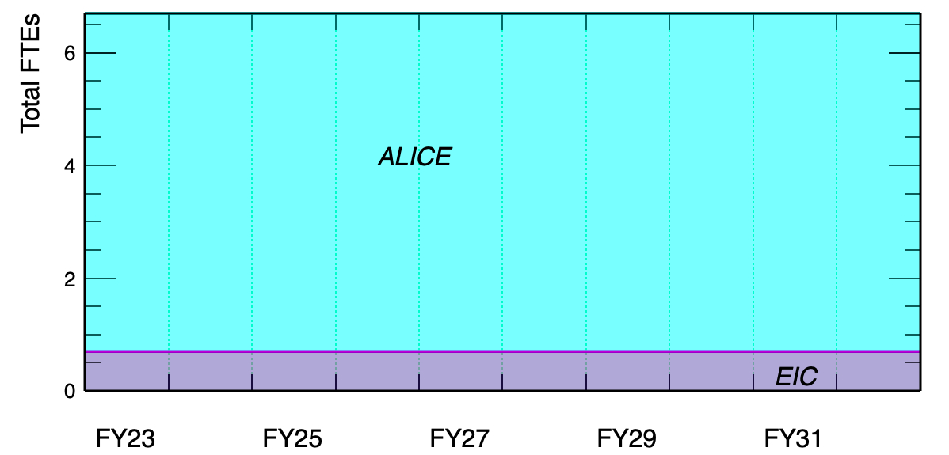
default
minimum

Slide 3
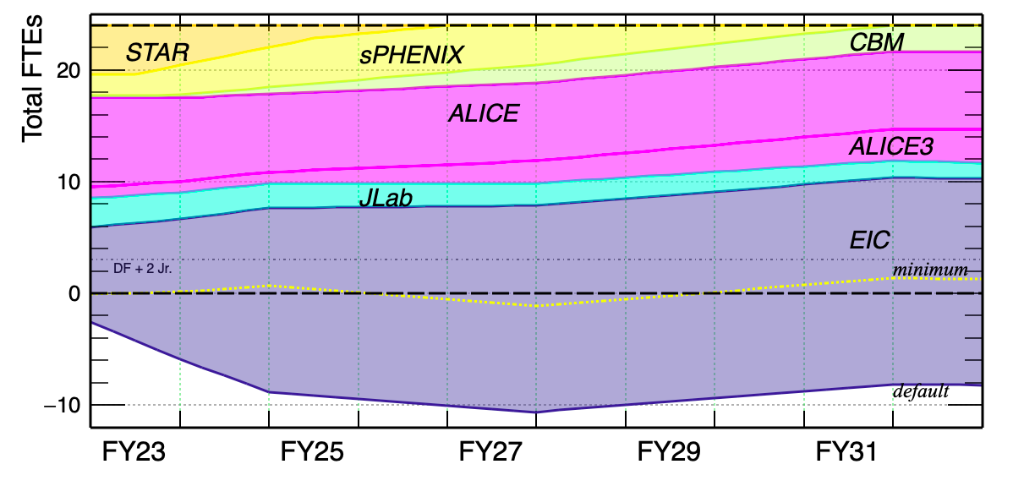
Default for Non-EIC Programs

Slide 4
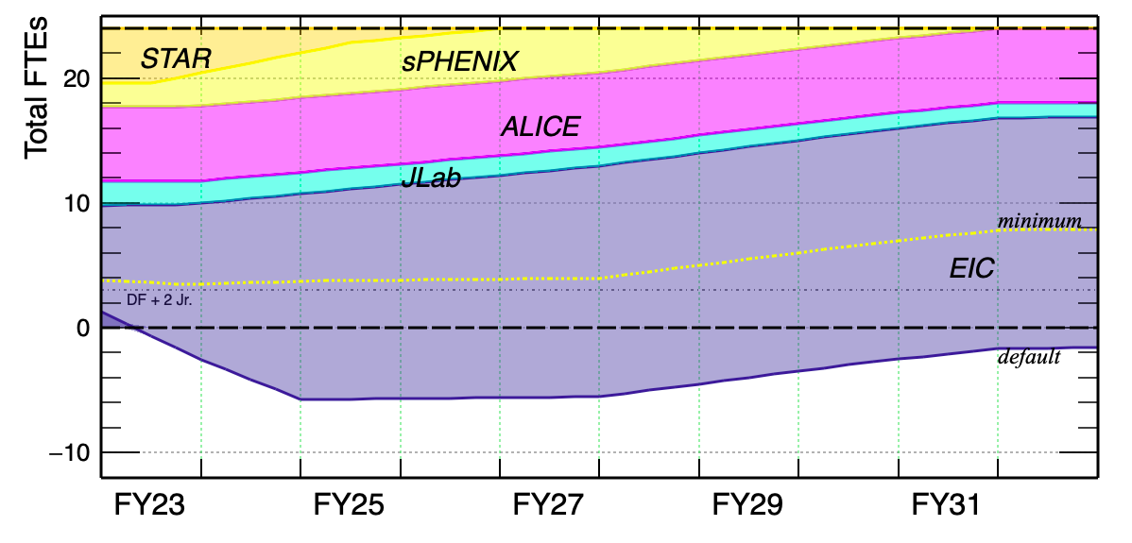
Minimum for Non-EIC Programs

Slide 5
0624 updates
Start with minimum efforts for HI sub-groups
Sharp ramp for EIC in the first two years to baseline (12.5, 17.5, 18.5)
Try to match the current total number of FTEs (24)

Slide 6
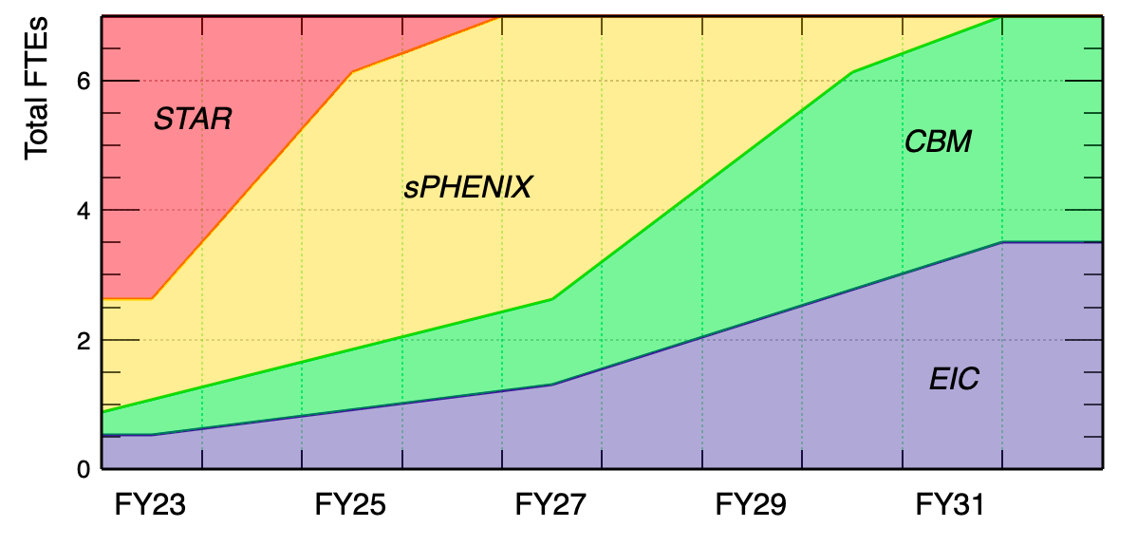
STAR/sPHENIX/CBM Group – baseline/minimum (3 Staff + 4 PD)

Slide 7
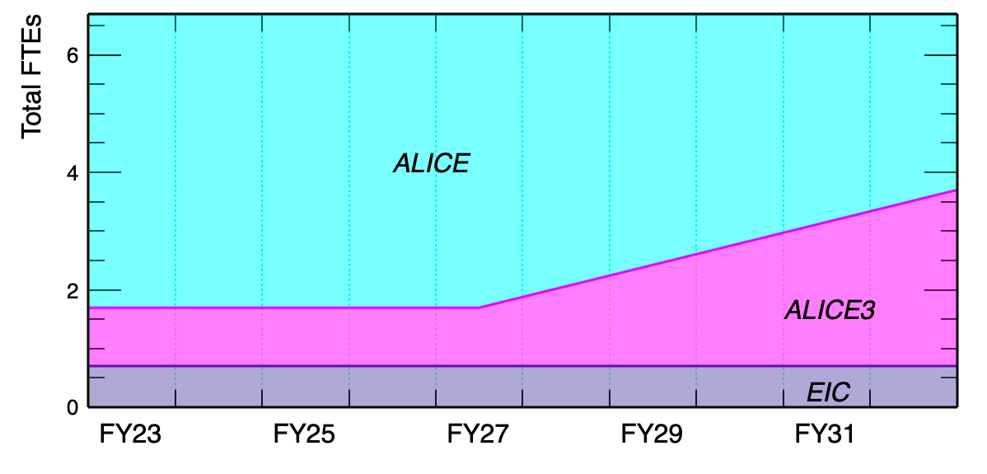
ALICE/ALICE3 – minimum (3 + 3 + 0.7(EIC))

Slide 8
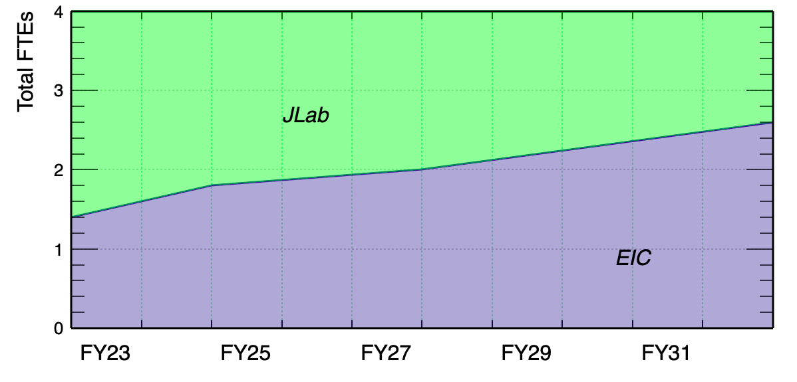
ME – baseline (2 + 2)

Slide 9
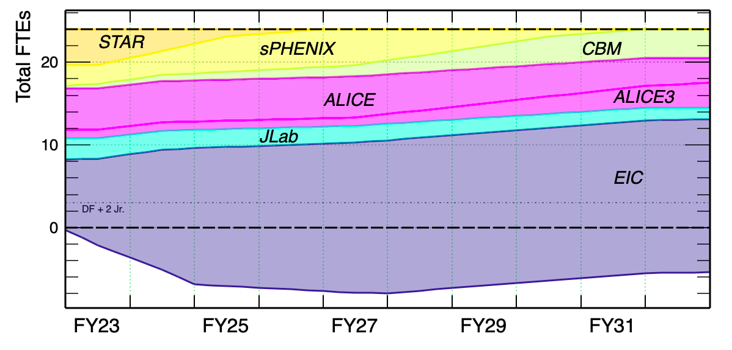
60%
34%

Slide 10
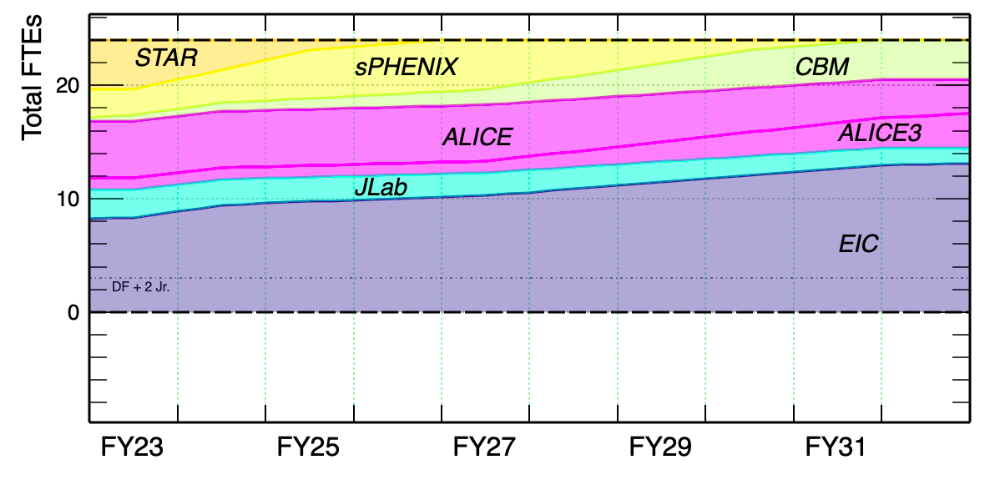

Slide 11
old

Slide 12
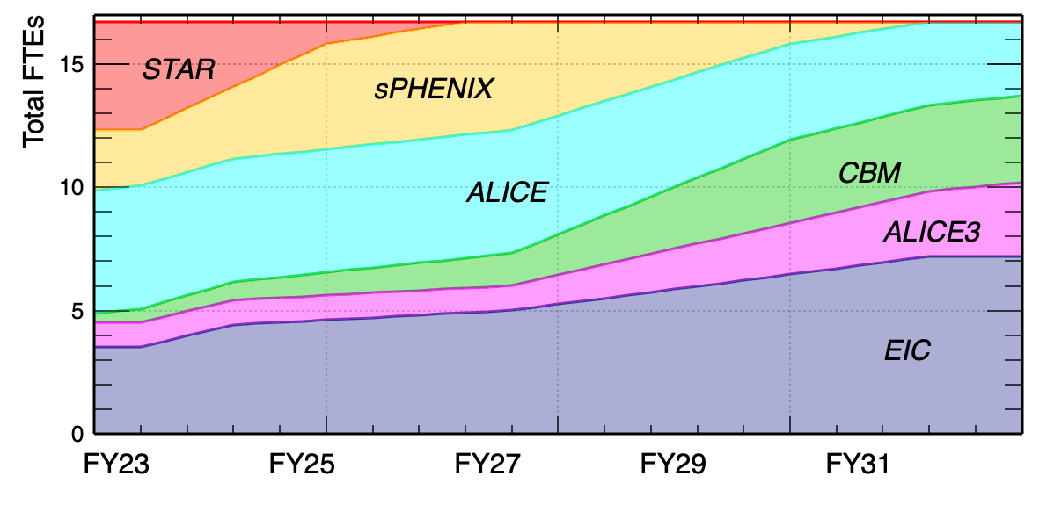
RNC HI Supported
All FTEs (instr, computing) included

Slide 13
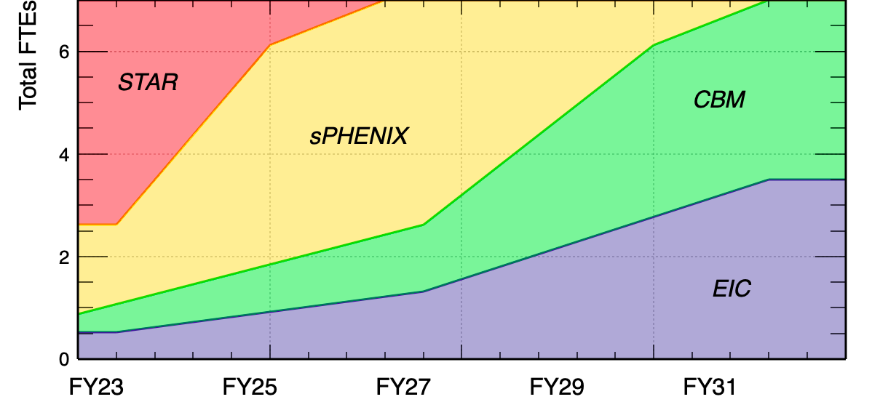
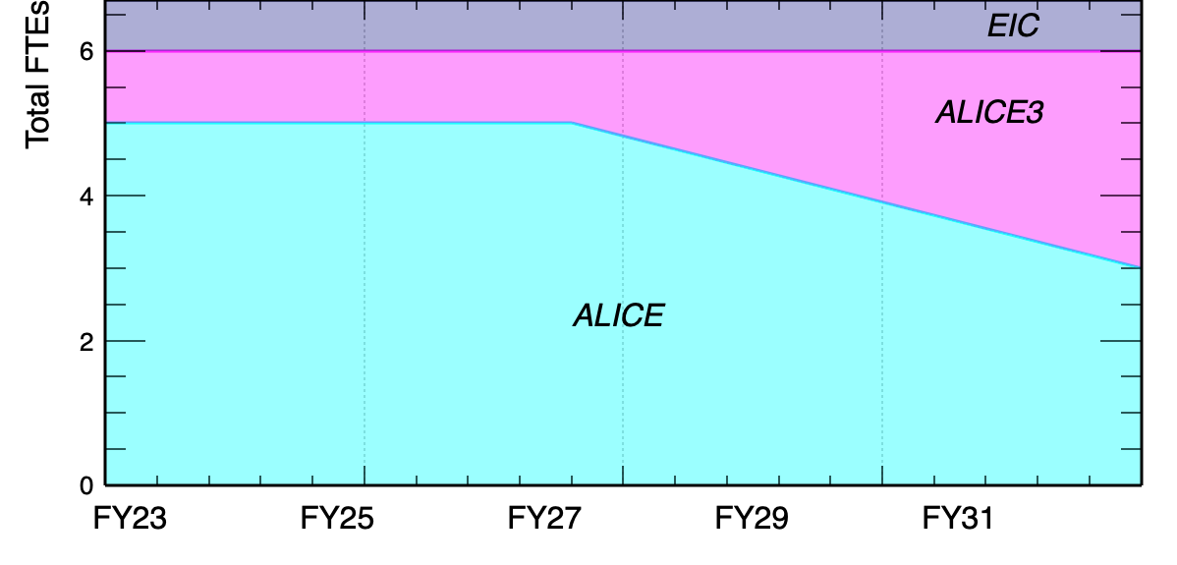
RNC HI Supported
RHIC
Unit? Can be % or $
Current instru. staff not added
EIC effort under HI fund?
LHC

Slide 14
Document writeup
Scientific and technological questions (what have been done and what need to be answered/tackled) (5 pages)
Microscopic characterization of QGP (RHIC – STAR/sPHENIX, LHC – ALICE/ALICE3)
QCD phase structure and EoS at high muB region (RHIC – STAR, FAIR – CBM)
Multi-dimensional (spin-) structure of nucleon and nuclei (RHIC – STAR, JLab exp., EIC)
State-of-the-art MAPS silicon tracker: what are technical advances we envision?
State-of-the-art computing: what are technical advances we envision?
RNC Strategic plan – CE (15 pages)
May be organized according to experiments. For each experiment, better to be further split into 0-2, 3-5 and 6-10 yr periods following our exercise done in the FTE spreadsheet
Question: instrumentation and computing development coupled together with experiments?
Request of increase? and Other scenarios (3-5 pages)
Decision points (FoCal, CBM, ALICE3), what will be the change in case of not supported
Summary

