Slide 1
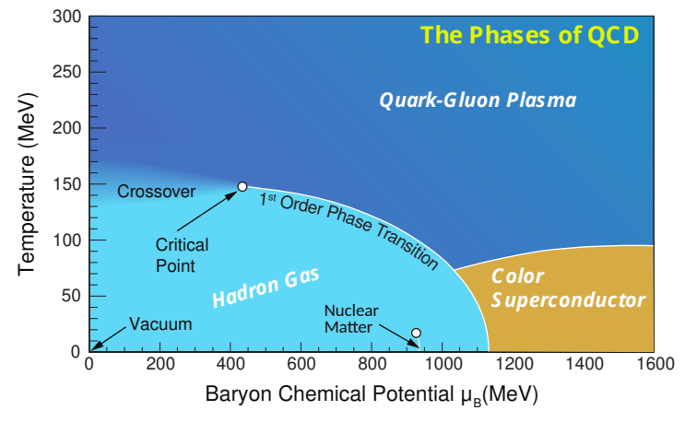
Highlights and Plan - STAR
Highlights:
- RHIC/STAR completed BES-II data taken, including large FXT datasets
- First set of BES-II publications focusing on FXT at 3 GeV (2 PRLs, 3 PLBs …)
Plans: (2022 – ~2025) (XD, GO, NX + postdocs)
- BES-II high precision measurements (collider + FXT)
collective flows, strangeness, hypernuclei, net-proton moments and dielectrons
μ_{B}/T = 2.5
3 GeV

Slide 2
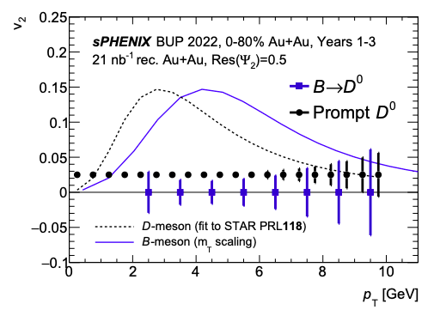
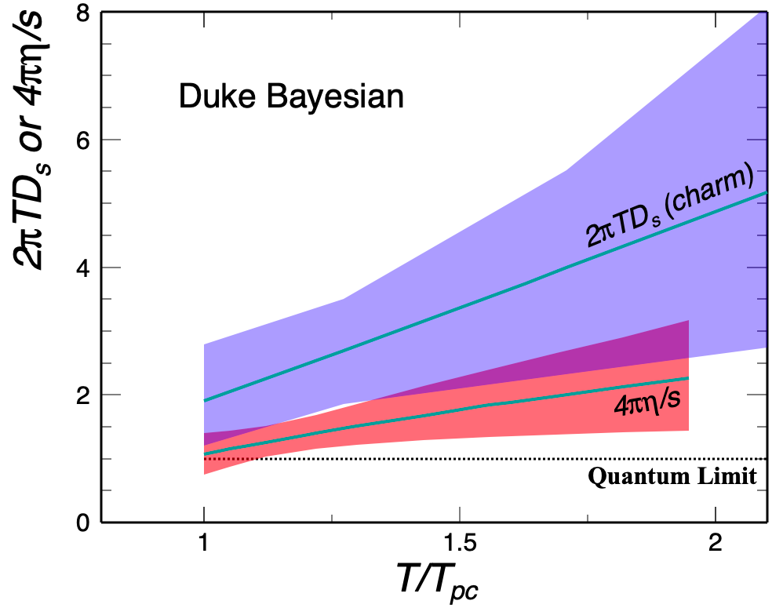
Highlights and Plan - sPHENIX
Highlights:
- sPHENIX heavy flavor program – one of three physics pillars
- MVTX construction/assembly
Plans: (2022 - ~2028) (XD, GO + postdocs)
- MVTX detector commissioning / calibration / operation (2023– 2025)
- Heavy flavor physics analyses (approximately 2023 – 2028?)
open bottom production/collectivity, HF baryons, D/Dbar v1 for initial B-field

Slide 3
CBM Initiative
Plans: (2023 - ~203x) (NX, GO + postdocs)
- MAPS silicon detector upgrade
- Physics interests:
proton high moments, hypernuclei (Y-Y), and dileptons

Slide 4
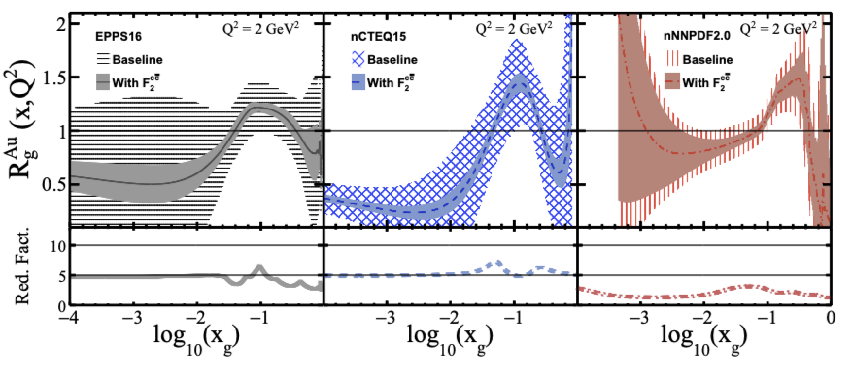
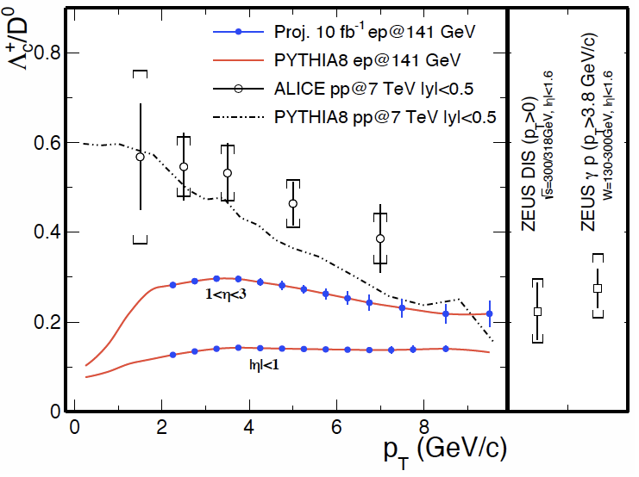
Heavy Flavor Program at EIC
Highlights:
- Conducted HF simulation studies utilizing MAPS-based tracker for HF measurements at EIC
charm F₂, gluon nPDF, charm baryons, gluon ΔG, gluon TMDs, CNM
Plans: (2022 - ~203x) (XD + postdocs)
- Continue physics development: new observables / simulation studies

Slide 5
