Slide 1
Per-Track Momentum Re-calibration (κ Table) Tested with K⁰S and Λ Mass Peaks
sPHENIX run3pp p+p 200 GeV, KFParticle V0s, DDSim templates
Xin Dong (LBNL)
287 segments, 32 runs, 284,648 events
κ(q, pT, η, φ) look-up table from runs 79509-79516 applied to every V0 daughter
Momentum scale and resolution refitted with and without κ
Tighter Λ selection for a cleaner Λ peak
1

Slide 2
Motivation and Questions
run3pp K⁰S peak ≈ 3 MeV/c² below PDG, width rises with pT much faster than in the full simulation
  DDSim calibration absorbed it: s = 0.991, a = 3.75 %/(GeV/c), b = 1.40 % (current defaults)
New input: per-track pT multiplier κ(q, pT, η, φ) derived on runs 79509-79516
  pT → κ·pT for each daughter; η, φ unchanged; masses recomputed
Questions
  Does κ remove the scale offset (s → 1)?
  How much of the fitted resolution was a charge-, η-, φ-dependent scale distortion?
  Does a table from runs 79509-79516 also work for later runs?
  Can a tighter Λ selection pin down the Λ peak (proton scale)?
Same candidates, three masses: KFP fit / recomputed without κ / recomputed with κ
2
Notes:
The K0S peak sits about 3 MeV below PDG and its width grows with pT much faster than in the full simulation. In the DDSim calibration this went into a global scale 0.991 and a curvature term 3.75 %/GeV, about 100 times the full simulation. A per-track correction table has been derived on runs 79509-79516. We apply it per daughter, recompute the masses and repeat the fit.

Slide 3
Data Set and Processing
• DST_TRKR_TRACKS, ana581_2026p005_v001, release ana.581 (streaming, MVTX misalignment, CDB)
• One condor job per segment: KFParticle K⁰S + Λ (no covariance cuts) → QA selection → mass vs pT
– 480714: KFP / no κ / with κ histograms, 287/287 OK, KFP histograms bin-identical to the earlier production
– 481293: + tight-Λ histograms + slim candidate trees (84 MB, cut studies now local), 287/287 OK, bin-identical
• Two periods: A = range of the κ table; B = all other runs (table applied as is)
period | runs | seg. | events | K⁰S QA cand. | Λ + anti-Λ cand.
A | 79509-79516 (8) | 95 | 94,173 | 19,841 | 38,100
B | 80904-81609 (24) | 192 | 190,475 | 107,418 | 243,169
QA candidates = all masses in the histogram range (signal + background)
All validation checks pass: fill macro, reproducibility, κ table, grid edges
3
Notes:
Same 287 segments as the covariance-free production used for the DDSim calibration. Period A is the run range of the table, period B the other 24 runs where the table is applied as is. One condor job per segment reruns KFParticle and fills all three mass versions in one pass, so before and after never depend on two productions.

Slide 4
V0 Reconstruction and Selection
level | KFParticle (pre-cuts) | offline QA (data and DDSim templates)
event | PV from SvtxVertexMap, crossing-matched | |z_PV| < 10 cm
track | pT > 0.1 GeV/c, ≥ 20 TPC hits, no χ²/DCA cut | |η| < 1.1, |DCA_xy| > 0.02 cm (both daughters)
pair | daughter DCA < 0.5 cm; vertex χ², volume off | DCA12 < 0.2 cm (SV-constrained → no effect)
mother | DIRA > 0.8, mass window | DIRA > 0.995, L_xy > 0.5 cm
species | K_S0 → π⁺π⁻, [Λ → pπ⁻]cc | Λ vs anti-Λ from the proton charge
tight Λ | — | + DIRA > 0.9995, |DCA_xy(π)| > 0.10, |DCA_xy(p)| > 0.03 cm
• No covariance-, χ²- or significance-based cut (DDSim cannot reproduce the covariance correlations)
• Cuts use the stored KFP values; they are not recomputed after κ
• All candidates kept (no best-candidate choice)
Fits use the QA histograms; the tight Λ selection is a separate study (slides 13-14)
4
Notes:
KFParticle pre-cuts are loose; all topological cuts are applied offline on stored values, identically for the three mass versions. No covariance, chi2 or significance cuts anywhere because DDSim cannot reproduce covariance correlations.

Slide 5
The κ Look-up Table
• 72,800 nodes: q = ±1 × 112 pT (0.1-20 GeV/c) × 13 η × 25 φ
• pT_corr = κ · pT, κ = 1/(1 + ε + qδ)
– ε: charge-even scale, qδ: charge-odd (sagitta-like) distortion
• Linear interpolation in (ln pT, η, φ), clamped at the edges
• Momentum vector scaled → η, φ unchanged; mass and V0 pT recomputed with PDG masses
• Mean κ applied (QA, period A): K⁰S π⁻ 0.9979, π⁺ 1.0163; Λ π 1.0077, p 1.0065
pT (GeV/c) | κ (q = −1) | κ (q = +1)
0.3 | 0.9952 | 1.0115
1.0 | 0.9725 | 1.0378
2.0 | 0.9379 | 1.0555
table nodes at η = 0, φ = 0
π⁺ and π⁻ are shifted in opposite directions → the K⁰S peak both moves and narrows
5
Notes:
Table convention from the file header: one over pT is multiplied by kappa_curv = 1 + eps + q delta, and kappa is its inverse. The charge-odd part dominates: negative tracks are scaled down, positive up, more at higher pT. Applied by linear interpolation in ln pT, eta, phi, clamped at the edges.

Slide 6
Momentum Scale / Resolution Fit
• Response per daughter: p_rec = s · p [1 + δ_p(pT) + σ G], σ/pT = √((a pT)² + (b/β)²)
– s scale, a curvature term, b multiple scattering; δ_p = full-sim proton bias (protons only)
• Templates: DDSim, 6M decays per species, no momentum smearing, same QA cuts; fixed random numbers
• Data: K⁰S in 7 V0-pT bins (0.2-4 GeV/c), Λ + anti-Λ in 5 bins (0.5-4 GeV/c, window 1.103-1.130 GeV/c²)
• Per bin: N × template + quadratic background, Poisson likelihood, Baker-Cousins χ² summed over bins
• Grid: a 0-8 %/(GeV/c), b 0.4-4 %, s 0.975-1.015 (widened: κ moves s to ≈ 1)
• K⁰S, Λ and joint fits; Δχ²_Λ = Λ χ² at the K⁰S best point − Λ minimum
• Periods A, B, all × KFP / no κ / with κ = 9 fits (+ 6 tight-Λ fits)
(a, b) are effective: they absorb every mass-width source DDSim does not model
6
Notes:
Same method as the DDSim main calibration. Templates are generated once without momentum smearing; for each grid point the daughter momenta are rescaled with fixed random numbers, so the chi2 surface is smooth. Per pT bin the data are fitted with N times the template plus a quadratic background, Poisson likelihood.

Slide 7
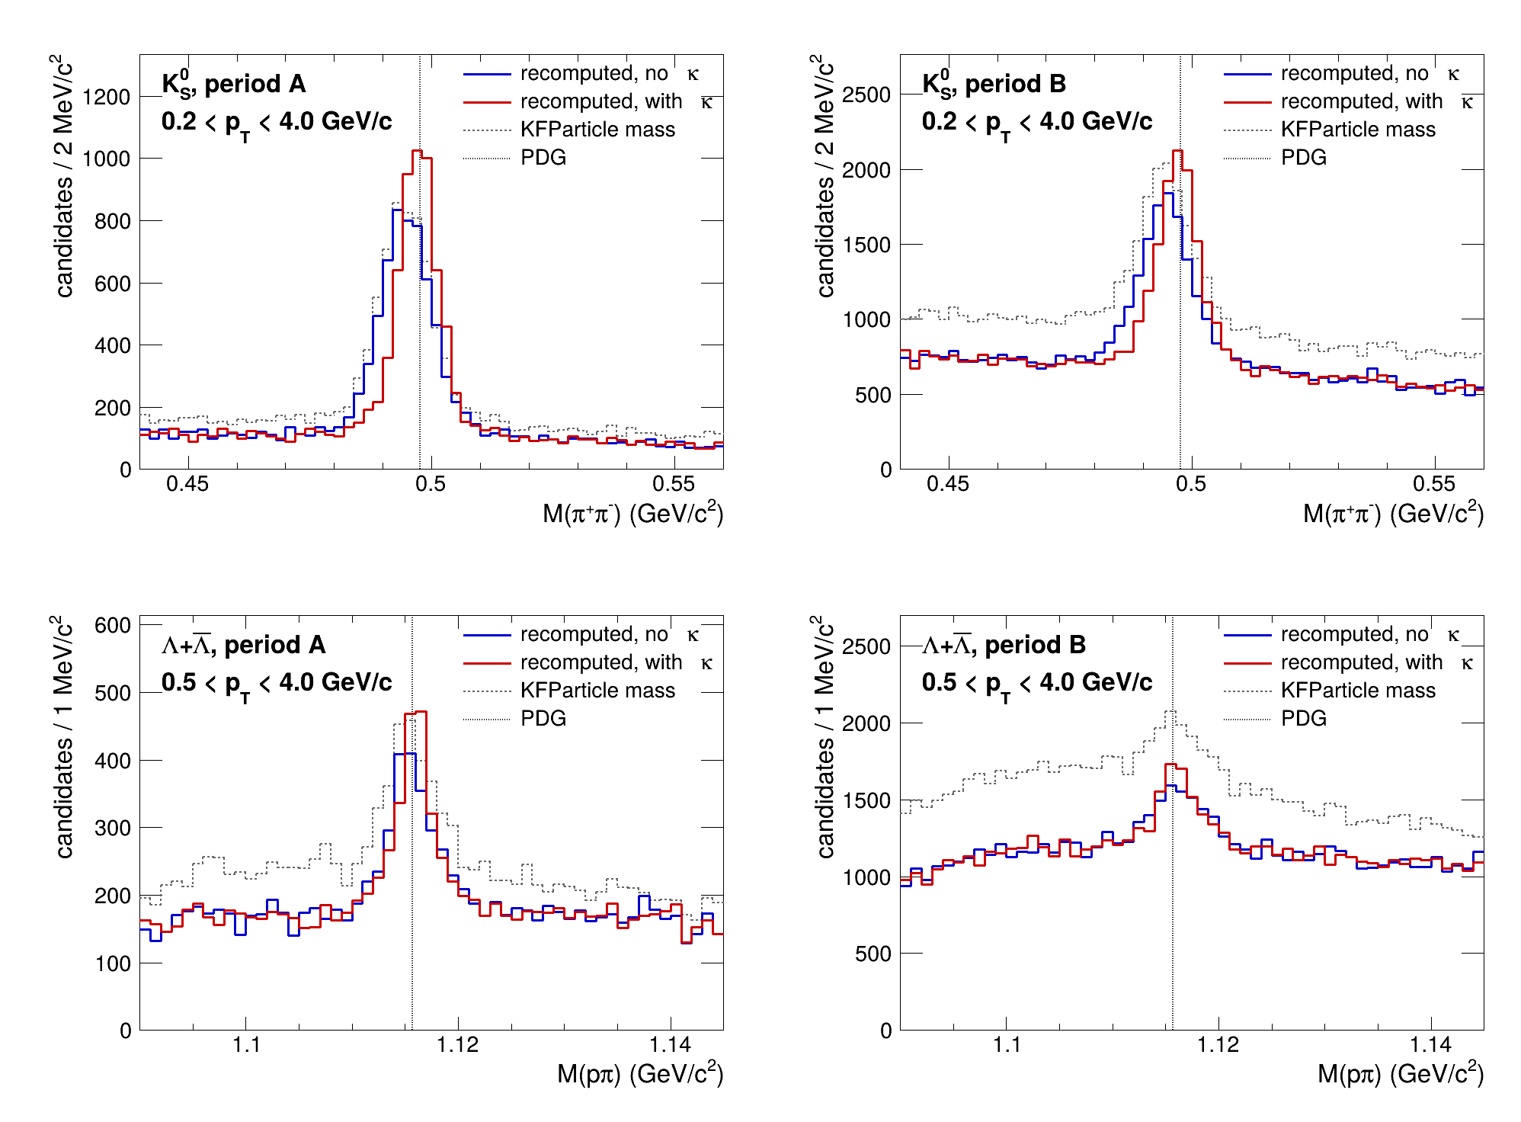
Mass Distributions Before and After κ
• K⁰S mean (MeV/c²)
– A 494.78 → 497.21
– B 494.57 → 497.04
– PDG 497.611
• K⁰S σ (MeV/c²)
– A 5.30 → 4.03
– B 5.43 → 4.33
• Λ σ (MeV/c²)
– A 2.16 → 1.63
– B 2.69 → 1.88
Gaussian fits, pT-integrated
blue: no κ, red: with κ, grey dashed: KFP mass; dotted: PDG
κ moves the K⁰S peak to within 0.4-0.6 MeV/c² of PDG and narrows both peaks
7
Notes:
Same QA-selected candidates; blue recomputed without kappa, red with kappa, grey dashed the KFParticle mass. The K0S peak moves to the PDG mass and narrows in both periods. The Lambda peak narrows. The KFP mass has 20-25 percent more background entries in the same window, not understood.

Slide 8
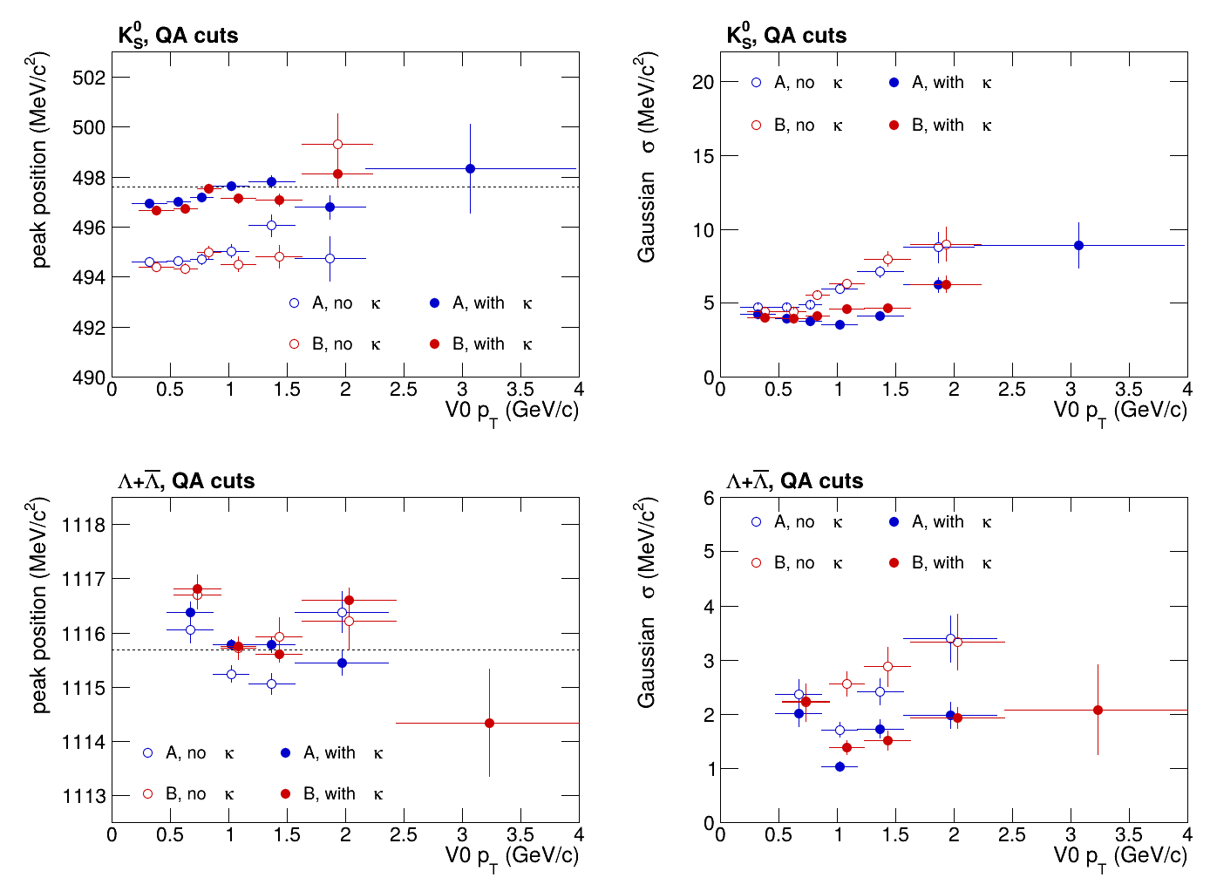
Peak Position and Width vs pT
• With κ the K⁰S peak is within ≈ 1 MeV/c² of PDG in every pT bin (496.6-498.3)
• K⁰S width at V0 pT 1.6-2.2 GeV/c:
– A 8.8 → 6.2 MeV/c²
– B 9.0 → 6.3 MeV/c²
• Λ peak stays ≈ 0.2-0.4 MeV/c² above PDG
– open issue: proton scale
open: no κ, full: with κ; blue A, red B; dashed PDG
Most of the high-pT width was a charge-dependent scale distortion
8
Notes:
Gaussian fits per V0-pT bin. Open: without kappa, full: with kappa; blue period A, red period B. The K0S width at high pT drops by about a third with kappa. Display only; the calibration uses the template fit.

Slide 9
Fit Results: Scale and Resolution
period | mass | a (%/GeV) | b (%) | s | χ²_K/389 | Δχ²_Λ
A | KFP | 3.00 | 1.60 | 0.991 | 470.4 | 2.2
 | no κ | 3.00 | 1.60 | 0.991 | 464.5 | 3.4
 | with κ | 1.50 | 1.40 | 0.999 | 468.5 | 6.1
B | KFP | 4.00 | 1.20 | 0.991 | 400.5 | 13.8
 | no κ | 4.00 | 1.20 | 0.991 | 473.1 | 30.5
 | with κ | 2.00 | 1.40 | 0.998 | 457.4 | 4.8
all | KFP | 3.75 | 1.40 | 0.991 | 421.5 | 13.9
 | no κ | 3.50 | 1.40 | 0.991 | 462.1 | 25.0
 | with κ | 1.75 | 1.40 | 0.998 | 473.9 | 9.0
• Scale: s 0.991 → 0.999 (A), 0.998 (B); curvature term halved (0.50 A, 0.50 B)
• K⁰S-Λ tension in B removed by κ: Δχ²_Λ 30.5 → 4.8
Period B keeps a larger curvature term after κ (2.00 vs 1.50 %/(GeV/c))
9
Notes:
K0S fit; the joint fit gives the same points for the recomputed versions. Delta chi2 Lambda is the Lambda chi2 at the K0S point minus the Lambda minimum: it measures K0S-Lambda consistency.

Slide 10
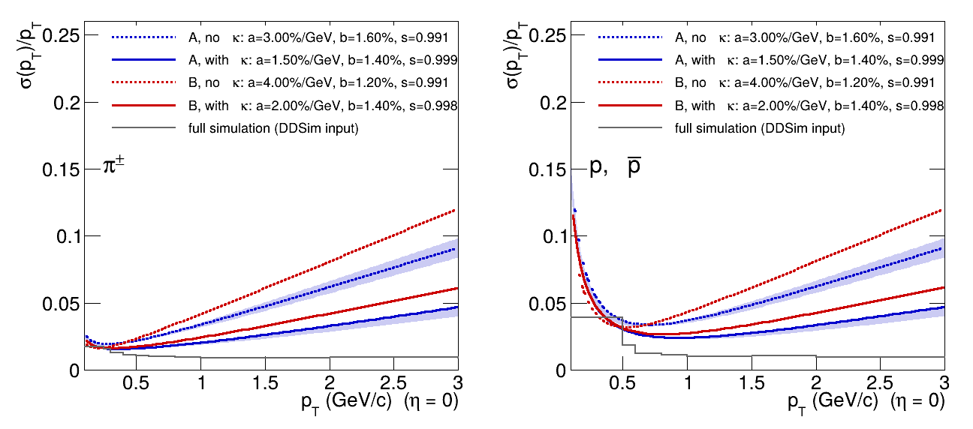
Single-Track Resolution
blue A, red B; dashed no κ, solid with κ; grey: full simulation
π σ/pT (%) | 1 GeV/c | 2 GeV/c | 3 GeV/c
A: no κ → κ | 3.4 → 2.1 | 6.2 → 3.3 | 9.1 → 4.7
B: no κ → κ | 4.2 → 2.5 | 8.1 → 4.2 | 12.1 → 6.2
With κ the pion resolution at 2 GeV/c roughly halves; still above the full simulation
10
Notes:
Fitted sigma over pT at eta 0 for pions and protons, period A blue and B red, dashed without and solid with kappa; grey the full-simulation response. Bands are the grid nodes with Delta chi2 below 2.3; in period B only the best node passes.

Slide 11
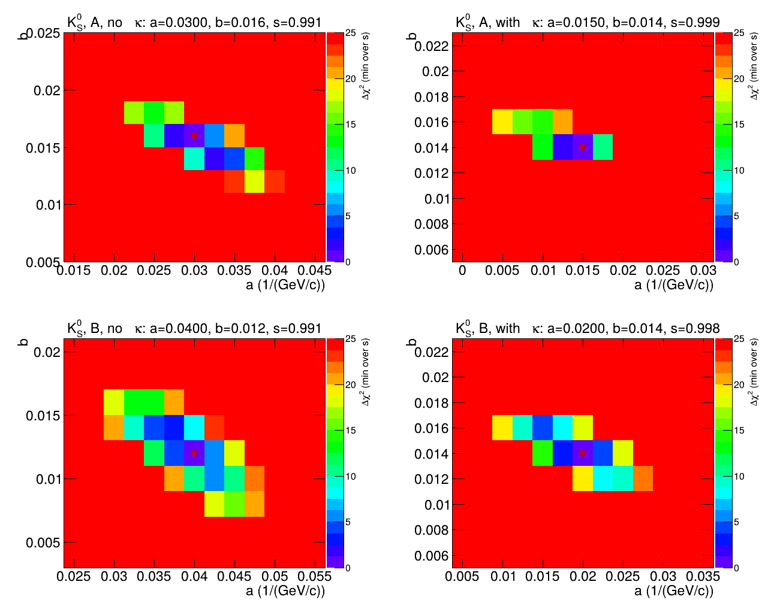
Δχ² Maps in (a, b)
• top: A, bottom: B
• left: no κ, right: with κ
• red star: best node
• a drops by 1.5 (A) and 2.0 (B) %/(GeV/c); b stays at 1.2-1.4 %
– grid step (0.25 %/GeV in a) limits the interval resolution
Well-separated minima: the κ effect is far larger than the statistical uncertainty
11
Notes:
K0S fit, minimised over s. Top period A, bottom B; left without, right with kappa. The best point moves to half the curvature term; the b term is stable. The minimum region is only a few grid nodes wide.

Slide 12
Run Dependence
runs | a (%/(GeV/c)), KFP mass
79509 seg. 0-30 | 2.00
79509-79516 (A) | 3.00
80904-80915 | 3.75
81556-81609 | 4.25
• K⁰S QA candidates per event:
– A 0.169-0.231
– B 0.251-0.980
• a grows with the same ordering
• Hypothesis: luminosity-dependent distortion (e.g. TPC space charge) - not tested
• κ (from period A) removes about half of a in both periods; B remains higher
• Candidate next step: κ table derived on period-B runs, or per-run fits
Resolution is run dependent: quote DDSim parameters per period
12
Notes:
KFP-mass fits on run groups. The curvature term grows with the run period, and so does the number of K0S candidates per event, which points to luminosity or pile-up. Not tested here. The kappa table removes about half of a in both periods.

Slide 13
Tighter Λ Selection: Choice of Cuts
31 segments, KFP mass, pT 0.5-4 | S | B | S/B | S²/(S+B) | S kept
QA selection | 363 | 1046 | 0.35 | 94 | 100 %
+ DIRA > 0.9995 | 332 | 383 | 0.86 | 154 | 91 %
+ L_xy > 2 cm (instead) | 93 | 907 | 0.10 | 9 | 26 %
tight: DIRA > 0.9995, |DCA(π)| > 0.10, |DCA(p)| > 0.03 | 289 | 168 | 1.72 | 183 | 80 %
• 720 combinations of DIRA, L_xy, π and p |DCA_xy|; only cuts DDSim can model
• Bias test (DDSim selects before smearing): peak width ratio tight / QA
– K⁰S: data 0.958 ± 0.042, DDSim 0.985; Λ: data 0.986 ± 0.149, DDSim 0.979
– DDSim Λ templates keep 0.76 of their candidates
Tight cut: S²/(S+B) × 1.96, no visible bias at the 5 % level (31 segments)
13
Notes:
Scan on the 31 segments with full ntuples, side-band subtraction, only cuts DDSim models. DIRA is the strongest handle, decay length does not help because daughters need silicon. Bias test: DDSim selects before momentum smearing; if a cut picks well-measured candidates in data the fitted resolution would be biased. The width ratio tight over QA agrees.

Slide 14
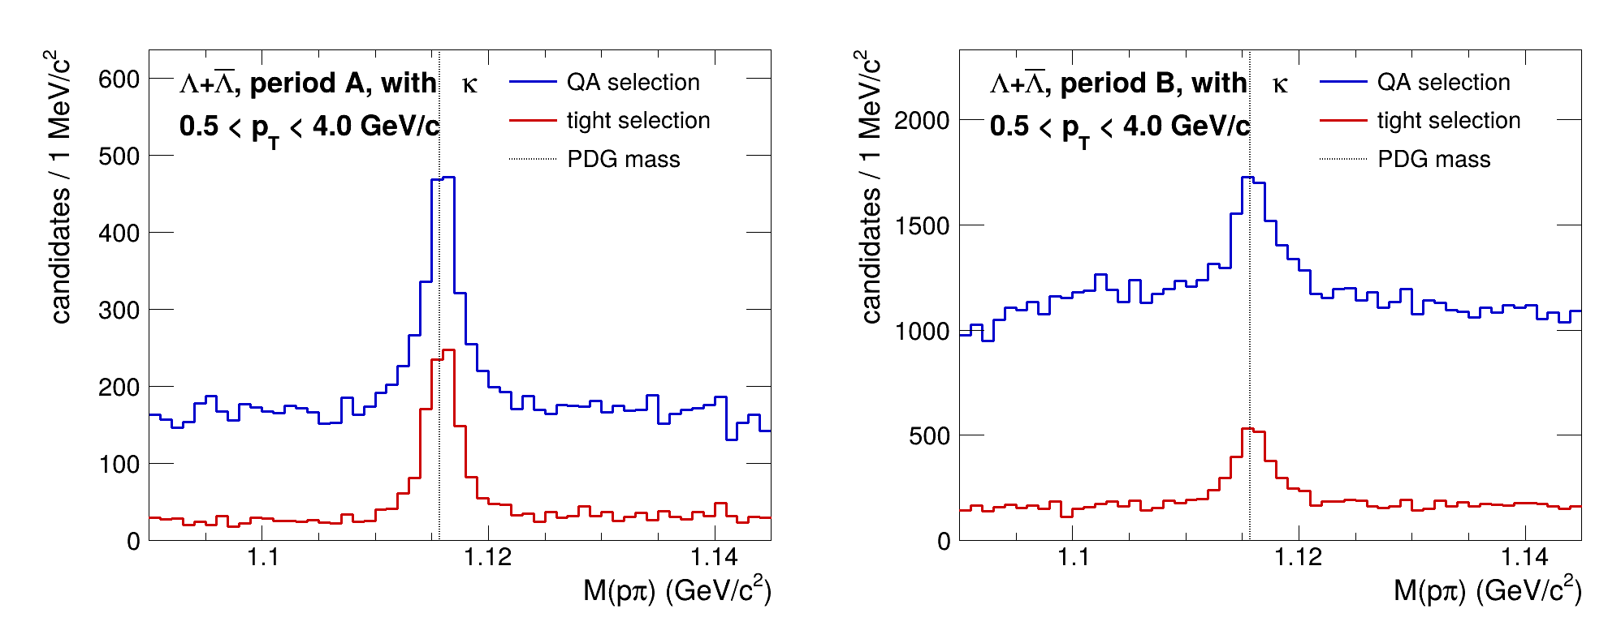
Tighter Λ Selection: Results
with κ | S/B | δ(peak) (MeV/c²) | S kept | s_Λ | a_Λ (%/GeV) | Δχ²_Λ
A: QA → tight | 1.02 → 4.19 | 0.087 → 0.071 | 71 % | 0.998 → 0.999 | 3.25 → 2.25 | 6.1 → 3.4
B: QA → tight | 0.28 → 1.20 | 0.108 → 0.080 | 60 % | 1.001 → 1.000 | 3.50 → 4.25 | 4.8 → 11.9
all: QA → tight | 0.35 → 1.65 | 0.076 → 0.056 | 74 % | 1.000 → 0.999 | 2.75 → 4.25 | 9.0 → 17.3
Used for the Λ scale (s_Λ = 0.999 A, 1.000 B), consistent with K⁰S
Not for resolution: in B tight data widths exceed the tight templates (pointing modelling?)
14
Notes:
Full sample, with kappa. Tight cuts: S over B up by four to five, peak-position error down by a quarter. Lambda-only scale agrees with K0S. Resolution: period A moves towards K0S, period B gets worse; the tight data widths at 1.2-2.4 GeV/c exceed the tight templates. So we use the tight selection for the scale only.

Slide 15
Summary and Next Steps
κ removes the momentum-scale offset: s 0.991 → 0.998; K⁰S peak within 0.4-0.6 MeV/c² of PDG
Curvature term halved: a 3.50 → 1.75 %/(GeV/c) (all), b ≈ 1.4 % unchanged
Works outside its run range (period B) but B keeps a larger a (2.00 vs 1.50)
K⁰S/Λ consistent with κ; tight Λ selection gives s_Λ = 0.999-1.000 (± 0.001)
Open
  Λ peak 0.26 MeV/c² above PDG with κ: proton scale / δ_p double counting?
  Tight Λ widths in period B (DIRA vs DCA cuts, local on the slim trees)
  KFP vs recomputed mass: 20-25 % more background and different χ² in B
Decision: DDSim response = (a) uncorrected all-run defaults,
(b) κ-corrected per period (analyses apply κ), or (c) wait for a period-B table
Note: DataDrivenSim/kappa_note/build/main.pdf (28 pp)
15
Notes:
Summary. Decision needed on what DDSim should use.

