Slide 1
STEP AP 242 Project
Contribution to the preparation
of deployment of STEP AP 242 ed.1
Figures for the documentation
of the AP 242 Introduction
Charleston workshop, 24th of Sept. 2011

Slide 2
Table
Figure “Managed 3D Model Based Engineering process
Figure “AP 242 information model ”
Figure “AP 242 Data Planning Model”

Slide 3







Managed 3D Model Based Engineering process
Preliminary
Development
Feasibility study
Market studies
Requirements mngt.
Concept
development
Concept
Product architecture design
Equipments specification
Packaging layout
Product
Engineering
Part design
Assembly design
Clash detection
Mountability examination
Evaluation
Test plan
Prototype
Crash test
Managed Model Based 3D Engineering
Process
planning
Process plans
Production
feasibility studies
Tool design
Tool assembling
Tool simulation
Tool
manufacturing
Tool component production
tool mounting
NC/ RC programming
Quality control
Sample part production
Part measuring
Sustainment
LT Archiving
Logistics
Product support

Slide 4
AP 242 information model overview
PDM
Process Plans
PDM
Part identification
Characterictics,
Document Management
General management information
Physical part
Activity and work management
Effectivity
Breakdown
Specification, and configuration
Requirements
Design Rules
Mating definition
Presentation
3D Machining
Form Features
3D PMI
(Product & Manuf. Info. )
3D assembly
constraints
3D shape
Data Quality
3D GD&T
3D annotation
3D kinematics
3D symbol
3D UDA
Motion
Constraints
2D
draughting
3D Composite
design
3D shape (explicit and parametric)
Constituent shape
3D
exact
explicit
geometry
3D
tesselated
explicit
geometry
3D
parametric
& constr. History
Material aspects
Laminate tables
Ply orientation
Addressed by the BO model:
PDM
system
Requirement
Managt. system
CAD
system
Process Planning
system

Slide 5
Figure 1 — Data planning model
Product Identification Core
Activity and
Work Management
Product Stucture
Document Management
Management
Resources
Information
Product Characterictics
Product concept,
Configuration & Effectivity
Requirements
Process planning
3D exact shape model
3D machining
form feature model
3D tessel. shape model
3D parametric model
3D assembly constraint
and mating definition
Design Rules
Presentation
3D shape data quality
Draughting
3D composite design
Geometric ShapeRelated
PDM
system
Requirement
Managt. system
CAD
system
Process Planning
system

Slide 6
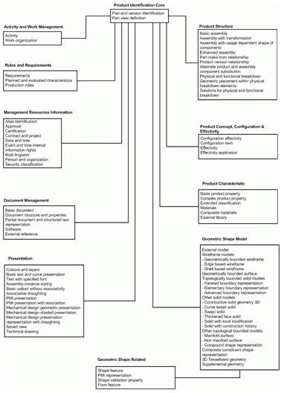

AP 242 Data Planning Model (initial)

Slide 7
Back up
slides

Slide 8
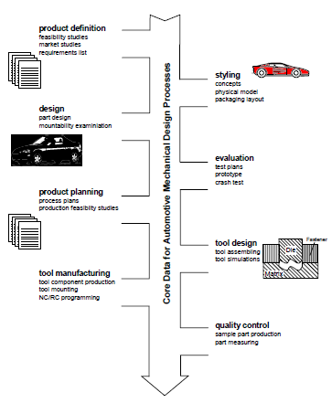
AP 214 proces

