Slide 1
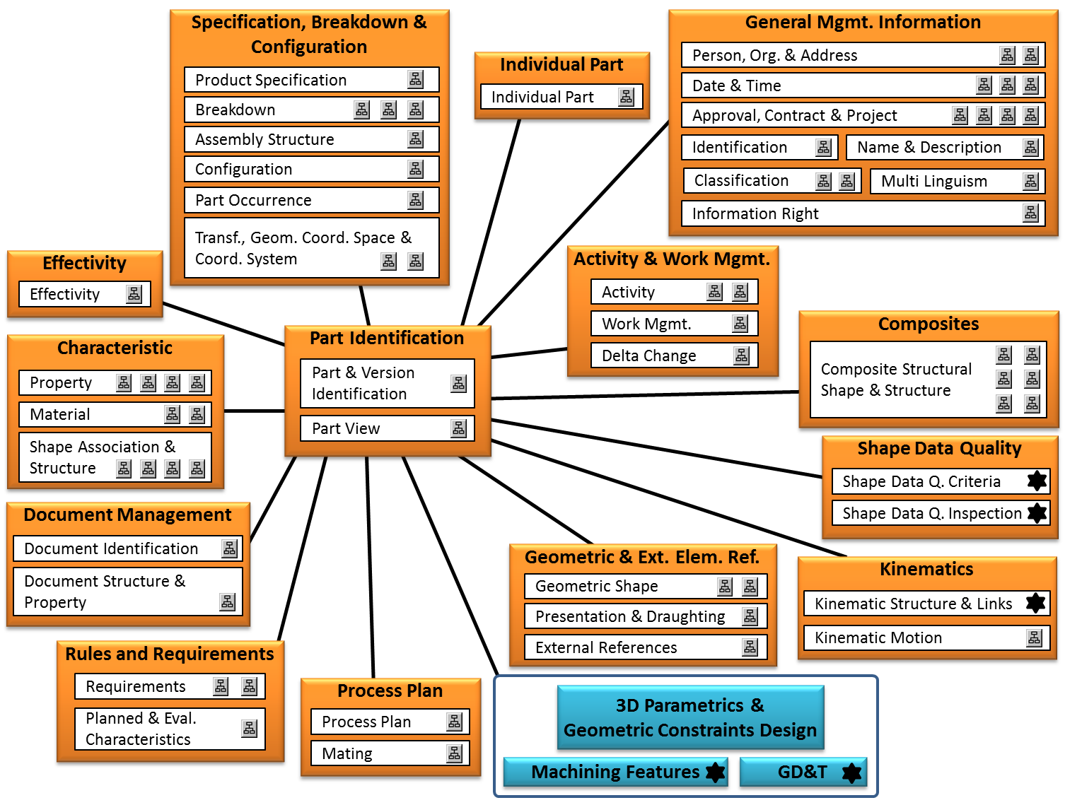
Capability with an XML representation
Capability without an XML representation
Capability not part of this version

Slide 2
Specification, Breakdown & Configuration
General Mgmt. Information
Individual Part
Person, Org. & Address
Product Specification
Date & Time
Breakdown
Individual Part
Approval, Contract & Project
Assembly Structure
Identification
Name & Description
Configuration
Classification
Multi Linguism
Part Occurrence
Information Right
Transf., Geom. Coord. Space &
Coord. System
Effectivity
Activity & Work Mgmt.
Effectivity
Activity
Part Identification
Work Mgmt.
Composites
Characteristic
Delta Change
Composite Structural
Shape & Structure
Property
Part & Version
Identification
Material
Part View
Shape Association & Structure
Shape Data Quality
Shape Data Q. Criteria
Document Management
Shape Data Q. Inspection
Document Identification
Geometric & Ext. Elem. Ref.
Document Structure &
Property
Kinematics
Geometric Shape
Presentation & Draughting
Kinematic Structure & Links
Rules and Requirements
External References
Kinematic Motion
Requirements
Process Plan
3D Parametrics &
Geometric Constraints Design
Planned & Eval.
Characteristics
Process Plan
Mating
Machining Features
GD&T

Slide 3
Capability with an XML representation
Capability without an XML representation
Capability not part of this version

Slide 4
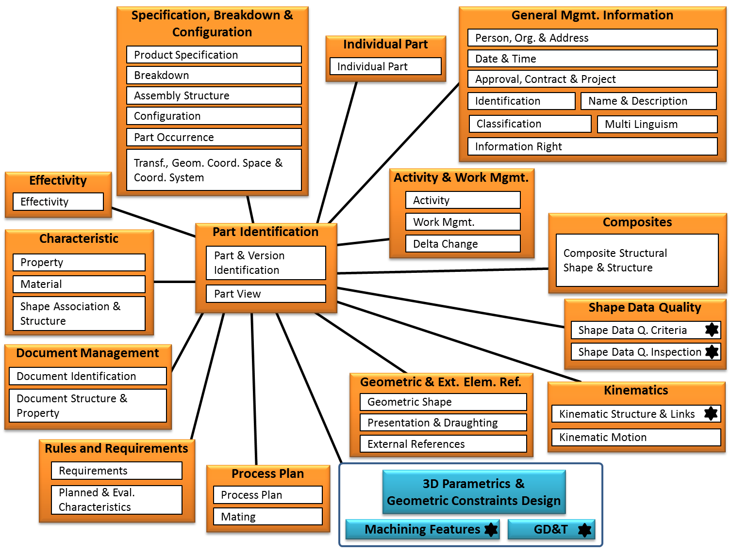
Capability with an XML representation
Capability without an XML representation
Capability not part of this version

Slide 5
Specification, Breakdown & Configuration
General Mgmt. Information
Individual Part
Person, Org. & Address
Product Specification
Date & Time
Breakdown
Individual Part
Approval, Contract & Project
Assembly Structure
Identification
Name & Description
Configuration
Classification
Multi Linguism
Part Occurrence
Information Right
Transf., Geom. Coord. Space &
Coord. System
Effectivity
Activity & Work Mgmt.
Effectivity
Activity
Part Identification
Work Mgmt.
Composites
Characteristic
Delta Change
Composite Structural
Shape & Structure
Property
Part & Version
Identification
Material
Part View
Shape Association & Structure
Shape Data Quality
Shape Data Q. Criteria
Document Management
Shape Data Q. Inspection
Document Identification
Geometric & Ext. Elem. Ref.
Document Structure &
Property
Kinematics
Geometric Shape
Presentation & Draughting
Kinematic Structure & Links
Rules and Requirements
External References
Kinematic Motion
Requirements
Process Plan
3D Parametrics &
Geometric Constraints Design
Planned & Eval.
Characteristics
Process Plan
Mating
Machining Features
GD&T

Slide 6
