Slide 1
Part structure
Part structure
Part
Part
Part
Version
Part
Version
Assembly structure
Occurrence
Assembly Definition
NextAssembly
OccurrenceUsage
Single
Occurrence
Part
View
Positioning
Positioning
Geometric
Coordinate
Space
relating
(ABS)
Geometric
Representation
Relationship
related
Geometric
Coordinate
Space
Composed
Geometric
Model
External
Geometric
Model

Slide 2
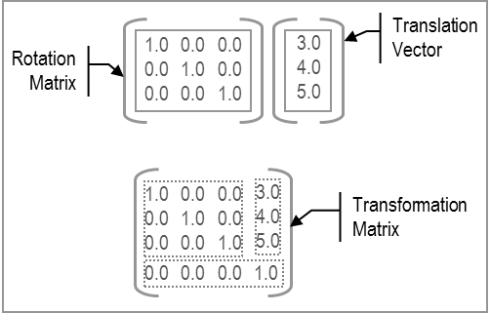
Part structure
Part structure
Part
Part
Part
Version
Part
Version
Assembly structure
Occurrence
Assembly Definition
NextAssembly
OccurrenceUsage
Single
Occurrence
Part
View
Cartesian
Transformation
rotationMatrix
scale
translationVector

Slide 3
Positioning
Geometric
Representation
Relationship WithPlacement Transformation
Positioning
Geometric
Coordinate
Space
Composed
Geometric
Model
relating
related
External
Geometric
Model
Geometric
Coordinate
Space
items S[1:?]
items S[1:?]
Axis
Placement
target
origin
Axis
Placement

Slide 4
Positioning
Geometric
Representation
Relationship WithCartesian Transformation
Positioning
Geometric
Coordinate
Space
Composed
Geometric
Model
relating
related
External
Geometric
Model
Geometric
Coordinate
Space
items S[1:?]
items S[1:?]
Cartesian Transformation
transformation
Axis
Placement
Position=[0,0,0]

Slide 5
Positioning
Positioning
Geometric
Coordinate
Space
Geometric
Representation
Relationship WithSame CoordinateSpace
Composed
Geometric
Model
relating
related
External
Geometric
Model
items S[1:?]
items S[1:?]
Position=[0,0,0]
Axis
Placement
Axis
Placement
Position=[0,0,0]

