Slide 1
GREEDYTRIP
OPENING QUESTION
Where are you going after this hackathon?
01
Notes:
0:00–0:15
Hey everyone—quick question: where are you going after this hackathon? [Pause and look around.] Any plans?

Slide 2
No idea? Even a good plan rarely survives the day.
I honestly cannot remember a trip where we followed the itinerary exactly.
Traffic happens.
Places close.
Reality disappoints.
The route you planned is already outdated.
The restaurant you planned around is suddenly closed.
Sometimes the stop just is not worth it.
02
Notes:
0:15–0:45
No idea? Exactly. Deciding where to go next can be surprisingly stressful. And even when we plan, the plan keeps changing. I honestly cannot remember a trip where we followed the itinerary exactly. Traffic happens, restaurants close, and sometimes a place is simply not as good as we expected.

Slide 3
THE SHIFT
Travel like a greedy search.
Choose the best next move. Learn. Recompute.
next = argmax utility(place | now, memory)
03
Notes:
0:45–1:05
So why not travel the way greedy search works? Instead of optimizing an entire day, choose the best next move with what you know now. Then learn from what happens and recompute when reality changes. That is GreedyTrip.

Slide 4
Three systems. One deterministic decision.
FRONTIER
MEMORY
ARGMAX
→
→
Bright Data
Moss
GreedyTrip
Builds the nearby frontier from public place data.
Retrieves the preferences that matter for each candidate.
Scores every feasible option and selects one deterministic winner.
OpenAI interprets language. It never chooses the winner.
04
Notes:
1:05–1:30
The architecture is deliberately separated. Bright Data builds the nearby frontier. Moss retrieves the preferences that matter for each place. Then GreedyTrip applies our deterministic utility function and picks exactly one winner. OpenAI only interprets language—it never ranks or selects destinations.

Slide 5
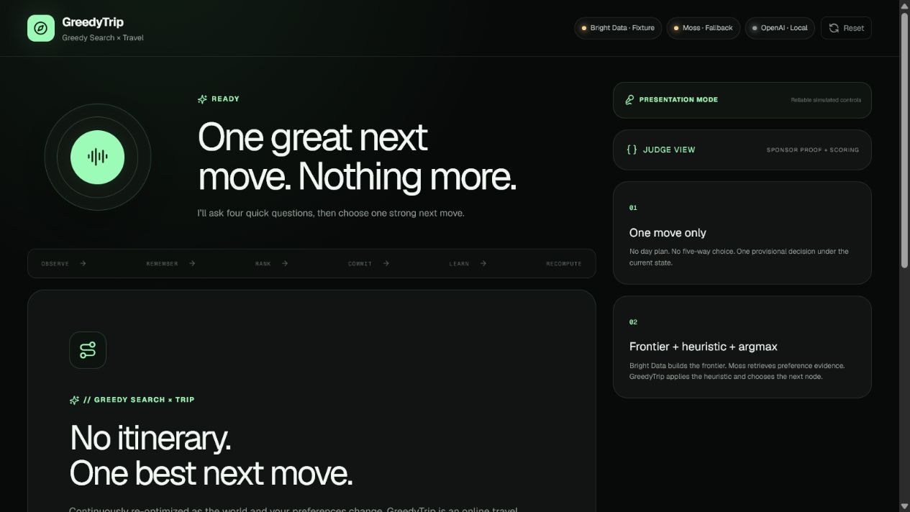
Watch GreedyTrip adapt in real time.
LEARN
A single sentence becomes preference memory.
▶
RERANK
Every feasible place is scored again.
INTERVENE
Speak only when switching is worth it.
DEMO
05
Notes:
1:30–2:50 — PLAY THE 80-SECOND DEMO VIDEO
Narration checkpoints:
1) Finish the four-question interview and show the first single recommendation.
2) Say: ‘That feels too touristy.’ Show Moss storing the preference and the deterministic ranking changing.
3) Move the simulated location and point out that GreedyTrip recomputes but stays silent below the intervention threshold.
4) Mark the current place unavailable and show the mandatory spoken replacement.

Slide 6
GREEDYTRIP
No itinerary. One best next move.
Continuously re-optimized as reality changes.
Travel like a greedy search.
06
Notes:
2:50–3:00
So, where are you going next? GreedyTrip gives you one confident move—and adapts when reality changes. No itinerary. One best next move.

