Slide 1
What is an algorithm
process or a set of rules to be followed in calculations or other problem-solving operations
more informally
a recipe for solving a problem

Slide 2
Example:Square Root Algorithm
Guess the square root of the number
Divide the working number by the guess
Average the quotient (from 2) and the guess
Make the new guess the average from step 3
If the new guess is “sufficiently different” from the old guess, go back to step 2, else halt.

Slide 3
Algorithm vs Program
an algorithm is a description of how to solve a problem
a program is an implementation of an algorithm in a particular language to run on a computer (usually a particular kind of computer)
difference between what we want to do and what we actually did

Slide 4
What’s the difference really?
we can analyze the algorithm independent of its implementation. This is the science in Computer Science
we can examine how easily, or with what difficulty, a language allows us to realize an algorithm
we can examine how different computers impact the realization of an algorithm

Slide 5
Aspects of an algorithm
Detailed: Provide enough detail to be implementable. Can be tricky to define completely, relies on “common sense”
Effective: the algorithm should eventually halt, and halt in a “reasonable” amount of time. “reasonable” might change under different circumstances (faster computer, more computers, etc.)

Slide 6
Aspects of an Algorithm (2)
Specify Behavior: the algorithm should be specific about the information that goes in (quantity, type, etc.) and the information that comes out.
General Purpose: algorithms should be idealized and therefore general purpose. A sorting algorithm should be able to sort anything (numbers, letters, patient records, etc.)

Slide 7
A lot to do!
That is a lot to do for the burgeoning programmer.
Get better as we go along, but good to know what the standards are!

Slide 8
Aspects of a Program: Readability
We will emphasize, over and over, that a program is an essay on problem solving intended to be read by other people, even if “other people” is you in the future!
Write a program so that you can read it, because it is likely that sometime in the future you will have to read it!

Slide 9
Readability(2): Naming
The easiest thing to do that affects readability is good naming
  use names for the items you create that reflect their purpose
  to help keep straight the types used, include that as part of the name. Python does not care about the type stored, but you do!
  remember "lower with under"

Slide 10
Code Listing 3.1 (bad)
vs
Code Listing 3.2 (good)

Slide 11
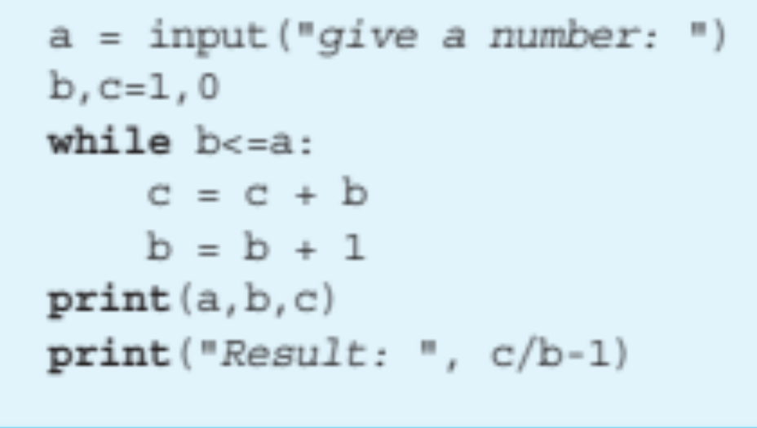
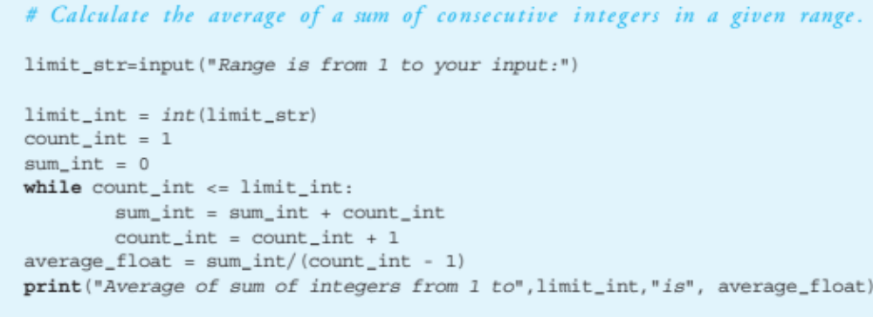
versus

Slide 12
Readability(3): Comments
info at the top, the goal of the code
purpose of variables (if not obvious by the name)
purpose of other functions being used
anything tricky. If it took you time to write, it probably is hard to read and needs a comment

Slide 13
Rule 6
If it was hard to write, it is probably hard to read. Add a comment.

Slide 14
Code Listing 3.3
Bad Comment Style

Slide 15
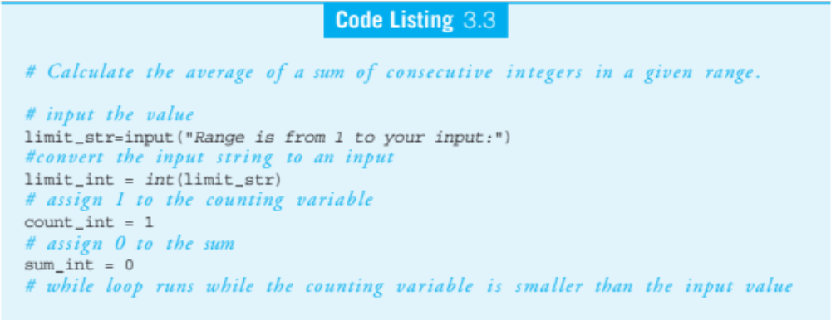
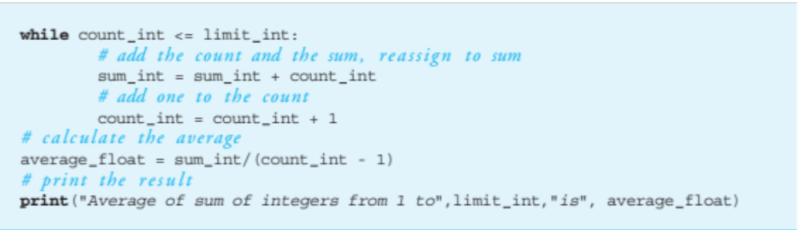

Slide 16
Readability(4): Indenting
indenting is a visual cue to say what code is “part of” other code.
This is not always required as it is in Python, but Python forces you to indent.
This aids readability greatly.

Slide 17
Aspects of Programming (2)
Robust: As much as possible, the program should account for inputs that are not what is expected. More on this with error handling in Chapter 14
Correct: Our programs should produce correct results. Much harder to ensure than it looks!

Slide 18
More on Problem Solving

Slide 19
The Problem is “Problem-Solving”
Remember, two parts to our goal:
  Understand the problems to be solved
  Encode the solution
  in a programming language, e.g. Python

Slide 20
Mix of both
The goal in each class is to do a little of both: problem solving and Python
Terribly important that we impress on you to try and understand how to solve the problem first before you try and code it.

Slide 21
Steps to problem solving
Engage/Commit
Visualize/See
Try it/Experiment
Simplify
Analyze/Think
Relax
Notes:
Actual: Be Proactive
See it
Simplify it
Stir it up
Pause and Reflect

Slide 22
Engage
You need to commit yourself to addressing the problem.
Don’t give up easily
Try different approaches
Set the “mood”
Just putting in time does not mean you put in a real effort!!!

Slide 23
Visualize/See the problem
Find a way that works for you,
some way to make the problem tangible.
draw pictures
layout tables
literally “see” the problem somehow
Everyone has a different way, find yours!

Slide 24
Try it/Experiment
For some reason, people are afraid to just try some solution. Perhaps they fear failure, but experiments, done just for you, are the best way to figure out problems.
Be willing to try, and fail, to solve a problem. Get started, don’t wait for enlightenment!

Slide 25
Simplify
Simplifying the problem so you can get a handle on it is one of the most powerful problem solving tools.
Given a hard problem, make is simplier (smaller, clearer, easier), figure that out, then ramp up to the harder problem.

Slide 26
Think it over/Analyze
If your solution isn’t working:
stop
evaluate how you are doing
analyze and keep going, or start over.
People can be amazingly “stiff”, banging their heads against the same wall over and over again. Loosen up, find another way!

Slide 27
One more thing, relax
Take your time. Not getting an answer right away is not the end of the world. Put it away and come back to it.
You’d be surprised how easy it is to solve if you let it go for awhile. That’s why starting early is a luxury you should afford yourself.

Slide 28
Babylonian Square Root Example

Slide 29
Reminder, rules so far
Think before you program!
A program is a human-readable essay on problem solving that also happens to execute on a computer.
The best way to imporve your programming and problem solving skills is to practice!
A foolish consistency is the hobgoblin of little minds
Test your code, often and thoroughly
If it was hard to write, it is probably hard to read. Add a comment.

