Slide 1
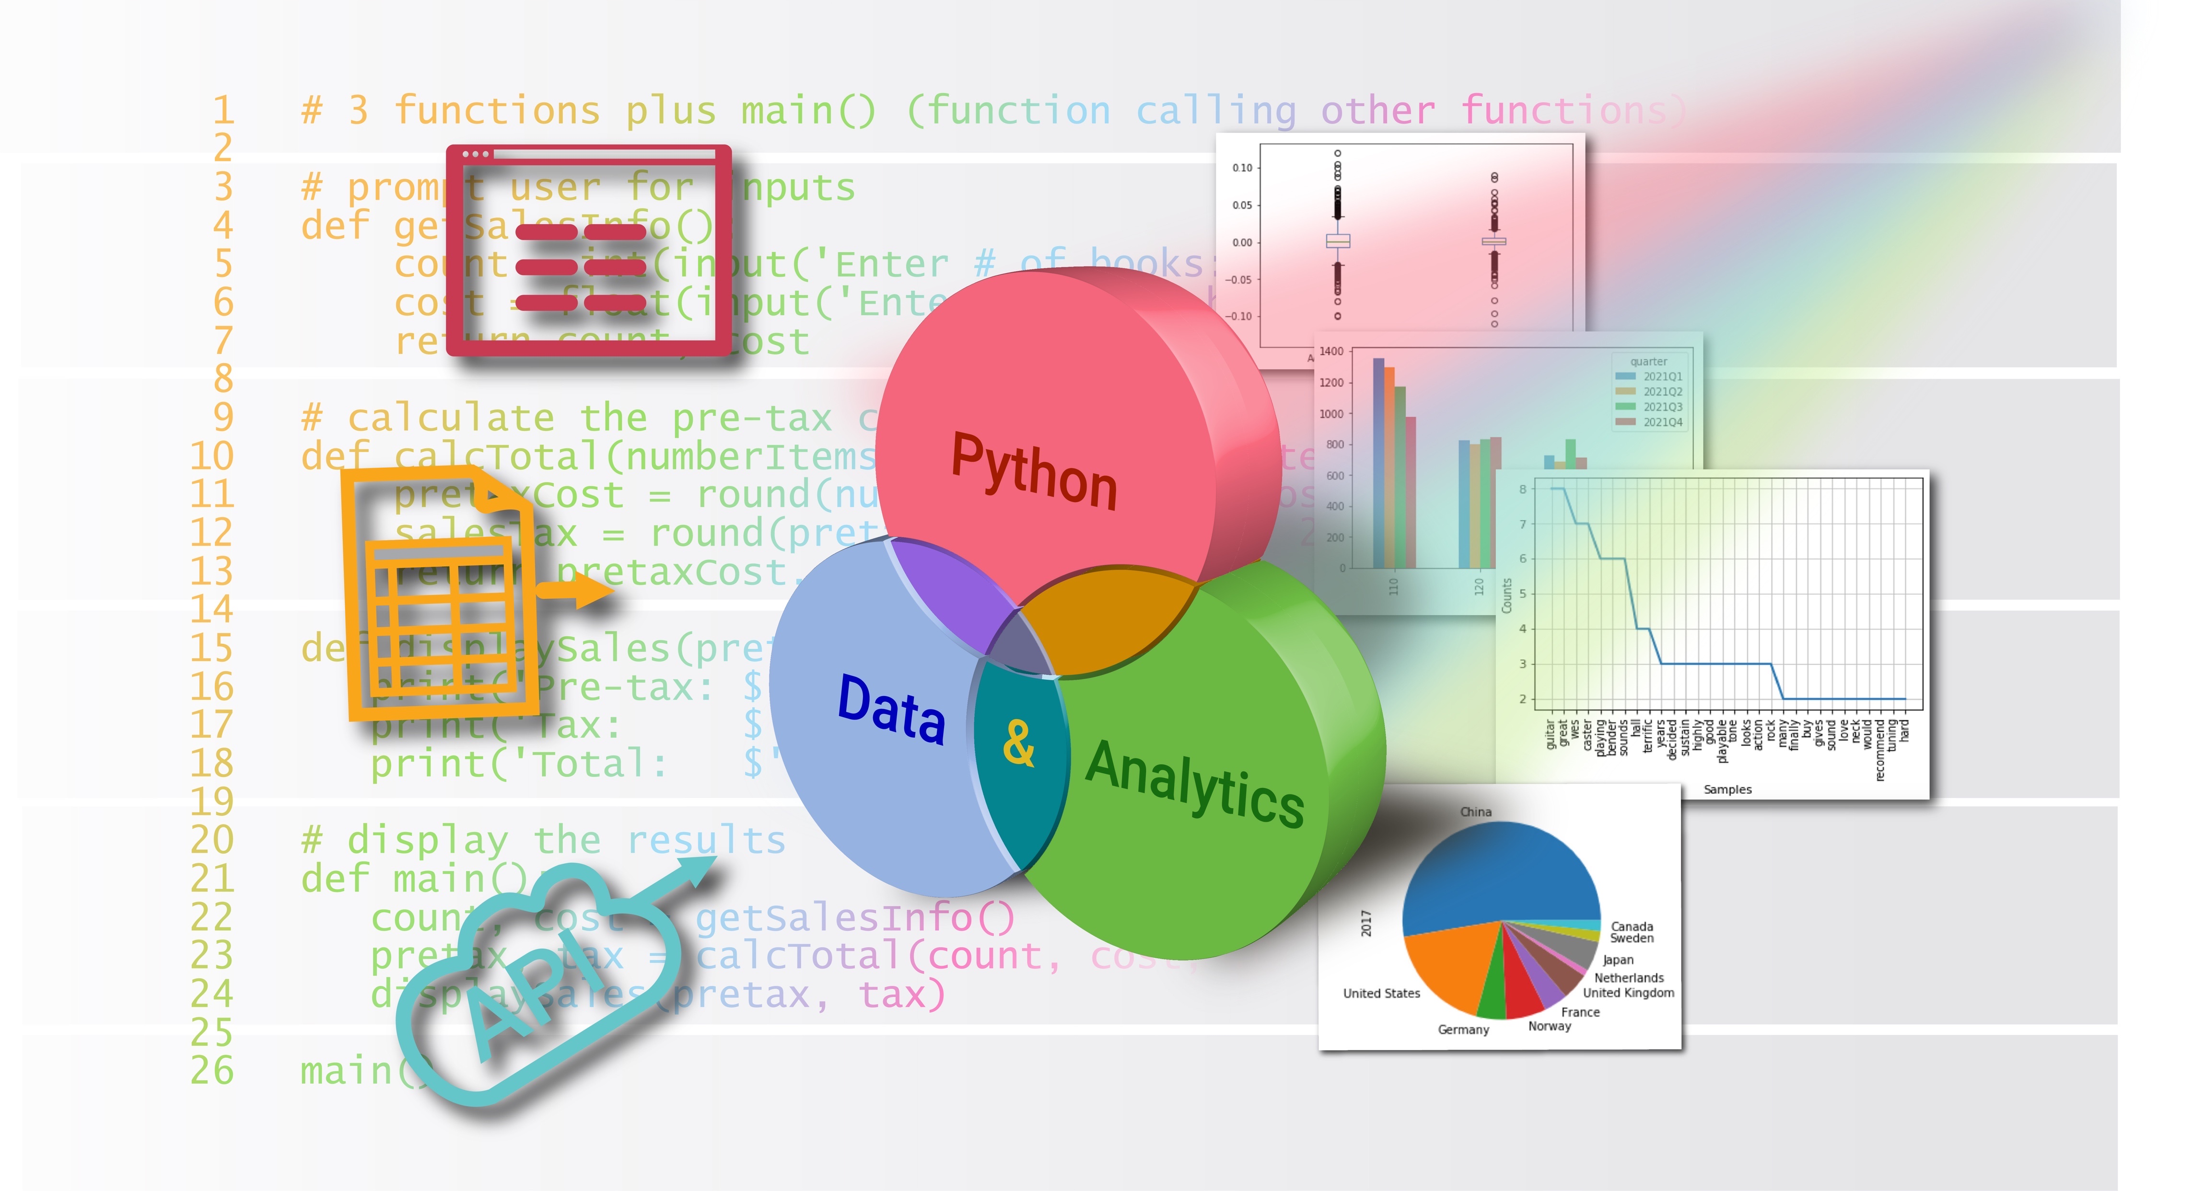
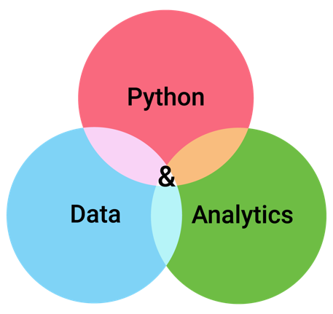

pandas for Data Preparation

Slide 2
Topics
About Data Preparation
Numbers
Dates
Categories
Strings
Key Fields
Inter-field Checking
Finding Missing Related Rows between Tables
Reorganizing Table Layout

Slide 3
Topics
About Data Preparation
The dataset
Numbers
Dates
Categories
Strings
Key Fields
Inter-field Checking
Finding Missing Related Rows between Tables
Reorganizing Table Layout

Slide 4
About Data Preparation
Data preparation involves refining your data to ready it for analysis or processing
Data cleaning – find and repair issues in data
Data reorganization – change the layout of data
Data preparation can be done in programs or interactively
Can generate new data columns and layouts from original source data
Allows you to compare original data with revised data

Slide 5
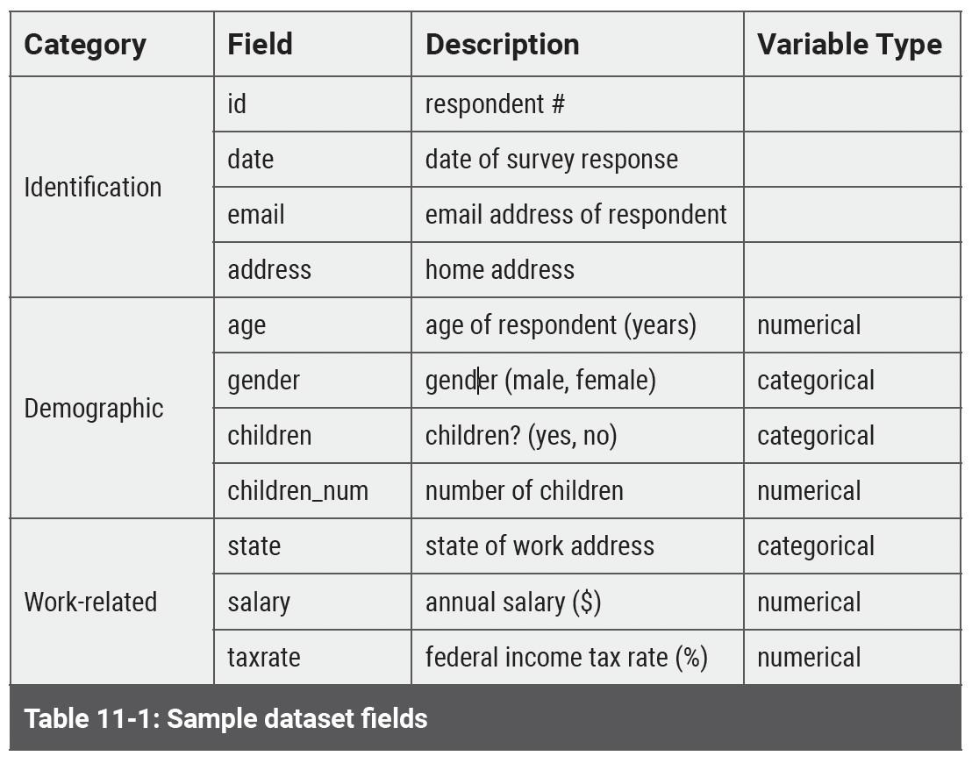
About Data Preparation The Dataset

Slide 6
Topics
About Data Preparation
Numbers
An example dataset
Missing values
Float vs. integer vs. other
What is a column's type?
An example column: Age
Another integer column: children_num
Marking outliers and transforming values: The taxrate column
Non-numeric values in numeric columns
Dates
Categories
Strings
Key Fields
Inter-field Checking
Finding Missing Related Rows between Tables
Reorganizing Table Layout

Slide 7
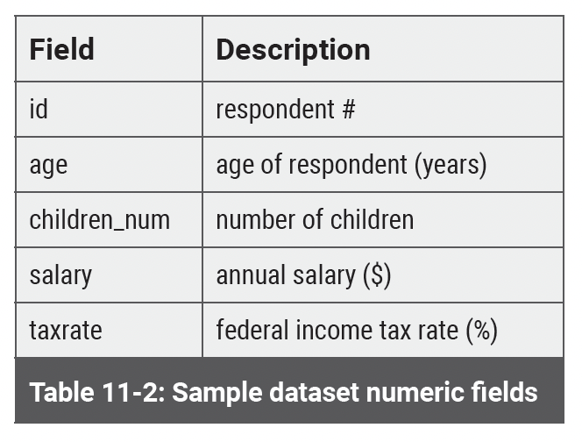
Numbers An example dataset
id,age,children_num,salary,taxrate
1,21,2,40000,22
2,29.4,0,50000,25
3,40,1,60,28
4,6,2,45000,21
,-1,-1,52500,25
six,28,1,47515,100
4,26,,,105

Slide 8

Numbers An example dataset
Notebook 11-2
[1]: | import pandas as pd df = pd.read_csv('DQ-Example-Numeric.csv') df
This notebook demonstrates some aspects related to working with numerical data issues
- missing values
- float vs. integer vs. other types
- the apply() method to transform a column
- working with lambda functions
- adjusting to smaller numeric types
- identifying outliers

Slide 9
Topics
About Data Preparation
Numbers
Dates
Categories
Strings
Key Fields
Inter-field Checking
Finding Missing Related Rows between Tables
Reorganizing Table Layout

Slide 10
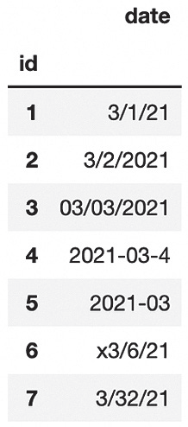
Dates
Notebook 11-3
[1]: | import pandas as pd df = pd.read_csv("DQ-Example-Dates.csv", index_col='id') df
This notebook demonstrates some aspects related to working with date data issues
- missing values
- use of a regular expression
- the to_datetime() function
- the special NaT (not a time) value

Slide 11
Topics
About Data Preparation
Numbers
Dates
Categories
Unique values: The children field
Another category field: Gender
Category by numeric ranges: The age field
Mapping fine to coarse labels: States and regions
Strings
Key Fields
Inter-field Checking
Finding Missing Related Rows between Tables
Reorganizing Table Layout

Slide 12
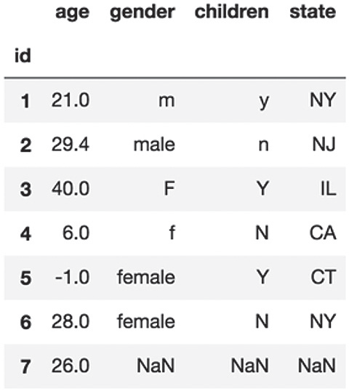
Categories
Notebook 11-4
[1]: | import pandas as pd df = pd.read_csv('DQ-Example-Category.csv', index_col='id') df
This notebook demonstrates some aspects related to working with categorical data, including these methods:
- unique()
- str.lower()
- map()
- astype()
- cut()
- merge()

Slide 13
Topics
About Data Preparation
Numbers
Dates
Categories
Strings
Key Fields
Inter-field Checking
Finding Missing Related Rows between Tables
Reorganizing Table Layout

Slide 14
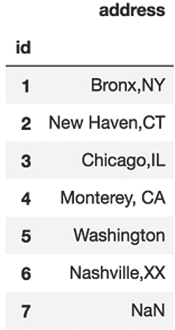
Strings
Notebook 11-5
[1]: | import pandas as pd df = pd.read_csv('DQ-Example-Strings.txt', index_col='id') df
This notebook demonstrates some aspects related to working with string data, including these methods:
- str.split()
- str.strip()
- tolist()
- apply()

Slide 15
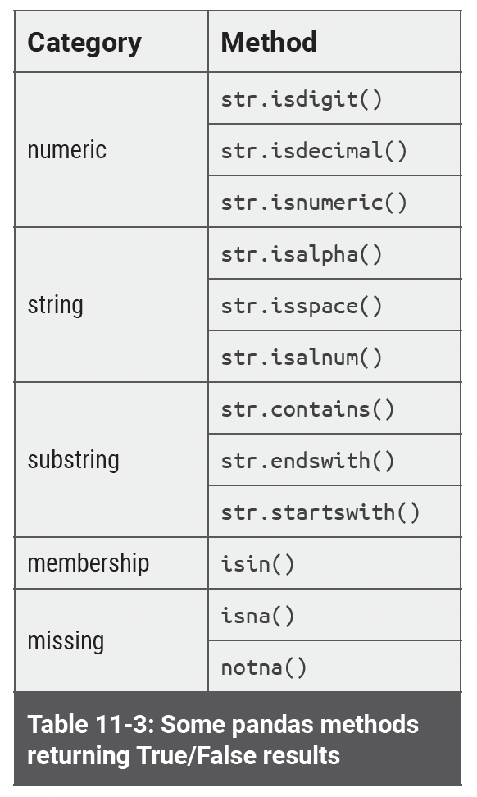
Strings

Slide 16
Topics
About Data Preparation
Numbers
Dates
Categories
Strings
Key Fields
Checking for uniqueness: the email field
Checking for integral, unique, not missing: the ID field
Inter-field Checking
Finding Missing Related Rows between Tables
Reorganizing Table Layout

Slide 17
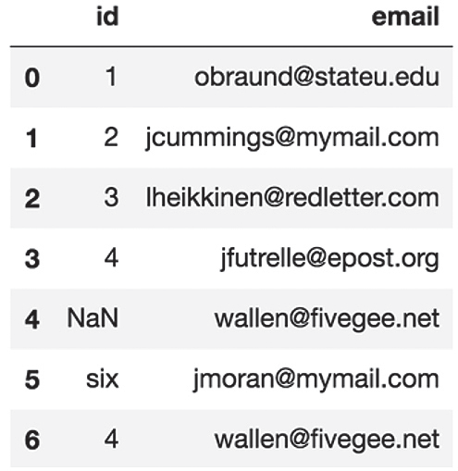
Key Fields
Notebook 11-6
[1]: | import pandas as pd df = pd.read_csv('DQ-Example-IDs.csv') df
This notebook demonstrates some aspects related to working with key fields, including:
- is_unique property
- duplicated() method
- drop_duplicates() method
- missing values check
- str.isdigit()

Slide 18
Topics
About Data Preparation
Numbers
Dates
Categories
Strings
Key Fields
Inter-field Checking
Finding Missing Related Rows between Tables
Reorganizing Table Layout

Slide 19
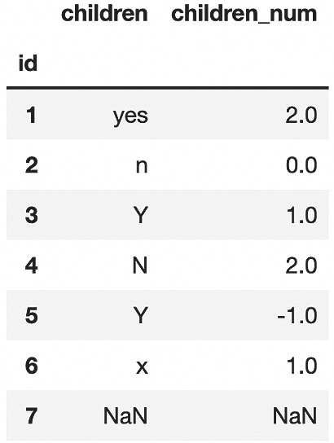
Inter-field Checking
Notebook 11-7
[1]: | import pandas as pd df = pd.read_csv('DQ-Cross-Check.csv', index_col='id') df
This notebook demonstrates some aspects related to inter-field checking, including:
- apply() method
- filter expressions
- boolean columns

Slide 20
Topics
About Data Preparation
Numbers
Dates
Categories
Strings
Key Fields
Inter-field Checking
Finding Missing Related Rows between Tables
Reorganizing Table Layout

Slide 21
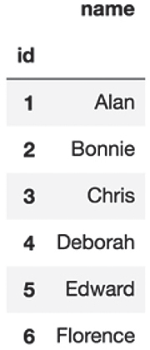
Finding Missing Related Rows between Tables
Notebook 11-8
[1]: | import pandas as pd df = pd.read_csv('contacts.csv', index_col='id') df
This notebook demonstrates some techniques for identify potentially missing rows using:
- join() method
- filtering with isna() method

Slide 22
Topics
About Data Preparation
Numbers
Dates
Categories
Strings
Key Fields
Inter-field Checking
Finding Missing Related Rows between Tables
Reorganizing Table Layout

Slide 23
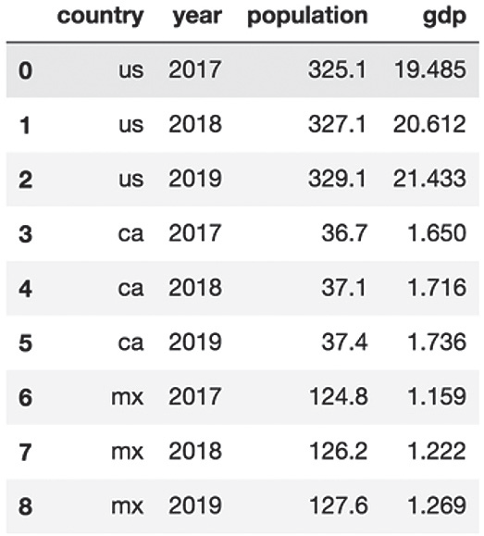
Reorganizing Table Layout
Notebook 11-9
[1]: | import pandas as pd df = pd.read_csv('popgdp.csv') df
This notebook demonstrates some ways to reorganize DataFrame layout, including these methods:
- pivot()
- transpose()
- melt()

Slide 24
Topic Recap
About Data Preparation
Numbers
Dates
Categories
Strings
Key Fields
Inter-field Checking
Finding Missing Related Rows between Tables
Reorganizing Table Layout

