Slide 1
Team gradient

Slide 2
Team members
Abyaz Javid
Mohammed Kenz Valappil
Abbas Rangoonwalla
Ethen Noah Soares
Rayyan Younus

Slide 3
QUESTION 1
Write a Python function to calculate and sort total sales for each product from a list of sales dictionaries. Output a dictionary with total sales and a list of product codes in descending order of sales.

Slide 4
Our approach
Product Identification
A set of unique products was created by extracting product_id from each transaction.
Sales Calculation
For each product we calculated the amount sold, and the total money made per product
Data Aggregation
We built a dataset where we matched each product to its relevant metrics
Sorting Products
We sorted by most profit generating and used the map we built to identify the products

Slide 5
Question 2
Write a recursive function to print the Fibonacci series until the nth number. Code will be checked with random values later.

Slide 6
A little bit about recursive functions

Slide 7
QUESTION 3
Implement a Python script that estimates a simplified carbon footprint based on energy consumption. The final program should be able to produce a result of carbon footprint when a random energy consumed value is entered.

Slide 8
Our approach
Data Extraction
We read company sustainability data from a CSV file, extracting information on company name, carbon footprint, energy usage, and water consumption.
Score Calculation
For each company, we calculated a sustainability score based on carbon footprint, energy usage, and water consumption using a custom formula.
Ranking Companies
The scores were stored in a dictionary, then sorted in descending order to rank companies based on sustainability.

Slide 9
Question 4
Given a list of dictionaries with city and energy usage data and a CSV file mapping cities to countries, write a function that aggregates energy usage by country. Sort the results to identify the countries with the highest and lowest energy consumption. Output the result as a dictionary.

Slide 10
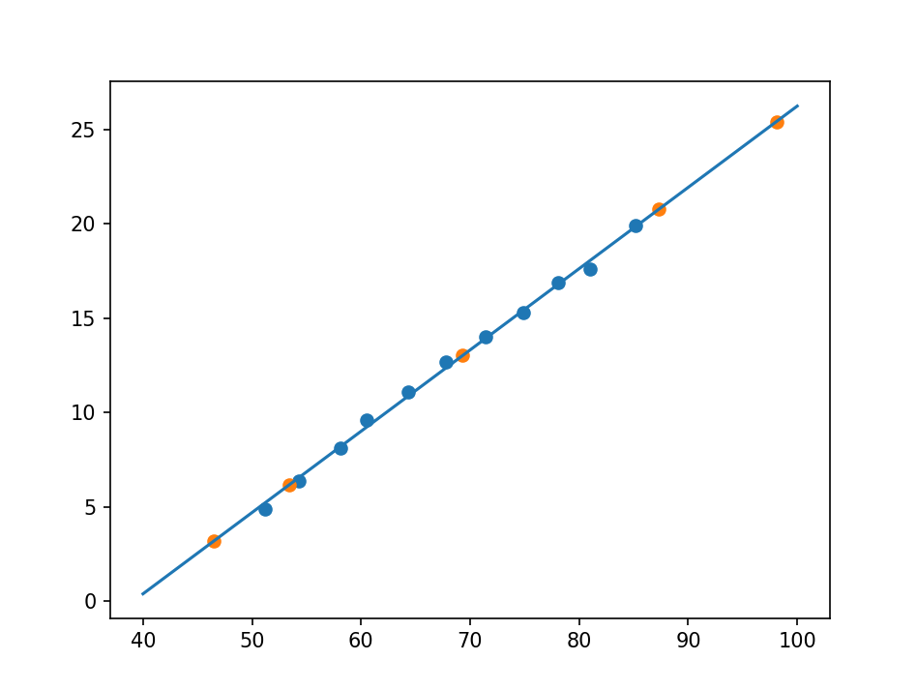
output

Slide 11
Thank you
:D

