Slide 1


Handling Spreadsheets
PYTHON IN FINANCE

Slide 2

Data
DIGITAL PIONEERS
In order to make visualisation, we need data in organised tabular form, suitable for plotting.

Slide 3
Data
DIGITAL PIONEERS
The pandas library provides easy to use data struction and data analysis tools to make your data easier to plot
READINGS
https://towardsdatascience.com/a-quick-introduction-to-the-pandas-python-library-f1b678f34673

Slide 4
DataFrame
DIGITAL PIONEERS
A fast and efficient object for data manipulation
READINGS
https://www.geeksforgeeks.org/python-pandas-dataframe/

Slide 5
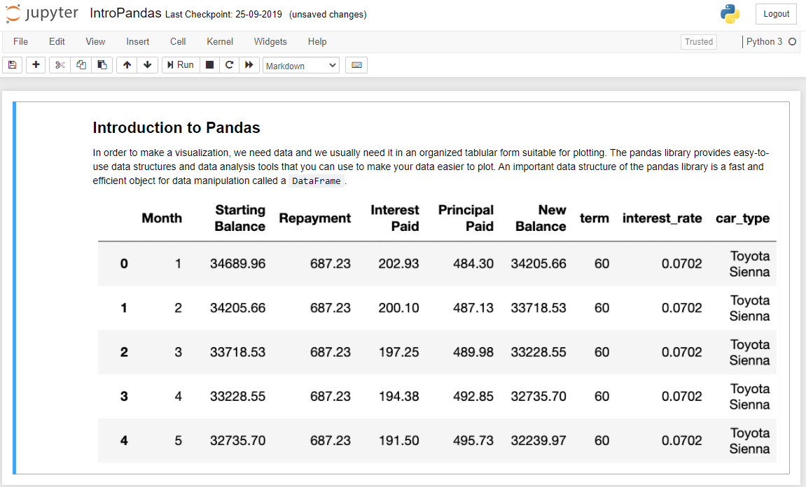
DIGITAL PIONEERS
Notes:
A Row represents the observation, A column represents a feature, the left label is called indexes. Each column has column name

Slide 6
DIGITAL PIONEERS
In order to create visualization, you first need data to work with
Demo: Load the CSV File and Excel File
READINGS
https://realpython.com/pandas-read-write-files/

Slide 7
DIGITAL PIONEERS
After reading the contents into your DataFrame, it’s important to examine your data
READINGS
https://searchdatamanagement.techtarget.com/definition/data
https://www.youtube.com/watcv=sIjSY05JE9Q

Slide 8
Examining Data
DIGITAL PIONEERS
-Assure data is correctly loaded
-See what data you have
-Check the validity of your data
Demo: Basic Operations
READINGS
https://pbpython.com/pandas_dtypes.html
https://pandas.pydata.org/pandas-docs/stable/reference/api/pandas.DataFrame.shape.html
https://pandas.pydata.org/pandas-docs/stable/reference/api/pandas.DataFrame.info.html

Slide 9
DIGITAL PIONEERS
When working with large datasets often time you are only interested in a small subset of that data

Slide 10
Slicing
DIGITAL PIONEERS
-How to select columns
-How to use slicing operations
Demo: Slicing
READINGS
https://www.freecodecamp.org/news/series-and-dataframe-in-python-a800b098f68/
https://pandas.pydata.org/pandas-docs/stable/reference/api/pandas.DataFrame.loc.html
Notes:
Series is a one-dimensional labeled array capable of holding any data type (integers, strings, floating point numbers, Python objects, etc.).

Slide 11
Filtering
DIGITAL PIONEERS
Car Type | Toyota Sienna
Interest Rate | 7.02%
Demo: Filtering
READINGS
https://www.freecodecamp.org/news/series-and-dataframe-in-python-a800b098f68/https://www.youtube.com/watcv=sIjSY05JE9Q

Slide 12
Managing Columns
DIGITAL PIONEERS
- Change Column names
- Remove unnecessary columns

Slide 13
Rename Column
DIGITAL PIONEERS
- Dictionary substitution
- List replacement
Demo: RenamingDeletingColumns
READINGS
https://cmdlinetips.com/2018/03/how-to-change-column-names-and-row-indexes-in-pandas/
https://cmdlinetips.com/2018/04/how-to-drop-one-or-more-columns-in-pandas-dataframe/

Slide 14
Aggregate functions
DIGITAL PIONEERS
- When working with a dataset, it’s a good idea to compute summary statistics
Demo: AggregateFunctions
READINGS

Slide 15
Identify missing data
DIGITAL PIONEERS
When working with a dataset, you will often run into missing values
NaN | None
  Denotes a missing value
READINGS

Slide 16
Identify missing data
DIGITAL PIONEERS
Missing Data
  Hint at data collection errors
  Indicate improper conversion or manipulation
  Not actually be consider missing
READINGS

Slide 17
Identify missing data
DIGITAL PIONEERS
Missing Data
  Zero
  False
  Not Applicable
  Entered an empty string
READINGS

Slide 18
Identify missing data
DIGITAL PIONEERS
Before you can graph data, you need to be sure there are no missing values
READINGS

Slide 19
Identify missing data
DIGITAL PIONEERS
Missing Data
  Hint at data collection errors
  Indicate improper conversion or manipulation
  Not actually be consider missing
Demo: IdentifyingMissingData
READINGS

Slide 20
Removing or filling missing data
DIGITAL PIONEERS
Removing missing data is simple solution
Imputing missing data has variety of ways
Demo: RemoveFillMissingData
READINGS

Slide 21
Exporting DataFrames
DIGITAL PIONEERS
Good idea to export them to either csv or excel files
Great way to share your results with others
Demo: ExportCSVExcel
READINGS

