Slide 1


Reporting Virtualization
PYTHON IN FINANCE

Slide 2

Matplotlib
DIGITAL PIONEERS
A powerful tool capable of producing complex publication-quality figures with fine layout control in two and three dimensions
Demo: BasicsMatplotlib

Slide 3
Setting Marker type and colors
DIGITAL PIONEERS
Demo: MarkerTypeColor
READINGS

Slide 4
Matlab-style vs object syntax
DIGITAL PIONEERS
Matplotlib has two different styles of syntax.
MatLab-style Syntax: A scripted interface designed to feel like MATLAB where Matplotlib maintain a Pointer to the active figure
Object-Oriented Syntax : Used in situations where you want more control over your figure
You can have plots created through a combination of MATLAB-style and object-oriented syntax.
Demo: MATLABvsObjectSyntax
READINGS

Slide 5
Setting titles, labels, and limits
DIGITAL PIONEERS
Create Plot Titles, Labels and Limits
Demo: TitlesLabelsLimits
READINGS

Slide 6
Grids
DIGITAL PIONEERS
Grid line can help to find the difference between two quantities in the graph
Demo: Grids
READINGS

Slide 7
Plots Legends
DIGITAL PIONEERS
Assist in assigning meaning to your various plot elements
Demo: Legends
READINGS

Slide 8
Saving plots to files
DIGITAL PIONEERS
Saving the plots outside of Jupyter Notebook is important, as allow to show your visualizations to others
Check your saved visualization, as there is always a possibility the graph doesn’t look the same as your notebook
Demo: SavePlotsFile
READINGS

Slide 9
Matplotlib wrappers(Pandas vs Seaborn)
DIGITAL PIONEERS
Matplotlib is a popular visualization library, but it has flows
Matplotlib Wrappers
Pandas
Seaborn
READINGS

Slide 10
Matplotlib Flaws
DIGITAL PIONEERS
Matplotlib Flaws
Defaults are not ideal
Library is low-level
Lack of integration with pandas data Structure
Demo: SavePlotsFile
READINGS

Slide 11
Boxplot
DIGITAL PIONEERS
A standardized way of displaying the distribution of data based on a five number summary
Tell you the values of your outliers
Identify if the date is symmetrical
Determine how tightly data is grouped
See if your data is skewed
Demo: MatplotlibWrappersPandasSeaborn
READINGS
https://towardsdatascience.com/understanding-boxplots-5e2df7bcbd51

Slide 12
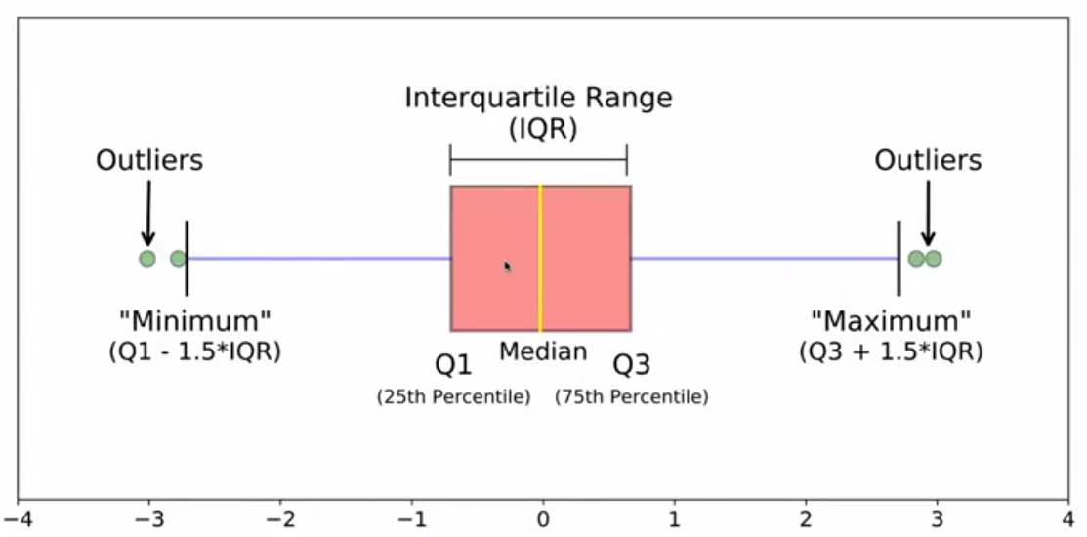
DIGITAL PIONEERS
READINGS

