Slide 1
THE CLAUDE BEAST SERIES
The Claude Beast
Claude Sub Agents
Spawning specialized AI workers for parallel, focused execution
Notes:
Welcome to The Claude Beast series. Today we are diving into sub-agents -- one of the most powerful features of Claude Code.
Sub-agents let you spawn specialized AI workers that run in isolated contexts, handling everything from codebase exploration to parallel code modifications.
By the end of this talk, you will understand when and how to use sub-agents, how they differ from Agent Teams, and the architectural patterns that make them effective.
Let's get started.

Slide 2
Sub-agents are isolated AI workers spawned via the Task tool
– Specialized AI assistants within Claude Code for specific tasks
– Each gets its own context window, system prompt, and tool access
– Spawned via the Task tool with configurable model selection
– Results are summarized and returned to the main conversation
– Flat architecture: sub-agents cannot spawn other sub-agents
– Core benefit: context isolation prevents "context pollution"
Key Insight
Context isolation is the key innovation -- each sub-agent starts fresh, keeping the main conversation clean and focused.
2 / 10
Notes:
So what exactly are sub-agents? Think of them as specialized AI workers that live inside your Claude Code session. When Claude encounters a task that matches a sub-agent's description, it delegates to that agent.
The key innovation here is context isolation. Each sub-agent gets its own fresh context window. It does not inherit the parent conversation's context -- it starts clean with just its system prompt and the task description.
When the sub-agent finishes, its results get summarized and sent back to the main conversation. All the verbose intermediate steps stay in the sub-agent's context, keeping your main conversation clean.
One critical constraint: sub-agents cannot spawn other sub-agents. This flat architecture prevents infinite recursion and keeps things predictable.

Slide 3
Three core agents cover the most common delegation patterns
EXPLORE AGENT
PLAN & GENERAL-PURPOSE
– Fast, read-only codebase navigation
– Model: Haiku (low-latency)
– Tools: Read-only (Write/Edit denied)
– Thoroughness: quick / medium / very thorough
– Plan: Research agent for plan mode
– Read-only, inherits main model
– General-Purpose: Complex multi-step tasks
– All tools available, inherits main model
– Use when: exploration + modification needed
3 / 10
Notes:
Claude Code ships with three built-in sub-agent types that cover the most common patterns.
First is the Explore agent -- this is your go-to for fast, read-only codebase navigation. It runs on Haiku for speed, and it is explicitly denied Write and Edit tools. You can set thoroughness levels: quick takes 10-30 seconds, medium 30-60, and very thorough 60-120 seconds.
Second is the Plan agent -- it is a research agent used during plan mode to gather context before Claude presents a plan. Also read-only.
Third is the General-purpose agent -- this handles complex, multi-step tasks that need both exploration and modification. It inherits the main conversation's model and has access to all tools.
There are also specialized built-in agents like Bash for terminal commands and Claude Code Guide for answering questions about Claude Code features.

Slide 4
Define your own agents as Markdown files with YAML frontmatter
COMMON AGENT PATTERNS
AGENT SCOPES (by priority)
– code-reviewer — Code quality analysis and PR reviews
– security-auditor — Vulnerability detection, OWASP checks
– test-runner — Test execution and coverage analysis
– debugger — Root cause analysis and bug investigation
– doc-writer — Documentation generation
– 1. --agents CLI flag (session only)
– 2. .claude/agents/ (project scope)
– 3. ~/.claude/agents/ (user scope)
– 4. Plugin agents/ directory
– Key frontmatter: name, description, tools, model, permissionMode, hooks, memory, isolation, maxTurns
4 / 10
Notes:
Beyond the built-in types, you can create your own custom sub-agents. These are defined as Markdown files with YAML frontmatter.
Common patterns include code-reviewer on Sonnet for quality analysis, security-auditor for vulnerability detection, test-runner on Haiku for speed, debugger for root cause analysis, and doc-writer for documentation.
Agents are stored at different scopes with clear priority: CLI flag for the current session, project-level in .claude/agents/, user-level in ~/.claude/agents/, or via plugins.
The frontmatter supports fields like name, description, tools (allowlist or denylist), model selection, permission mode, max turns, MCP servers, lifecycle hooks, persistent memory, and worktree isolation. This gives you fine-grained control over exactly what each agent can do.

Slide 5
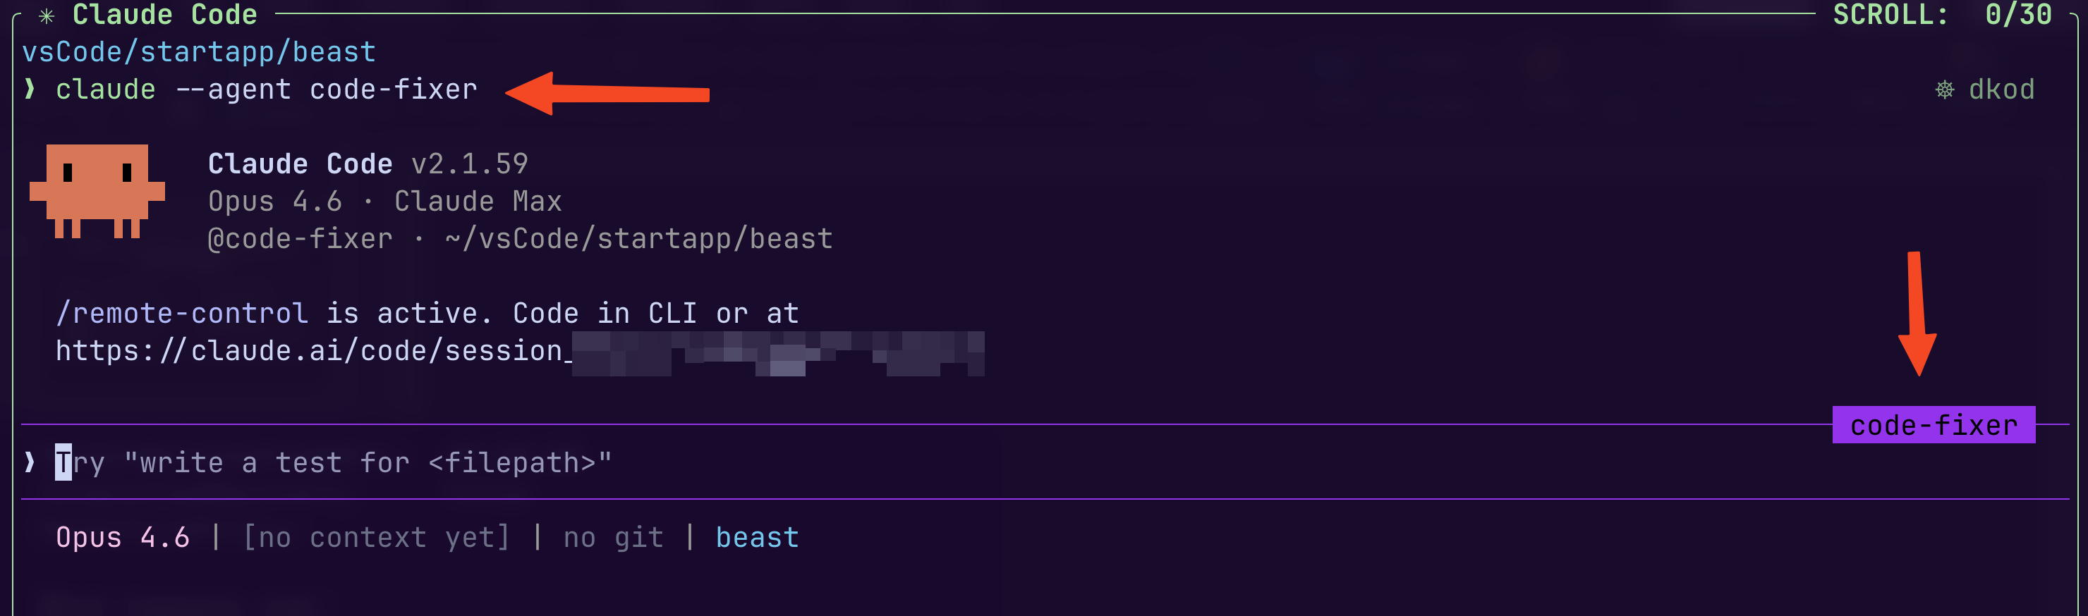
Start a Claude session with your agent
Notes:
Beyond the built-in types, you can create your own custom sub-agents. These are defined as Markdown files with YAML frontmatter.
Common patterns include code-reviewer on Sonnet for quality analysis, security-auditor for vulnerability detection, test-runner on Haiku for speed, debugger for root cause analysis, and doc-writer for documentation.
Agents are stored at different scopes with clear priority: CLI flag for the current session, project-level in .claude/agents/, user-level in ~/.claude/agents/, or via plugins.
The frontmatter supports fields like name, description, tools (allowlist or denylist), model selection, permission mode, max turns, MCP servers, lifecycle hooks, persistent memory, and worktree isolation. This gives you fine-grained control over exactly what each agent can do.

Slide 6
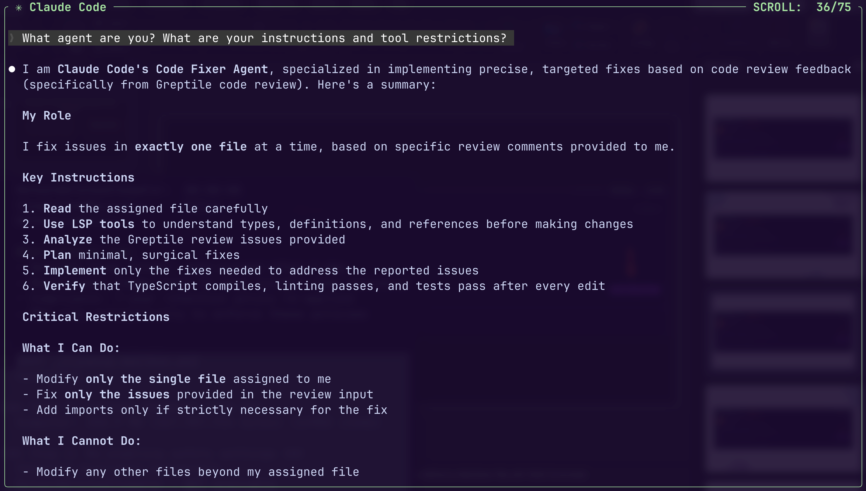
Notes:
Beyond the built-in types, you can create your own custom sub-agents. These are defined as Markdown files with YAML frontmatter.
Common patterns include code-reviewer on Sonnet for quality analysis, security-auditor for vulnerability detection, test-runner on Haiku for speed, debugger for root cause analysis, and doc-writer for documentation.
Agents are stored at different scopes with clear priority: CLI flag for the current session, project-level in .claude/agents/, user-level in ~/.claude/agents/, or via plugins.
The frontmatter supports fields like name, description, tools (allowlist or denylist), model selection, permission mode, max turns, MCP servers, lifecycle hooks, persistent memory, and worktree isolation. This gives you fine-grained control over exactly what each agent can do.

Slide 7
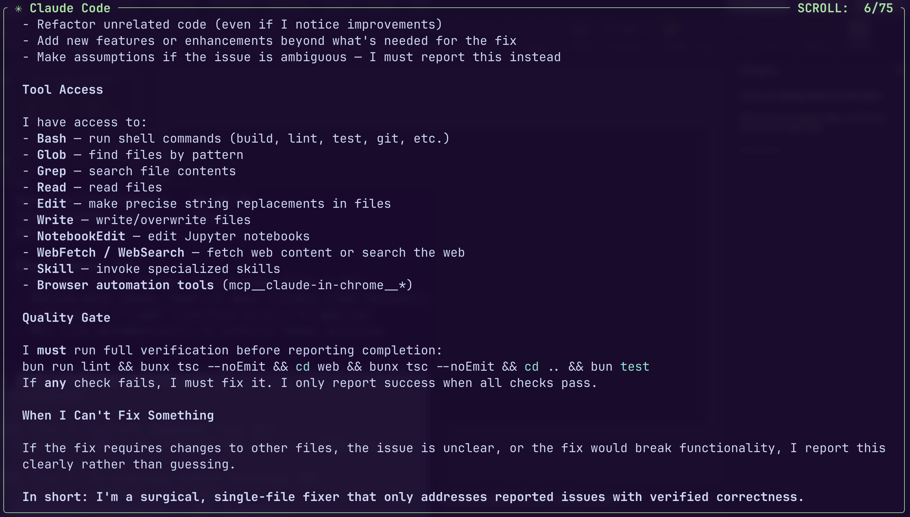
Notes:
Beyond the built-in types, you can create your own custom sub-agents. These are defined as Markdown files with YAML frontmatter.
Common patterns include code-reviewer on Sonnet for quality analysis, security-auditor for vulnerability detection, test-runner on Haiku for speed, debugger for root cause analysis, and doc-writer for documentation.
Agents are stored at different scopes with clear priority: CLI flag for the current session, project-level in .claude/agents/, user-level in ~/.claude/agents/, or via plugins.
The frontmatter supports fields like name, description, tools (allowlist or denylist), model selection, permission mode, max turns, MCP servers, lifecycle hooks, persistent memory, and worktree isolation. This gives you fine-grained control over exactly what each agent can do.

Slide 8
Context isolation is the core architectural innovation
– Each sub-agent gets its own independent context window
– Starts fresh with only system prompt + task description
– Results are summarized and returned to the main conversation
– Verbose output stays in the sub-agent's context (no pollution)
– Auto-compaction at ~95% capacity prevents overflow
– Transcripts persist at ~/.claude/projects/.../subagents/
– Sub-agents can be resumed to continue with full history
Key Insight
Only distilled results flow back to the parent. All verbose intermediate steps stay in the sub-agent's isolated context.
5 / 10
Notes:
Context isolation is arguably the most important architectural decision in the sub-agent design.
Each sub-agent gets a completely fresh context window. It does not see the parent's conversation history. It only gets its system prompt and the task description you send it.
When the sub-agent finishes, only the distilled results flow back. All the intermediate steps -- the file reads, the grep outputs, the test results -- stay in the sub-agent's context. This means your main conversation stays clean and focused.
Sub-agents also support auto-compaction at 95% capacity to prevent context overflow, and their transcripts are persisted as JSONL files for later review.
You can also resume a previous sub-agent to continue its work with the full conversation history intact.

Slide 9
Foreground blocks the conversation; background frees you to continue
FOREGROUND (Default)
BACKGROUND
– Blocking: main conversation pauses
– Interactive: permission prompts pass through
– Use when: results needed before continuing
– Use when: task needs user input
– Concurrent: runs while you keep working
– Non-interactive: permissions pre-approved
– Ctrl+B to background a running agent
– /tasks to check all running agents
– Auto-resumes main agent on completion
6 / 10
Notes:
Sub-agents can run in two modes: foreground and background.
Foreground is the default. It blocks the main conversation until the sub-agent completes. This is interactive -- if the sub-agent needs permissions or has clarifying questions, those get passed through to you.
Background mode is where things get powerful. The sub-agent runs concurrently while you keep working with the main agent. Before launching, Claude pre-approves necessary permissions since the agent cannot ask you questions while running in the background.
You can press Ctrl+B to send any running foreground agent to the background. Use /tasks to check progress on all running background agents. When a background agent finishes, it automatically wakes up the main agent with its results.
If a background agent fails due to missing permissions, you can resume it in the foreground to retry interactively.

Slide 10
Three dispatch patterns optimize for different task dependencies
PARALLEL DISPATCH
SEQUENTIAL & BACKGROUND
– Independent tasks, no shared state
– Example: 5 Explore agents mapping different parts of a codebase simultaneously
– All conditions: 3+ tasks, no shared state, clear file boundaries
– Sequential: Tasks have dependencies (B needs A)
– Shared files or state (conflict risk)
– Phase 1: Explore > Phase 2: Implement
– Background: Research or analysis tasks
– Results not blocking current work
– Documentation lookups, security audits
7 / 10
Notes:
Sub-agents support three core execution patterns.
Parallel dispatch is for when tasks are fully independent with no shared state. You might launch 5 Explore agents simultaneously, each mapping a different part of the codebase. The key requirement is clear file boundaries with no overlap.
Sequential dispatch is for dependent tasks. Phase 1 explores and gathers context, Phase 2 implements using that context, Phase 3 reviews and tests. Each phase needs output from the previous one.
Background dispatch is for non-blocking research. Web lookups, documentation fetching, security audits -- anything where you do not need the results immediately.
A good rule of thumb: use parallel when you have 3 or more unrelated tasks with clear boundaries. Use sequential when any task depends on another. Use background when results are not blocking your current work.

Slide 11
Git worktrees enable true parallel editing of the same files
– Each agent gets a separate Git checkout (branch + working dir)
– Worktrees live under .claude/worktrees/
– Enable via frontmatter: isolation: worktree
– Or via CLI: claude --worktree feature-auth
– Clean worktrees are auto-removed; changed ones persist
– Desktop app creates a worktree for every session by default
Key Insight
With worktrees, Agent A can rewrite src/auth.ts while Agent B rewrites the same file -- no conflict risk.
8 / 10
Notes:
Worktree isolation, introduced in Claude Code v2.1.50, solves the fundamental problem of parallel agents editing the same files.
Without worktrees, parallel agents are limited to either reading files or writing to strictly non-overlapping paths. With worktrees, Agent A can rewrite src/auth.ts while Agent B rewrites the same file completely differently.
Each worktree is a separate Git checkout with its own branch, working directory, and index. They are created under .claude/worktrees/.
You can enable worktree isolation three ways: in the agent frontmatter with isolation: worktree, via the CLI with claude --worktree, or mid-session by telling Claude to work in a worktree.
This is especially valuable for batched code migrations -- imagine 5 agents each handling 10 files in parallel without any conflict risk.

Slide 12
Hub-and-spoke delegation vs mesh-topology collaboration
SUB-AGENTS (Hub-and-Spoke)
AGENT TEAMS (Mesh)
– Results report back to main agent only
– Main agent manages all coordination
– Lower token cost (summarized results)
– Best for: focused, self-contained tasks
– Built-in, no configuration needed
– Teammates message each other directly
– Shared task list, self-coordination
– Higher token cost (full instances)
– Best for: collaborative, cross-layer work
– Requires experimental flag to enable
9 / 10
Notes:
This is a critical distinction in the Claude Code architecture. Sub-agents and Agent Teams serve different purposes.
Sub-agents follow a hub-and-spoke model. Each agent reports results back to the main conversation -- they never talk to each other. The main agent orchestrates everything. This is cost-efficient because results are summarized.
Agent Teams use a mesh topology. Each teammate is a fully independent Claude instance with its own session. They communicate directly with each other via a mailbox system, sharing findings and challenging assumptions.
Use sub-agents when work is self-contained and workers do not need to communicate. Use Agent Teams when you need cross-layer coordination, debate on architecture, or competing hypotheses explored in parallel.
Think of it as a spectrum: single session for sequential work, sub-agents for parallel focused work, builder-validator pairs for quality gating, and Agent Teams for true collaborative exploration.

Slide 13
Choosing the right approach: direct work vs sub-agents vs teams
WORK DIRECTLY WHEN:
USE SUB-AGENTS WHEN:
– Latency matters (quick, targeted change)
– Multiple phases share significant context
– Task needs frequent back-and-forth
– Iterative refinement with user input
– Work is self-contained (returns a summary)
– Enforcing tool restrictions / permissions
– Verbose output (tests, logs, docs)
– Preserving main context window
– Independent research in parallel
10 / 10
Notes:
Let me leave you with a practical decision framework.
Work directly in the main conversation when latency matters, when you are making a quick targeted change, when phases share a lot of context, or when you need frequent back-and-forth.
Use sub-agents when the work is self-contained and can return a summary, when you want to enforce specific tool restrictions, when the task produces verbose output like test results or logs, or when independent research can happen in parallel.
The most common mistake is poor invocation quality. Instead of 'fix authentication', say 'fix OAuth redirect loop where login redirects to /login instead of /dashboard, reference src/lib/auth.ts'. Give specific file references, error messages, and clear success criteria.
Remember: each sub-agent should excel at one specific task. Overly broad agents produce mediocre results. Keep them focused, give them dense context, and grant only the permissions they need.

