Slide 1


Airbnb Recommendation for Travelers in NYC
Qingqing Cao
01/08/2020

Slide 2
Introduction
New York is one of the world's major commercial, financial and culatual centers. Its core, Manhattan, is the most densely populated borough. It is known of many major attractions. Every year, many travelers choose New York for different reasons. They may come for sight seeing, shopping, arts and shows, nightlife, or business trips, etc. Travelers usually wish to stay in neiborhoods that close to their places of interests, and they usually have a budget limit for accomendations. This project is to help travelers to choose the best area for choosing airbnb based on their locations and interests.
People who might be interested in this projects are traverlers who plan to choose airbnb in NYC.

Slide 3
Data Usage
The purpose of traveling are divided into four categories: outdoors, arts, shopping, and food. Boroughs and Neighborhood information are acquired from the lab data. Locations related to these categories are explored and clustered using Foursquare API. Airbnb data is downloaded from the website: https://www.kaggle.com/dgomonov/new-york-city-airbnb-open-data/data.

Slide 4
Methodology
1) use Foursquare API to explore restaurant, arts, shopping center, outdoor activity locations in Manhattan;
2) show these locations on the map and use labels to show their name and category;
3) cluster airbnb in Manhattan by their prices and popularities;
4) show the airbnb locations on the map

Slide 5

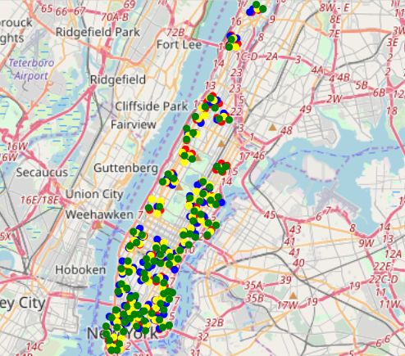
Results
Red markers show restaurant clusters; yellow markers show shopping places; blue markers how arts places; green markers show locations for outdoors. From the distribution of these clusters in the map, those four colors mix up evenly, which means there is no place that only one or two categories take advantages.
The more we reach the south of Manhattan, more attractions(include all four categories) show up. Most attractions accumulated on the south of the Broadway-Lafayette Street. And east side of the Manhattan has more attractions than the west side.

Slide 6
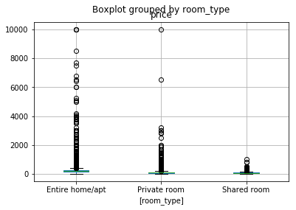
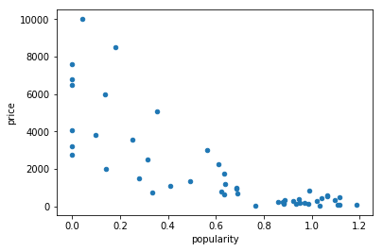
Results
The price is related to the room type. Entire room/apt has the highest mean price compared with private room or shared room. More outliers show in the type of entire room/apt, and followed by private room, and shared room.
We assume the reviews per month is related to the popularity of the host. The one with higher reviews per month is more popular. Generally cheaper airbnb has higher popularities. This is not always the truth because the popularity of the location is also decided by other reasons such as the hosts' attitudes, the cleanness of the room, etc.

Slide 7
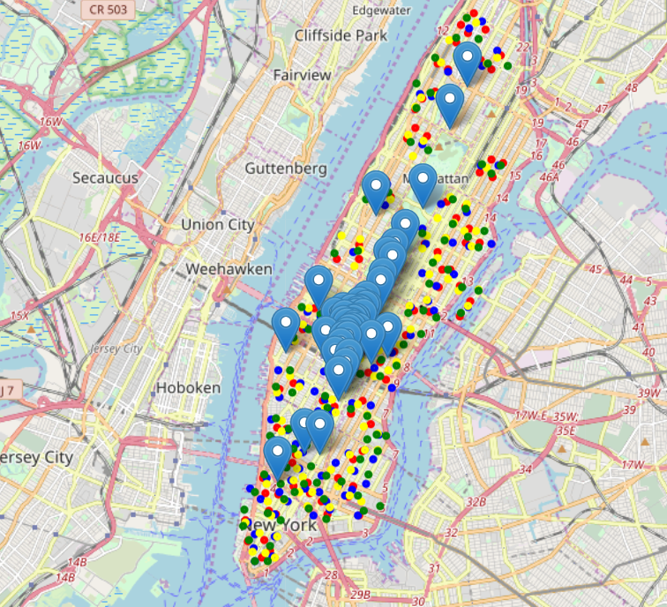
Results
The price of the airbnb is generally higher on the south of Manhattan. This might be because they are close to many attractions.
The majorities of the airbnb apartments are between 23rd and 50th street. The price and popularity are very diverse in this area.

Slide 8
Conclusions
(1) There is no differences among the distribution of restaurants, arts, shopping and outdoors location. Travelers can always enjoy them in the same area.
(2) More attractions lay on the south part of Manhattan, and east side has more attractions than west side of Manhattan.
(3) Airbnb price is related to the room type. Usually private house/apt has higher price than private room or shared room. Generally cheaper airbnb will attract more travelers.
(4) The price of the airbnb is higher on the south of Manhattan and lower on the north tof Manhattan, similar trend as the attractions number.
(5) For most travelers, the area between 23rd and 50th street is most recommended for them to choose airbnb. The price is very diverse in this area and there are many attractions in the area.

