Slide 1

Department of Computer Science &Engineering Artificial Intelligence & Machine Learning
A.P. Shah Institute of Technology G.B.Road,Kasarvadavli, Thane(W), Mumbai-400615
UNIVERSITY OF MUMBAI
Academic Year 2023-2024

Slide 2
UNIT CONVERTER
Computer Science & Engineering Artificial Intelligence and Machine Learning
By
Mahesh Shinde (22106128)
Anup Singh (22106104)
Shubham Patil (22106047)
Harsh Salunkhe (22106133)
Under the Guidance of Prof. Sayali Badhan

Slide 3
Index
Introduction
Objectives
Features
Future Scope
Block Diagram
Technology Stack
Implementation
Advantages
Conclusion
References

Slide 4
Introduction
In a world where measurements and units vary across borders and disciplines, the need for a versatile and accurate unit converter is ever-present. The Unit Converter Application aims to be the quintessential solution to this universal challenge, providing a streamlined and user-friendly tool for converting between different units of measurement.

Slide 5
Objective
To develop a user-friendly unit converter application that provides quick and accurate conversions between diverse units of measurement, catering to the needs of students, professionals, and enthusiasts in various fields.

Slide 6
Features
Convenience : A convenient way to perform unit conversions.
Accuracy : The accuracy of the application programmed with up-to-date conversion factors and formulas.
Time-Saving :The application can save users a significant amount of time when performing multiple conversions.
Ease of Use :User-friendly interface that makes the application accessible to users of all levels of expertise.
Consistency :the application ensures consistent conversions adhering to standard measurement units.

Slide 7
Future scope
The future scope of unit converter applications includes
improved user interfaces
real-time data integration
voice recognition

Slide 8
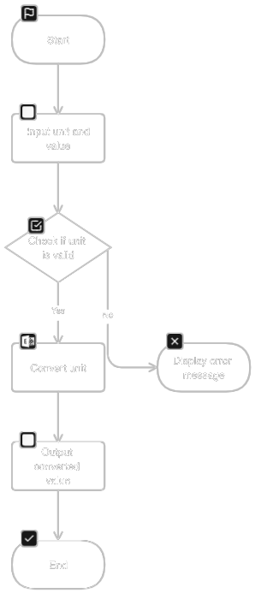
BLOCK DIAGRAM

Slide 9
Technology Stack
Programming Language :Java
JDK Version: JDK-JavaSE20
Text Editor: Visual Studio Code

Slide 10
PROJECT WORK

Slide 11
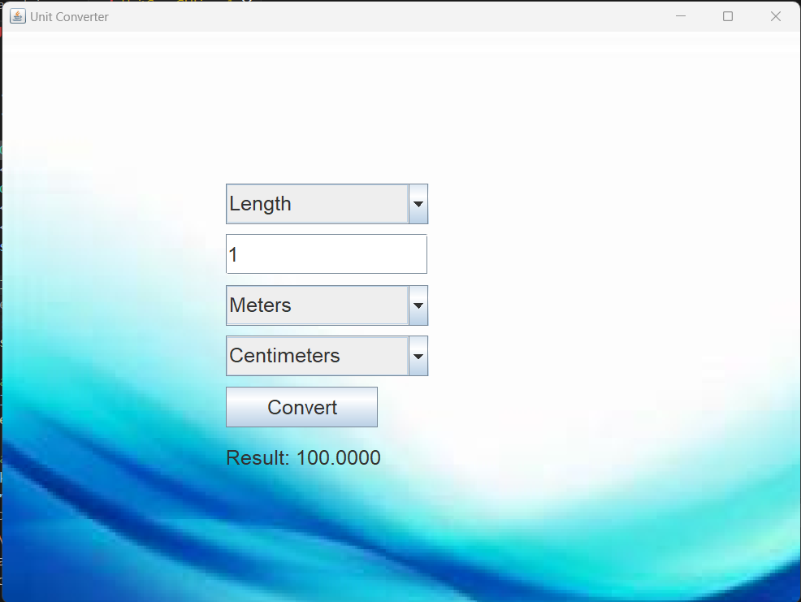
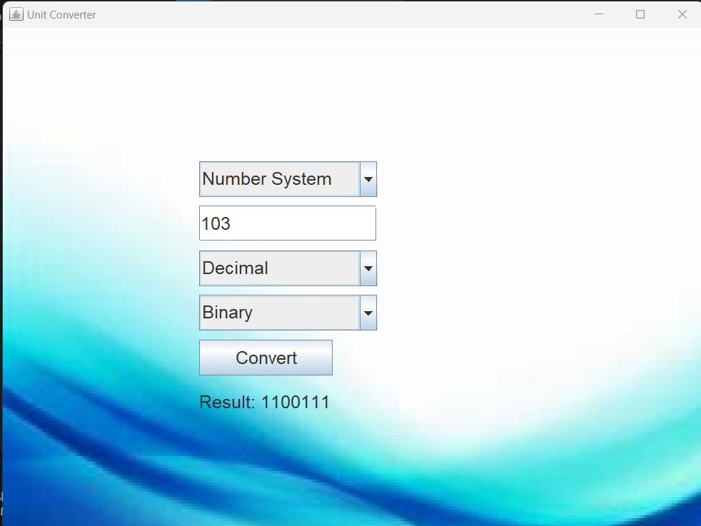
Implementation

Slide 12
Applications
Engineering and Construction
Science and Research
Healthcare
Cooking and Culinary Arts
Travel and Geography
Education
Environmental Sciences
Manufacturing and Industry
Energy and Utilities
International Trade and Import/Export

Slide 13
Conclusion
Summarize the Value Offered:
Begin by summarizing the cits role in simplifying ore value proposition of the unit converter application, emphasizing unit conversions for users.
Versatility and Adaptability:
Emphasize the versatility of the app, catering to a diverse user base, including students, professionals, travelers, and home users.

Slide 14
References
Research paper
[1] Deitel, P. J., & Deitel, H. M. (2008). Java How to Program (8th ed.). Pearson. (Chapter 12 covers GUI in Java)
[2] Sierra, K., & Bates, B. (2005). Head First Java. O'Reilly Media. (A beginner-friendly introduction to Java programming)
[3] Shneiderman, B., & Plaisant, C. (2016). Designing the User Interface: Strategies for Effective Human-Computer Interaction (6th ed.). Pearson.
[4]Official Java Documentation
[5]Java Swing Documentation
[6]Oracle's Java Tutorials

Slide 15


