Slide 1

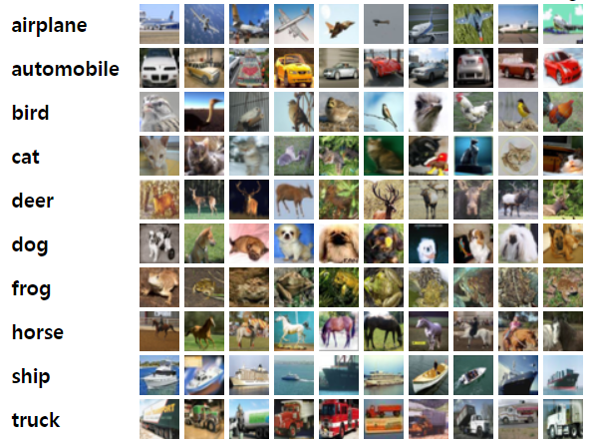
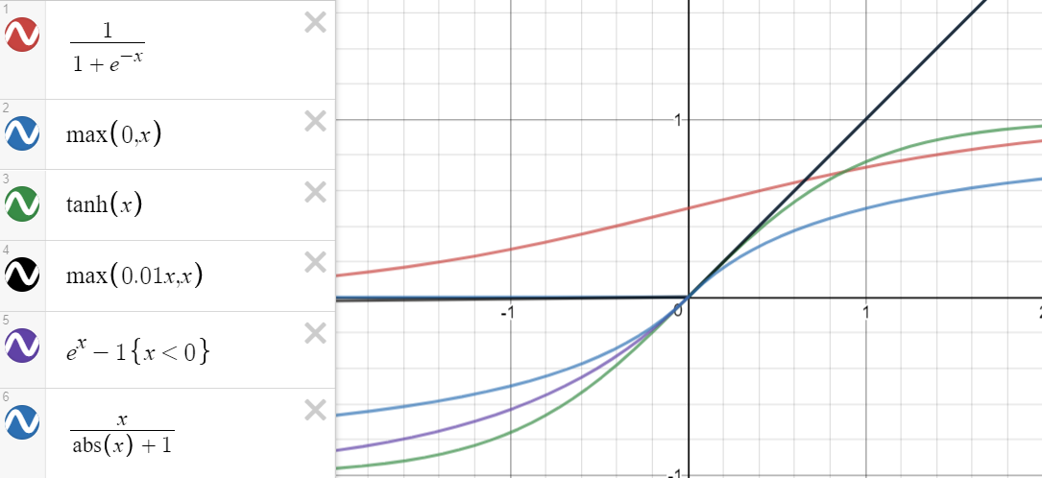
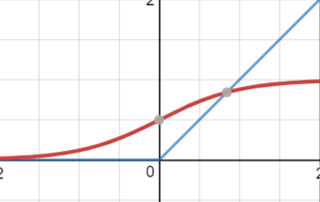
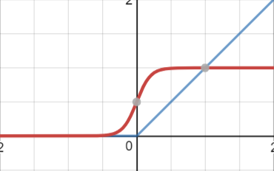
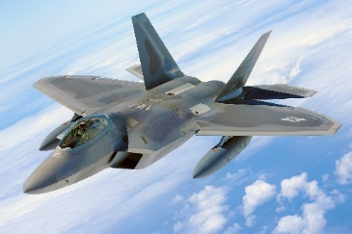
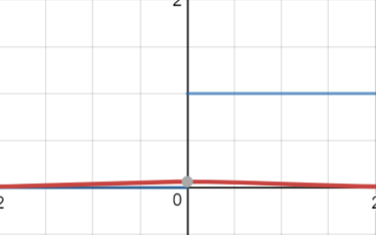
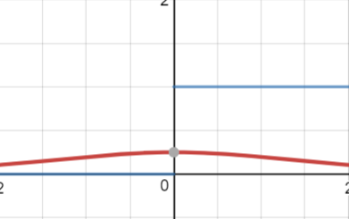
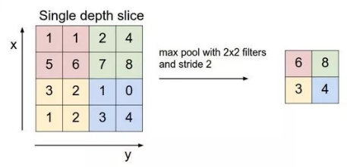
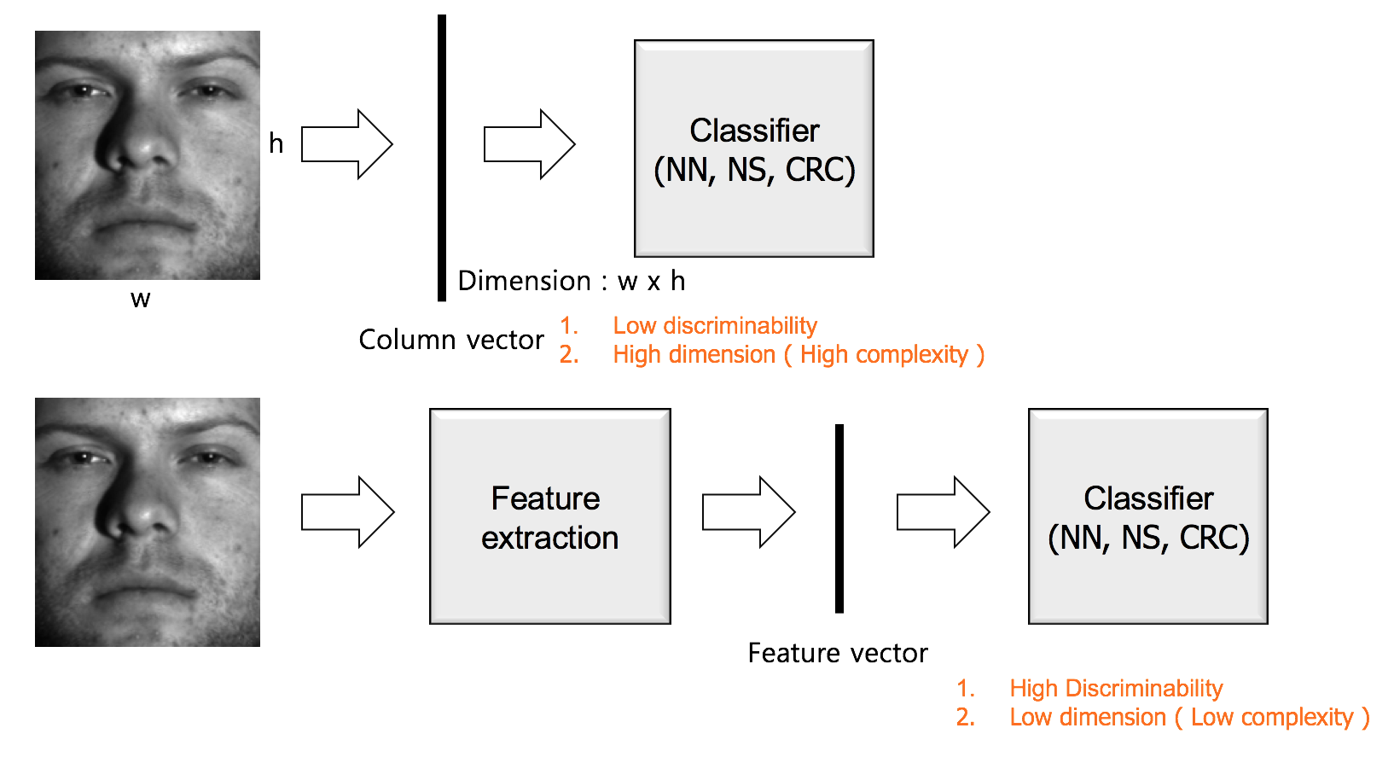
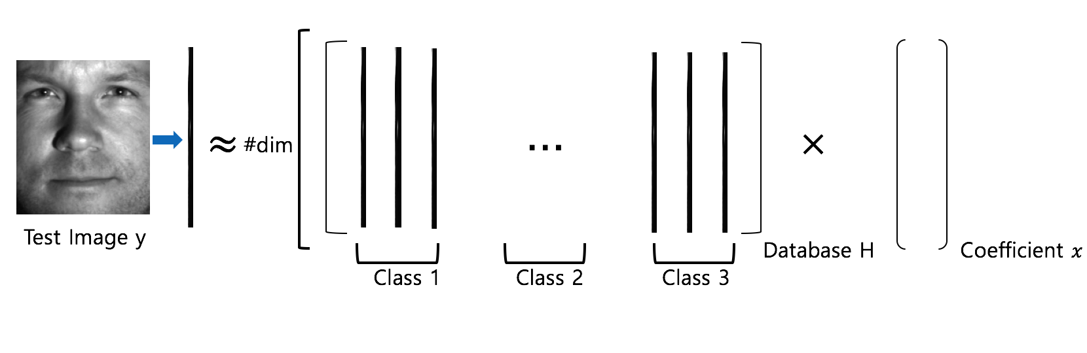
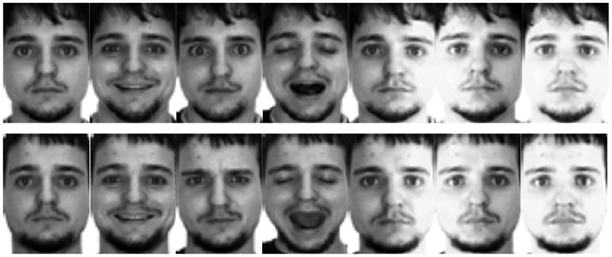
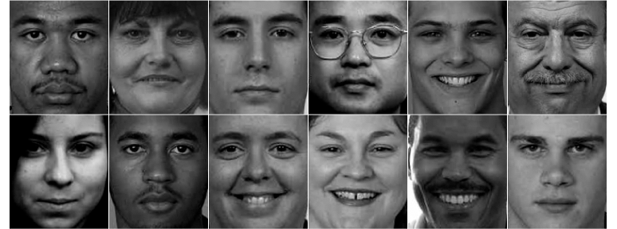
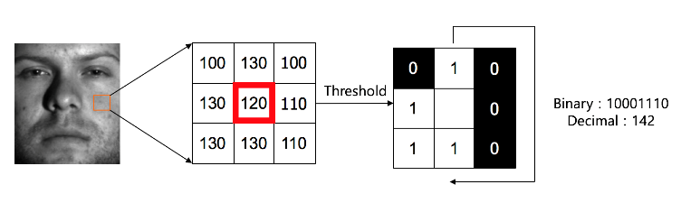
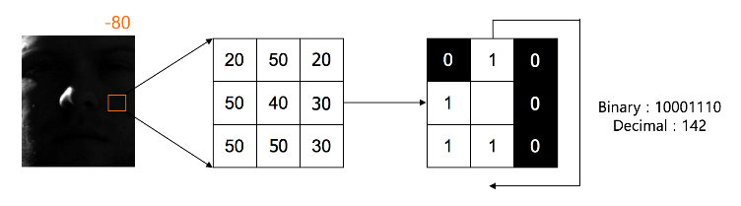

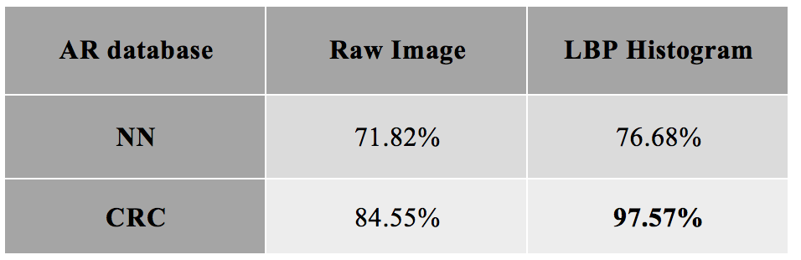
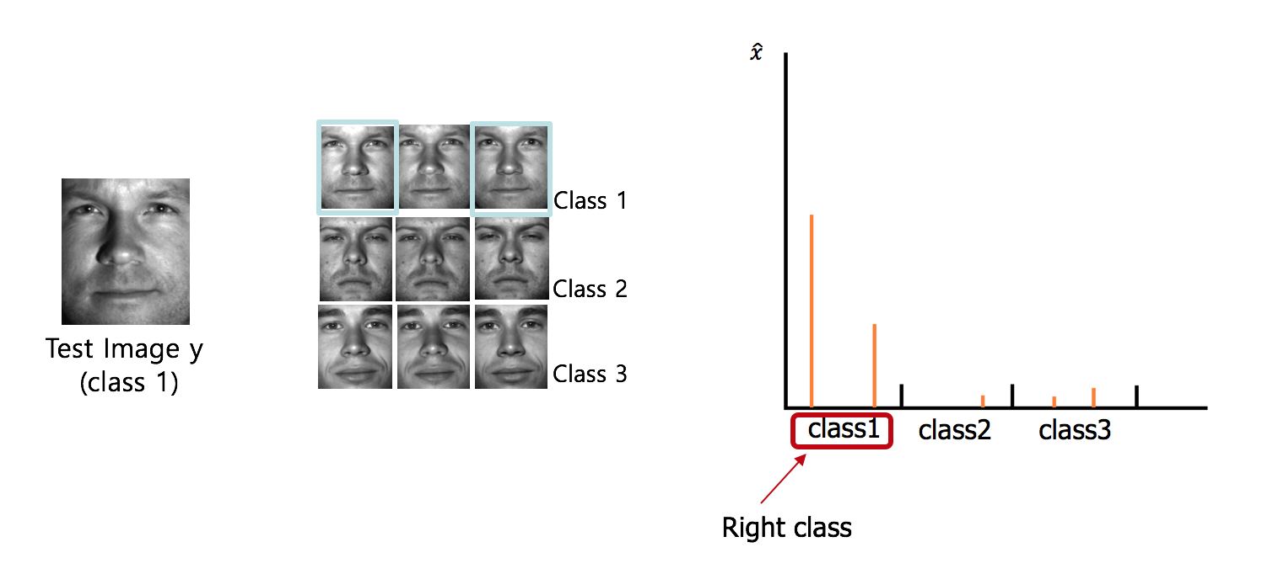
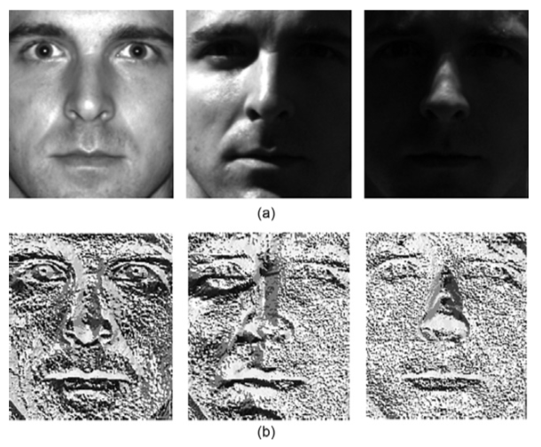
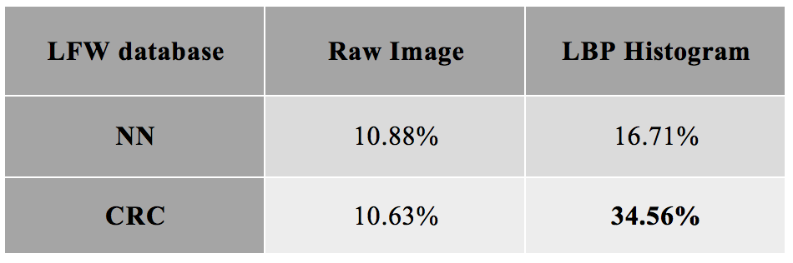
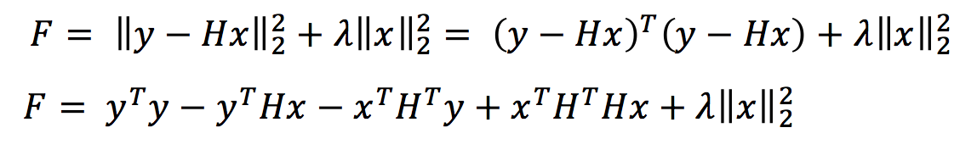
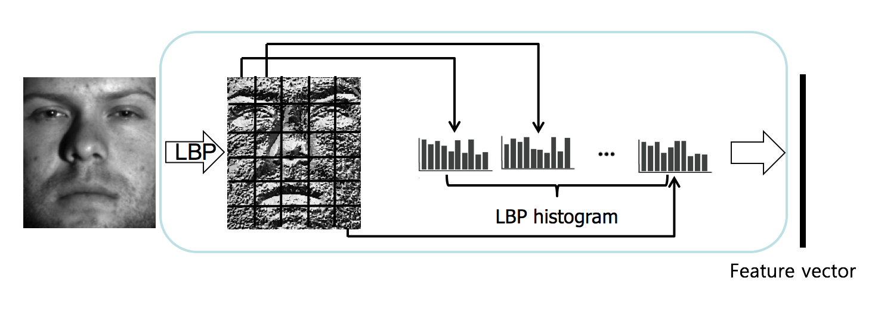
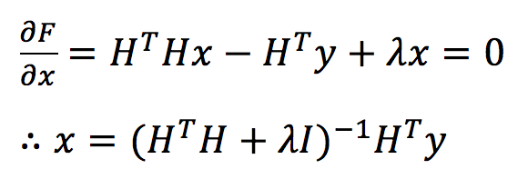
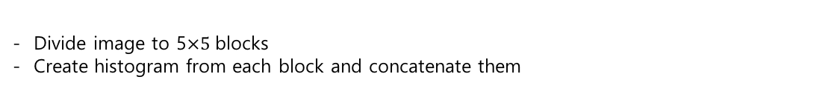
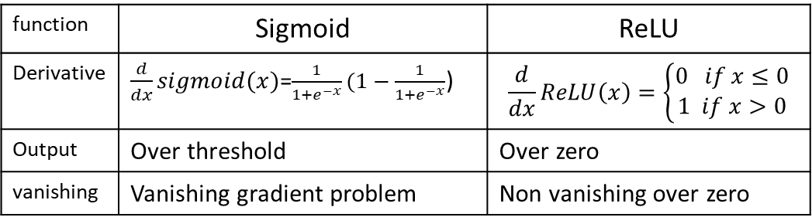
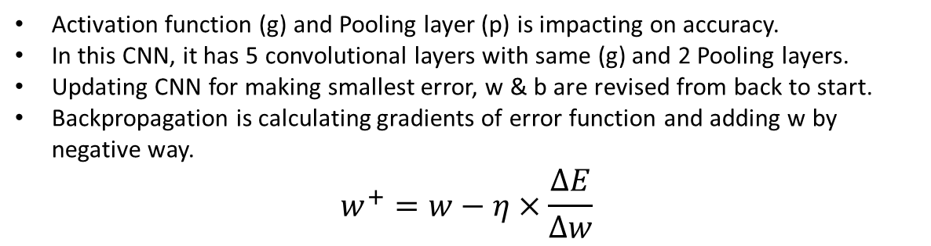
Impacts of Activation functions and Pooling layer on image classification
School of Electrical Engineering, Korea University, Seoul, Korea
2011160121 Gabin Kim
CNN (Convolutional Neural Network)
Activation function
Experimental Results
Input image(x) is CIFAR10 which has 50000 training and 10000 test images.
By Convolution, images can be mapped by 64 features and each layer has weight(w) and bias(b).
Accuracy variation by Activation functions
ReLU shows highest accuracy among 6 functions.
function | Sigmoid | ReLU
Derivative | $\frac{d}{dx}sigmoid(x)$=$\frac{1}{1+e^{−x}}(1−\frac{1}{1+e^{−x}}$) | $$\frac{d}{dx}ReLU\left(x\right)=\left\{\begin{aligned}0 if x≤0 \\ 1 if x>0\end{aligned}\right.$$
Output | Over threshold | Over zero
vanishing | Vanishing gradient problem | Non vanishing over zero
w & b
Backpropagation(e)
Ship 0.2
Airplane 0.7
Truck 0.1
Sigmoid is covering zero to 1, using for training set to determine pass or fail.
Sigmoid makes neurons saturating. (Gradient vanishing)
ReLU is defined as the positive part. (One sided)
ReLU has better gradient propagation compared to sigmoid that saturate in both directions. Addition and multiplication is efficient. (Linearity)
Softsign and ELU also expect high accuracy.
Sigmoid and hyperbolic tangent show lowest accuracy.
Layer1
->convolution
->Activation function
-> Subsampling
-> Max pooling
Layer2
->convolution
->Activation function
-> Subsampling
-> Max pooling
Output(y)
Accuracy variation by Pooling layer
Input image(x)
Pooling layer
Feature map can be divided by 2*2 patches. Each output is a subsampling by max or average operation.
Efficient to calculate compare to convolution. It has a risk of information-loss.
CNN is combined convolutional layer and pooling layer
Activation function (g) and Pooling layer (p) is impacting on accuracy.
In this CNN, it has 5 convolutional layers with same (g) and 2 Pooling layers.
Updating CNN for making smallest error, w & b are revised from back to start.
Backpropagation is calculating gradients of error function and adding w by negative way.
$$w^{+}=w−η×\frac{∆E}{∆w}$$
Conclusion
Activation function can determine accuracy of image classification.
ReLU is efficient for calculating and prevent from vanishing problem.
Pooling can be a second method for improving accuracy.
It is expected to increase accuracy by mixing activation functions and using max pooling.
Robust Face Recognition using Local Binary Pattern
School of Electrical Engineering, Korea University, Seoul, Korea
2013170959 Min-cheol Sagong
Feature Extraction
Classifier
Experimental Results
(1) Database
AR database
Make feature matrix with database
Calculate coefficient that makes database close to test image
LFW database
Local Binary Pattern
Recognition
(1) LBP
(1) Collaborative Representation Classifier(CRC)
(2) Recognition
Compare with center pixel
Name 0 that has bigger value than center
Name 1 that has smaller value than center
Strong for Low illumination image
Invariant to monotonic gray scale change
Conclusion
(2) LBP Histogram
- LBP makes monotonic grayscale invariant
- Better results are achieved by using LBP Histogram & CRC
- LFW database shows low results because it is more realistic than AR database
Reference
Divide image to 5$×5 \text{blocks}$
Create histogram from each block and concatenate them
[1] Ahonen, Timo, Abdenour Hadid, and Matti Pietikainen. "Face description with local binary patterns: Application to face recognition." IEEE transactions on pattern analysis and machine intelligence 28.12 (2006): 2037-2041.
[2] Zhang, Lei, Meng Yang, and Xiangchu Feng. "Sparse representation or collaborative representation: Which helps face recognition?." Computer vision (ICCV), 2011 IEEE international conference on. IEEE, 2011.

