Slide 1
Jena Inference
http://jena.sourceforge.net/inference/

Slide 2
Setting up Jena
Following JenaRDFAPI.ppt to set up Jena
All the tutorials for Jena reasoners can be found at: C:\Jena\Tutorial\reasoner (download Tutorial.zip from the course website under software subtitle, and unzip it under C:\Jena)

Slide 3
Jena inference support
Supporting a range of inference engines or reasoners to be plugged into Jena
Mainly for RDFS and OWL, but
It includes a generic rule engine that can be used for many RDF processing or transformation tasks.
Inference: refer to the abstract process of deriving additional information
Reasoner: refer to a specific code object that performs the reasoning tasks

Slide 4
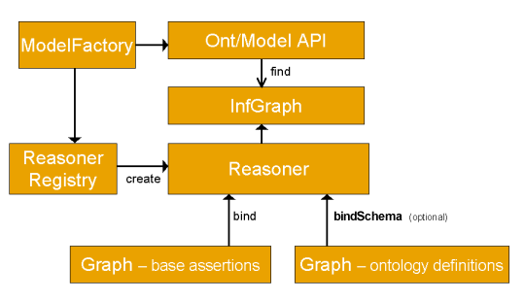
Overall structure

Slide 5
Reasoning overall structure
Applications normally access the inference machinery by using the ModelFactory to associate a data set with some reasoner to create a new Model.
Ontology API links appropriate reasoners into the OntModels
The reasoner API supports the notion of specializing a reasoner by bining it to a set of schema or ontology data using the bindSchema call
The specialized reasoner can then be attached to different sets of instance data using bind calls
To keep the design as open ended as possible, Jena2 also includes a ReasonerRegistry. It is possible to register new reasoner types and to dynamically search for reasoners of a given type.

Slide 6
Available reasoners
Transitive reasoner
  Provides support for storing and traversing class and property lattices.
  This implements just the transitive and symmetric properties of rdfs:subPropertyOf and rdfs:subClassOf
RDFS rule reasoner
  Implements a configurable subset of the RDFS entailments
OWL, OWL Mini, OWL Micro Reasoners
  A set of useful but incomplete implementation of the OWL/Lite subset of the OWL/Full language
DAML micro reasoner
  Used internally to enable the legacy DAML API to provde minimal inferencing
Generic rule reasoner
  A rule based reasoner that supports user defined rules, forward chaining, tabled backward chaining and hybrid execution strategies are supported.

Slide 7
The Inference API
Finding a reasoner
  Each type of reasoner is the instance of a factory class ReasonerFactory.
  There are convenient methods on the ReasonerRegistry for locating a prebuilt instance of the main reasoners:
    getTransitiveReasoner, getRDFSReasoner, getRDFSSimpleReasoner, getOWLReasoner, getOWLMiniReasoner, getOWLMicroReasoner

Slide 8
Configuring a reasoner
ReasonerFactory.create method can be used to pass the RDF encoded configuration details to a Jena Resource object
Reasoner.setParameter is used to set the parameter for the reasoners

Slide 9
Applying a reasoner to data
Once you create an instance of a reasoner, it can be attached to a set of RDF data to create an inference model
It is done by either putting all the RDF data into one Model or by separating them into two components – schema and instance data.

Slide 10
Accessing inferences
Through inference model, other applications can access the inferences, which means that they can access additional statements which are entailed from the bound data by means of the reasoner.
Depending on the reasoner, these additional virtual statements may all be precomputed the first time the model is touched, maybe dynamically recomputed each time or be computed on demand but cached.

Slide 11
Reasoner description
The reasoners can be described using RDF metadata which can be searched to locate reasoners with appropriate properties.
Reasoner.getCapabilities and Reasoner.supportsProperty can be used to access this descriptive metadata.

Slide 12
Reasoner tutorial 01
To show how to set up a reasoner
First create a dataset
  Property “p” is a subproperty of property “q”
  A resource “a” with value “foo” for “p”.
String NS = "urn:x-hp-jena:eg/";
// Build a trivial example data set
Model rdfsExample = ModelFactory.createDefaultModel();
Property p = rdfsExample.createProperty(NS, "p");
Property q = rdfsExample.createProperty(NS, "q");
rdfsExample.add(p, RDFS.subPropertyOf, q);
rdfsExample.createResource(NS+"a").addProperty(p, "foo");

Slide 13
Reasoner tutorial 01
Now create an inference model which performs RDFS inference over this data
Then check that the resulting model should show that “a” should also has property “q” of value “foo” by virtue of the subPropertyOf entailment.
InfModel inf = ModelFactory.createRDFSModel(rdfsExample);
Resource a = inf.getResource(NS+"a");
System.out.println("Statement: " + a.getProperty(q));

Slide 14
Reasoner tutorial 01
import com.hp.hpl.jena.rdf.model.*;
import com.hp.hpl.jena.vocabulary.*;
import com.hp.hpl.jena.reasoner.*;
public class reasonerTutorial01 {
private static String NS = "urn:x-hp-jena:eg/";
public static void main(String args[]) {
// Build a trivial example data set
Model rdfsExample = ModelFactory.createDefaultModel();
Property p = rdfsExample.createProperty(NS, "p");
Property q = rdfsExample.createProperty(NS, "q");
rdfsExample.add(p, RDFS.subPropertyOf, q);
rdfsExample.createResource(NS+"a").addProperty(p, "foo");
InfModel inf = ModelFactory.createRDFSModel(rdfsExample);
Resource a = inf.getResource(NS+"a");
System.out.println("Statement: " + a.getProperty(q));
}
}
reasonerTutorial01.java

Slide 15

Reasoner tutorial 01
C:\jena\tutorial\reasoner\reasonerTutorial01.java

Slide 16
Setting up reasoners
To create the same reasoner as tutorial 01, we can also use ReasonerRegistry.
Or manually by
Or setting up a reasoner configuration file (ontology is schema.rdf)
Reasoner reasoner = ReasonerRegistry.getRDFSReasoner();
InfModel inf = ModelFactory.createInfModel(reasoner, rdfsExample);
Reasoner reasoner = RDFSRuleReasonerFactory.theInstance().create(null);
InfModel inf = ModelFactory.createInfModel(reasoner, rdfsExample);
Reasoner boundReasoner = reasoner.bindSchema(schema);
InfModel inf = ModelFactory.createInfModel(boundReasoner, data);

Slide 17
Operations on inference models
For many applications, one simply creates a model incorporating some inference step, using the ModelFactory methods, and then just works with the standard Jena Model API to access the entailed statements.
But you can do more

Slide 18
Validation
Ontology language validation
  E.g., Domain and range validation for properties.
InfModel.validate()
  Performs a global check across schema and instance data looking for inconsistenecies.
  The result is a ValidityReport object which comprises a simple pass/fail flag, and details of detected inconsistencies
Model data = FileManager.get().loadModel(fname);
InfModel infmodel = ModelFactory.createRDFSModel(data);
ValidityReport validity = infmodel.validate();
if (validity.isValid()) {
System.out.println("OK");
} else {
System.out.println("Conflicts");
for (Iterator i = validity.getReports(); i.hasNext(); ) {
System.out.println(" - " + i.next());
}
}

Slide 19
Reasoner tutorial 02
Testing validation
Dataset: C:\Jena\Jena-2.5.5\testing\reasoners\rdfs\dttest2.nt
<http://www.hpl.hp.com/semweb/2003/eg#foo> <http://www.hpl.hp.com/semweb/2003/eg#bar> "25.5"^^<http://www.w3.org/2001/XMLSchema#decimal> .
<http://www.hpl.hp.com/semweb/2003/eg#bar>
<http://www.w3.org/2000/01/rdf-schema#range> <http://www.w3.org/2001/XMLSchema#integer> .

Slide 20
Reasoner tutorial 02
import java.io.*;
import java.util.Iterator;
import com.hp.hpl.jena.util.*;
import com.hp.hpl.jena.util.iterator.*;
import com.hp.hpl.jena.rdf.model.*;
import com.hp.hpl.jena.vocabulary.*;
import com.hp.hpl.jena.reasoner.*;
public class reasonerTutorial02 {
private static String fname = "file:///C:/Jena/Jena- 2.5.5/testing/reasoners/rdfs/dttest2.nt";
public static void main(String args[]) {
Model data = FileManager.get().loadModel(fname);
InfModel infmodel = ModelFactory.createRDFSModel(data);
ValidityReport validity = infmodel.validate();
if (validity.isValid()) {
System.out.println("OK");
} else {
System.out.println("Conflicts");
for (Iterator i = validity.getReports(); i.hasNext(); ) {
System.out.println(" - " + i.next());
}
}
}
}
C:\Jena\Tutorial\reasoner\reasonerTutorial02.java

Slide 21
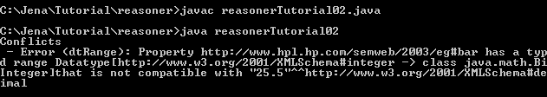
Reasoner tutorial 02

Slide 22
Derivations
It is sometimes useful to trace where an inferred statement was generated from.
It is achieved through the InfModel.getDerivation(Statement) method.
This returns a iterator over a set Derivation objects through which a brief description of the sources of the derivation can be obtained.
Using Derivation.PrintTrace method to print them out.
Derivation information is rather expensive to compute and store

Slide 23
Reasoner tutorial 03
Derivation
Data set: C:\Jena\Tutorial\reasoner\data03.ttl
@prefix eg: <urn:x-hp:eg/> .
eg:A eg:p eg:B .
eg:B eg:p eg:C .
eg:C eg:p eg:D .

Slide 24
Reasoner tutorial 03
import java.io.*;
import java.util.Iterator;
import com.hp.hpl.jena.util.*;
import com.hp.hpl.jena.rdf.model.*;
import com.hp.hpl.jena.reasoner.*;
import com.hp.hpl.jena.reasoner.rulesys.*;
public class reasonerTutorial03 {
private static String fname = "file:///C:/Jena/Tutorial/reasoner/data03.ttl";
private static String NS = "urn:x-hp:eg/";
public static void main(String args[]) {
Model data = FileManager.get().loadModel(fname);
String rules = "[rule1: (?a eg:p ?b) (?b eg:p ?c) -> (?a eg:p ?c)]";
Reasoner reasoner = new GenericRuleReasoner(Rule.parseRules(rules));
reasoner.setDerivationLogging(true);
InfModel inf = ModelFactory.createInfModel(reasoner, data);
PrintWriter out = new PrintWriter(System.out);
for (StmtIterator i = inf.listStatements(inf.getResource(NS+"A"), inf.getProperty(NS+"p"), inf.getResource(NS+"D")); i.hasNext(); ) {
Statement s = i.nextStatement();
System.out.println("Statement is " + s);
for (Iterator id = inf.getDerivation(s); id.hasNext(); ) {
Derivation deriv = (Derivation) id.next();
deriv.printTrace(out, true); } }
out.flush(); }
}
C:\Jena\Tutorial\reasoner\reasonerTutorial03.java

Slide 25
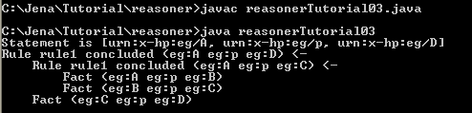
Reasoner tutorial 03

Slide 26
The RDFS Reasoner
Jena2 includes an RDFS reasoner (RDFSRuleReasoner) which supports almost all the RDFS entailments
This reasoner is accessed using ModelFactory.createRDFSModel, or manually via ReasonerRegistery.getRDFSReasoner()

Slide 27
The RDFS Reasoner
The RDFSRuleReasoner can be configured to work at three different compliance levels:
  Full: implements all the RDFS axioms and closure rules with exception of bNode entailments and datatypes. It is computational expensive.
  Default: omits the expensive checks for container membership properties and the “everything is a resource” and “everything should have a type” rules.
  Simple: implements just the transitive closure of subPropertyOf and subClassOf relations, the domain and range entailments and the implications of subPropertyOf and subClassOf. It omits all the axioms

Slide 28
The RDFS Reasoner
Using setParameter to set up reasoner:
Or by constructing an RDF configuration description and passing that to the RDFSRuleReasonerFactory
reasoner.setParameter(ReasonerVocabulary.PROPsetRDFSLevel, ReasonerVocabulary.RDFS_SIMPLE);
Resource config = ModelFactory.createDefaultModel()
.createResource()
.addProperty(ReasonerVocabulary.PROPsetRDFSLevel, "simple"); Reasoner reasoner = RDFSRuleReasonerFactory.theInstance()Create(config);

Slide 29
Reasoner tutorial 04
RDFS example
Dataset: C:\Jena\Jena-2.5.5\doc\inference\data\rdfsDemoSchema.rdf and C:\Jena\Jena-2.5.5\doc\inference\data\rdfsDemoData.rdf
Create an inference model to find rdf.type of colin and Person.
<rdf:Description rdf:about="&eg;mum">
<rdfs:subPropertyOf rdf:resource="&eg;parent"/>
</rdf:Description>
<rdf:Description rdf:about="&eg;parent">
<rdfs:range rdf:resource="&eg;Person"/>
<rdfs:domain rdf:resource="&eg;Person"/>
</rdf:Description>
<rdf:Description rdf:about="&eg;age">
<rdfs:range rdf:resource="&xsd;integer" />
</rdf:Description>
<Teenager rdf:about="&eg;colin">
<mum rdf:resource="&eg;rosy" />
<age>13</age>
</Teenager>
data
schema

Slide 30
Reasoner tutorial 04
import java.io.*;
import java.util.Iterator;
import com.hp.hpl.jena.util.*;
import com.hp.hpl.jena.rdf.model.*;
import com.hp.hpl.jena.vocabulary.*;
import com.hp.hpl.jena.reasoner.*;
public class reasonerTutorial04 {
private static String fnameschema = "file:///C:/Jena/Jena- 2.5.5/doc/inference/data/rdfsDemoSchema.rdf";
private static String fnameinstance = "file:///C:/Jena/Jena- 2.5.5/doc/inference/data/rdfsDemoData.rdf";
private static String NS = "urn:x-hp:eg/";

Slide 31
Reasoner tutorial 04
public static void main(String args[]) {
Model schema = FileManager.get().loadModel(fnameschema);
Model data = FileManager.get().loadModel(fnameinstance);
InfModel infmodel = ModelFactory.createRDFSModel(schema, data);
Resource colin = infmodel.getResource(NS+"colin");
System.out.println("colin has types:");
for (StmtIterator i = infmodel.listStatements(colin, RDF.type, (RDFNode)null); i.hasNext(); ) {
Statement s = i.nextStatement();
System.out.println(s); }
Resource Person = infmodel.getResource(NS+"Person");
System.out.println("\nPerson has types:");
for (StmtIterator i = infmodel.listStatements(Person, RDF.type, (RDFNode)null); i.hasNext(); ) {
Statement s = i.nextStatement();
System.out.println(s);} }
}
C:\Jena\Tutorial\reasoner\reasonerTutorial04.java

Slide 32
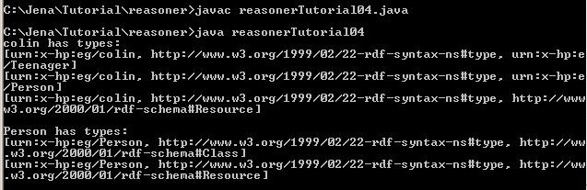
Reasoner tutorial 04

Slide 33
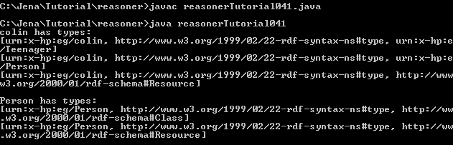
Reasoner tutorial 04
reasonerTutorial041.java defines a method called printStatements to simplifies the code.

Slide 34
Reasoner tutorial 04
public static void main(String args[]) {
Model schema = FileManager.get().loadModel(fnameschema);
Model data = FileManager.get().loadModel(fnameinstance);
InfModel infmodel = ModelFactory.createRDFSModel(schema, data);
Resource colin = infmodel.getResource("urn:x-hp:eg/colin");
System.out.println("colin has types:");
RDFNode n = (RDFNode) null;
printStatements(colin, RDF.type, n, infmodel);
Resource Person = infmodel.getResource("urn:x-hp:eg/Person");
System.out.println("\nPerson has types:");
printStatements(Person, RDF.type, n, infmodel); }
public static void printStatements(Resource r, Property p, RDFNode o, Model m) {
for (StmtIterator i = m.listStatements(r, p, o ); i.hasNext(); ) {
Statement s = i.nextStatement();
System.out.println(s); }
}
C:\Jena\Tutorial\reasoner\reasonerTutorial041.java

Slide 35
Reasoner tutorial 04
Check the validation
ValidityReport validity = infmodel.validate();
if (validity.isValid()) {
System.out.println("\nOK");
} else {
System.out.println("\nConflicts");
for (Iterator i = validity.getReports(); i.hasNext(); ) {
ValidityReport.Report report = (ValidityReport.Report)i.next();
System.out.println(" - " + report);
}
}
C:\Jena\Tutorial\reasoner\reasonerTutorial042.java

Slide 36
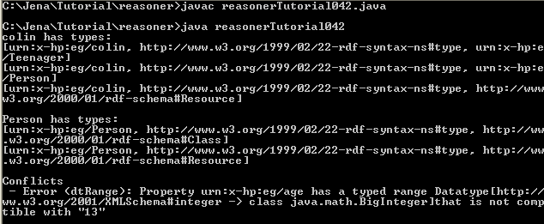
Reasoner tutorial 04

Slide 37
The OWL reasoner
Jena2 provides a rule-based implementation of the OWL-Lite
For OWL DL, use the external DL reasoner such as Pellet, Racer or FaCT.
Jena DIG interface makes it easy to connect to any reasoner that supports the DIG standard.

Slide 38
OWL coverage
Jena OWL reasoners are instance-based reasoners, means that they use rules to propagate the if- and only-if- implications of the OWL constructs on instance data.
Reasoning about classes is done indirectly
  For each class, a prototypical instance is created and elaborated,
  If the prototype for a class A can be deduced as being a member of class B → A is subClassOf B
It is the extensions of the RDFS reasoner
  Default OWL rule reasoner (ReasonerRegistry.getOWLReasoner())
  OWLMini reasoner: omit the forward entailments from minCardinality/someValuesFrom (in order to avoid bNodes to get into infinite expansions)
  OWLMicro reasoner: supports RDFS plus property axioms, intersectionOf, unionOf and hasValue. It omits the cardinality restrictions and equality axioms which might ends up with higher performance.

Slide 39
OWL Configuration
This reasoner is accessed using ModelFactory.createOntologyModel(OWL_MEM_RULE_INF) or
Manually via ReasonerRegistery.getOWLReasoner().

Slide 40
Reasoner Tutorial 05
OWL example
Data set
  Schema: C:/Jena/Jena-2.5.5/doc/inference/data/owlDemoSchema.xml
  Instance: C:/Jena/Jena-2.5.5/doc/inference/data/owlDemoData.xml

Slide 41
Reasoner tutorial 05
import java.io.*;
import java.util.Iterator;
import com.hp.hpl.jena.util.*;
import com.hp.hpl.jena.rdf.model.*;
import com.hp.hpl.jena.vocabulary.*;
import com.hp.hpl.jena.reasoner.*;
public class reasonerTutorial05 {
private static String fnameschema = "file:///C:/Jena/Jena- 2.5.5/doc/inference/data/owlDemoSchema.xml";
private static String fnameinstance = "file:///C:/Jena/Jena- 2.5.5/doc/inference/data/owlDemoData.xml";
private static String NS = "urn:x-hp:eg/";

Slide 42
Reasoner tutorial 05
public static void main(String args[]) {
Model schema = FileManager.get().loadModel(fnameschema);
Model data = FileManager.get().loadModel(fnameinstance);
Reasoner reasoner = ReasonerRegistry.getOWLReasoner();
reasoner = reasoner.bindSchema(schema);
InfModel infmodel = ModelFactory.createInfModel(reasoner, data);
Resource nForce = infmodel.getResource(NS+"nForce");
RDFNode n = (RDFNode) null;
Property p = (Property) null;
System.out.println("nForce *:");
printStatements(nForce, p, n, infmodel); }
public static void printStatements(Resource r, Property p, RDFNode o, Model m) {
for (StmtIterator i = m.listStatements(r, p, o ); i.hasNext(); ) {
Statement s = i.nextStatement();
System.out.println("-" + PrintUtil.print(s)); }
}
}
C:\Jena\Tutorial\reasoner\reasonerTutorial05.java

Slide 43
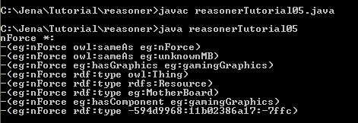
Reasoner tutorial 05
subclass inheritance
property inheritance
cardinality reasoning

Slide 44

Reasoner tutorial 05
Test whether “white box recognized as gaming computer”
Resource gamingComputer = infmodel.getResource(NS+"GamingComputer");
Resource whiteBox = infmodel.getResource(NS+"whiteBoxZX");
if (infmodel.contains(whiteBox, RDF.type, gamingComputer)) {
System.out.println("White box recognized as gaming computer");
} else {
System.out.println("Failed to recognize white box correctly");
}
C:\Jena\Tutorial\reasoner\reasonerTutorial051.java

Slide 45
Reasoner tutorial 05
Check the validation
ValidityReport validity = infmodel.validate();
if (validity.isValid()) {
System.out.println("\nOK");
} else {
System.out.println("\nConflicts");
for (Iterator i = validity.getReports(); i.hasNext(); ) {
ValidityReport.Report report = (ValidityReport.Report)i.next();
System.out.println(" - " + report);
}
}
C:\Jena\Tutorial\reasoner\reasonerTutorial052.java

Slide 46
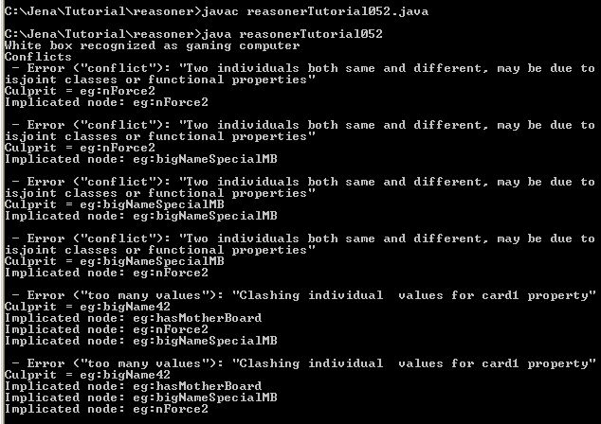
Reasoner tutorial 05

Slide 47
The transitive reasoner
It provides support for storig and traversing class and property lattices.
It just contains the transitive and symmetric properties of rdfs:subPropertyOf and rdfs:subClassOf.
The GenericRuleReasoner can use an instance of the transitive reasoner for handling those two properties.

Slide 48
The general purpose rule engine
Jena2 has a general purpose rule-based reasoner which is used to implement both the RDFS and OWL reasoners but is also available for general use.
This reasoner supports rule-based inference over RDF graphs and provides forward chaining, backward chaining and a hybrid execution model
The configuration is done through a single parameterized reasoner GenericRuleReasoner

Slide 49
Rule syntax and structure
A rule for the rule-based reasoner is defined by a Java Rule object with a list of body terms (premises), a list of head terms (conclusions) and an optional name and optional direction.
A rule set is simply a list of rules.

Slide 50
Rule syntax and structure
Rule := bare-rule .
or [ bare-rule ]
or [ ruleName : bare-rule ]
bare-rule := term, ... term -> hterm, ... hterm // forward rule
or term, ... term <- term, ... term // backward rule
hterm := term
or [ bare-rule ]
term := (node, node, node) // triple pattern
or (node, node, functor) // extended triple pattern
or builtin(node, ... node) // invoke procedural primitive
functor := functorName(node, ... node) // structured literal
node := uri-ref // e.g. http://foo.com/eg
or prefix:localname // e.g. rdf:type
or <uri-ref> // e.g. <myscheme:myuri>
or ?varname // variable
or 'a literal' // a plain string literal
or 'lex'^^typeURI // a typed literal, xsd:* type names supported
or number // e.g. 42 or 25.5

Slide 51
Some rule examples
[allID: (?C rdf:type owl:Restriction), (?C owl:onProperty ?P),
(?C owl:allValuesFrom ?D) -> (?C owl:equivalentClass all(?P, ?D)) ]
[all2: (?C rdfs:subClassOf all(?P, ?D)) -> print('Rule for ', ?C)
[all1b: (?Y rdf:type ?D) <- (?X ?P ?Y), (?X rdf:type ?C) ] ]
[max1: (?A rdf:type max(?P, 1)), (?A ?P ?B), (?A ?P ?C)
-> (?B owl:sameAs ?C) ]

Slide 52
Rule files
# or // are comment lines
Prefix: @prefix pre: <http://domain/url#>.
Import other rule file: @include <urlToRuleFile>.
# Example rule file
@prefix pre: <http://jena.hpl.hp.com/prefix#>.
@include <RDFS>.
[rule1: (?f pre:father ?a) (?u pre:brother ?f) -> (?u pre:uncle ?a)]

Slide 53
Loading rule files
Rule files can be loaded and parsed using
  List rules = Rule.rulesFromURL(“file:myfile.rules”); or
  BufferedReader br = /*open reader*/ ;
  List rules = Rule.parseRules(Rule.rulesParserFromReader(br) );
  Or String ruleSrc = /* list of rules in line */;
  List rules = Rule.parseRules( ruleSrc );

Slide 54
Forward chaining engine
If the rule reasoner is configured to run in forward mode, then only the forward chaining engine will be used.
First, the inference model will be queried,
Then, all the relevant data in the model will be submitted to the rule engine.
Then, any fired rule generated additional triples are stored in an internal deductions graph and can in turn trigger additional rules.
There is a remove primitive which can be used to remove unwanted triples.
Finally, this cascade of rule firings continues until no more rules can be fired.

Slide 55
Forward chaining engine
Once the preparation phase is complete, the inference graph wil take these triples as the union of all (original and deducted)
If the inference model is changed by adding or removing statements, the forward rules only explore the consequences of the added or removed triples.
There is no guarantee of the order in which matching rules will fire or the order in which body terms will be tested, however once a rule fires its head-terms will be executed in left-to-right order.

Slide 56
Backward chaining engine
If the rule reasoner is running in backward chaining mode, it uses a logic programming (LP) engine with a similar execution strategy to Prolog engines.
When the inference mode is queried, the query is translated into a goal and the engine attempts to satisfy that goal by matching to any stored triples and by goal resolution against the backward chaining rules.
Rule will be executed in top-to-bottom, left-to-right order with backtracking.

Slide 57
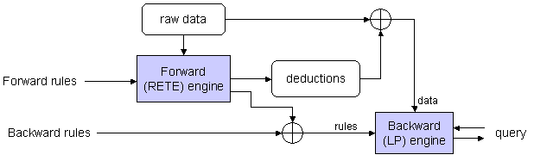
Hybrid rule engine
The combination of forward and backward chaining rule engines.
The forward engine runs and maintains a set of inferred statements in the deduction store.
Any forward rules which assert new backward rules will instantiate those rules according to the forward variable bindings and pass the instantiated rules to the backward engine.
Queries are answered by using the backward chaining LP engine, including the merge of the supplied and generated rules on raw and deducted data.

Slide 58
Generic rule reasoner configuration
Using Reasoner.setParameter to configure the reasoner.
The parameters include:
  PROPruleMode: forward, forwardETE, backward, hybrid
  PROPruleSet: filename-string
  PROPenableTGCCaching: if true, causes an instance of the TransitiveReasoner to be inserted in the forward dataflow to cache the transitive closure of the subProperty and subClass lattices.
  PROPenableFunctorFiltering: if true, this causes the structured literals (functors) generated by rules to be filtered out of any final queries. This allows them to be used for storing intermediate results hidden from the view of the InfModel’s clients.
  PROPenableOWLTranslation: if ture, this causes a procedural preprocessing step to be inserted in the dataflow which supports the OWL reasoner (it translates intersectionOf clauses into groups of backward rules in a way that is clumsy to express in pure rule form)

Slide 59
Builtin primitives
The procedural primitives are implemented by a Java object stored in a registry.
Additional primitives can be created and registered.
Each primitive can optionally be used in either the rule body, the rule head or both.
Builtin examples:
  isLiteral(?x), bound(?x…), equal(?x, ?y), lessThan(?x, ?y), sum(?a, ?b, ?c), strConcat(?a1,…?an, ?t), regex(?t, ?p), remove(n,…), listContains(?|, ?x)

Slide 60
Reasoner tutorial 06
Demo: one property as being the concatenation of two others and to build a rule reasoner to implement this.
Data set: C:\Jena\Tutorial\reasoner\data06.ttl
@prefix eg: <urn:x-hp:eg/> .
eg:r eg:concatFirst eg:p .
eg:r eg:concatSecond eg:q .
eg:A eg:p eg:B .
eg:B eg:q eg:C .

Slide 61
import java.io.*;
import java.util.Iterator;
import com.hp.hpl.jena.util.*;
import com.hp.hpl.jena.rdf.model.*;
import com.hp.hpl.jena.reasoner.*;
import com.hp.hpl.jena.reasoner.rulesys.*;
import com.hp.hpl.jena.vocabulary.*;
import com.hp.hpl.jena.ontology.*;
public class reasonerTutorial06 {
private static String fname = "file:///C:/Jena/Tutorial/reasoner/data06.ttl";
private static String NS = "urn:x-hp:eg/";
public static void main(String args[]) {
Model rawData = FileManager.get().loadModel(fname);
String rules =
"[r1: (?c eg:concatFirst ?p), (?c eg:concatSecond ?q) -> " +
"[r1b: (?x ?c ?y) <- (?x ?p ?z) (?z ?q ?y)] ]";
Reasoner reasoner = new GenericRuleReasoner(Rule.parseRules(rules));
//reasoner.setParameter(ReasonerVocabulary.PROPtraceOn,Boolean.TRUE);
InfModel inf = ModelFactory.createInfModel(reasoner, rawData);
Resource A = inf.getResource(NS + "A");
System.out.println("A * * =>");
Iterator list = inf.listStatements(A, null, (RDFNode)null);
while (list.hasNext()) {
System.out.println(" - " + list.next());}
}
}
C:\Jena\Tutorial\reasoner\reasonerTutorial06.java

Slide 62

Reasoner tutorial 06

Slide 63
Reasoner tutorial 06
reasonerTutorial06.java: dataset is loaded from reading the dataset file (data06.ttl)
reasonerTutorial061.java: dataset is created in the same java file.
reasonerTutorial062.java: set the trace on to see how the rule is implements and inference is created.
Reasoner reasoner = new GenericRuleReasoner(Rule.parseRules(rules));
reasoner.setParameter(ReasonerVocabulary.PROPtraceOn, Boolean.TRUE);

Slide 64
import java.io.*;
import java.util.Iterator;
import com.hp.hpl.jena.util.*;
import com.hp.hpl.jena.rdf.model.*;
import com.hp.hpl.jena.reasoner.*;
import com.hp.hpl.jena.reasoner.rulesys.*;
import com.hp.hpl.jena.vocabulary.*;
import com.hp.hpl.jena.ontology.*;
public class reasonerTutorial061 {
private static String NS = "urn:x-hp:eg/";
public static void main(String args[]) {
Model rawData = modelFromN3("eg:r eg:concatFirst eg:p .\n" +
"eg:r eg:concatSecond eg:q .\n" + "eg:A eg:p eg:B .\n" + "eg:B eg:q eg:C .\n");
Resource A = rawData.getResource(NS + "A");
String rules = "[r1: (?c eg:concatFirst ?p), (?c eg:concatSecond ?q) -> " +
" [r1b: (?x ?c ?y) <- (?x ?p ?z) (?z ?q ?y)] ]";
Reasoner reasoner = new GenericRuleReasoner(Rule.parseRules(rules));
InfModel inf = ModelFactory.createInfModel(reasoner, rawData);
System.out.println("A * * =>");
Iterator list = inf.listStatements(A, null, (RDFNode)null);
while (list.hasNext()) {
System.out.println(" - " + list.next()); }
}
public static Model modelFromN3(String src) {
String fullSource = "@prefix owl: <http://www.w3.org/2002/07/owl#> .\n" +
"@prefix rdf: <http://www.w3.org/1999/02/22-rdf-syntax-ns#> .\n" +
"@prefix rdfs: <http://www.w3.org/2000/01/rdf-schema#> .\n" +
"@prefix eg: <" + NS + ">.\n" + "@prefix : <#> .\n"+ src + "\n";
Model result = ModelFactory.createDefaultModel();
result.read(new StringReader(fullSource), "", "N3");
return result; }
}
C:\Jena\Tutorial\reasoner\reasonerTutorial061.java

Slide 65
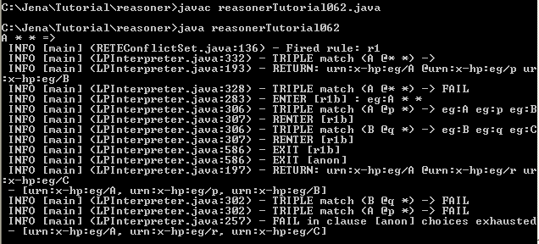
Reasoner tutorial 06

Slide 66
Reasoner tutorial 07
Demo a property as being both symmetric and transitive
Data set:C:\Jena\Jena-2.5.5\doc\inference\data\demoData.rdf
Rule file: C:\Jena\Jena-2.5.5\doc\inference\data\demo.rules
[transitiveRule: (?A demo:p ?B), (?B demo:p ?C) -> (?A demo:p ?C) ]
[symmetricRule: (?Y demo:p ?X) -> (?X demo:p ?Y) ]
<demo:TransProp rdf:about="&demo;p" />
<rdf:Description rdf:about="&demo;a">
<p rdf:resource="&demo;b" />
</rdf:Description>
<rdf:Description rdf:about="&demo;c">
<p rdf:resource="&demo;a" />
</rdf:Description>
<rdf:Description rdf:about="&demo;b">
<p rdf:resource="&demo;d" />
</rdf:Description>
rule
data

Slide 67
Reasoner tutorial 07
import java.io.*;
import java.util.Iterator;
import com.hp.hpl.jena.util.*;
import com.hp.hpl.jena.rdf.model.*;
import com.hp.hpl.jena.reasoner.*;
import com.hp.hpl.jena.reasoner.rulesys.*;
import com.hp.hpl.jena.vocabulary.*;
import com.hp.hpl.jena.ontology.*;
import com.hp.hpl.jena.reasoner.ReasonerRegistry;
import com.hp.hpl.jena.vocabulary.ReasonerVocabulary;
public class reasonerTutorial07 {
private static String fdata = "file:///C:/Jena/Jena- 2.5.5/doc/inference/data/demoData.rdf";
private static String frule = "../../Jena- 2.5.5/doc/inference/data/demo.rules";
private static String demoURI = "http://jena.hpl.hp.com/demo#";

Slide 68
public static void main(String args[]) {
// Register a namespace for use in the demo
PrintUtil.registerPrefix("demo", demoURI);
// Create an (RDF) specification of a hybrid reasoner which loads its data from an external file.
Model m = ModelFactory.createDefaultModel();
Resource configuration = m.createResource();
configuration.addProperty(ReasonerVocabulary.PROPruleMode, "hybrid");
configuration.addProperty(ReasonerVocabulary.PROPruleSet, frule);
// Create an instance of such a reasoner
Reasoner reasoner = GenericRuleReasonerFactory.theInstance().create(configuration);
// Load test data
Model data = FileManager.get().loadModel(fdata);
InfModel infmodel = ModelFactory.createInfModel(reasoner, data);
// Query for all things related to "a" by "p"
Property p = data.getProperty(demoURI, "p");
Resource a = data.getResource(demoURI + "a");
StmtIterator i = infmodel.listStatements(a, p, (RDFNode)null);
while (i.hasNext()) {
System.out.println(" - " + PrintUtil.print(i.nextStatement()));
}
}
}
C:\Jena\Tutorial\reasoner\reasonerTutorial07.java

Slide 69

Reasoner tutorial 07

Slide 70
Summary
Practicing and mastering all the tutorials on your own.
Be able to create similar tutorials using your own examples.

